Slide 1
IEEE CEDA Taipei Chapter Report 2021
Chair: Jie-Hong Roland Jiang, National Taiwan University
Vice Chair: Mark Po-Hung Lin, National Chiao Tung University
December 3, 2021

Slide 2
CEDA Taipei Chapter
Founded in 2010 (4th quarter)
Technical/financial co-sponsor of
seminars, tutorials, forums, student events and workshops/symposia/conferences in the areas of
EDA and IC design in Taiwan
Organization
Chair: Jie-Hong Roland Jiang, National Taiwan University
Vice Chair: Mark Po-Hung Lin, National Chiao Tung University
Representatives: Ing-Chao Lin, National Cheng Kung University, Wai-Kei Mak, National Tsing Hua University

Slide 3
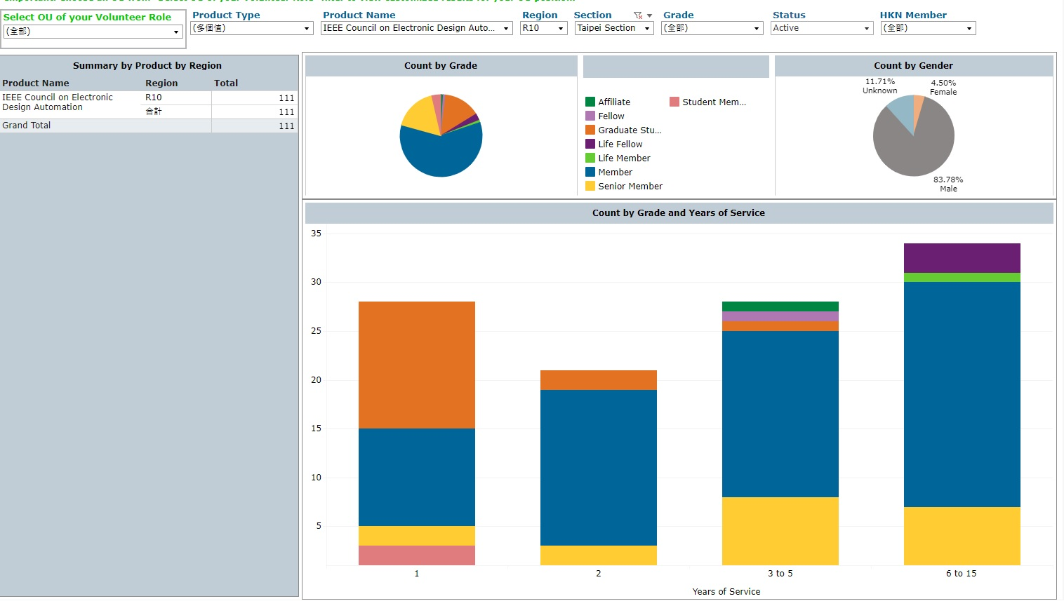
Membership Promotion
Member growth:
85 active members (2021/7/31)
106 active members (2021/9/30)
111 active members (2021/11/30)

Slide 4
IEEE Taipei Section Thesis Award
Target 1 PhD + 1 MS thesis awards from CEDA branch
Received 4 PhD + 2 MS thesis applications
Recommended 1 PhD + 1 MS theses

Slide 5
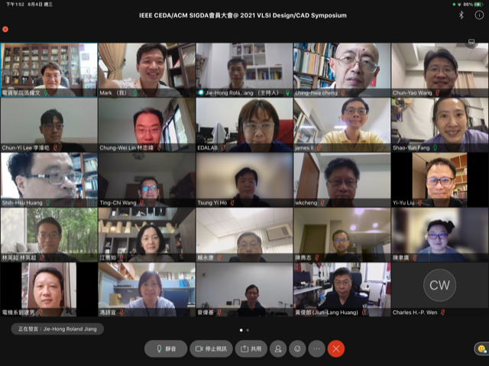
Member Meetings in 2021
Virtual meeting on August 4
A side event in VLSI Design / CAD Symposium
Physical meeting on 12/19 at National Taiwan University
A side event in EDA Workshop

Slide 6
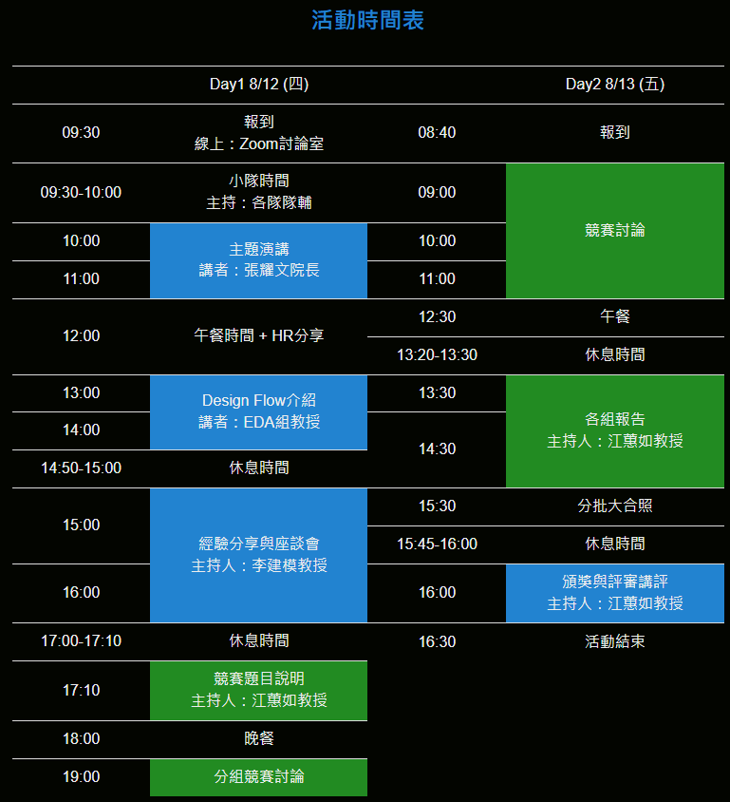
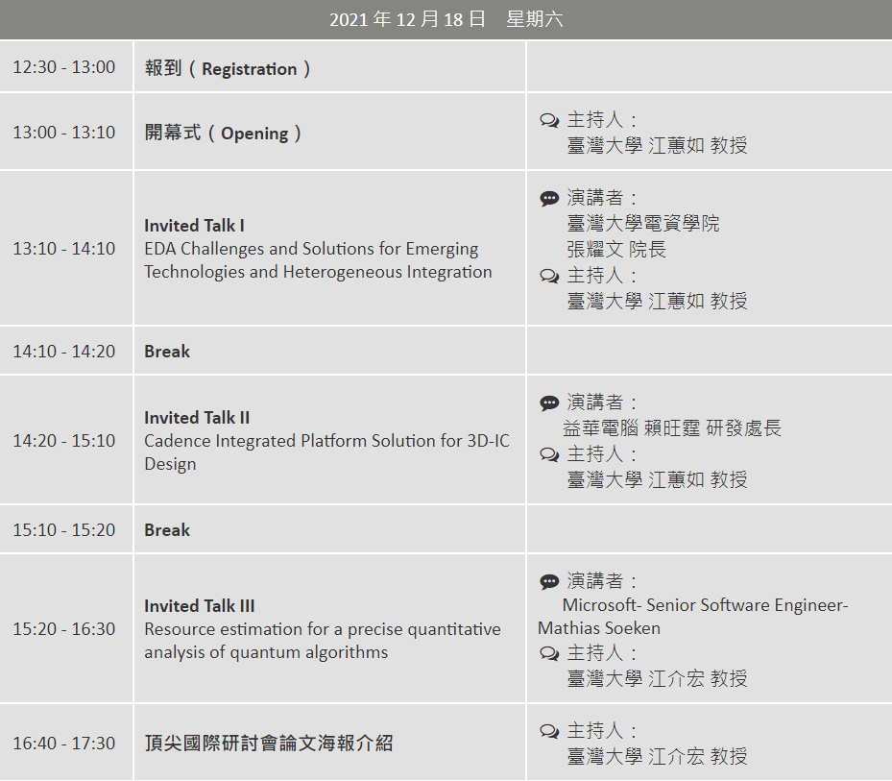
Activities in 2021
EDA Summer Camp (virtual) on August 12-13
EDA Workshop (virtual+physical at NTU) on December 18-19

Slide 7
Thank you!

