Slide 1
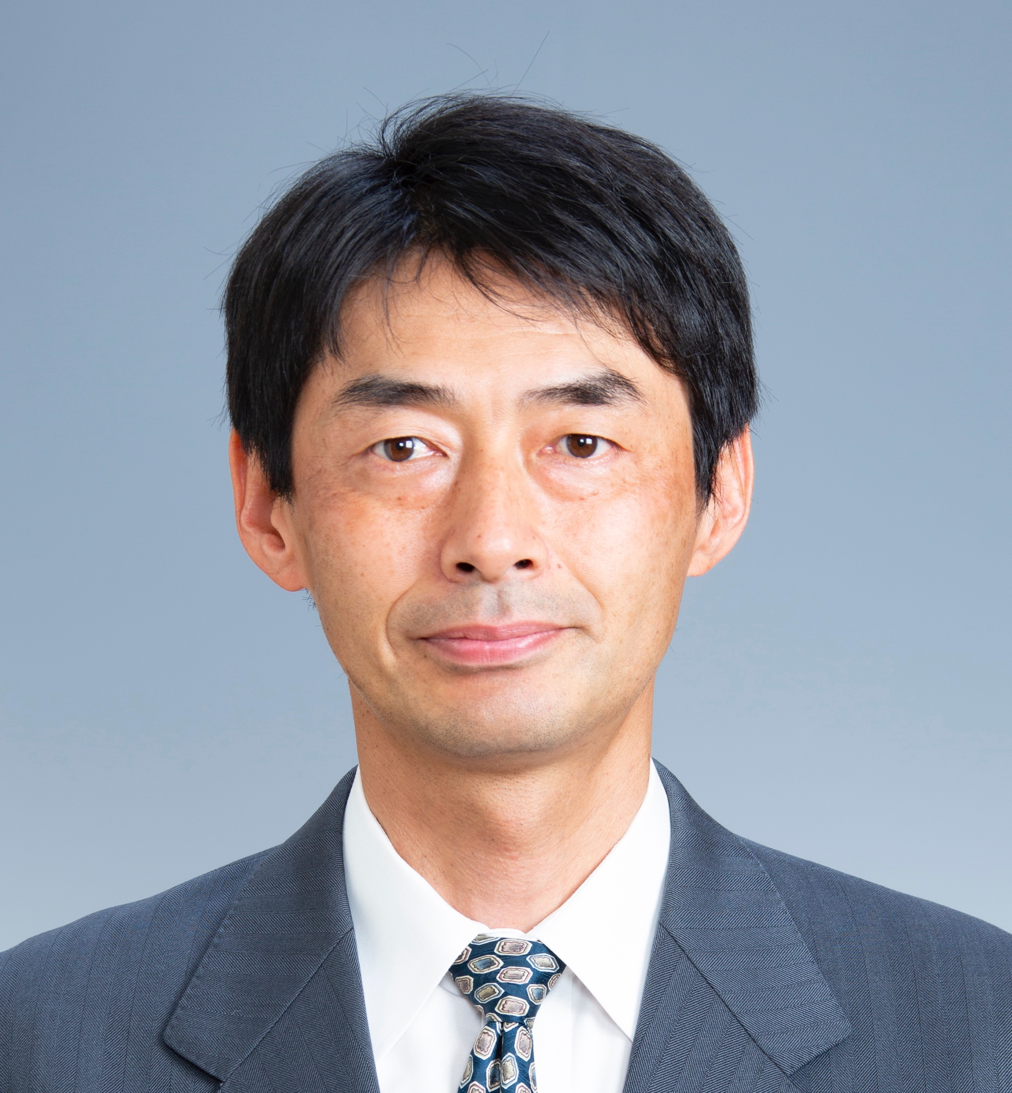
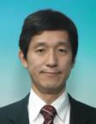
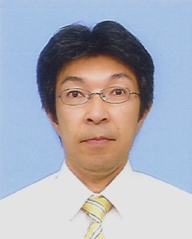
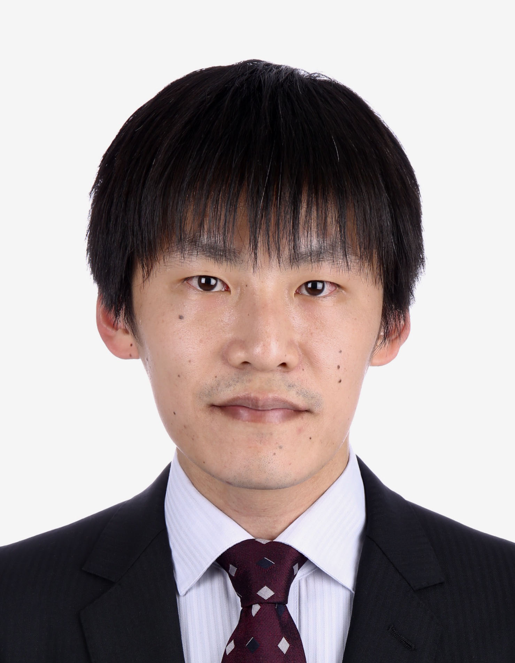
All Japan Joint Chapter (AJJC)
http://sites.ieee.org/jc-ceda/
Summary of CEDA All Japan Joint chapter 2021 activities and 2022 plan
CEDA AJJC Officers 2021/2022
Y. Takashima
(Chair)
Y. Tamiya
(Vice Chair)
K. Shimamura
(Secretary)
K. Kawamura
(Treasurer)

Slide 2
AJJC Summary of 2021 activities
Supported Technical Meetings, Workshops and Symposiums (10 events)
IPSJ SLDM (Information Processing Society of Japan, Special Interest Group on System and LSI Design Methodologies)
IEICE VLD (Institute of Electronics, Information and Communication Engineers, Technical Group on VLSI Design Technologies)
SASIMI (Workshop on Synthesis And System Integration of Mixed Information technologies)
Awards given
SASIMI Young Researcher Award (4 recipients)
Academic Research Award (4 recipients)
Design Gaia Best Poster Award (1 recipient)

Slide 3
AJJC Summary of 2022 Plan
Support Technical Meetings, Workshops, Symposiums and Seminars
IPSJ SLDM Technical Meetings
IEICE VLD Technical Meetings
SASIMI
DA Symposium
Workshop on Circuit and Systems
Inter-University Seminars
Encourage young researchers by Awards
SASIMI Young Researcher Award
Academic Research Award
Design Gaia Best Poster Award

