Slide 1
Design Automation Technical Committee (DATC)
Jinwook Jung
IBM Research
IEEE CEDA BoG Meeting @ DAC 2021
December 5th, 2021

Slide 2
DATC Goal and Committee Members
Goal: Provide forum for discussing strategies/issues in design automation
Task: DATC Robust Design Flow (RDF)
  Academic reference RTL-to-GDS design flow
  Preserve and integrate leading research codes, including contest outcomes
  Trigger flow-scale/cross-stage optimization research via EDA tools from academia
New chair and co-chair in 2021
GitHub Link: https://github.com/ieee-ceda-datc
Committee | Affiliation | Role
Jinwook Jung | IBM Research, USA | Chair / Integration
Andrew B. Kahng | UC San Diego, USA | Co-chair / Flow
Victor N. Kravets | IBM Research, USA | Logic synthesis
Jianli Chen | Fudan Univ., China | Placement
Yih-Lang Li | National Yang Ming Chiao Tung Univ., Taiwan | Routing
Iris Hui-Ru Jiang | National Taiwan Univ., Taiwan | Previous chair
Notes:
The DATC, is a technical committee of IEEE CEDA.
The goal is to provide a forum where we can discuss strategies and issues in design automation field.
In this regard, the main task of DATC for several years has been to develop and support an ACADEMIC reference design flow called RDF.
It is free for academic and non-commercial research use.
The latest version of RDF supports a complete RTL-to-GDS path for any purposes based on OpenROAD tool chains.
The table shown below shows the current member of DATC.

Slide 3
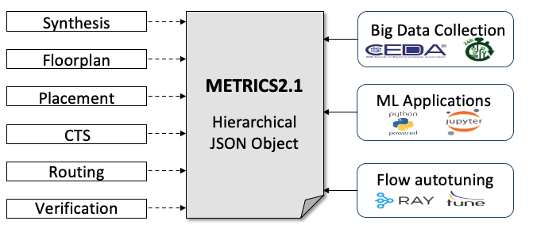
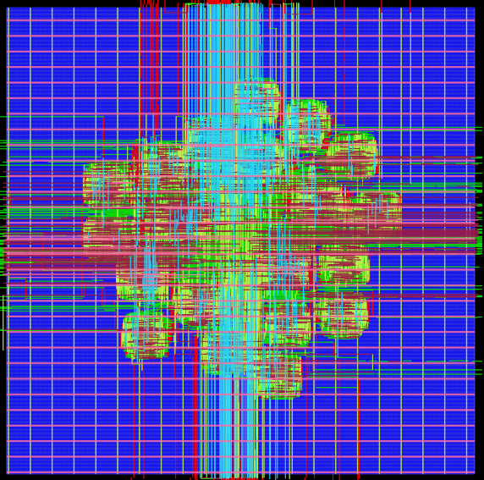
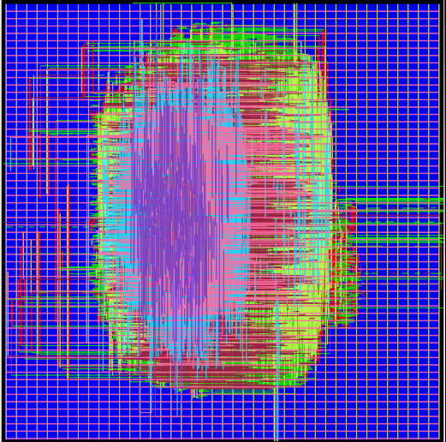
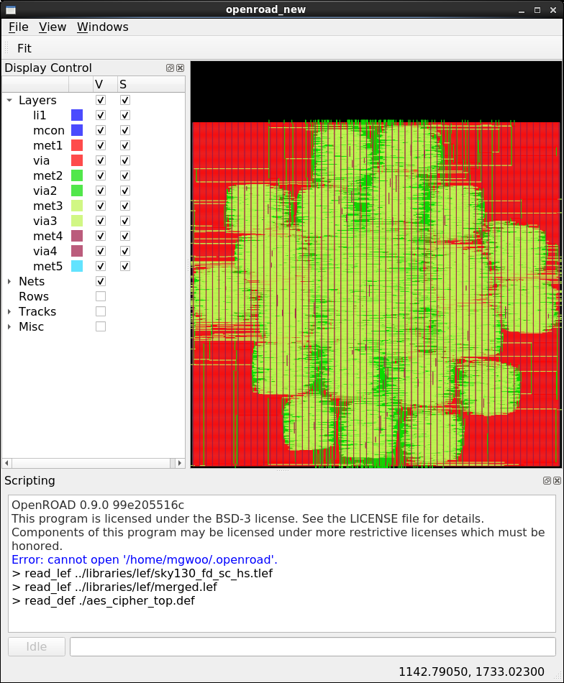
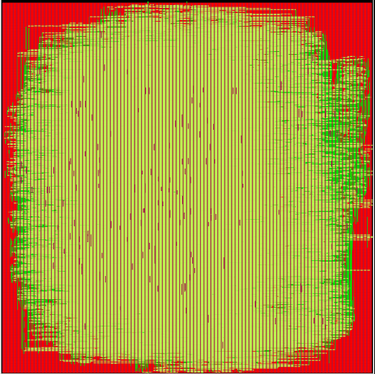
DATC Activities 2021
DATC RDF 2021 Updates
  Chisel and hardware generator support
  RTL obfuscation using ASSURE
  DFT support with Fault toolchain
  Robust benchmark conversion with RosettaStone
New initiatives
  METRICS2.1: common metrics standardization for AI/ML applications
  FlowTuner: generic design flow tuning framework with various search algorithms
  Calibration repository: reference analysis data for STA, RCX, and IR drop research
Notes:
In this talk, I have described the latest release of DATC RDF.
It has five key updates to the previous RDF releases, which include Chisel and hardware generator designs, RTL obfuscation, new ABC synthesis script, DFT support, and robust benchmark conversion.
I have also presented three new initiatives of DATC this year.
They include: common metrics system for AI/ML applications, a flexible flow autotuning framework supporting various flows and search algorithms, and the expanded calibration repository with noise introduction.
We are looking forward to any suggestions and contributions to our efforts, and please visit our GitHub organization page for finding our recent activities.

Slide 4
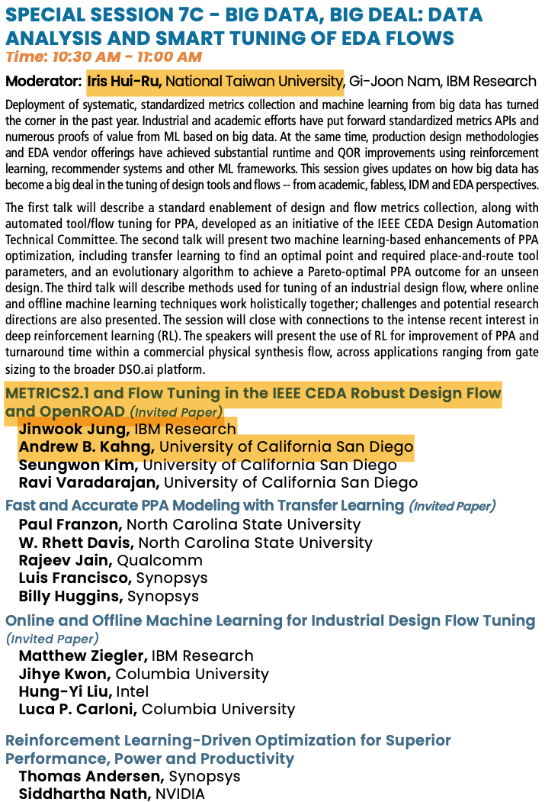
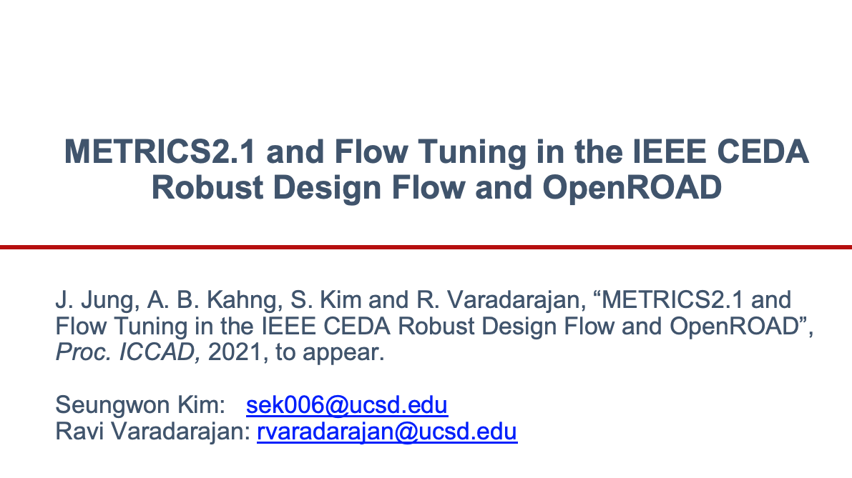
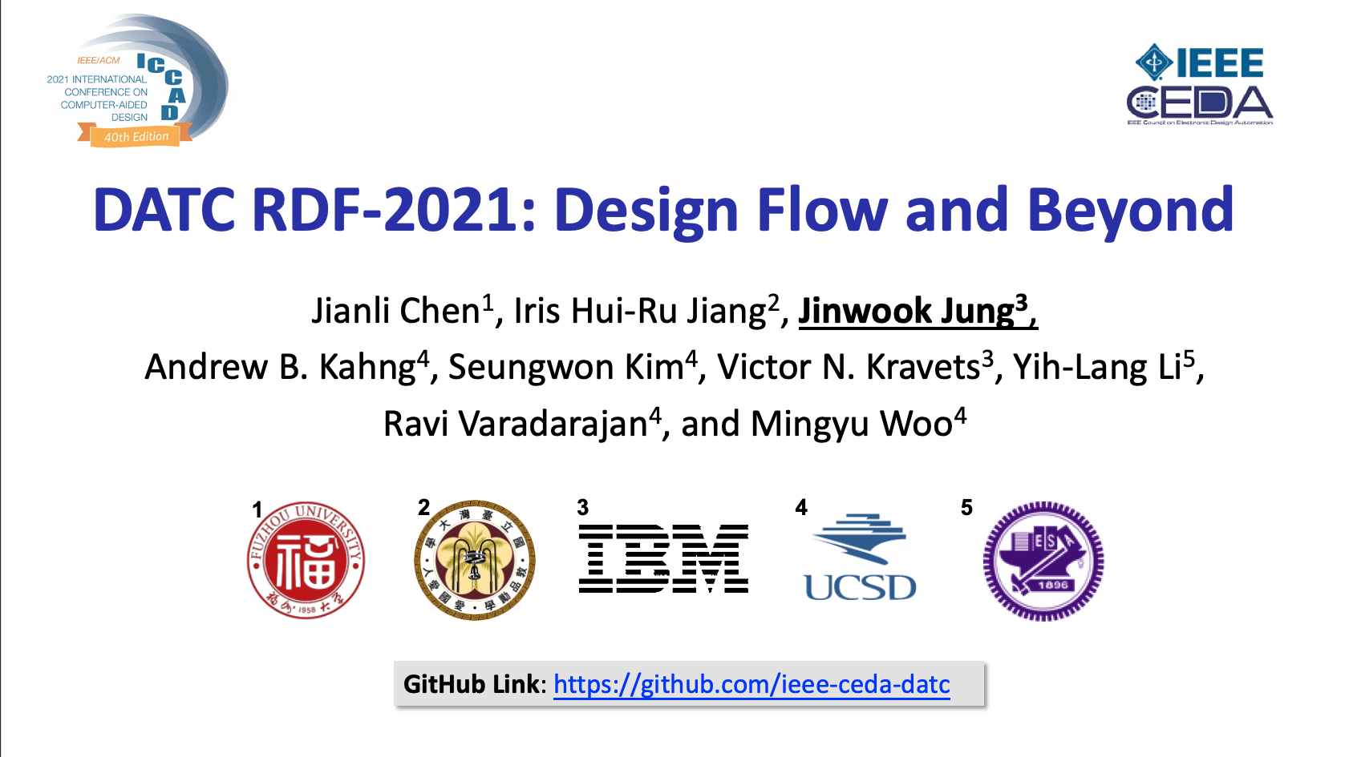
DATC Activities 2021
Two invited paper presentations @ ICCAD’21
Organized special session @ ICCAD’21

Slide 5
DATC Plans 2022
RDF, METRICS, and FlowTuner Tutorial @ ASP-DAC 2022
New committee members
Explore future directions
  Modern and complete benchmarks for physical design
  Extensive design and flow co-tuning
  Intelligent and accelerated logic synthesis
  Large-scale design of experiments on cloud environment
Please provide suggestions and contribute to our effort!
GitHub Link: https://github.com/ieee-ceda-datc

