Slide 1
Governing Documents
Agnieszka Dubaj
5 December 2021

Slide 2
CEDA Bylaw and Constitution Changes
Removal of the list of Technology Organizations from the Bylaws
  Section II.3
    The Member Technology Organizations shall be those formally admitted to the Council by the Board of Governors in accordance with the Council Constitution. The Member Technology Organizations are listed on the CEDA website
  The highlighted language replaces the current list of Member Technology Organizations.
  Pros: To make it easier to add and remove MTOs without the formal process of updating the documents through IEEE
  Cons: None

Slide 3
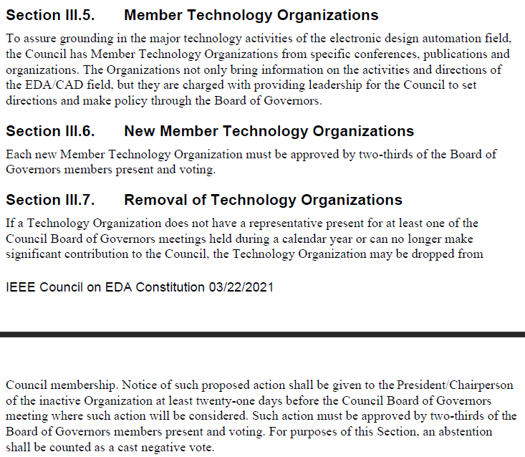
Technology Organizations – CEDA Constitution

Slide 4
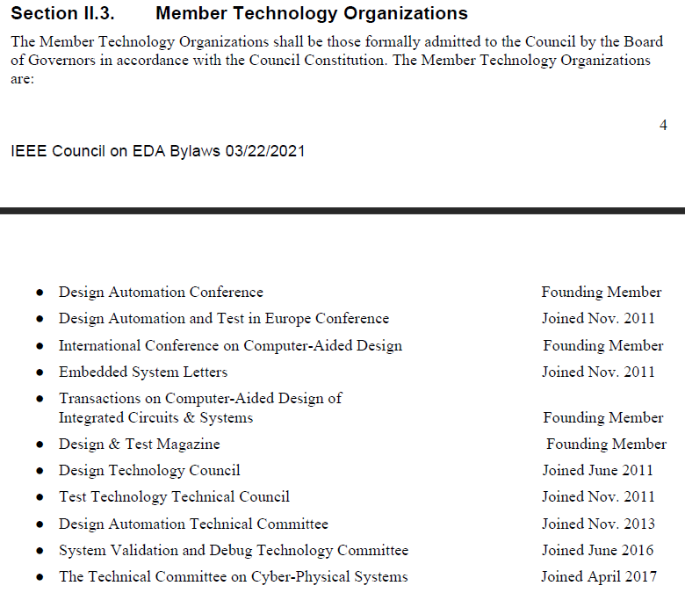
Technology Organizations – BYLAWS

Slide 5
Motion
Agnieszka Dubaj moves to approve the removal of the listing of Member Technology Organizations from the IEEE CEDA Bylaws.

