Slide 1
Initiatives
Ian O'Connor – Ecole Centrale Lyon, FR
Jose Ayala – UCM, ES
Jorge J. Gomez-Sanz – UCM, ES
Pierre-Emmanuel Gaillardon – University of Utah, US

Slide 2
Initiatives portfolio
represent CEDA in the various IEEE initiatives (and their flagship conferences) in which CEDA has interest:
Confirmed:
Smart Cities : Jose Ayala (U. Complutense, Madrid, ES)
Brain: Jose Ayala (U. Complutense, Madrid, ES)
IoT: Jorge Gomez Sanz (U. Complutense, Madrid, ES)
Task Force on Rebooting Computing: I. O'Connor (EC Lyon, FR) / Pierre-Emmanuel Gaillardon (U. Utah, US)
Future Networks: I. O'Connor (EC Lyon, FR)

Slide 3
Status of Activity
Smart Cities Initiative (SCI)
Voting member, partner of SCI
Supporting International Smart Cities Conference (ISC2) 2021 (September, virtual)
Main focus on urban mobility and smart energy
Lack of clear alignment between CEDA and SCI interests – no current participation in committee
Brain Initiative
Prior participation in Brain Transition committee
Main focus on medical and materials side of neurotechnology, although some common points exist (data processing)
Lack of clear alignment between CEDA and Brain Initiative interests – no current participation in committee

Slide 4
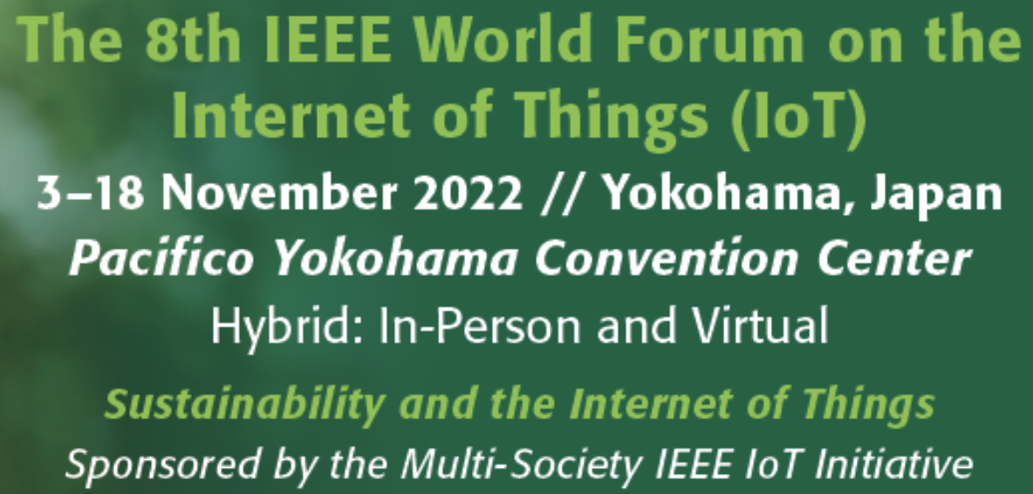
Status of activity
IoT Initiative
Good connection with Initiative leaders (ComSoC)
De-facto voting member
Major sponsor (not leading sponsor)
IoT Magazine requests contributions from societies
MoU renewed (Feb. 25th 2021)
WF-IoT 2021
Hybrid conference (New Orleans, June-July 2021)
WF-IoT 2022
Hybrid conference (Yokohama, November 2022)

Slide 5
Status of activity
Task Force on Rebooting Computing (TFRC)
Following monthly meetings
Low-Power Computer Vision Challenge (LPCVC)
International Roadmap on Devices and Systems (IRDS)
International Conference on Rebooting Computing (ICRC)
Actions planned:
Organize a CEDA-sponsored special session
At ICRC, related to CEDA
At ICCAD, related to TFRC
Co-organize a workshop on quantum computing EDA
co-located with an EDA conference or as an independent event
Future Networks Initiative (FNI)
Possible actions
CEDA contribution to International Network Generations Roadmap (INGR)
Organize a CEDA-sponsored special session at 5G World Forum (WF5G) October 2022

