Slide 1
Solid State Circuits Society
Vivek Tiwari
December 3, 2021
Thanks to Bryan Ackland for years of service to SSCS/CEDA!

Slide 2
SSCS Highlights
Finance summary
Financially strong – Reserves > $12M
  2020 operational surplus was $1.4M (excluding initiative/project expense and investment returns)
  2021 forecasted operational surplus is $994K
Key Initiatives focus in 2021
  Platform for IC Design Outreach (PICO) Program
  James D. Meindl Memorial Educational Fund/Innovators Award
          Project examples include “development of tools that provide broad access to design and simulation resources”
  Education and Future Talent Fund
  Online mentoring
  Diversity in leadership and membership
IEEE Confidential

Slide 3
SSCS Highlights (contd.)
Publications
  Journal and Letters doing well
  Open Access journal published >20 papers for the first time in 2021 which starts it on the road to an impact factor
  Magazine very popular – esp. monthly comments
Conferences
  After Feb’20, all conferences were fully virtual until Nov’21– greater surplus
  A-SSCC organized a hybrid event in Nov’21: Total attendance was more than double last year’s virtual event and >30% higher than the 2019 in-person event.
  Mentoring at all major conferences
  Continuing decline in industry submissions
Education
  Webinar per month with 200-500 attendees
  Launched a Career Center, Reinvigorated the Podcast Series, Held Professional Development Workshops

Slide 4
CEDA/SSCS Joint Activities
Design & Test Magazine
Journal on Exploratory Solid-State Computational Devices and Circuits (JXCDC)
CEDA Currents in Solid State Circuits Magazine
Rebooting Computing Initiative (& IOT and Brain Initiatives)
Future explorations:
Joint Webcasts on special topics, cross-publicity of respective Webinars
Others?
Leveraging JXCDC better
Increase cross-engagement on Initiatives (e.g. SSCD Committee - PICO in 2022)
Standards – Semiconductors Device Modelling and Measurements (EDS, SSCS, CEDA)
CEDA members as Mentors in Mentoring Program
Joint Membership Stats
 | Asset Product Part # | Affiliate | Associate Member | Fellow | Graduate Student Member | Life Fellow | Life Member | Life Senior | Member | Senior Member | Student Member | Grand Total
IEEE Council on Electronic Design Automation | CNCCEDA044 | 5 | 3 | 13 | 112 | 13 | 7 | 6 | 368 | 145 | 21 | 693

Slide 5
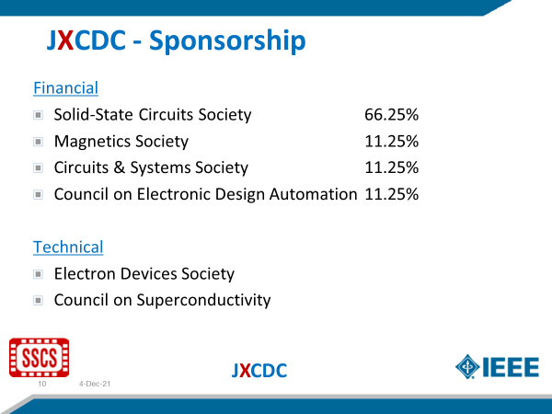
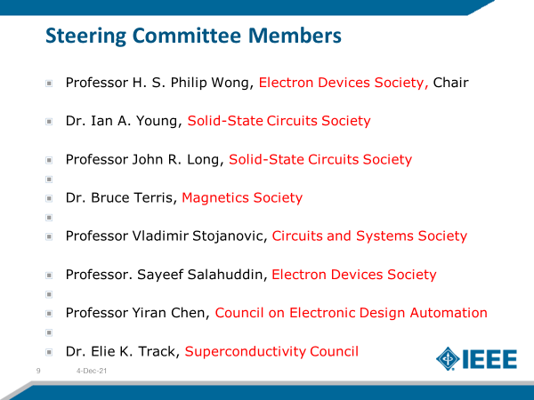
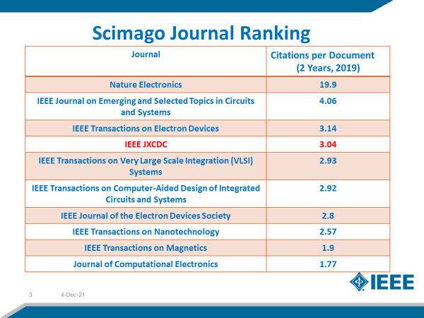
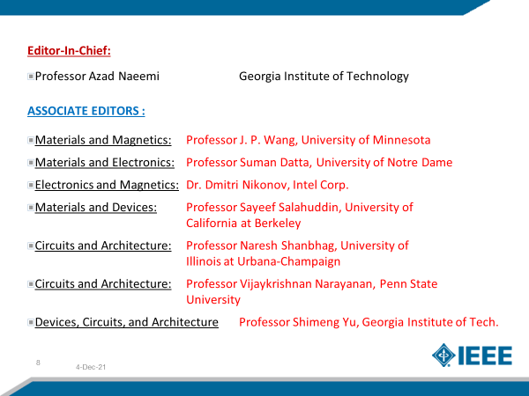
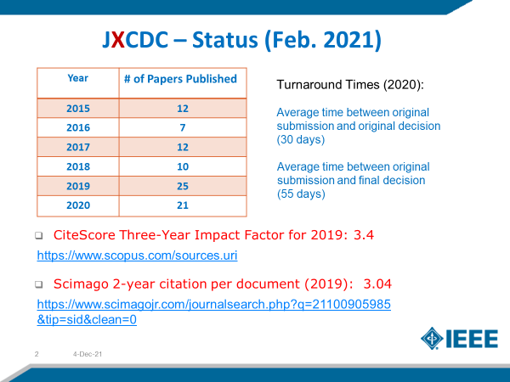
Backup

Slide 6
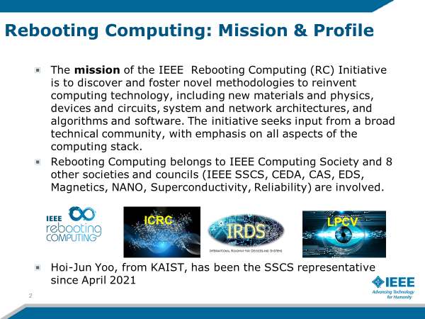
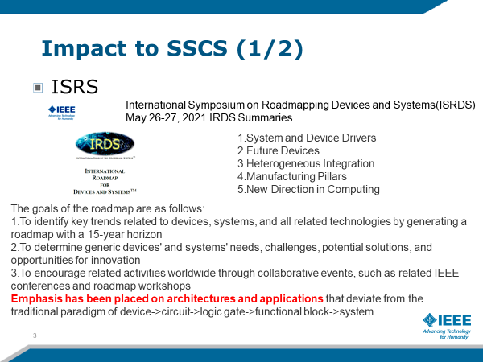
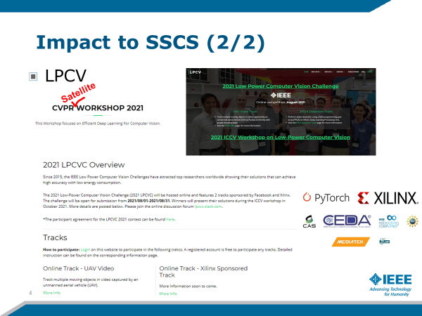
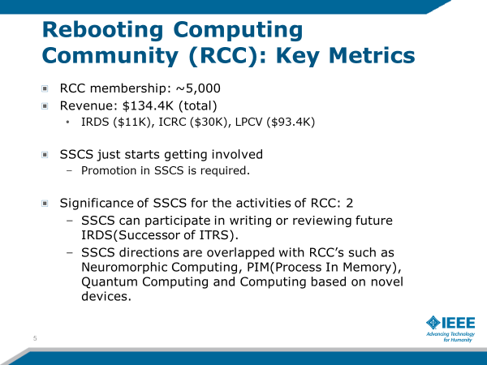
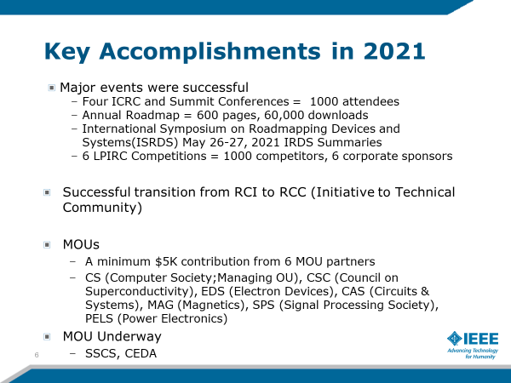
Backup
IEEE Confidential

Slide 7
Backup
Brain Initiative (Rikky Muller) Aug 2021 Update
  Formed to create a technical community to facilitate cross-disciplinary collaboration and coordination to advance research, standardization and development of engineering and technology to improve our understanding of the brain to treat diseases and improve human condition
  SSCS Joined in March 2021 as an affiliate non-voting member ($15K for three years of membership). Appointed Rikky as liaison (Milin as alternate).
  Key accomplishments: established 2021 joint SSCS-Brain Best Paper Award (allocated $500 from IEEE Brain). Winner will be announced in Winter edition of the magazine.
  Planned activities: technology roadmap joint effort, SSCS presentation in IEEE Brain webinar series and IEEE Brain Podcast Series, SSCS-Brain Workshop 2022.
  Revenue – Total $204,500 (primarily comes from Society contributions and workshops/forums).
  Seek to grow this area within SSCS and across the societies. SSCS members and students can join IEEE brain as individual members for free. Currently planning a joint workshop between SSCS and IEEE brain, engage in roadmaps and standards committees
IEEE Confidential

Slide 8
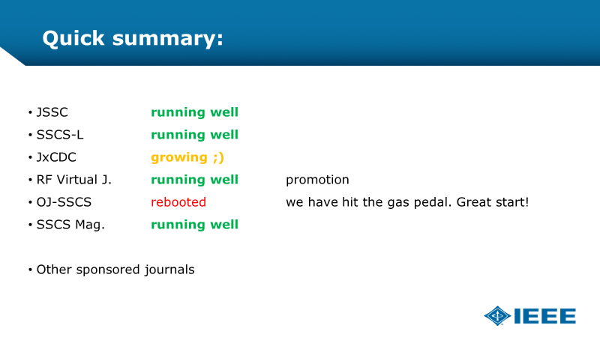
Backup: SSCS Publications
IEEE Confidential

