Slide 1
CEDA Strategy
Yao-Wen Chang
President-elect
Revised from David’s earlier slides. Thank David!!

Slide 2
Strategy Committee
President-elect, Yao-Wen Chang
Committee:
  Sani R. Nassif
  Shishpal S. Rawat
  Sachin Sapatnekar
  Donatella Sciuto

Slide 3
CEDA Vision and Mission
Vision: To be the leading provider of technical information and community services in Design and Automation of Electronic and Embedded Systems
Mission: The purposes of the Council shall be scientific, literary, and educational in character. The Council shall strive to advance the theory, practice, and application of methodologies, tools and technology for the design and development of Electronic and Embedded Systems. The Council shall promote cooperation and exchange of technical information among its members in workshops, conferences, contests and publications.

Slide 4
CEDA Strategy Aligned with IEEE Strategy (2015-2020)
Provide more opportunities, products, and services aimed, particularly, young professionals and entrepreneurs
  Get to know CEDA well, and also join CEDA committees!
Ensure the vitality and relevance of our core activities in standards, conferences, education, and publications
  Adapt to evolving world: EDA’s focus changed
Develop programs in public service focused on knowledge and technology promotion for emerging areas and humanitarian efforts
  Create/consolidate CEDA “members”
Evaluate and handle organizational structures and processes to meet the demands of a changing environment while managing the financial and sustainable health of IEEE
  Changes in CEDA EC and BoG structure and operation

Slide 5
CEDA Strategy Goals for 2018-2019
CEDA must enter into new domains to have future. CEDA must provide enough resources for such initiatives, three selected fields
  Cyber-Physical Systems (CPS) and IoT: Join forces with CPS week in 2018, consolidate IoT in major CEDA events (DAC, DATE, ESWEEK)
  Nano-technologies and devices: design tools and methodologies to be aligned with new EU FET Flagship projects – 1B Euro in graphene, quantum computing, and nano-systems
  Machine learning based optimization: invite key persons from for special sessions & talks?
Consolidate CEDA community and visibility
  Keep CEDA industrial links development (Cadence Global Collaboration Framework and Standards)
  Create new chapters/activities to foster visibility with scientific community
  Cooperate with CEDA founding societies (specially young professionals and outreach programs)
Consolidate growth of CEDA “community,” and measure progress and success
  Make committees more active than now: VPs define position with an objective/topic to focus on; define goals within first 3 months, evaluation of performance each year

Slide 6
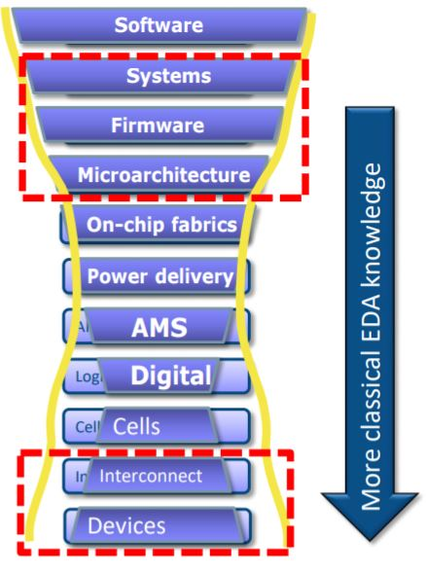
Old/New Fields for CEDA – Growth and Visibility
DAC focus needs re-evaluation: even less submissions than usual (only growth in machine learning, embedded system, security)
  Pressure from ESDA, new “business model”?
Other new fields and events
  South America: SBCCI (25-30% financial in 2018) & LASCAS
  China: EDA Symposium, etc.
  ICRC: Rebooting computing
  WF-IoT: CEDA growth?
  ATS & ITC-Asia: testing conferences in general
  RTCAS: Real-time system
  NVMSA: Emerging memory design
New
areas
for expansion
New
areas
for expansion

Slide 7
Development of CEDA’s Visibility
Keep growing with new CEDA chapters: Africa, South America, Asia, and Europe
  Africa: Morocco and Tunisia already incorporated (Egypt, no follow up, somewhere else?)
  Expand in South America (beyond Brazil) and Asia
  Europe too: No active chapters (new one in Spain), target in France, Germany, Switzerland, and Italy
CEDA Distinguished Lecturer Program (DLP) and Luncheon Keynotes
  Clear increase of visibility for CEDA, move program up: Up to 10 CEDA distinguished lecturers; 2-3 lectures per DL per year
  Consolidate CEDA Luncheon Keynotes “branding” in major events and invited sessions in events of sponsored societies (EDA/ML at ISCAS 2018, and new TA group in CASS done about “new EDA”)
Development of Student Activities and promotion in social media
  CEDA is present in Ph.D. forums of ASP-DAC, DAC, and DATE
  Student competitions in key topics: CAD Contest at ICCAD, IoT Competition at DATE, DAC (Low-Power Competition over)?
  Summer schools aligned with sponsoring societies are important (e.g., PD summer school in Taiwan)

Slide 8
New Models for CEDA Publications
Conference integration into periodicals is becoming a reality
  Done for ESWEEK 2017, outcome positive (suggestions to improve)
  If/Which conferences to suggest this model (ICCAD, others)?
Recognition issues: DAC EC keeps pushing for “the best of..” journals
  “Best of DAC”: Discussions with IEEE TCAD and ACM TECS journals
  “Best of EDA”: Re-focused papers from EDA conferences for magazines (D&T, etc.)
  “Best/Most influential papers”: Evaluation of highest impact after 5-10 years
Fields where CEDA publications can be proposed: Nano-technologies and CPS
  TESS rejected (refocus on CPS)

Slide 9

Questions & Suggestions
Thank You!!
Email: ywchang@ntu.edu.tw

