Slide 1
Finances update
Marina Zapater

Slide 2
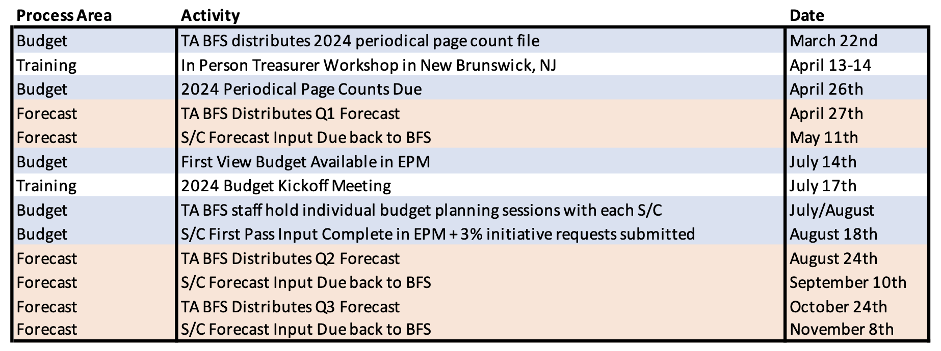
Key financial dates 2023
CEDA July meeting on 9th July (before first-view budget available)
Still probably we need to approve budgets in July meeting

Slide 3
2023 Current expenses status
(Distinguished Lect.)
(CEDA luncheons)
(YPP@DATE)

Slide 4
Current expenses status
Operational - Conference Catalyst
We’ll be around 5k above budget by end of the year
Plus some extra 5k for graphics design
Volunteer travel:
Only 6k (out of ~52k) spent so far, but no EC meeting expenses yet
Estimation is that this year we will spend the budget
Other expenses to come as conferences take place

Slide 5
Current expenses status – Points to discuss
Initiatives:
So far, only 10k (out of 98k) spent in YPP@DATE
Status of other initiatives ?
2023 chapter funding situation
Did chapters claim their funding?
22k were budgeted, but not all chapters claimed budget in 2022
Periodicals page rate adjustments

Slide 6
2022 Financial results
2022 not yet closed → should close mid-April (but not yet)
We work only with FM13 results, which do not include:
final distribution of packaged product revenues and expenses
true-up of expenses from Publishing Operations
true-up of copub revenue/expense to sponsoring OUs
remaining conference adjustments
Overall:
underspending in technical activities
major conferences not providing benefits

