Slide 1
Executive Committee Meeting Agenda Friday, 17 June 2022
DAC
Awards Schedule (Georges/Miguel)
Luncheon (TY/Amanda)
Expense Reimbursements (Marina)
Agenda/Meeting Schedule (Gi-Joon/Amanda)
Awards Updates (Georges)
Governing Docs Motion (Elena/Amanda)
Finalize the Initiative Project/Status (Ian)
Google Workspace Pricing Change (Amanda)

Slide 2
DAC 2022 – Awards Schedule
Tuesday | Wednesday | Thursday
Phil Kaufman (1) ACM Pioneering (1) ACM Fellows (5) IEEE Fellows (5) Richard Newton (1) Kirchmayer (1) (slide only) IEEE Robert Noyce (1) Under 40 (4) Marie Pistilli Women (1) | ACM Outstanding New Faculty (1) ACM Outstanding Dissertation Award (1) ACM TODAES BPA & Rookie Author (1) TRETS BPA (2) TCAD BPA (3) IEEE McCluskey Technical Achievement (1) IEEE Goode Memorial (1) Kirchmayer (1) (presentation) | ACM Distinguished Service (2) SIGDA Service (4) CEDA Outstanding Service (1) DAC BPA Design Track BPA DIET ESS Track BPA IP Track BPA HAC@DAC Winners SDC Winners

Slide 3
CEDA EC/BoG Schedule
Sunday - July 10, 2022 at the Moscone Center Room 3020
Breakfast
EC - 9:00AM-12:00PM
Lunch 12:00-1:00PM
BoG - 1:00PM-4:00PM
Monday - July 11, 2022 - 7:00 PM
Dinner - Mastro's Steakhouse 399 Geary Street
Tuesday, July 12, 2022 - 12:00-1:30PM at the Moscone Center 3018
Distinguished Speaker Luncheon featuring Dr. X. Sharon Hu

Slide 4
Governing Docs Motion
MOTION: Agnieszka Dubaj moved to approve the removal of the listing of Member Technology Organizations from the IEEE CEDA Bylaws. David Atienza seconded. Motion passed.
From IEEE
"The CEDA Constitution currently states that each Member Technology Organization has a voting representative on the Board of Governors.
"Article IV: Council Officers and Board of Governors Section IV.1. Board of Governors Council business will be conducted by its Board of Governors, which shall include the following voting and non-voting members. Voting Members: ● Member Society Representatives (casting one vote per Society) ● Member Technology Organization Representatives ● Officers of the Council ● Chairpersons of the Council’s Standing Committees who are IEEE members"
If the Member Technology Organizations appoint representatives with voting rights to the BoG, then they do need to be listed in the Bylaws so that the voting rights of each MTO are codified in the governing documents.
We cannot recommend approval of this proposed revision."

Slide 5
Google Workspace Changes
Google Drive and Gmail aliases will no longer be free
Currently 35 users
Recommend Business Standard Plan $12/user per month
Need to decide by June 27 if you want to continue with Google’s service
Alternate Option:
IEEE Functional Alias Service (see next slide)
Conference Catalyst Dropbox or free Google Drive (limited service)

Slide 6
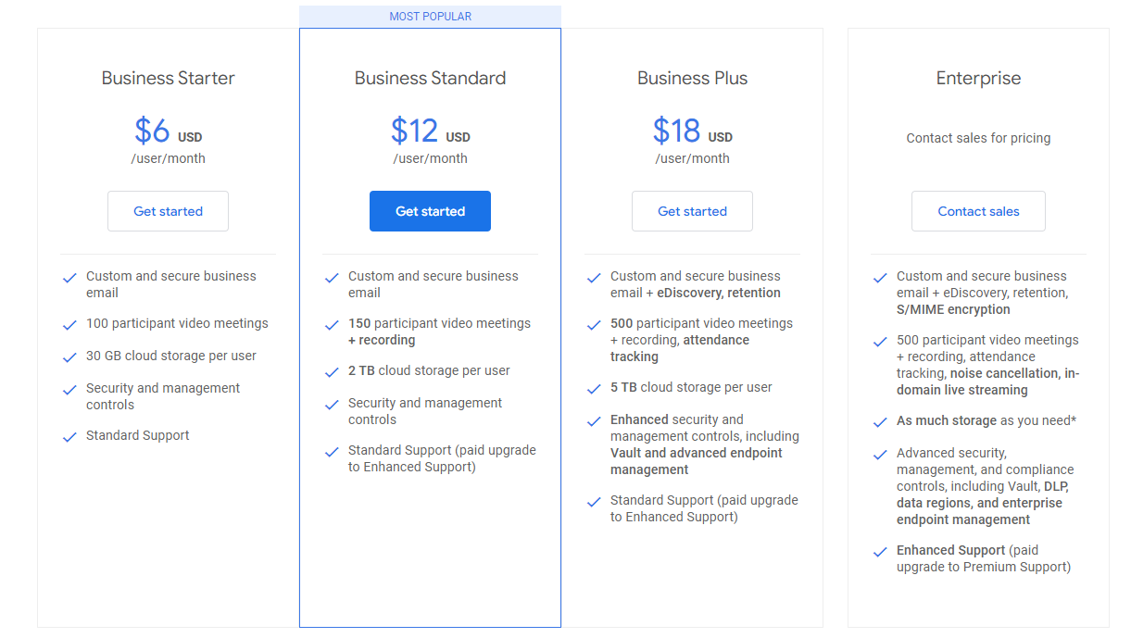
Google Workspace Changes

Slide 7
IEEE Alias Service

