Slide 1
Executive Committee Meeting Agenda Friday, 20 May 2022
Awards updates
Newton and TCAD (Georges)
2022 Kirchmayer award presentation at DAC (Gi-Joon)
2022 Kaufman dinner (Amanda)
Conferences
ASP-DAC conference format (Virtual/Online/In-person) recommendation based on DATE/DAC experience (Cristiana/Joerg/Masanori/Gi-Joon)
Technical sponsorship for International Conference on Field-Programmable Technology (ICFPT)
DAC (Miguel)
DAC EC Dinner (Amanda)
LATS financial sponsorship
Finance Update (Marina)
Initiatives project discussion (Ian/TY/Enrico/Marina)

Slide 2
DAC 2022
SEMICON 2023/2024
DAC CEDA rep term limit discussion
Awards
Proposed schedule from Miguel
Google form due Monday, May 23
Expenses being reviewed
EC Dinner (Amanda)

Slide 3
DAC 2022 – EC/BoG RSVP
In-Person
Aparna Dey
Georges Gielen
Masanori Hashimoto
Jörg Henkel
Jiang Hu
Enrico Macii
Tulika Mitra
Subhasish Mitra
Gi-Joon Nam
Ian O'Connor
Amanda Osborn
Partha Pande
Jose Rayas-Sanchez
L.Miguel Silveira
Ioana Vatajelu
Marina Zapater
Qi Zhu
Madie Nelson
Virtual
Agnieszka Dubaj
Tsung-Yi Ho
Cristiana Bolchini
Yao-Wen Chang

Slide 4
DAC 2022 – Awards Schedule
Tuesday | Wednesday | Thursday
Phil Kaufman (1) IEEE Robert Noyce (1) ACM Pioneering (1) ACM Fellows (1) IEEE Fellows (4) Richard Newton (1) Under 40 (4) Marie Pistilli Women (1) Pat Pistilli Scholarship (1) | IEEE Goode Memorial (1) IEEE McCluskey Technical Achievement (1) ACM ONFA (1) ACM Outstanding Dissertation Award (1) CEDA Outstanding Service award (1) ACM Distinguished Service Award (2) ACM Service Awards (1) TODAES BPA (1 award, 5 authors) TRETS BPA (1 award, multiple authors) TCAD BPA (2 awards, multiple authors) | DAC BPA Design Track BPA DIET ESS Track BPA IP Track BPA SDC Winners HAC@DAC Winn
Which one should be moved to Thursday (if needed)?

Slide 5
Financial Sponsorship Request
Conference: IEEE Latin-American Test Symposium – LATS
Venue: Montevideo, Uruguay
Time: September, 5 - 8
General chair: Raoul VELAZCO (emeritus research Director CNRS) Yervant Zorian
The Executive Director of Fundación Julio Ricaldoni (FJR) of the university in Uruguay agreed with the following numbers:
Financial sponsors: CEDA (25%) and FJR (75%) Technical sponsors: CEDA (20%) and FJR (80%)
The person that will sign the MOU is the dean of the Engineering School and president of the administration committee of FJR: María Simon

Slide 6
Technical Sponsorship Request
Conference: Int. Conf. Field Programmable Technology – ICFPT
Venue: Hong Kong
Time: December
General chair: Wei ZHANG

Slide 7
Technical/Financial Sponsorship Request
Conference Name: 23rd IEEE Latin American Test Symposium (LATS2022)
Sponsorship Year: 2022
Conference website: www.lats.tttc-events.org
Contact Name: Letícia Maria Bolzani Poehls (Program Co-Chair)
Contact E-mail: leticia@poehls.com or poehls@ids.rwth-aachen.de

Slide 8
Description of Conference
Is the conference currently indexed in IEEE Xplore: Yes
Does the conference maintain a public archive of its papers: No
Approximate breakdown of academic/industrial attendance: 75% 25% Approximate breakdown of local/international attendance: 20% 80%
Provide a 1-paragraph overview of the conference (Please point out features that link this conference to the EDA community and CEDA, and show the strategic importance of the conference area of interest)
The IEEE Latin-American Test Symposium (LATS) is a recognized test and fault tolerance techniques forum attended by professionals from all over the world, in particular from Latin-America, to present and discuss various aspects of system, board, and component testing as well as design, manufacturing and in-field considerations with fault tolerance in mind. All presented papers are published in the IEEE Xplore Digital Library and the best papers of its 23rd edition will be invited to re-submit to IEEE Design & Test, Journal of Electronic Testing: Theory and Applications (JETTA) and IEEE Transactions on Computer-Aided Design of Integrated Circuits and Systems (TCAD).

Slide 9
History of Conference
 | Place | Attendance | Submitted Papers | Accepted Papers | Budget Total | Final Surplus
Most recent (e.g. 2021) | Punta del Est, Uruguay | Virtual conference (estimation 70) | 40 | 23 (full papers + posters) | US$ 2241.77 | US$ 0.0
Most recent (e.g. 2020) | Maceio, Brazil | Virtual conference (estimation 40) | 44 | 23 full papers | US$ 11.228,19 | US$ 0.0
Previous (e.g. 2019) | Santiago, Chile | 40 | 69 | 35 (full papers + posters) | US$ 19,553.33 | US$ 0.0
Previous (e. g. 2018) | São Paulo, Brazil | 57 | 68 | 45 (full papers + posters ) | US$ 21,500.00 | US$ 0.0
Previous (e.g. 2017) | Bogota, Colombia | 54 | 45 | 33 (full papers + posters ) | US$ 17,157.00 | US$ 5374.00
Previous (e.g. 2016) | Foz Iguaçu, Brazil | 72 | 53 | 34 (full papers + posters ) | US$ 26,103.00 | US$ 0.00

Slide 10
Finance update
Many “housekeeping” activities since beginning of the year
2022 Budget and Forecast Updates (in the post-COVID era)
2023 Budget elaboration dates and timeline

Slide 11
Finance update
Many “housekeeping” activities since beginning of the year
NextGen and Concur access (and NextGen training…)
Getting up-to-speed with recent changes (CCs, ACs)
Setting up all VP of Finance rights correctly (some approvals got delayed…)
CEDA Credit card
2022 Budget vs Forecast Updates (in the post-COVID era)
2023 Budget dates and timeline

Slide 12
2022 Budget vs Forecast updates
Forecast updates: the opportunity to adjust for the deviations of the 2022 budget
1st quarter (mid-May)
2nd quarter (mid-August)
3rd quarter (mid-November)
Main items to adjust:
Periodical products (changes to page counts for 2022) → can still be submitted
Conference products → changes due to COVID expected (we seem back to 2019 data)
Initiatives (see next slide)

Slide 13
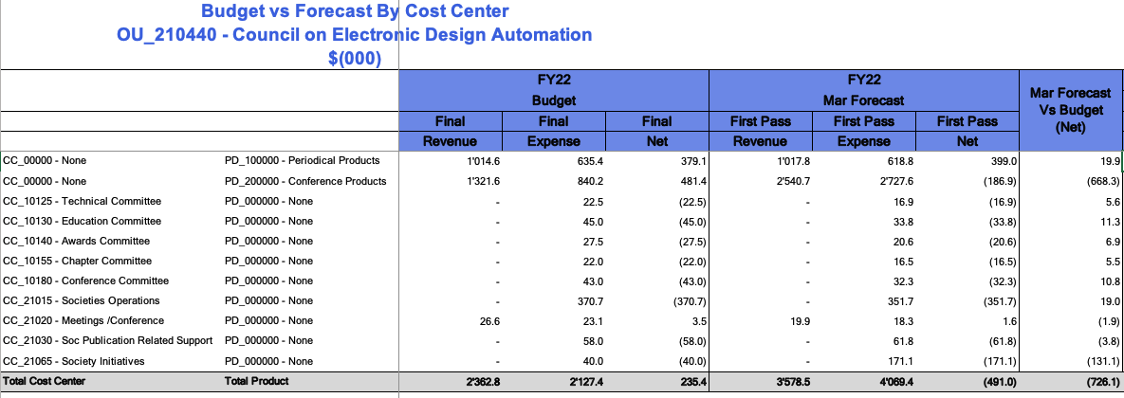
2022 Budget vs Forecast updates

Slide 14
2022 Initiatives Project budget
Approved 3% amount in 2022 budget → 40k
Current forecast overview for projects (CC_21065 – Society initiatives):
Current 50% spending in forecast → 131.1K
~2022 50% spending in forecast → 157.0K
Still available to apply for 25.9K
Updates/changes can be still incorporated into Q1 forecast (to be informed ASAP)

Slide 15
2023 Budget elaboration
First-pass updates from July 20th to August 11th.
First view available on Nextgen on July 14th
Ideally to be discussed internally at some point between those dates
Discussion during July 10th DAC meeting instead
Expense reimbursement document (ask Crisitiana)

