Slide 1
CEDA EC Meeting
Friday, 17 March 2023

Slide 2
Executive Committee Meeting Agenda
Kaufman Dinner Recap
February TAB Recap
Fellow Selection Process
TAB Level Initiatives
TCAS-AI Journal
TAB CoS Seed: Funding Opportunities
DAC 2023 Finance and Planning
DATE 2023
Agenda
Meeting Planning
Registration
CEDA Bylaw Changes
Open for Discussion

Slide 3
Kaufman Dinner Event on 02/23
https://www.semi.org/en/communities/esda/mediaLibrary/2022_PhilKaufmanAward
CEDA needs to participate in table assignment process!
Two CEDA’s tables had blocked views from the podium
ESDA’s comments that CEDA is NOT a main sponsor
Did ESDA respond with a written apology letter afterwards?
Kaufman Award 2023 planning
How many nominations?
Aligning with ICCAD or ISSCC?

Slide 4
February TAB Meeting Recap
Fellow Selection Process
From each S/C, candidates in top/bottom buckets will be/not be elevated to full reviews.
S/Cs with more than ~30 nominations or more than 6000 members become their own cohorts (i.e. no change)
For others, S/Cs will be aggregated into larger groups within divisions.
In Division I, EDA, CAS and SSCS have all >6K members, so they stay without change
CEDA & Nano will be merged into a cohort
Strategic planning discussion in DATE EC meeting
TCAS-AI Journal proposal
TAB CoS Seed: Funding Opportunities
TAB Level Initiatives

Slide 6
S/C Nominations Historic Data
Three-year average values are used
S/TC | Av. Nom. | Membership | Nom/Member
AES | 17.3 | 4.8 | 3.6
AP | 30.3 | 8.9 | 3.4
BIO | 3.3
BT | 2.3 | 1.4 | 1.7
CAS | 30.3 | 9.9 | 3.1
CE/CT | 5.3 | 2.6 | 2.1
CEDA | 16.7
CI | 28.7 | 7.6 | 3.8
COMM | 119.0 | 24.4 | 4.9
COMP | 148.3 | 36.7 | 4.0
CS | 35.7 | 8.0 | 4.5
CSC | 3.7
DEI | 4.7 | 1.8 | 2.6
ED | 42.3 | 9.0 | 4.7
EDU | 6.3 | 3.2 | 2.0
EMB | 29.7 | 8.6 | 3.4
EMC | 5.3 | 3.4 | 1.6
EP | 4.7 | 2.3 | 2.0
GRS | 19.0 | 5.3 | 3.6
IA | 33.0 | 9.7 | 3.4
IE | 29.7 | 8.7 | 3.4
IM | 5.0 | 3.7 | 1.4
IT | 10.3 | 3.6 | 2.9
ITS | 6.3 | 2.4 | 2.6
MAG | 11.3 | 2.5 | 4.5
MTT | 30.7 | 10.5 | 2.9
NANO | 7.7
NPS | 9.0 | 2.7 | 3.3
OE | 3.0 | 1.7 | 1.8
PC | 0.0 | 0.5 | 0.0
PE | 79.0 | 30.1 | 2.6
PEL | 17.0 | 8.9 | 1.9
PHOT | 45.3 | 6.1 | 7.4
PSE | 1.0 | 0.7 | 1.4
R/RL | 4.3 | 1.5 | 2.9
RA | 32.3 | 11.7 | 2.8
RFID | 0.3
SEN | 7.0
SIT | 0.7 | 1.5 | 0.4
SMC | 13.7 | 4.9 | 2.8
SP | 63.3 | 16.1 | 3.9
SSC | 18.7 | 10.2 | 1.8
Sysco | 4.0
TMC/TEM | 3.7 | 2.6 | 1.4
UFFC | 12.3 | 2.0 | 6.2
VT | 19.3 | 5.6 | 3.5
 | 22.2 | 7.3 | 3.0

Slide 7
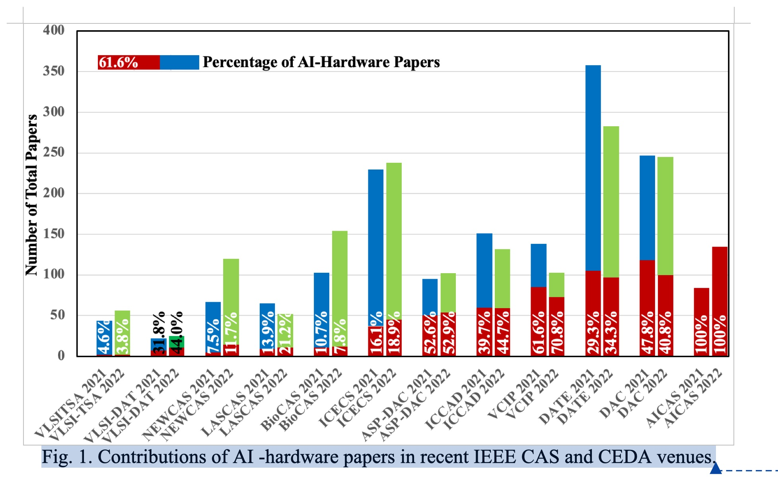
TCAS-AI Journal proposal
A new journal proposal by CAS
The argument is that there are significant papers of AI hardware in conferences.
But they use several conferences sponsored by CEDA
It’s not approved yet, but it will be discussed again in June TAB meeting
The biggest concern is the overlap with TCAD
Action items?

Slide 8
DAC 2023 Finance and Planning
Financial situation is difficult
Still doing many/most things in the same way they have always been done
Hard to break with old habits, convictions
ACM pushing hard to ensure surplus (otherwise will have to drop out in 2, 3 years)
15% overhead added to budget
60th DAC was planned to be celebratory
San Francisco is an expensive city, unionized, hard to avoid many costly expenses
Original budget was “expense-balanced” (no surplus, no overhead
Synopsys dropped out, Cadence reduced some support
Now struggling to pay expenses

Slide 9
DAC 2023 Finance and Planning
Major expense items are:
Conference management, overly expensive ($500K)
A/V ($500K), Exhibition (Sales, room, etc, $440K), Food and Beverage ($350K)
Moscone ($190K), registration costs ($112K), direct, EC costs ($165K)
2023 likely to be “expense-balanced”, 2024 budget starting
Budget was approved with several strong warnings for 2024
Drastic reduction in directly controlled costs (e.g. EC costs)
Sponsors taking more active role in managing several aspects (RFPs for services, negotiations)
Tough road ahead
Clear clash of perceptions, hard to change “old” ways
Advisory Committee was setup and started working; experienced people, will help

Slide 10
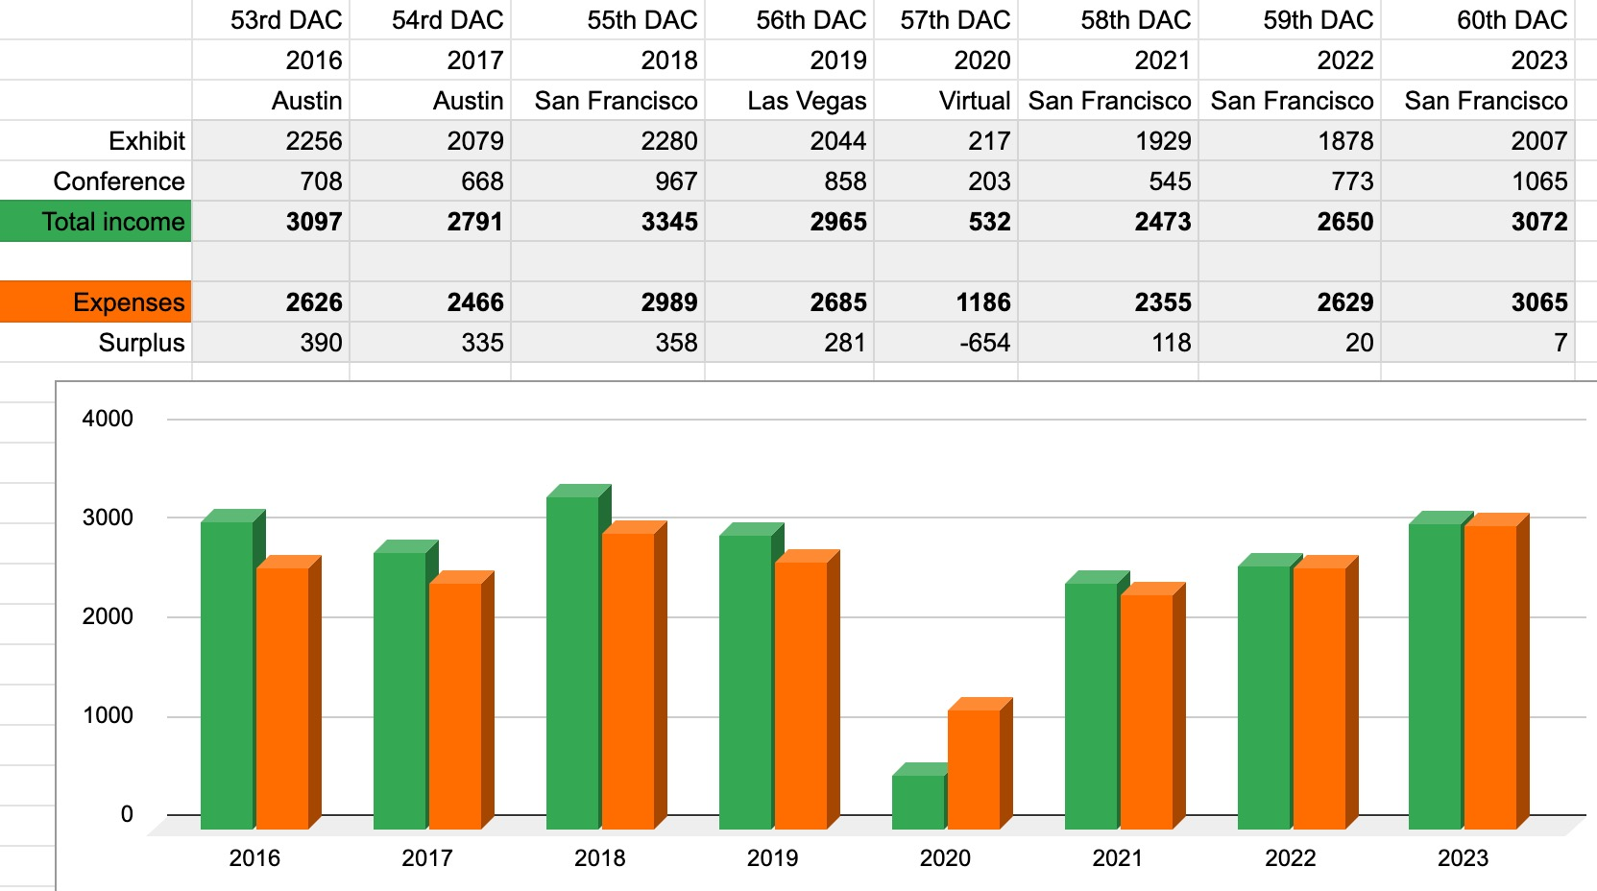
DAC Income and Expenses over the Years ($K)
Pre-covid
Reference
year
2023 Budget

Slide 11
[TAB CoS] Seed Funding Opportunities; application due on 30 March 2023
TAB Committee on Standards is looking for proposals from IEEE Societies and Councils (S/Cs) activities to 1) promote activities leading to a new standard development such as submission of a PAR to IEEE SA 2) publicize the importance of standards development through meetings, workshops or conferences 3) cultivate the interest in contributing to standards through various means such as participation recognition with certificates 4) prioritize on new applications for sustainability and cost effectiveness For this call for proposal, topics of interests include but not limited to the following: a) Climate change such as clean energy b) Smart sensors c) Smart health d) Intelligent transportation e) Technology management f) Data analytics guidelines g) Open source h) Other areas promoted by technical committees of societies/councils/OUs These awards are for up to USD$10,000. In addition, in alignment with the priorities of SA and the IEEE, up to USD$20,000 may be offered for new proposals that impact sustainability for either our material universe, for instance, energy or climate change, or sustainability in our information universe, for instance, in internet safety, security, or usefulness.

Slide 12
About the New Initiatives Program

Slide 13
What is a New Initiative?
An IEEE initiative is a new program, service, or product … that will provide significant benefit to members, the public, the technical community, or customers, … or which could have lasting impact on the IEEE or its business processes
Initiatives must be of strategic importance to IEEE
Initiatives are not operational necessities at the time of their initiation
Projects that can be funded by appropriate baseline budget reductions within the unit are not classified as initiatives

Slide 14
Submitting to NIC
All proposal ideas and applications are submitted via OpenWater
Two-phase submission process for seed grants
Project description
Seed grant proposal
Three-phase submission process for new initiatives
Project description
Preliminary proposal
Full proposal and business plan

Slide 15
Seed Grant Process
Seed Grant: Funds innovative or pilot projects that require US $40,000 or less and take 12 or fewer months to complete
NIC provides feedback using a form in OpenWater
Feedback is compiled and sent to applicant for their consideration
Does not require discussion or voting at a meeting
Project Description
NIC evaluates/scores proposals in OpenWater
NIC discusses proposals and votes to fund or not to fund at their next meeting
Proposal
Notes:
Lesleigh

Slide 16
New Initiatives Process
New Initiatives: Large–scale projects typically seeking US $100K or more for up to three 12–month periods
NIC provides feedback using a form in OpenWater
Feedback is compiled and sent to applicant for their consideration
Description
NIC evaluates/scores proposals in OpenWater
NIC discusses proposals and votes to invite a full proposal or not to invite a full proposal
Preliminary Proposal
NIC evaluates/scores proposals in OpenWater
NIC discusses proposals and votes whether or not to recommend to the IEEE Board of Directors to fund or not fund
Full Proposal and Business Plan
Notes:
Lesleigh

Slide 17
CEDA Bylaw Changes
Let’s discuss this @ DATE EC meeting

Slide 18
DATE 2023 EC Meeting Preparation
The usual VP-level updates
IEEE Fellow Selection Process updates
TCAS-AI Journal updates
CEDA Bylaw changes
TAB CoS Seed funding and planning
Free registrations

Slide 19
Finance update
Reminder: new travel guidelines (IEEE reminded us to enforce the new guidelines) Notably:
Flights: No economy premium, extra legroom or priority boarding unless pre-approved by Society President. Seat selection is ok.
Travel insurance for trip cancellation or lost baggage is ok. Medical coverage is not ok.
Co-sponsorhip publication agreements review
Financial Sponsoring:
IEEE Design & Test – 33.4%
IEEE X-CDC : Exploratory Solid-State Computational Devices and Circuits – 11.25%
IEEE M-IOT : Internet of Things Magazine – 19.30%
T-SPI : Signal and Power Integrity – 15%
Technical sponsoring:
T-SUSC : Sustainable Computing
Multi-scale computing systems (Sunset)

