Slide 1
IEEE CEDA Executive Committee Meeting
March 19, 2018
Dresden, Germany
David Atienza – President
president@ieee-ceda.com
david.atienza@epfl.ch

Slide 2
Conferences
Luca Fanucci
Committee
Ayse Coskun (DAC rep)
Donatella Sciuto (DATE rep)
Gi-Joon Nam (ICCAD rep)
Masanori Hashimoto(ASP-DAC rep)
Yao-Wen Chang (past VP)

Slide 3
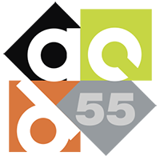
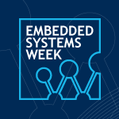
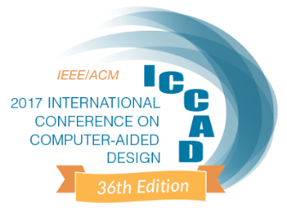
CEDA Conferences Status on 12 November 2017 @ BoG
19 financially sponsored ones, 15 technically
ASP-DAC (25%*)
BMI
DAC (33.3%)
DATE (26.5%)
DDECS (25%*)
DTIS (25%)
EDPS
ESWEEK (25%)
ETS (25%)
FDL
FMCAD
GLSVLSI
ICCAD (46.7%)
IDT
iNIS
ITC-Asia (50%)
IVSW (100%)
IMSTW (100%)
IOLTS (100%)
IOTA
ISED
ISVLSI
LASCAS (20%*; from 2018)
LATS
MEMOCODE (15%)
MPSoC (33.3%)
NOCS (40%)
RC
SBCCI
SIES (50%)
SMACD
VLSID
VLSI-SoC (25%)
WF-IoT (8.5%)
EDPS
Blue: Financial sponsorship (%share)
Green: technical sponsorship

Slide 4
Current Status
ASP-DAC (25%*)
BMI
DAC (33.3%)
DATE (26.5%)
DDECS (25%*)
DTIS (25%)
EDPS
ESWEEK (25%)
ETS (25%)
FDL
FMCAD
GLSVLSI
ICCAD (46.7%)
IDT
iNIS
ITC-Asia (50%)
IVSW (100%)
IMSTW (100%)
IOLTS (100%)
IOTA
ISED
ISVLSI
LASCAS (20%*; from 2018)
LATS
MEMOCODE (15%)
MPSoC (33.3%)
NOCS (40%)
RC
SBCCI
SIES (50%)
SMACD
VLSID
VLSI-SoC (25%)
WF-IoT (8.5%)
Ongoing items
Updating list of CEDA Sponsored Conference w.r.t. 2018 changes:
IMSTW → IOLTS
IOTA → ?, etc.
Analyzing evolution of main topics addressed (CFP, Special Sessions, etc.)
Analyzing evolution of the acceptance rate especially in technically sponsored conferences
Analyzing CEDA logo visibility in the relevant web-sites, CFP, etc.
Blue: Financial sponsorship (%share)
Green: technical sponsorship

Slide 5
Recent New Sponsorship Applications
Financial (50%)
7th Non-Volatile Memory Systems and Applications Symposium, Hakodate, Japan, August 28-31, 2018 Acceptance Rate: 55% (2017) co-located with 24th IEEE International Conference on Embedded and Real-Time Computing Systems and Applications
Technical
Asian-Host: Asian Hardware Oriented Security and Trust Symposium, Hong Kong, December 2018 Acceptance Rate: 46% (2017) and 51% (2016)
PATMOS: Power And Timing Modeling, Optimization and Simulation Costa Brava, Spain, July 2-4, 2018 Acceptance Rate: 66% (2017), 56% (2016), 63% (2015), 51% (2014)

Slide 6
Vision for 2018-2019
Support CEDA Sponsored Conference Organizer with Publicity to solicitate paper submission especially for the ones with high acceptance rate.
Stimulate CEDA Sponsored Conference Steering Committee to include new areas of CEDA interest such Internet of Things (IoT), bio-electronic systems design, new methodologies to conceive nano-technology based devices, artificial intelligence and security.
Expand CEDA visibility to other regions (such as Asia and South America) and support their conferences.
Stimulate healthy CEDA technically sponsored conference to apply for CEDA financial sponsorship
Strengthen the collaboration between academia and industry
Continue with Conference Activities to involve Young Researchers (education talk, contest, etc.)

