Slide 1

Florence, Italy
DATE 2019, 25 – 29 March 2019, Florence, Italy

Slide 2
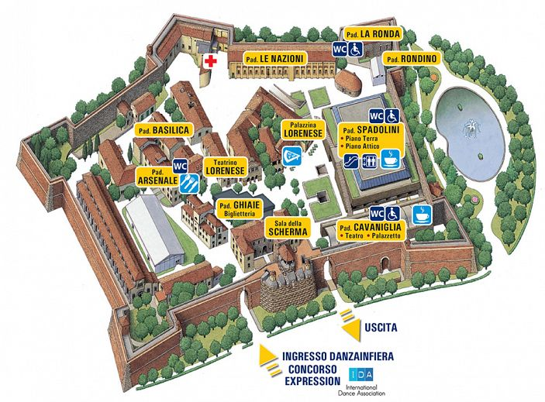
Venue
FIRENZE FIERA
Fortezza da Basso
Padiglione Spadolini, lower floor
Address:
Viale Filippo Strozzi no. 1.
Florence, Italy
Entrance

Slide 3
Special Days
Model-Driven Design of Intelligent Systems
Embedded Meets Hyperscale and HPC

Slide 4
Call for Paper / Exhibition

