Slide 1
Item # | Time | Agenda Item- (Location: Westminster 2)
0 | 08:30 | Breakfast
1 | 9:00 | Call to Order (David Atienza), Roll Call (McGillis), Minutes approval (David)
2 | 9:05 | Subhasish- Awards (no slides)
3 | 9:20 | Cristiana- Finance (slides received)
4 | 9:40 | Conferences- Luca , remote access *- Conferences (slides received) DAC update - David (on behalf of Ayse)
5 | 10:00 | Gi-Joon- Activities (slides received)
6 | 10:15 | Miguel- Publications (slides received)
7 | 10:30 | José- Initiatives (slides received)
8 | 10:45 | Dennis- Standards
9 | 11:00 | CEDA Bylaws update - David (on behalf of Agnieszka)(slides received)
10 | 11:15 | Yao-Wen and David - Strategy and TAB strategic point
11 | 11:30 | Shishpal - Nominations and Appointments for CEDA EC 2020-21*
 | 12:00 | LUNCH
00 | 13:00-17:00 | See BoG Agenda

Slide 2
Awards at ICCAD
Subhasish Mitra, VP Awards
Stanford University

Slide 3
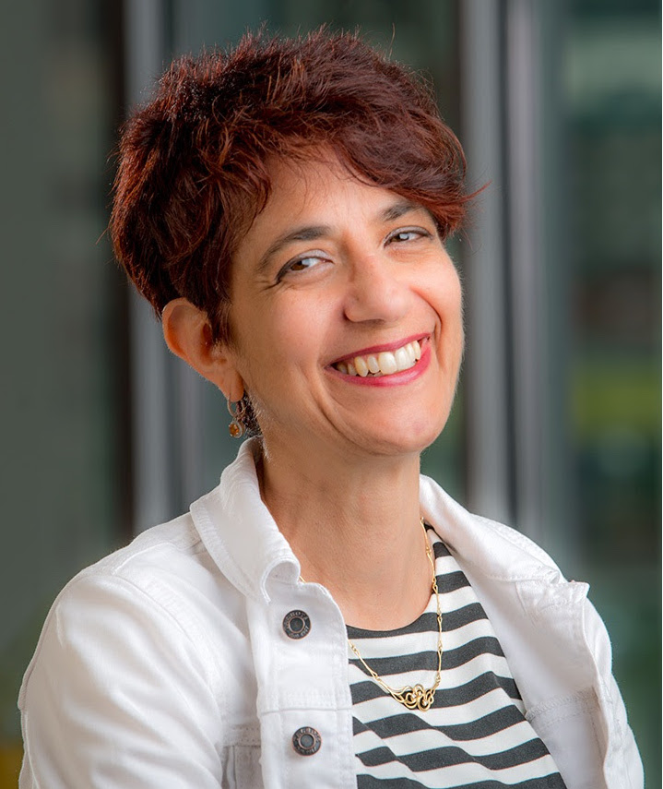
Outstanding Service Recognition
IRIS BAHAR
Brown University
For outstanding service to the EDA community as ICCAD General Chair in 2018

Slide 4
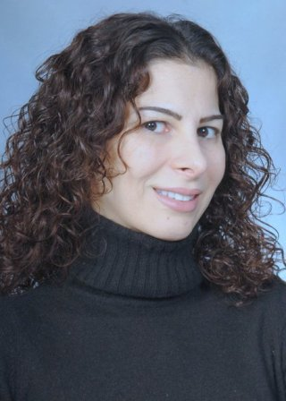
IEEE Fellow Recognition
Farinaz Koushanfar
University of Southern California San Diego
for contributions to hardware and embedded systems security and to privacy-preserving computing

Slide 5

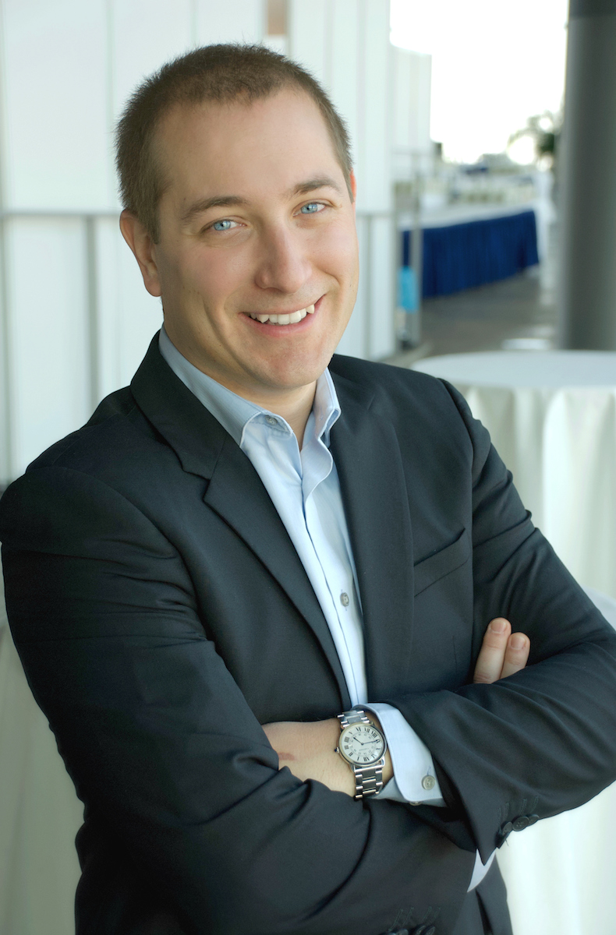
IEEE CEDA Ernest S. Kuh Early Career Award
Pierre-Emmanuel Gaillardon
University of Utah
For contributions to Electronic Design Automation targeting emerging logic and memory technologies

Slide 6

Call for Nominations
2020 IEEE CEDA Ernest S. Kuh Early Career Award
Nominations Due: 15 April
See CEDA website for more details:
http://ieee-ceda.org/awards/ernest-s-kuh-early-career
2020 IEEE/ACM A. Richard Newton Technical Impact Award in Electronic Design Automation
See SIGDA or CEDA website for more details
Notes:
Next up Finance

Slide 7
Finance
Cristiana Bolchini/Politecnico di Milano

Slide 8
Status
Financial reserve as of Sep 2018: ~$2.5M
A slightly lower net w.r.t. plan because of additional sponsored activities
Based on the results of 2018 ($85.7K to spend beyond the budget)
  The DL program as a standard technical activity
  Some additional activities
  Additional Executive Committee expenses to travel

Slide 9
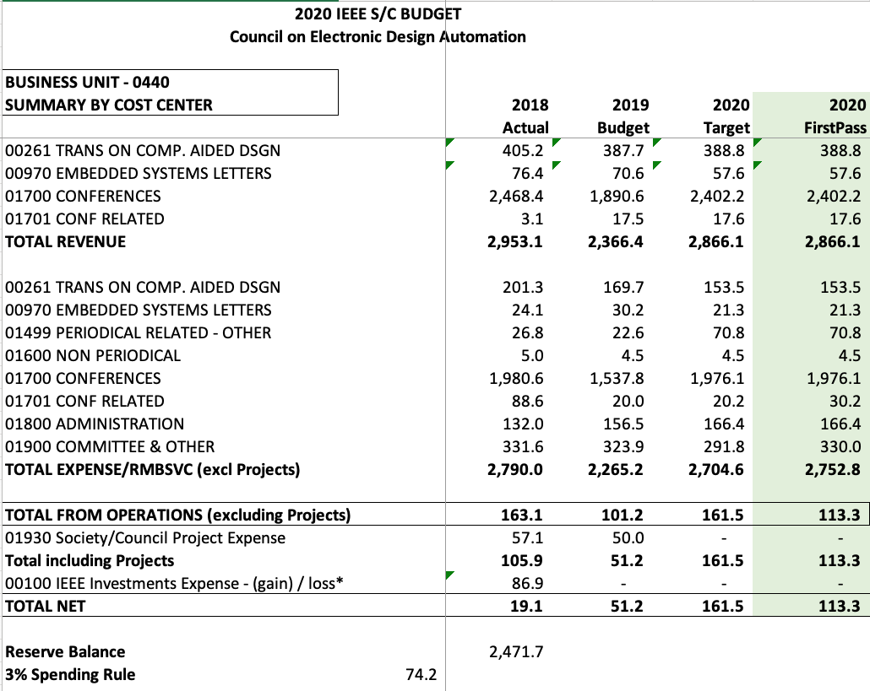
Budget 2020 - approved
Optimistic net on conferences
Sara Dailey’s change of
contract type
overestimated

Slide 10
Budget 2020 – Expenses details
Local chapters 25K
Distinguished Lecturers 20K
CEDA Luncheons @ 43K
ASP-DAC | DAC | DATE | ICCAD
Awards 17K
Phil Kaufman 28K
Technical committees 25K
Student events 25K
DAC | DATE | ICCAD
Secretarial Services ~ 60K
Committee Travels ~ 45K
Web & Promotion ~ 10K
Student grants 20K
DivEDA 5K
DAPE workshop 5K
CPS Summer school 5K
ML-CAD workshop 5K

Slide 11
Activities sponsored by CEDA
Local chapters: ~ 22K
Distinguished Lecturers ~ 10K
CEDA Luncheons @ ~ 42K
ASP-DAC | DAC | DATE | ICCAD
Awards ~ 15K
Phil Kaufman ~ 30K
Student contests ~ 30K
Technical committees ~ 20K
DATC | SVDTC | TCCP
ML-CAD Workshop
Workshop on Logic and Synthesis
International Seasonal School on Physical Design Automation
CPS Summer School
ESWeek Student Support
DAPE Workshop
Diversity in EDA
DAC Student Demo
P R O J E C T S
Students grants: 50

Slide 12
Looking to 2020
Students’ sponsorship as a project
(on 50% net surplus from 2019)
DL program adjustments – several opportunities for DLs but limited funds
Activities that cannot be «projects» anymore need a new context
Notes:
Next up: conferences

Slide 13
Conferences
Luca Fanucci, University of Pisa
  Ayse Coskun (DAC rep)
  Donatella Sciuto (DATE rep)
  Tsung-Yi Ho (ICCAD rep)
  Masanori Hashimoto (ASP-DAC rep)
  Yao-Wen Chang (past VP Conferences)

Slide 14
Status of Conferences
5 Long-lasting CEDA Conferences: DAC, ASP-DAC, ICCAD, DATE, ES WEEK
38 additional sponsored conferences: 20 Financial and 18 Technical
Added 5 new conferences (4 in 2018, 2 in 2019 and 1 in 2020) mainly to include new areas of interest for CEDA (Non-Volatile Memory Systems, Hardware Security, Internet of Things, Machine Learning for EDA) and expand CEDA visibility in Asia.

Slide 15
New Sponsored Conferences
  COINS: International Conference on Omni-layer Intelligent systems, Barcelona, Spain, July 27-29 2020 (Technical)
  IEEE/ACM Machine Learning for CAD (MLCAD) Workshop’s, Canmora, Canada; 3-4, September 2019 (Financial 50%)
  IEEE/ACM International Symposium on Low Power Electronics and Design (ISLPED), Lausanne, Switzerland, 29-31, July 2019 (Financial 15%)
  7th Non-Volatile Memory Systems and Applications Symposium, Hakodate, Japan, August 28-31, 2018 (Financial 50%)
  27th Asian Test Symposium, Hefei, Anhui, China, October 15‐18, 2018 (Financial 50%)
  Asian-Host: Asian Hardware Oriented Security and Trust Symposium, Hong Kong, 17-18 December 2018 (Technical)
  23rd Conference on Design of Circuits and Integrated Systems, Lyon, France, 14-16 November 2018 (Technical)

Slide 16
On-going Directions
Expand CEDA visibility to other regions (such as Africa, Asia and South America) and support their conferences
  discussion on-going with ICAT “Internet Of Things And Telecommunications International Congress 2020, Marocco.
Increase CEDA’s influence in growing areas related to EDA and ES, such as EDA for Internet of Things, EDA for bio-electronic systems design, and artificial intelligence for EDA.
  discussion on-going with AICAS 2021 “IEEE International Conference on Artificial Intelligence Circuits and Systems”
Stimulate healthy CEDA technically sponsored conferences to apply for CEDA financial sponsorship
“CEDA Student Travel Grant Program” to be considered for 2020-2021 term for supporting student participation at CEDA sponsored conferences especially the ones from developing countries or those with a verified need.
Notes:
Next up: Activities

Slide 17
Activities
Gi-Joon Nam (IBM Research)
  Committee Members
    All local chapter chairs

Slide 18
CEDA Activity Overview
Distinguished Speaker Luncheon at DAC, DATE & ICCAD
Sponsoring Conference Activities and Workshops
Distinguished Lecturer Program
Local Chapters (i.e., Outreach Program)
Member Technology Organization

Slide 19
Distinguished Speaker Luncheon Presentation
ICCAD’19: Nov. 5, from 12:30 pm to 1:30 pm, Legacy Ballroom
  “Current Progress in Quantum Computing” by Paul Nation from IBM Research
DATE’20: Mar. 18, ALPEXPO, Grenoble, France
  “Leveraging Embedded Intelligence in Industry: Challenges and Opportunities” by Jim Tung, Mathworks Fellow
    AI (ML and DL) implementation on embedded system – processor, GPU and FPGA
Suggestion: More engagements with other CEDA ECs, particularly with Strategy & Initiatives chairs

Slide 20
Distinguished Speaker Luncheon Presentation: Past Talks
DAC’19: “Simulation Technologies for Image Systems Engineering” by Brian A. Wander, from Stanford Univ.
DATE’19: “Heterogeneous, High Scale Computing in the Era of Intelligent, Cloud-Connected Devices”, David Pellerin, from Amazon USA
ICCAD’18: “Analyzing the Disruptive Impact of a Silicon Compiler” by Andreas Olofsson from DARPA
DAC’18: “Energy Efficient Neuromorphic Learning and Inference at Nanoscale” by Gert Cauwenberghs, from UC San Diego
DATE’18: “From Inverse Design to Implementation of Robust and Efficient Photonics for Computing” by Jelena Vuckovic, from Stanford Univ.
ICCAD’17: “Socially Assistive Robotics: Creating Robots that Care and Shaping the Future of Work” by Maja Mataric, from Univ. of Southern California
DAC’17: “Computer Architecture and Design: Looking Back, Projecting Forward” by Mary Jane Irwin, from Penn State Univ.
DATE’17: “Internet of Everything is Our Opportunity” by Keith Willett, from Merck

Slide 21
Sponsored Conference Activities and Workshops
Special Session: 2019 CAD Contest at ICCAD
  Chair: Ulf Schlichtmann – Technical University of Munich, Germany.
  Problem A: Logic Regression on High Dimensional Boolean Space (Cadence Design Systems, Inc.)
  Problem B: System-level FPGA Routing with Timing Division Multiplexing Technique (Synopsys, Inc.)
  Problem C: LEF/DEF Based Open-Source Global Router (Mentor Graphics & University of California San Diego)
  DATC RDF–2019: Towards a Complete Academic Reference Design Flow

Slide 22
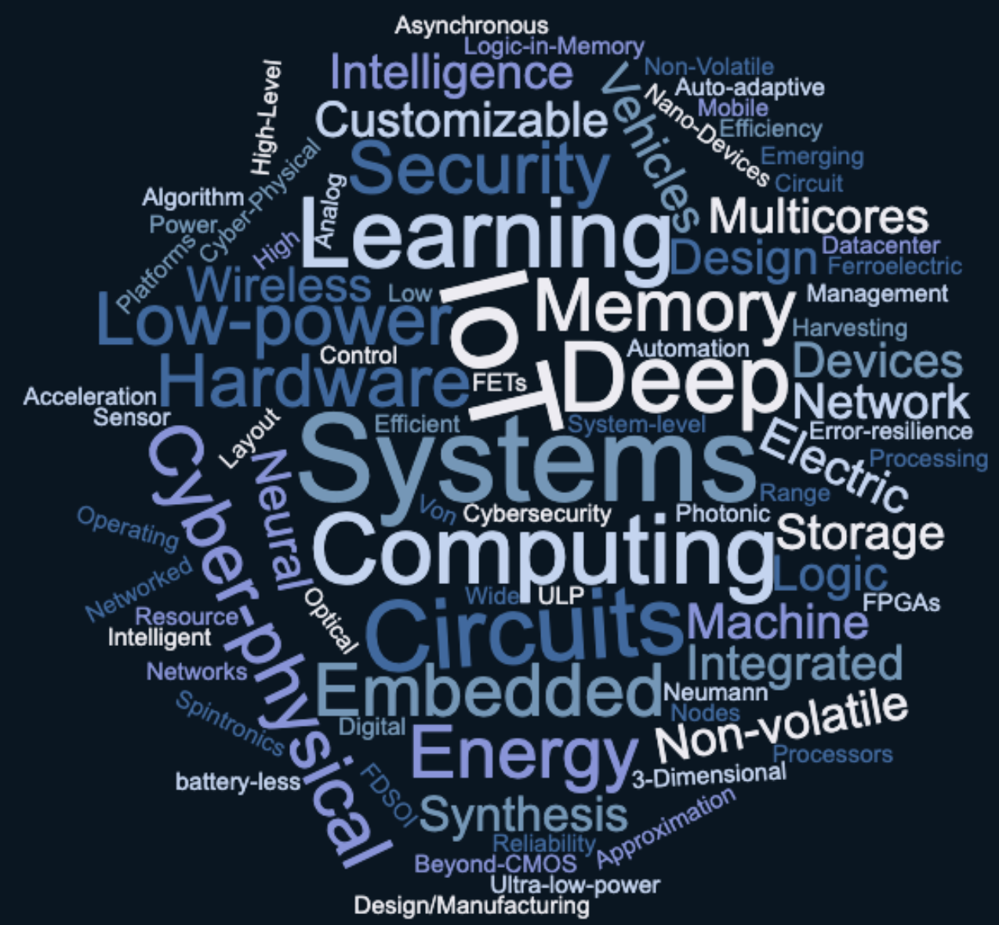
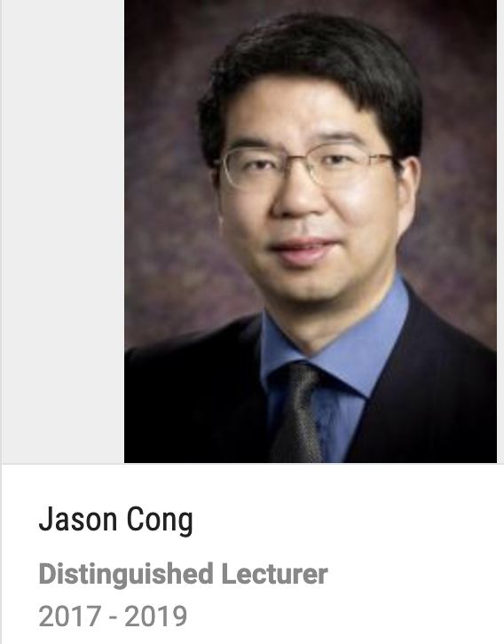
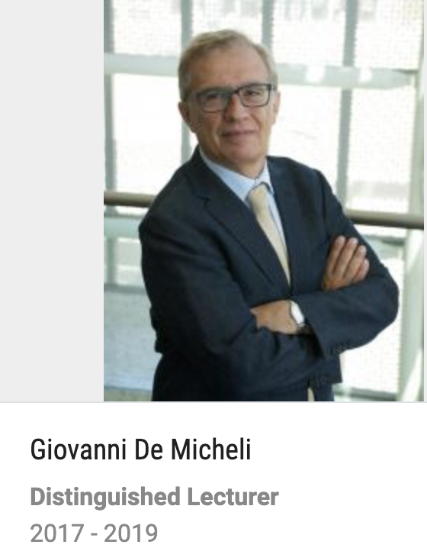

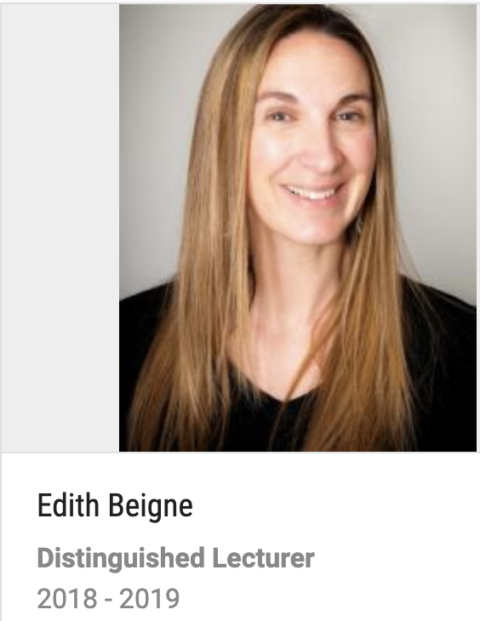
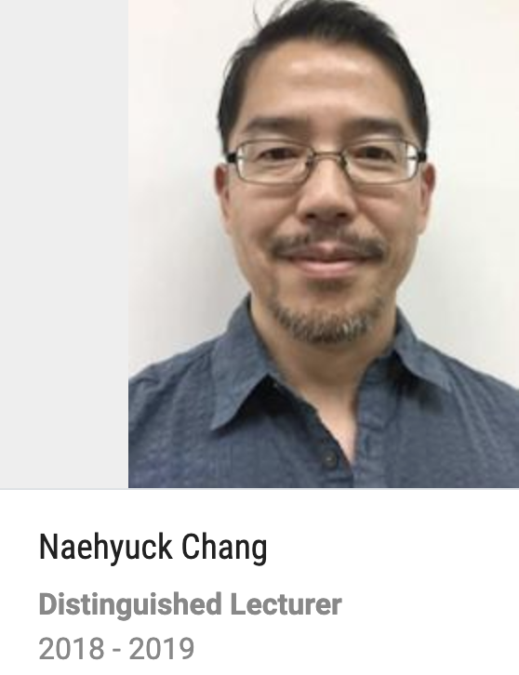
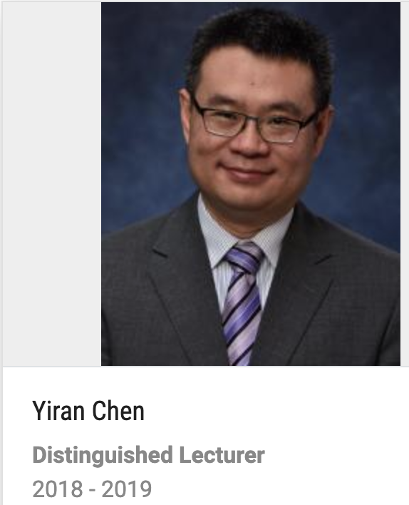
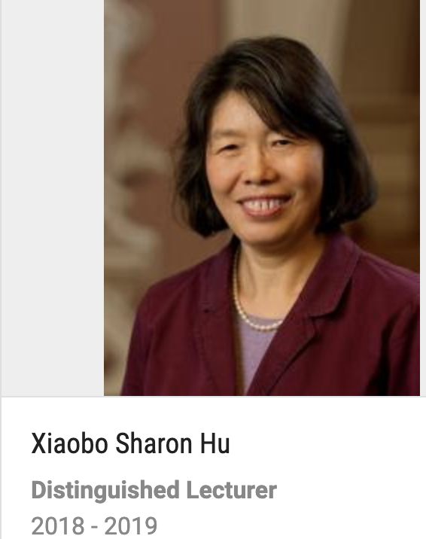
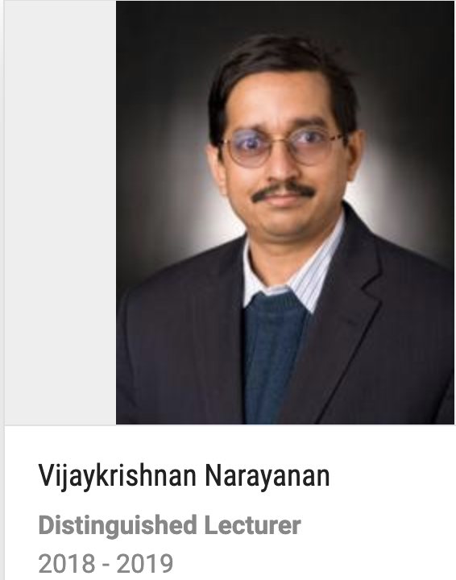
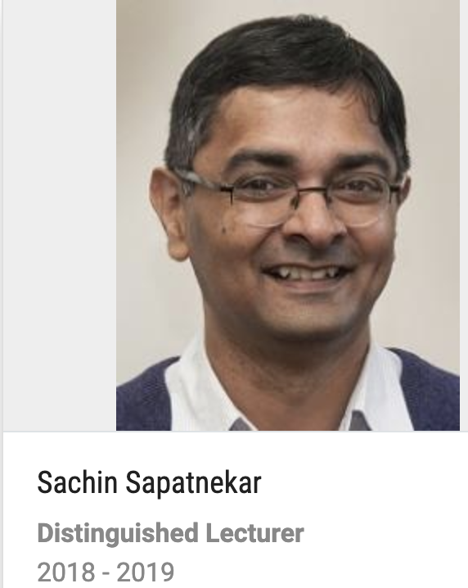
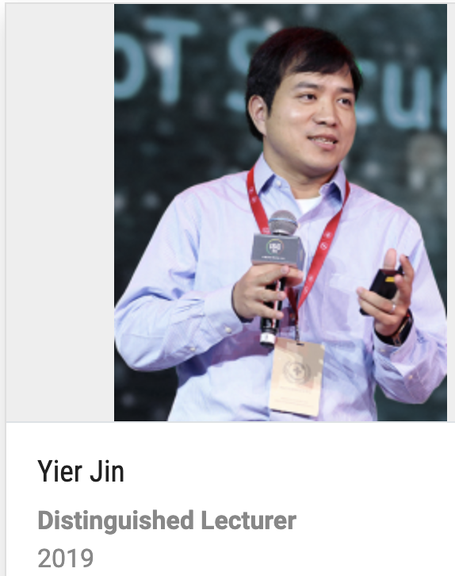
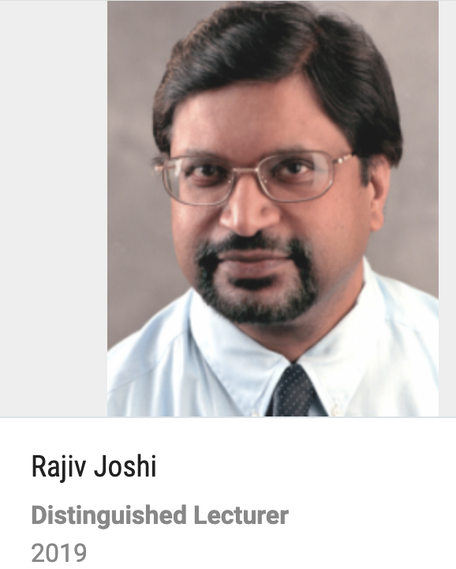
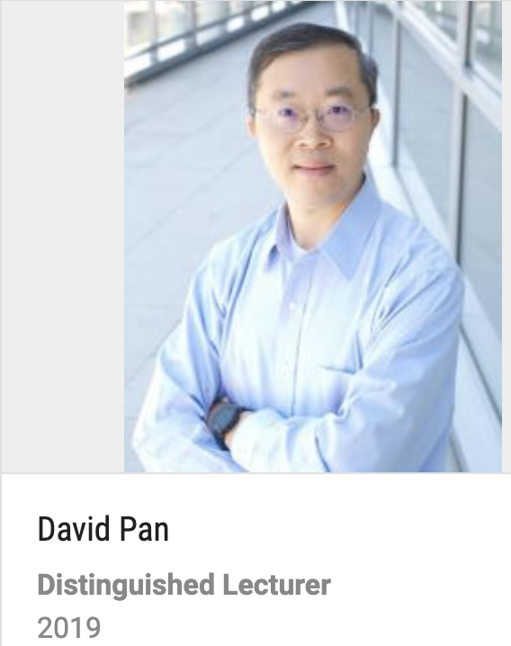
Current CEDA Distinguished Lecturers

Slide 23


CEDA DL Guidelines
There is no limitation of DL visits in current DL guidelines
Each Distinguished Lecturer may present a maximum of 3 DLP lectures each year.
Each IEEE-CAS Society (IEEE-CASS) chapter will be allowed a maximum of 4 DLP lectures per year. All expenses of the first two DLP lectures at each IEEE-CASS chapter will be covered by the IEEE-CASS DLP program. The CASS DLP will pay for travel for the third and fourth lectures. The local travel expenses of the third and fourth lectures will be covered by the local chapter organizing the event.
20 DLs
A DSP tour consists of at least 2 speaking events by the same speaker.

Slide 24
New CEDA DL Guidelines
Budget for 2020: 20K for 9 DLs
Each Distinguished Lecturer may present a maximum of 2 DLP talks each year.
Each chapter will be allowed a maximum of 3 DL lectures per year. All expenses of the first two DL lectures at each chapter will be covered by the CEDA DLP program. For the third lecture, the CEDA DLP will only pay for travel and the local travel expenses will be covered by the local chapter organizing the event.

Slide 25
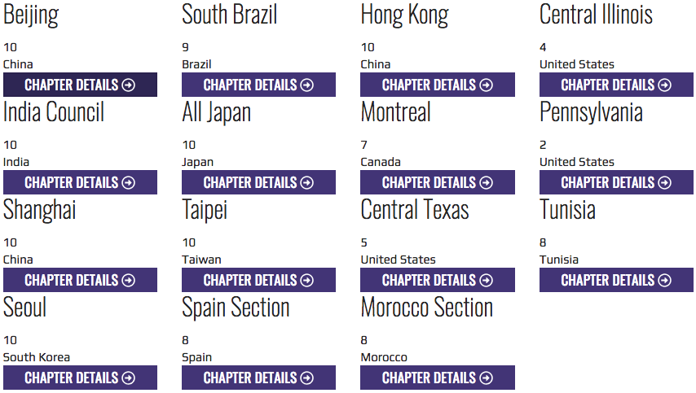
Outreach Program: Local Chapters
Regular face-to-face meetings are recommended with chapter officers
Regular chapter activity updates are required at IEEE vTools

Slide 26
Member Technology Organizations
DATC (Design Automation Technical Committee)
  Chair: Iris Hui-Ru Jiang (huiru.jiang@gmail.com), National Taiwan University
  https://ieee-ceda.org/technical-committee/datc
SVDTC (System Validation and Debug Technology Committee)
  Chair: Darshan Patra (ppatra@ieee.org)
  https://sites.google.com/a/ieee-ceda.com/svdtc/
TCCPS (Technical Committee on Cyber-Physical Systems)
  Chair: Shiyan Hu (shiyan@mtu.edu)
TTTC (Test Technology Technical Council)
  Chair: Yervant Zorian (Yervant.Zorian@synopsys.com)

Slide 27
DATC
Iris Hui-Ru Jiang
  Victor Kravets
  Jianli Chen
  Yi-Lang Li
  Jinwook Jung
  Andrew Kahng

Slide 28
Design Automation Technical Committee
Design Library
Construct an academic reference design flow
Goal in 2016:
  OpenDesign Flow Database v1.0
Goal in 2017:
  Robust Design Flow: from logic synthesis to physical design
Goal in 2018:
  Robust Design Flow v2.0: extended to detailed placement and detailed routing
Goal in 2019:
  Robust Design Flow v3.0: linking to ISPD contest and extended to cloud
Liberty, DEF/LEF,
Verilog, SDC
Verilog
Liberty
Logic synthesis
Verilog’
Floorplanning
LEF/DEF
Global placement
Detailed placement
RC extraction
Verilog’, DEF’, SPEF
Timing analysis
Liberty, SDC
Gate sizing
Legalization
Verilog’’, DEF’’
LEF
Global routing
Routing guide
Detailed routing
Design result (Verilog, DEF)

Slide 29
Design Automation Technical Committee
Design Library
Construct an academic reference design flow
Goal in 2016:
  OpenDesign Flow Database v1.0
Goal in 2017:
  Robust Design Flow: from logic synthesis to physical design
Goal in 2018:
  Robust Design Flow v2.0: extended to detailed placement and detailed routing
Goal in 2019:
  Robust Design Flow v3.0: linking to ISPD contest and extended to cloud
Liberty, DEF/LEF,
Verilog, SDC
Verilog
Liberty
Logic synthesis
Verilog’
Floorplanning
LEF/DEF
Global placement
Detailed placement
RC extraction
Verilog’, DEF’, SPEF
Timing analysis
Liberty, SDC
Gate sizing
Legalization
Verilog’’, DEF’’
LEF
Global routing
Routing guide
Detailed routing
Design result (Verilog, DEF)

Slide 30
Execution Plan/Status in 2019
Meetings
  Regular skype meetings
  Status meeting at DAC 2019 and ICCAD 2019
Special session at ICCAD 2019 (with CAD Contest)
  DATC RDF-2019: Towards a Complete Academic Reference Design Flow
Put the flow in cloud
  Will be hosted by OpenRoad project servers
Link with EDA research contest (with ISPD Contest, CAD Contest)
Continue collaboration with other “open” EDA projects
  OpenRoad project from DARPA ERI program
Notes:
3.
Currently on a private server
4.
Link with 2019 ISPD contest: done
Link with 2019 CAD contest: on-going discussion
5.
Collaboration with ERI: scheduled on March 21 (EDA Workshop, Hsinchu, Taiwan)

Slide 31
2019 DATC Members
First | Last | Affiliation | Role
Iris Hui-Ru | Jiang | National Taiwan Univ., Taiwan | Chair / Timer
Victor | Kravets | IBM, USA | Logic synthesis
Jianli | Chen | Fuzhou Univ., China | Placement
Yih-Lang | Li | National Chiao Tung Univ., Taiwan | Routing
Jinwook | Jung | IBM, USA | Integration
Andrew | Kahng | UCSD, USA | Vice chair / Flow
Integration: cloud
Flow: collaboration with ERI
Impact: link with 2019 ISPD Contest and more
NEW
Notes:
Next up: publications

Slide 32
Publications
L. Miguel Silveira, INESC-ID / IST - U Lisboa, Portugal
Naehyuck Chang, School of Electrical Eng., KAIST, South Korea
Luigi Carro, Dept. Informatics, UFRGS, Brazil
Sachin Sapatnekar, Dept. ECE, U Minnesota, USA
Rajesh Gupta, Dept. CSE, UC San Diego, USA, (EiC TCAD)
Joerg Henkel, Embedded Systems, KIT, Germany, (EiC D&T)
Sri Parameswaran, School of CSE, UNSW, Australia, (EiC ESL)
L. Miguel Silveira, INESC-ID/IST - U Lisboa, Portugal (CEDA VP Pubs)
Publications Committee

Slide 33


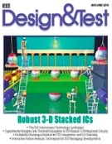

CEDA Participation in Periodicals
Sole financial sponsor:
  Embedded Systems Letters (ESL)
  Trans. Computer-Aided Design (TCAD)
Financial co-sponsor:
  Design & Test magazine
  JxCDC
  JFlexP
Technical co-sponsor:
  TSUSC
E
P
e
ε
Y
μ_{B}
M
σ
H

Slide 34
Ongoing & Upcoming Activities
Sara Dailey rrovides Editorial and Administrative Support
  Supports D&T, TCAD, ESL
  Became an Independent Contractor for CEDA (status change)
Move to online only, a push from IEEE
  TCAD and ESL available only online in 2020
OA (accelerated process) ongoing
  Decision to „wait and see“, to be revisited
  Expected impact in 2020

Slide 35
Ongoing & Upcoming Activities
D&T
  D&T is on a new cycle, Focus on embedded software to be pushed
ESL
  Pushing for quick turnaround time
  Search for new EiC for ESL
TCAD
  Discussion on publication models: OA, Print/Online, etc
  Search for “new” EiC for TCAD
JxCDC
  Became financial co-sponsor, increase involvement in Steering Committee
Journal Flexible and Printed Electronics
  New Journal under discussion, to be voted again at next TAB meeting
  Assumed financial co-sponsorship

Slide 36

TCAD - Transactions on
Computer-Aided Design
Financial sponsor: CEDA
Finance, size, click counts, publication dates: healthy/stable
Worked to strengthen CPS/IOT/Embedded. Maintain connection with ESWeek
  Signed new MoU to publish ESWeek, 5 year period (ACM & IEEE)
  TECS does not print its ESWeek issue; only online
  TCAD moving to online only in 2020
Ongoing discussions about publishing models:
  Outlet for target Conferences
  Print/online (settled)
Editor in Chief:
Rajesh Gupta
University of California San Diego, CA, U.S.A.
rgupta@ucsd.edu
Deputy EiC:
Xin Li
Duke University, NC, U.S.A.
xinli.ece@duke.edu

Slide 37
TCAD - Transactions on
Computer-Aided Design
Editorial Board: Currently at 57
Started 2018 with 51 AEs (32 from previous board, 19 new)
      Turnaround by AE: Avg: 60 days (1.1 -- 178), Sigma: 21
      All 51 continued, plus 6 new added through a new round of solicitation (9 nominations)
        Abdoulaye Gamatie, LIRMM, France: Embedded Systems
        Claudionor Coelho, Google, USA: Machine learning/AI Automation
        Philip Brisk, UC Riverside, USA: Microfluidics
        Suman Chakraborty, IIT Kharagpur, India: Microfluidics
        Swaroop Ghosh, Penn State University, USA: Embedded Security
        Xun Jiao, Villanova University, USA: Approximate Computing
Current Stats: 2019 year-to-date
    Turnaround by AE: Avg: 53 days (31 -- 113)
        N: 88: <30 days; 300: 31-60 days; 137: 61-90 days; 48: 91-120 days; 13: > 120 days.

Slide 38
TCAD - Transactions on
Computer-Aided Design
Papers Submitted
      2019: : 779: 432 (original). Max: Emerging tech., Modeling/Sim, Embed Sys, Embed Sec
        1 KN paper, 3 SI (HOST, ESWeek, HW/Embd Security)
    2018: 853: 478 (original), 375 (revised). Max: Emerging tech., Modeling/Sim
    2017: 899: 515 (original), 384 (revised). Max: Emerging Tech, Modeling/Sim, Test
        5 KN papers, 3 SI (IOT, Cross-layer Rel, Physical Design)
    2016: 818: 527 (original), 291 (revised). Max: Emerging Tech, Modeling/Sim
        11 KN papers, 4 SI (CPS, IOT, Cross-layer Rel, Physical Design)
Current Acceptance Ratio (prior 12 months): 171/404 or 42.3%.
    Pending manuscripts: 190. Oldest manuscript in the system: 2018-0198 (181 days)
    Acceptance Rate: 36%-49%, IF: 1.94 [TODAES: 0.85, TVLSI: 1.7, TCAS-I: 2.4, D&T: 1.4]
Approved page budget:
    2200 (2019).
    Average of 16 regular papers per issue. Page charges remain issue with some authors.

Slide 39
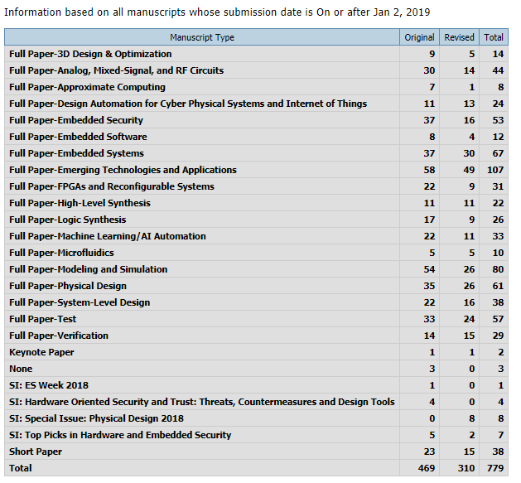
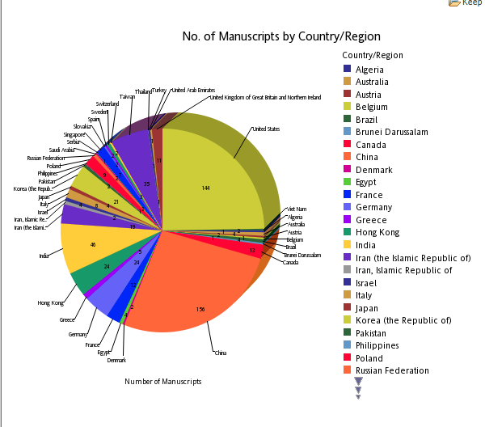
TCAD
RECEIVED
DECIDED

Slide 40
TCAD - Transactions on
Computer-Aided Design
Reaching end of two year term for Editorial Board: Search for new EiC
Publications committee had discussed issue and was leaning towards reappointing current EiC, as mentioned in previous EC meetings
  Experienced publications manager
  Oversaw relevant transition of TCAD into new fields and overture to new publishing models
  Work in progress…
  Backlog for TCAD is still too large, which requires special attention
Run survey as determined by regulations
  Collected 340+ responses
  Overall satisfaction with current running and direction of journal
  Relevant comments to take in consideration for future Editorial Board composition

Slide 41
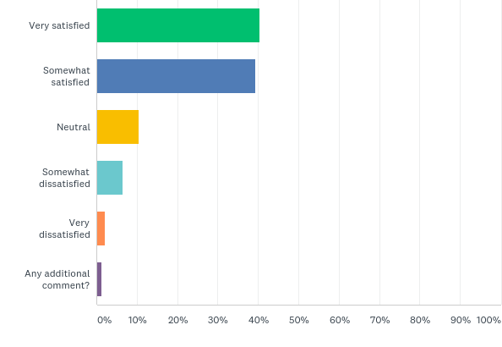
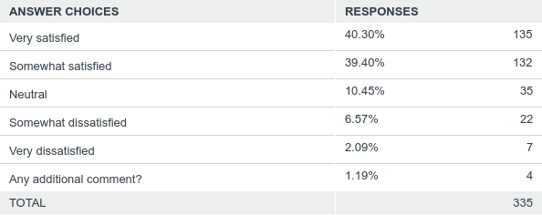
Q1: How satisfied are you with how TCAD is serving its readership and authors?
IEEE TCAD Survey
Answered: 335 Skipped: 5

Slide 42
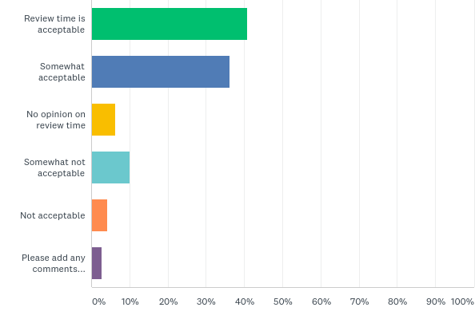
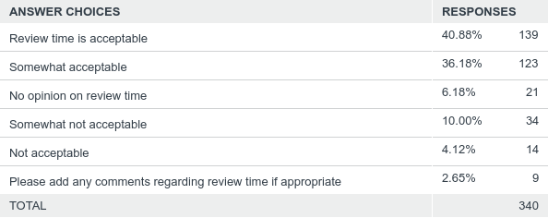
Q2: Do you feel that submissions to TCAD are moving through the review cycle in a timely manner?
IEEE TCAD Survey
Answered: 340 Skipped: 0

Slide 43
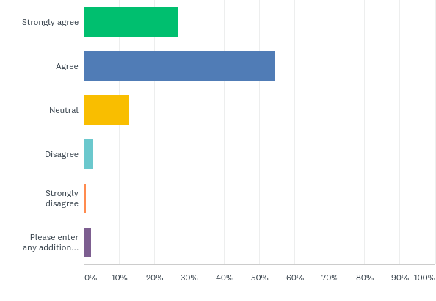
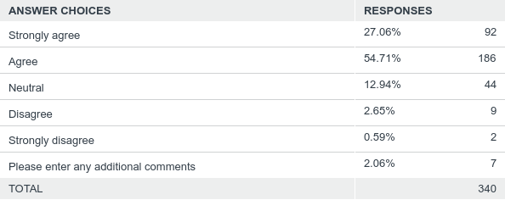
Q3: Do you agree that the quality of papers appearing in TCAD is in keeping with maintaining or improving its reputation?
IEEE TCAD Survey
Answered: 340 Skipped: 0

Slide 44
Q4: How well do you feel that the has EiC fulfilled his role?
IEEE TCAD Survey
Answered: 177 Skipped: 163
[open question]
Many respondents skipped question, not unusual
Generically very supportive of EiC
Relevant comments raised of Editorial Board (expertise, active, etc) that will require attention
Some strong comments deserving special attention

Slide 45
Q5: TCAD Challenges: In your view what are the top 2 - 3 things that TCAD can do to ensure its long term success as the leading magazine in its areas, reflecting latest research
IEEE TCAD Survey
Answered: 167 Skipped: 173
[open question]
Many respondents skipped question, not unusual
Many relevant answers but covering too many topics from the handling of the review process, to the topics/areas to cover, etc
Excellent material for analysis

Slide 46
Q6: TCAD Positioning: Looking at the papers published in TCAD over the last two or three years, do these papers reflect the true state of the art on Computer-Aided Design? If not what are the major missing topical areas?
IEEE TCAD Survey
Answered: 160 Skipped: 180
[open question]
Many respondents skipped question, not unusual
Some relevant answers but suggestions cover many areas, from pushing for reinforcements of existing topics to broadening to new topics
Good material for analysis

Slide 47
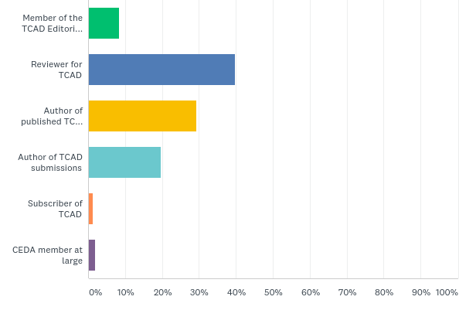
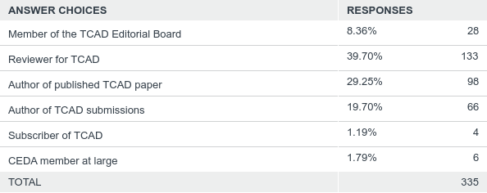
Q7: (Survey Analytics) Please pick the most appropriate characterization, starting from the top:
IEEE TCAD Survey
Answered: 335 Skipped: 5

Slide 48
TCAD - Transactions on
Computer-Aided Design
Search Committee would like propose the current Editor-in-Chief,
Rajesh Gupta, UC San Diego, USA
to be reappointed for a 2nd two-year term at the helm of TCAD.
Would also suggest that the current Deputy Editor-in-Chief,
Xin Li, Duke University, China/USA
is also proposed for a 2nd year term (final decision to be made by the EiC)
An updated statement and description of future plans will be asked of the EiC specially taking into account the need to reduce backlog, to continue to reduce turnaround time and to address many issues raised regarding the composition and work of the Editorial Board
Vote
required

Slide 49

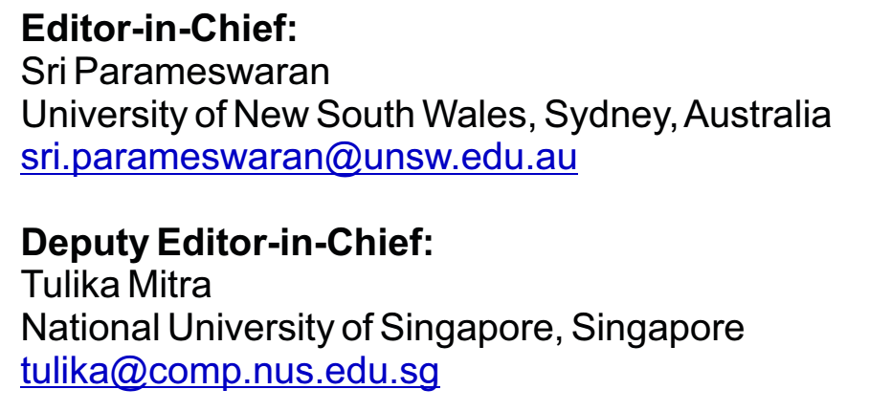
ESL – Embedded Systems Letters
Financial sponsor: CEDA
Four pages only, Four issues per year
Strives for quick turnaround
Room to grow: initiatives underway
Finance, size, attention (click counts), submission-to-publication times, publication dates: healthy/stable
Upcoming period very important:
Monitor Impact Factor, attract more submissions, keep improving quality
Increase visibility, motivate new initiatives
Moving to online only in 2020

Slide 50
ESL – Embedded Systems Letters
~20% acceptance rate
Plagiarized papers have reduced significantly
In 2018 it was included in the
  Science Citation Index Expanded (also known as SciSearch®)
  Journal Citation Reports/Science Edition
  Current Contents®/Engineering Computing and Technology
A call for perspective papers and a call for special issues are circulated quarterly
  A number of perspective papers have been submitted
A number of special issues have been published / in the pipeline
  Special section of ESL Embedded Security Challenge (ESC)
  Special Issue on Emerging Topics in Secure and Trustworthy Cyber-Physical Systems
  Special Issue on Real-Time Technologies in CPS
  Special Issue on Buildsys 2018

Slide 51
ESL – Embedded Systems Letter
Manuscript Type | Number of Manuscripts | Percentage of Total
Letters to the Editor | 3 | 2.0%
Original Manuscripts | 97 | 64.2%
Response Manuscript | 5 | 3.3%
Reviews | 3 | 2.0%
Special Issue on Embedded Security Challenge | 8 | 5.3%
Special Issue on Emerging Topics in Secure and Trustworthy Cyber-Physical Systems | 17 | 11.3%
Special Issue on Real-Time Technologies in CPS | 18 | 11.9%
Total: | 151 | 100.0%
6:42:32 PM

Slide 52
ESL – Embedded Systems Letter
Reaching end of two year term for Editorial Board: Search for new EiC
Tulika Mitra, the current Deputy EiC was an excellent candidate, but declined due to other opportunities
  Lesson to learn, perhaps took too long to seek further engagement
Published a call for nominations
  Proactively consider potential candidates
  Encouraged them to submit applications
  6 candidates received, info circulated
  Metrics defined according to regulations
  Candidates scored and further discussions ensued

Slide 53
ESL – Embedded Systems Letter
ESL EiC Evaluation - 2019
Search Committee | Curriculum Vitae | Track Record of IEEE service | Experience with Managing Publications | Leadership Qualities | Organizational and management skills | Position statement and future plans | Total
 | 10% | 10% | 20% | 10% | 20% | 30%
Candidate A | 4,17 | 4,17 | 3,83 | 4,67 | 4,17 | 1,83 | 3,45
Candidate B | 1,83 | 1,17 | 0,33 | 1,83 | 2,00 | 0,17 | 1,00
Candidate C | 3,83 | 3,50 | 3,83 | 4,50 | 4,00 | 4,17 | 4,00
Candidate D | 4,17 | 4,33 | 4,17 | 4,67 | 4,50 | 4,67 | 4,45
Candidate E | 4,67 | 5,00 | 4,67 | 5,00 | 4,83 | 4,67 | 4,77
Candidate F | 1,83 | 1,17 | 0,67 | 1,83 | 1,67 | 1,00 | 1,25
Showing average scores from Search Committee members
All members had similar individual rankings
Top ranked candidate was also one of top initial suggestions

Slide 54
ESL – Embedded Systems Letter
Candidates D and E were the top vote getter’s, but Candidate C impressed for her willingness and potential (she was 2nd in one of the scores). Candidates D and E had excellent position statements.
Search Committee would like propose Candidate E
Preeti Ranjan Panda, IIT Delhi, India
to be appointed for a two-year term at the helm of ESL.
Would also like to suggest that Candidate C,
Francesca Palumbo, U Sassari, Italy
is proposed for Deputy EiC (final decision to be made by the EiC)
Vote
required

Slide 55

IEEE Design & Test
Editor in Chief:
Jörg Henkel
Karlsruhe Institute of Technology (KIT), Karlsruhe, Germany
henkel@kit.edu
Associate EiC:
Partha Pande
Washington State University, WA, U.S.A.
pande@eecs.wsu.edu
Financial sponsors: SSCS, CASS, CEDA
Technical sponsor: TTTC
Mostly composed of Special Issues, Surveys
and Tutorial papers
  Regular paper submissions are negligible
Acceptance and interest over content has clearly improved
Impact factor more than doubled
Finances steady but still losing money, needs closer monitoring
Joerg Henkel on 2nd term as EiC of D&T
  A search for a new EiC to start in early 2020

Slide 56
Status Special Issues (1/2)
IEEE Design & Test
SBCCI SI, Guentzel, Huebner. 7 submitted.
Cross-Layer Design of Cyber-Physical Systems (Devendra, Chakraborty, Chen, Annaswamy). 17 submitted.
Embedded Intelligence in the Internet-Of-Things (Dick, Shang, Wolf, Yang).9 submitted.
Cyber Security for Embedded Controls in Cyber-Physical Systems, Khorrami, Chai, Chidambaram, 3 submitted.
Machine Intelligence at the Edge (Benini, Chen, Xiong, Zhang). 8 submissions.
Robust Resource-Constrained Systems for Machine-learning (Shafique, Theocharides, Mutlu, Choi). 9 submissions.
Event-Triggered Circuits and Systems Sparse Information Processing, Marcia, Zarar, Studer, Gupta.
Autonomous Systems Design, Saidi, Ernst, Ziegenbeing, Deshmukh,

Slide 57
IEEE Design & Test
Status Special Issues (2/2)
Design and Management of Mobile Platforms, Ogras, Pasricha, Kishnevsky, Ayoub
VTS19 SI
Design and Test Solutions for Embedded Systems with Non-volatile Memories, Jian-Jia Chen, Yuan-Hao Chang, Sam H. Noh, Nikil Dutt
OpenSource EDA,
WESE: SI on Learning for Embedded Systems.
Summary:
Well filled pipeline with hot topics and good mix of areas
However: Some recent (2019) GE teams attracted only a small amount of papers (i.e. 3) such that some planned SIs might turn out to be only special sections instead of special issue

Slide 58
JxCDC – Journal on Exploratory Solid-State
Computational Devices and Circuits
E
P
e
ε
Y
μ_{B}
Explore materials, devices and computation circuits to enable Moore’s law to continue beyond a 10-15 year horizon with associated density scaling and improved energy efficiency
Financial sponsors:
  Solid-State Circuits Society (66.25%) Magnetics Society (11.25%)
  Circuits and Systems Society (11.25%) Council on EDA(11.25%)
Technical co-sponsors:
  Council on Superconductivity, Electron Devices Society
Open Access: started 2015, striving to get an Impact Factor
EiC: Ian Young (Intel)
CEDA rep@SC: Yiran Chen, Duke University (recent change)
M
σ
H

Slide 59
JXCDC – Status
E
P
e
ε
Y
μ_{B}
M
 | Accepted | In Review
2019 (end of Oct.) | 16 | 12
Regular Papers solicitation plus……
Special Topic #1 - Pub. with June Issue
(6 papers published)
Special Topic #2 - Pub. with Dec. Issue
(6 papers published)
Special Topic #3 - Pub. With Dec. Issue
(6+ papers published - estimated)
σ
H
 | Published
2015 | 12
2016 | 7
2017 | 12
2018 | 10
2019 (Estimate) | >24
Next Special Topic Call for Papers ends Jan 15th 2020

Slide 60
JXCDC – Special Topics for 2019/2020
E
P
e
JXCDC 2019 Special Topic #1 ( closed Dec 31st 2018)
“Non-volatile Memory for Neuromorphic Computing”
[Published in June 2019 Issue 1 Part-2]
JXCDC 2019 Special Topic #2 ( closed April 30th 2019)
“Ferroelectric Materials for Advanced Logic, Analog and Memory Applications” [Publishes in Dec 2019 Issue 2 Part-2]
(Editor Prof. Azad Naeemi Georgia Institute of Technology)
JXCDC 2019 Special Topic #3 (closed on August 31st 2019)
“Spin-Orbit Torque For Advanced Magnetic Logic and Memory" – aligned with spintronics” [Publishes in Dec 2019 Issue 2 Part-3]
(Guest Editor Dr. Dmitri Nikonov, Intel Corp.)
JXCDC 2020 Special Topic #1 (closes on Jan 15th 2020)
“Exploratory Devices and Circuits for Compute-In-Memory”
(Editor Prof. Shimeng Yu, Georgia Institute of Technology)
Y
μ_{B}
ε
M
σ
H

Slide 61
JXCDC – Other
E
P
Completed JXCDC’s 2nd PRAC review in June 20th, Atlanta, GA
  First one was Feb 2017; final PRAC document approved Oct 25th
  Will take a careful look at PRAC!!
Paper solicitation is the JXCDC’s highest priority with focus on.
  Special Topics – New “Call for Papers” sent 4 times per year (with sponsor support)
  Active Steering Committee made up of Sponsor Reps.
Learned in 2018 that in order to get an Impact Factor need to have more than 20 papers published per year.
  JXCDC is listed in Clarivate Analytics’ Emerging Sources Citation Index (ESCI).
Will need more intervention in 2020+
  CEDA members already published there; good feedback; quick, well run
  But lagging with respect to original goals: too few papers, difficulty in finding niche
  In need of a push, news ideas, more proactiveness
e
ε
Y
μ_{B}
M
σ
H

Slide 62
Strategic Tasks 2020-2021
Move to print only
Impact of Accelerated Initiative towards Open Access
Readership enhancement, Consider new possibilities in areas of growth
EiC Search for D&T
  D&T financial turnaround and increased visibility
ESL growth, Impact Factor/Thomson Reuters metrics
TCAD development, embedded and cyberphysical systems topics
  Developping relation with ESWeek, further analysis of model
JxCDC further development
  Impact factor, number of submissions
  Engagement in SC, increased visibility within CEDA
Notes:
Next up: initiatives

Slide 63
New Initiatives
Jose Ayala - UCM
Miroslav Vasic - UPM
Jorge Garcia-Sanz - UCM
Marina Zapater - EPFL
Pierre-Emmanuel Gaillardon UTAH

Slide 64
Ongoing Activities
Participation in IEEE IoT Initiative
voting member
active participation in monthly discussions
representative members in WF-IoT
open opportunities in newsletter and IoT Magazine
starting transition discussions
positive results of WF-IoT 2019 in Limerick, 2020 in New Orleans

Slide 65
Ongoing Activities
Participation in IEEE Smart Cities Initiative
voting member
active participation in monthly discussions
open opportunities in webinars
still looking for a formula to make money
ISC2 2019 (Casablanca) was successful in terms of registrations but the organization was very poor

Slide 66
Ongoing Activities
IEEE Brain Initiative Transition Plan
roadmap for future activities of IEEE Brain initiative opens new topics related to CEDA
participating in the discussions of the transition plan committee. Still the formula has to be defined, probably under a leading society.
Second PELS-CEDA DAPE Workshop
this time as ICCAD special session
hard to catch interest from CEDA community
IEEE Rebooting Computing
active participation

Slide 67
Future
Define our efforts and interest from the community in these initiatives
Promote the participation, difusion, and organization of related activities
Have an open mind for areas of interest
Help on defining sustainable (profitable) models in the running initiatives
Notes:
Next up: standards (no slides)

Slide 68
Standards
Dennis Brophy
Notes:
Next up: gov docs

Slide 69
Governing Documents
Agnieszka Dubaj
Secretary & Chair of Constitution & Bylaws Committee

Slide 70
Bylaws and Constitution Updates
Governing documents have to be compliant with IEEE guidelines
New Committees and Assignments documented
Text and Layout formatting will be cleaned up by IEEE

Slide 71
Bylaws Updates
Section II.3
  Added Member Technology Organizations:
    SVDTC
    The Technical Committee on Cyber-Physical Systems
Section III.1
  Added: VP for Awards, VP for Initiatives, VP for Standards
Section III.3
  President-Elect duties updated
    DAC Representative
Section III.4
  Additional responsibility of the Secretary as Chair of the Constitution and Bylaws committee

Slide 72
Bylaws Updates - continued
Section III.11
  VP for Awards R&Rs defined
Section III.12
  VP for Initiatives R&Rs defined
Section III.13
  VP for Standards R&Rs defined
Section III.14/Section IV.12
  Removed the role of Chair Constitution and Bylaws Committee from Immediate Past-President’s responsibilities, transferred to Secretary
  Removed the role of Parliamentarian from the Secretary’s duties

Slide 73
Bylaws Update - continued
Section IV.1
  Added Awards, Fellows and Initiatives to the list of Committees
Section IV.6
  Updated duties of the Nominations and Appointments Committee - compliance
Section IV.7
  Updated the Finance Committee process – compliance
Section IV.8
  Standards Committee duties defined
Section IV.9
  Activities Committee process brought to compliance

Slide 74
Bylaws Update - continued
Section IV.10
  Awards Committee duties and process defined
Section IV.11
  Fellows Committee duties and process defined
Section IV.14
  Strategy Committee process updated and decoupled from duties of President-elect
Section V.8
  Editors-in-Chief term of office updated

Slide 75
VP for Young Professionals
  New position: VP for Young Professionals
  Remove YP responsibilities from VP of Initiatives
    WIE remains
  Updated Bylaws to reflect the change
Section III.15. Vice-President for Young Professionals
The Vice-President for Young Professionals shall be responsible for educational programs and activities linked to Council’s mission statement and targeting Young Professionals. In addition, the Vice-President for Young Professionals shall support and maintain effective relations with IEEE YP.
Notes:
Next up: strategy

Slide 76
Strategy Committee
President-elect, Yao-Wen Chang
Committee:
  Giovanni De Micheli
  Sani R. Nassif
  Shishpal S. Rawat
  Sachin Sapatnekar
  Donatella Sciuto

Slide 77
In 2018: IEEE FC’s Motion on Disempowering Councils
Fellow Committee approved to dis-allow councils for fellow process
  Main reasons: (1) very high elevation probability for TCs, (2) more consistent fellow evaluations, (3) problem with convening FECs with 5 Fellows, and (4) overlapping areas of technical expertise with those of Societies
Problems with this move
  Damage interdisciplinary and multidisciplinary technical activities
  Cause further burden on Society Fellow Committees
  No problem and only minor % of processing fellows through councils
Our CEDA strategies?
  Worked with 6 parent societies and other councils to stop the move
  Encouraged council supporters to send letters to the president, BoD, & FC chair
  Asked the motion to be approved at TAB meeting before sending it to BoD
  Go for the EDA Society (EDAS)? (1) better to form a task force first,
  (2) organize meetings at major EDA conferences for discussion

Slide 78
TC Fellow Nomination and Elevation Statistics
Fewer nominations and higher elevation rates
Nominations | BIO | CEDA | RFID | CSC | NANO | SEN | SysC
2012 | 3 | 11 | 0 | 1 | 0 | 2 | 1
2013 | 6 | 6 | 0 | 2 | 6 | 0 | 0
2014 | 4 | 11 | 0 | 3 | 4 | 9 | 2
2015 | 0 | 11 | 0 | 1 | 5 | 3 | 0
2016 | 2 | 10 | 0 | 0 | 7 | 4 | 3
2017 | 3 | 21 | 0 | 3 | 6 | 5 | 4
2018 | 4 | 18 | 2 | 1 | 10 | 1 | 4
Elevation | BIO | CEDA | RFID | CSC | NANO | SEN | SysC
2012 | 2 | 6 | 0 | 1 | 0 | 0 | 1
2013 | 2 | 3 | 0 | 1 | 2 | 0 | 0
2014 | 1 | 4 | 0 | 2 | 2 | 4 | 2
2015 | 0 | 5 | 0 | 1 | 1 | 1 | 0
2016 | 0 | 4 | 0 | 0 | 2 | 1 | 0
2017 | 1 | 9 | 0 | 1 | 1 | 2 | 2
2018 | 2 | 6 | 0 | 0 | 2 | 0 | 2
% | BIO | CEDA | RFID | CSC | NANO | SEN | SysC | IEEE (no TCs)
2012 | 66.7 | 54.6 |  | 100.0 |  | 0.0 | 100.0 | 40.8
2013 | 33.3 | 50.0 |  | 50.0 | 33.3 |  |  | 35.6
2014 | 25.0 | 36.4 |  | 66.7 | 50.0 | 44.4 | 100.0 | 33.9
2015 |  | 45.5 |  | 100.0 | 20.0 | 33.3 |  | 34.2
2016 | 0.0 | 40.0 |  |  | 28.6 | 25.0 | 0.0 | 35.9
2017 | 33.3 | 42.9 |  | 33.3 | 16.7 | 40.0 | 50.0 | 31.4
2018 | 50.0 | 33.3 | 0.0 | 0.0 | 20.0 | 0.0 | 50.0 | 32.3
Mean | 34.7 | 43.2 | 0.0 | 58.3 | 28.1 | 23.8 | 60.0 | 34.9
CI-95% | ±28.1 | ±9.3 | 0.0 | ±48.5 | ±15.4 | ±24.3 | ±51.9 | ±2.9

Slide 79
Elevation Probability vs Mean Number of Nominations

Slide 80
“New Findings” from FC on Societies and Councils
Some takeaways on Elevation Probability (EP) data
Small Societies and Councils have large variations in EP over time due to small number effects and also often have higher than average EP. Furthermore, Councils generally have higher EP than Societies.
Possible explanation: IEEE Judges “over-weigh” the rankings in small Societies and Councils
  Top ranking nominees in small Societies and Councils tend to be elevated with higher probability than middle ranked nominees in larger Societies. E.g., a nominee ranked #15 among 40 has an EP in the 10%-25%, much smaller than the EP of top ranking nominees in small Societies and Councils.
  A possible solution would be to require that IEEE Judges performed more due diligence on the nominees of small Societies and Councils without being influenced too much by the provided rank/score ➔ Small Societies and Councils should not rank/score nominees, just provide the narrative on nominee’s impact.
  If S/TCs with less than or equal to X nominees did not rank/score their nominees then:
    For X=10, there would be ~50 unranked nominees out of ~900. Workload increase: ~5 nominees per IEEE Judge.
    For X=20, there would be ~140 unranked nominees out of ~900. Workload increase: ~14 nominees per IEEE Judge.
Will inform FSPS and Ad Hoc of these recent findings to re-discuss the matter.

Slide 81
Counter Arguments from TCs Viewed by Stefano Galli (FC Chair)
TCs can better evaluate nominees that have contributed to very specific fields for which it is difficult to find experts in one Society.
  Not convincing and unfounded, TCs use Fellows from their constituent Societies as evaluators, there is no reason why Societies would not be able to evaluate nominees referred to TCs.
  And if the topic is so esoteric, it is not easier to find Evaluators in Councils because the same evaluators are listed under the constituent Societies.
TCs are communities, they should be allowed to evaluate nominees.
  The argument is somewhat weak, should we then extend the same argument to the other 19 Technical Communities we have (Big Data, BlockChain, Brain, etc.)?
Today, some contributions are interdisciplinary, and this requires the capability of picking evaluators from different Societies.
  The argument has some validity and recognizes an existing trend;
  However, it happens very rarely that nominees are referred to TCs because of the interdisciplinary nature of their work (not measured, but consistent feedback form Judges);
  And even then, it cannot be stated with certainty that the necessary expertise to evaluate them cannot be found in Societies (no need to appoint evaluators that are all experts, also some “generalists” can be appointed as they would still comment intelligently).

Slide 82
Problems Beyond Stats Viewed by Stefano
There is a strong belief that nominees evaluated by TCs get a “pass” because they need to compete with a smaller pool of candidates.
  This is confirmed by the higher than usual elevation probability of some TCs, but the problem extends to small Societies as well. Stats alone are not enough to justify taking away evaluations form Councils
Nominees that contribute to computer, signal processing, power, or comms, compete with 50-120 nominees if they go through a Society but would compete with 3-15 nominees if evaluated by a TC.
Fellow “worthiness” is not a binary state, there is a continuum in the qualification and the process is competitive because of the finite number of elevations available.
Due to the competitive nature of the process, it is very important that ALL nominees contributing to the same field be evaluated by the same committee so that we have a single ranking.

Slide 83
Stefano’s Suggestions to FC: Reaffirm the 2018 Decision?
Implementation of the motion:
  Sent for approval to the IEEE Board in February 2020
  Implemented for Fellow Class 2022, i.e., for 2021 evaluations
If yes, should FC also consider additional provisions?
  Allow nominators to specify secondary/tertiary S/TCs so that a wider pool of Fellows can be chosen as evaluators (address inter-disciplinary cases)?
  Resolve the issue of small Societies as in one or more of the following:
    Group small Societies per Division? Basically FC makes them as Councils but larger, so FC gets a single ranking of affine fields.
    Not allow expedited evaluation of small Societies (<15 nominees)?
    Flag all nominees from small Societies and with a preliminary Pass recommendation for discussion at the FC f2f meeting?

Slide 84
Stefano’s Suggestions to FC: Reaffirm the 2018 Decision?
If no, should FC consider alternative solutions?
  S/TCs with less than X nominees do not rank/score their nominees but just provide narrative answers:
    This requires Judges to perform more due diligence which should be manageable after the Expedited Evaluation Procedure starts in 2020
      For X=10, there would be ~50 unranked nominees out of ~900. Workload increase: ~5 nominees per IEEE Judge.
      For X=20, there would be ~140 unranked nominees out of ~900. Workload increase: ~14 nominees per IEEE Judge.
    Another good side effect is that any bias a small S/TC may have (gender, geographical, etc.) would not propagate to the Fellow Committee.
  Have a panel of Judges that looks at nominations referred to TCs and decides which ones should be moved to Societies and which ones can stay with TCs.
    This can be combined with allowing nominators to specify secondary/tertiary Society.

Slide 85
Many against this Motion
David: Wrong to say Councils call upon Fellows of Societies for evaluation. I am not sure if there are more Councils representatives as the members of the Ad-Hoc committee. It is not a very “transparent” process either…
Yao-Wen: I got a chance to talk to the TAB chair, Prof. Ray Liu, last month and he was also strongly against disallowing councils to nominate fellows mainly because councils play a crucial role in disciplinary collaborations among societies, which is a very important mechanism for our IEEE to grow in emerging areas.
Yonhua Tzeng (NTC): Council’s FEC is very important to NTC. We have recruited many outstanding younger scholars and technologists from Fellow nominees who were evaluated by our FEC to become our active volunteers. The success rate is about the same as the average value across IEEE. Many multidisciplinary volunteers are working very hard and diligently wishing to be recognized as a Fellow in the future.
John Przybysz (Superconductivity): The goal of the Fellow review process is to ensure that only the best candidates are elected to the rank of Fellow. There is no evidence that this goal is not being achieved. Equal elevation probability is not the goal. We can achieve that with a lottery. In any case, we want candidates to be evaluated by those who know their work and are best able to fairly and honestly rate their achievements. The Societies and Councils do not choose Fellows, they review and rank nominations. We trust the IEEE Fellow Committee to normalize scores and choose the best candidates for election by the Board of Directors.

Slide 86
Many against this Motion (cont’d)
Jagadish (Photonics Society): Councils have an important role to play in terms of multidisciplinary fields. It makes no sense to stop them evaluating Fellow candidates. That means we will be disadvantaging members of our community working in multidisciplinary fields while science and engineering is becoming more multidisciplinary. People working in multidisciplinary fields will be ranked poorly by societies as they look at from their discipline perspective. We are making big fuss about this based on poor statistics. I have served on both council and society fellow committees as well as Fellow committee and I haven’t seen major differences in terms of elevated candidates. We will oppose any move to stopping councils evaluating fellow candidates.
Meyya Meyyappan: A nominee chooses to go through a TC because he/she contributed in a topic that falls in the field of interest of that TC, not to circumvent having to compete with a larger pool… TCs are not evaluating nominees who could go through some of their parent societies but those who are directly involved in their FOI… It looks to me some of you have decided on this change way back and since then have been putting forward one argument after the other to justify it. Like someone writing the conclusions of the paper first and then walk into the lab to cook up or simply make up the results. What you keep missing is that Councils were formed for something specific where impact of that technology can be across multiple Societies. Often, contributions and developments in the FOI of the TC continue independent of the sponsoring Societies and a clear separation has developed between TCs and their founding Societies and continues so.

Slide 87
Comments from Nazanin Bassiri-Gharb (UFFC-S)
The statistics presented are neither strong nor the statistics should play a role for a technical area to submit nominations for some of their most meritorious members for Fellow grade elevation
”nominees evaluated by TCs get a “pass” because they need to compete with a smaller pool of candidates”
  Stats alone are not enough to justify taking away evaluations from Councils. There is no such a thing as a “pass”. maybe there is a better pre-selection of nominations in the smaller communities.
“Nominees that contribute to computer, signal processing, power, or comms, compete with 50-120 nominees if they go through a Society but would compete with 3-15 nominees if evaluated by a TC.”
  And all nominations get evaluated by a large group of evaluators at the IEEE level. technical societies do a substantially better job at creating strong packages for the nominees than the larger societies, where the evaluation committee has a larger “workload”.
“Fellow “worthiness” is not a binary state, there is a continuum in the qualification and the process is competitive because of the finite number of elevations available.”
  This is not an argument that shows there is any existing problem to be fixed.

Slide 88
Comments from Nazanin Bassiri-Gharb (UFFC-S)
“ALL nominees contributing to the same field be evaluated by the same committee so that we have a single ranking.”
  It clearly underlies why the Technical Councils should retain all their rights for nomination and evaluation of their members to Fellow grade. Technical councils or a small societies exist by virtue of a very strong and common FOI. They are not at the same level of any of the “Future Directions” initiatives that have indeed not yet graduated to become a Council.
  Sending a nominee from a council to a society for “re-evaluation” implies that this candidate will not be evaluated at all with peers contributing to the same field, but often, a very different field.
  Sensors, Superconductivity and Nanotechnology Councils are only some of the councils that UFFC has supported over the years and neither myself nor our Fellows Committee Chairs feel that UFFC should evaluate our affiliate Council members. These Council, while originally derived from a desire to support a strongly growing interdisciplinary field, are fully free-standing entities. The overlap of a member of the Superconductivity member with another member of the Superconductivity Council is by orders of magnitude larger than with any other member of the UFFC-S.
  The grouping for the sake of numbers is even more faulty. Ultrasonics, Ferroelectric and Frequency Control would get lumped together with Instrumentation and Measurements. What we consider Instrumentation doesn’t cut it with them and vice versa.
Asking nominees from the technical councils and smaller societies to have secondary and tertiary nominators and evaluators, puts undue burden on some of our members, and specifically implies that the judgement of the current evaluators are faulty

Slide 89
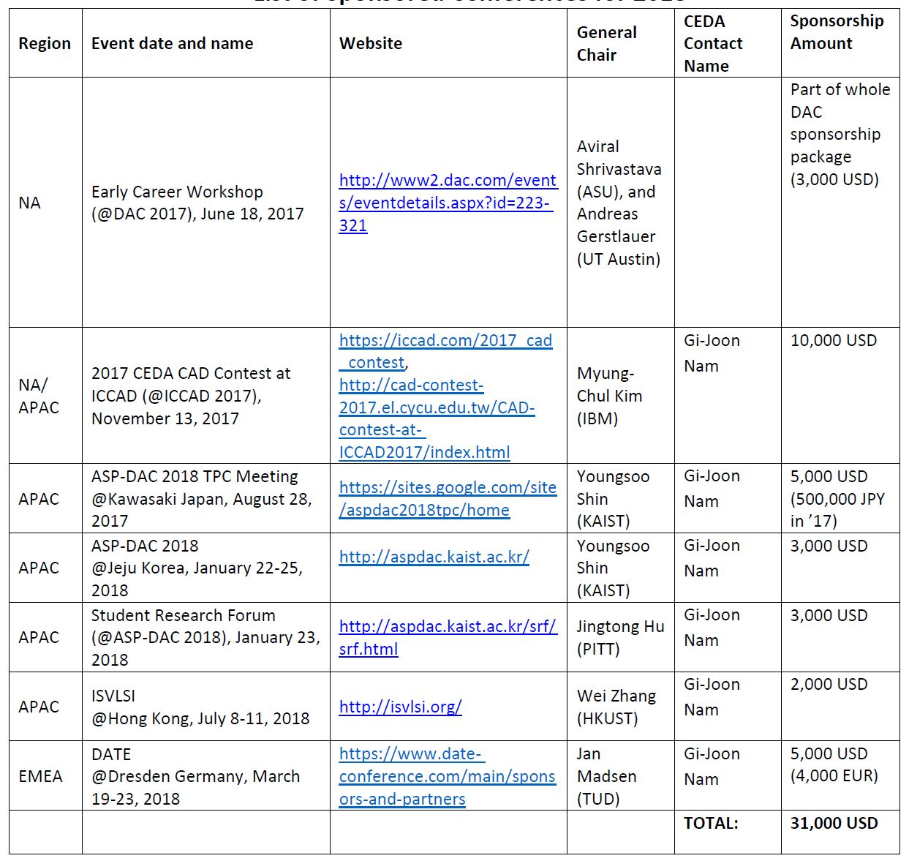
CEDA & Cadence Global Sponsorship Collaboration
Sponsored Conferences for 2018, any more to add?
Notes:
Next up: Nomination slate? Or lunch…

Slide 90
Board of Governors Meeting
Item # | Time | Agenda Item- (Location: Westminster 2)
12 | 13:00 | Call to Order (David Atienza), Roll Call (McGillis), Minutes approval (David)
13 | 13:10 | Finance (budget approval) Cristiana Bolchini
14 | 13:25 | Nominations/Appointments; Motions before the Body Shishpal Rawat
15 | 14:00 | Initiatives José Ayala
16 | 14:20 | Publicity Vasilis Pavlidis
17 | 14:35 | Conferences Luca Fanucci
18 | 14:50 | Publications L. Miguel Silveira
000 | 15:10 | -------------------------------- BREAK ------------------------------------------
19 | 15:30 | Activities Gi-Joon Nam
20 | 15:50 | Standards Dennis Brophy
21 | 16:05 | Awards
22 | 16:15 | Strategy Yao-Wen Chang
23 | 16:40 | Old Business, New Business, Action Item/Motion Review David Atienza
0000 | 17:00 | Adjournment David Atienza

Slide 91
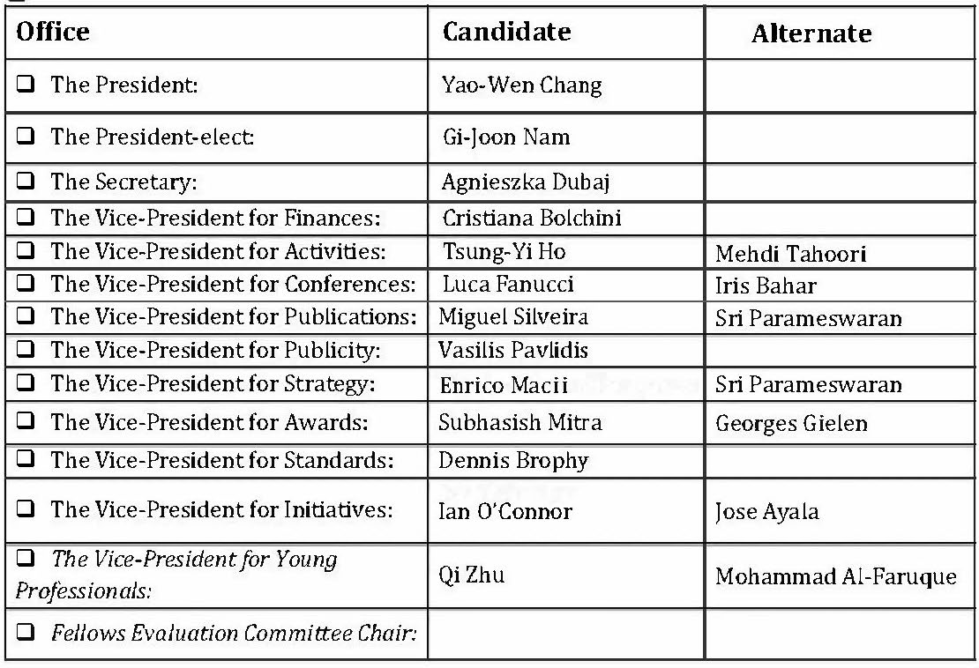
Proposed Slate 2020 & 2021

Slide 92
Old/New Business

Slide 93
President Report
CEDA Student Travel Program (from January 1st, 2020).
DAC-SEMI Status
Growth strategy of IEEE
Conferences charges revision in IEEE
Status of OA publications in IEEE
Initiative to remove right for Fellow nominations from Councils

Slide 94
IEEE CEDA Student Travel Program
Guidelines created and revised by Cristiana and Gi-Joon, ready for CEDA EC for approval
Application on-line on CEDA website
  Includes IEEE Student Registration and affiliation with CEDA)
Management of Grants
  Up to $1000 for intra-continental travels and $1500 for inter-continental travels
  Use of IEEE Concur to proceed with reimbursements
Discussion if other requests (ESWEEK, DAC, etc.) should follow the same process
MOTION: Create the CEDA Student Travel Grant program in 2020

Slide 95
DAC-SEMI Collaboration Status
Quite disappointing conclusions so far on penalty charges for DAC 2020
  $300K already charged to ACM and IEEE due to hotel cancellations, on-going negotiations with SEMI to get free convention center for DAC 2021
Registration fees and Expo/I LOVE DAC passes:
  DAC-SEMI working to finalize expo pass/I LOVE DAC dates and fees
  I LOVE DAC Campaign will be shortened, suggested (April 1 – May 30); after May 30 fees go up to $50 after July 1 and onsite fees are $100
ESDA – DAC Advisory Committee:
  ESDA has formed an ESDA DAC advisory committee. Why? No one knows, their main goal is “to make DAC successful”. Members include VP level executives from the larger EDA companies.

Slide 96

IEEE Strategy for Growth (Revenue)
Optimize long term value of all customers
Cross-sell new content to existing customers, add external content
New customer growth in:
  Key growth Markets: China, Japan and UK
  Develop new products and services for new markets to prepare for shifts in industry
  Developing markets: Latin America, Russia, Middle East
  Corporate sectors: P&E, Aerospace, Automotive, Computing, Semicon, Telecom

Slide 97

Global Outlook 2019
$259.6 M + 4.5% earned / $247.6 +5.8% Cash vs. 2018
2019 Revenue Growth Targets appear achievable
Sales Plan:
Emphasize Xplore options,
power of access to IEEE, and
  Drive usage → aid retention
  “Add on” products → new revenue
  Customer demand → new products
Challenges Facing IEEE Sales Effort
Protracted Pricing and Contract Negotiations
OA Business & Sales Plans I.e. opportunity requires new business practices, systems
WW Government Budgets, Taxes and
Terms & Conditions
Focus H2 2019:
Harvest corporate pipeline, esp. USA, China and Japan
Recapture 40 - 370 lost units in India, & establish 2020 go-to-market plans,
Continue to position, propose and close IEEE – Rutgers mini-MBA for engineers
Open Access Revenue Opportunities
  Minimize Risk and Maximize Opportunity, including Close one or more R&P

Slide 98
Total Number of IEEE Conferences

Slide 99
Conference Gross Revenues
From Financially-Sponsored Conference Events, in $M
CAGR 2009-18: 6.07%

Slide 100
Charge and Cost in Technical Co-Sponsorship
Original Framework and Overview
The TCS charge ($1000/conference plus $15/paper) was based on an analysis of 2013 operations
The charge was intended to cover 2/3 of the cost associated with TCS
  Sponsoring OUs had an option of paying the charge or billing the conference – “cost recovery”
  Intended to reduce the MCE overhead burden by “cost recovery”
It was anticipated that the TCS charge would moderate the growth of TCS conferences
TAB implementation started in 2016
  Conference Publication distributions continue to go to sponsoring S/Cs
  A online tool has been developed and available to assess the value of TCS conferences
MGA policy has evolved
  2016-2017 the TCS charge was absorbed at the MGA board level
  Starting in 2018, the TCS charge is passed to the sponsoring Geo Unit, or the conference
  Conference Publications distributions continue to stay at the MGA board level

Slide 101
Full (100%) TCS Cost Allocation
Conference Committee’s work in alignment with SSC/CoE, improved financial transparency
Issues with current TCS charge at 2/3 of the cost:
  1/3 of the TCS cost is covered by OH – not in full control to manage, reduce, or pass down the cost
Pathway to 100% TCS Cost Allocation
  Re-evaluate TCS cost
  100% TCS cost allocation algorithms: $/conference + $/paper
  Review, discussions, feedbacks, and decision
  Communication plan
  Implementation plan and schedule
Future: FCS Cost Allocation

Slide 102
TCS Cost Allocation Breakdown
2018 Actual Experience
Total allocation – all IEEE TCS conferences 2,092.3k 100%
  Total allocation for TA TCS conferences 906.3k 43.3% (2018) 42.4% (2017)
  Total allocation for MGA TCS conferences 1,186.0k 56.7% (2018) 57.6% (2017)
Total allocation for all TA TCS conferences 906.3k 100%
  Total charge paid by S/Cs 591.3k 65.2% (2018) 58.7% (2017)
  Total charge paid by conferences 315.0k 34.8% (2018) 41.3% (2017)
Total allocation for all MGA TCS conferences 1,186.0k 100%
  Total charge paid by MGA OUs 950.2k 83.1% (2018)
  Total charge paid by conferences 200.8k 16.9% (2018)

Slide 103
Full (100%) TCS Cost Allocation – Algorithm
Based on 2018 Actuals
Related numbers in 2018
  Total TCS Cost: $3,005.1K
  2018 TCS Conferences: 860
  2018 TCS Papers: 82,155
Cost Allocation Algorithms
  Option 1: $1,000/conf + $27/paper → Cost Split (Event : Paper) = (28% : 72%)
  Option 2: $2,100/conf + $15/paper → Cost Split (Event : Paper) = (59% : 41%)
  Option 3: $1,500/conf + $21/paper → Cost Split (Event : Paper) = (43% : 57%)
    Example: A TCS Conference with 100 papers → $1,500 + $21 X 100 = $3,600
Current Algorithm
  2/3 Allocation: $1,000/conf + $15/paper → Cost Split (Event : Paper) = (41% : 59%)
    Example: A TCS Conference with 100 papers → $1,000 + $15 X 100 = $2,500

Slide 104
Full (100%) TCS Cost Allocation – Schedule
Implementation Plan
Solicit feedbacks and gain consensus
  Confirm algorithm changes, planned schedule
  Broader communications and discussions from 2019 June Meeting Series
  Approval/endorsements from all stakeholders at 2019 Nov Meeting Series
Implementation timeline
  Effective for TCS conferences for which the creation of the MoU starts after 1 January 2021, the new algorithm (full TCS cost allocation) will be applied
Benefits from the allocated one year transition period
  For related OUs to assess the values from and their relationship with the TCS conferences – decide whether to absorb the TCS cost or to pass down the cost to TCS conferences
  Helpful for OUs in budget planning for the coming year – allow OUs to assess the financial impact and prepare for it
  Useful for OUs to communicate external partners on the coming changes if needed, no surprise

Slide 105
The Numbers of TAB Publications
Average growth of TAB periodicals is 4-5/year, although a handful of pubs have ceased publication recently
# PUBLICATIONS
Including the 14 new accelerated OA journals for 2020
YEARS

Slide 106
Status of New accelerated OA publications
Approved Feb 2019 TAB meeting
IEEE Open Journal of Antennas and Propagation
IEEE Open Journal of Circuits and Systems
IEEE Open Journal of the Communications Society
IEEE Open Journal of the Computer Society
IEEE Open J. of Engineering in Medicine and Biology
IEEE Open Journal of Industry Applications
IEEE Open Journal of the Industrial Electronics Society
IEEE Open Journal of Intelligent Transportation Systems
IEEE O. J. of the Microwave Theory and Techniques Society
IEEE Open Journal of Nanotechnology
IEEE Open Journal of Power Electronics
IEEE Open Journal of Signal Processing
IEEE Open Journal of Solid-State Circuits
IEEE Open Journal of Vehicular Technology
Societies with IEEE Access Sections
IEEE Photonics Society (PHOT)
IEEE Broadcast and Technology Society (BTS)
IEEE Electronics and Packaging Society (EPS)
IEEE Reliability Society (REL)
IEEE Power and Energy Society (PES)
IEEE Engineering in Medicine and Biology Society (EMB)

Slide 107
Status: IEEE Accelerated OA Plan New Pubs (14)
IEEE Open website contains information about IEEE’s OA options for authors https://open.ieee.org
Press release about our OA plans (June 11): https://www.ieee.org/about/news/2019/14-new-open-access-journals.html
In Works
Done
Title | Status | EiC Known | Editorial Board Known | Initial S/C Announce. & Call | S1M Ready (Peer Review) | Full Market. Executed | First Paper Submitted
OJ-AP | Cohort 1
OJ-CAS | Cohort 1
OJ-COMS | Cohort 1 |  |  |  |  | Planning
OJ-CS (Computer) | Cohort 1 |  |  |  |  | Planning
OJ-EMB | Cohort 1 |  |  |  |  | Planning
OJ-IA | Cohort 1
OJ-IES | Cohort 1 |  |  |  |  | Planning
OJ-ITS (ITSS) | Cohort 1

Slide 108
Status: IEEE Accelerated OA Plan New Pubs (14)
In Works
Done
Title | Status | EiC Known | Editorial Board Known | Initial S/C Announce. & Call | S1M Ready (Peer Review) | Full Market. Executed | First Paper Submitted
OJ-MTT | Cohort 1
OJ-NANO | Cohort 1 |  |  |  |  | Planning
OJ-PEL | Cohort 1 |  |  |  |  | Planning
OJ-SP | Cohort 1 |  |  |  |  | Planning
OJ-SSC | Cohort 1 |  |  |  |  | Planning
OJ-VT | Cohort 1
OAJ-PES | Change name & scope |  | Existing
J-STARS (GRSS) | Flip | Existing | Existing

Slide 109
Status: IEEE Access Sections (6)
In Works
Done
Title | Status | Associate Editors Known | Initial S/C Announce. & Call | Access’ S1M Ready | Full Market. Execution | First Paper Submitted
PHOT | Access Section
BTS | Access Section
EPS | Access Section
REL | Access Section
PES | Access Section
EMB | Access Section

Slide 110
Update on Fellow matters, including the decision to refer Fellow Nominees to Societies only
Stefano Galli – sgalli@ieee.org
2018-2019 IEEE Fellow Committee Chair
23 November 2019 – Technical Activities Board

Slide 111

Rationale for Decision (1/2)
Expertise to evaluate technically any Nominee is already in Societies because “Council Evaluators” are actually IEEE Fellow who are members of Societies, thus there is no need to have Councils doing the same job of Societies and creating separate rankings.
  Fellows elevated through Councils are members of Societies (not Councils, as Councils have no individual membership), so Fellow Evaluators used by Councils are readily available for appointment to the Fellow Committees of Societies .
Due to the competitiveness of the Fellow process, it is very important that:
  (a) All Nominees contributing to same/similar fields be evaluated by the same evaluating Committee so that number of separate rankings is minimized.
    It is very difficult for the IEEE Fellow Committee to merge into a single ranking tens of distinct rankings of Nominees that have contributed to different fields and in different ways (research, practice, etc.) and it is not at all immediate to normalize S/TC scores so it is important to minimize the number of separate rankings, especially for same/similar fields.
    Arriving to a single ranking and setting a Pass/Fail threshold is essential because Fellow “worthiness” is not a binary state, there is a continuum in qualification and the process is competitive because of the finite number of available slots.
  (b) Evaluating Committees do not evaluate too few Nominees.
    Committees that evaluate a few Nominees cannot calibrate well their assessments vis-à-vis the general degree of qualification of the whole pool of ~1,000 Nominees. The issue of uncalibrated evaluations from small Societies also needs to be addressed.
    There are a lot of small Societies with uncalibrated assessments.
    Society Fellow Committees evaluate between 1 and 125 Nominees per year. Median: 10 ; 90th-percentile: 56 (mean of last 5 yrs, 2015-2019).

Slide 112
Rationale for Decision (2/2)
Nominees evaluated by Councils are at an advantage with respect to Nominees evaluated by Societies with similar FOI because they compete with a much smaller pool of Nominees.
  Nominees that contribute to computer, signal processing, power, or comms compete with 50-125 Nominees if they go through a Society but would compete with 3-15 Nominees if evaluated by a Council… this gives better chances of elevation.
  Small Societies and Councils have large variations in Elevation Probability over time due to small number effects and often have much higher EP than the overall average.
  The problem is possibly compounded by the fact that IEEE Fellow Committee members value very much S/TC evaluations and rankings and tend to “over-weigh” the high-ranking Nominees in small Societies and Councils.
It is a valid point that Councils can better evaluate Nominees that have contributed to fields that are multi-disciplinary in nature or fall between the FOIs of multiple Societies.
  This is the case when Evaluators should be chosen from more than just one single Society.
Although these are rare cases, a solutions to this problem has been developed: allow the Nominator to identify a primary Society to handle the evaluation of the Nominees and additional 1-2 secondary Societies from which to choose additional Evaluators.
  The Chair of the Fellow Committee of the primary Society will be able to access a wider pool of Fellows in choosing Evaluators and thus have a set of Evaluators capable of reviewing Nominees with multi-disciplinary contributions.

Slide 113
Implementation Aspects
The motion will be:
  Sent for approval to the IEEE Board in February 2020.
  Implemented for Fellow Class 2022, i.e., for 2021 evaluations.
If the motion is approved by the IEEE Board, the Fellow Committee will:
  Allow Nominators to identify a primary Society whose Committee will handle the evaluation of the Nominee plus additional 1-2 secondary Societies (multi-disciplinary cases).
  Limit the Expedited Evaluation Procedure (EEP) to Societies with >15-20 Nominees.

Slide 114
Looking to 2020
Start of CEDA Students Travel Grant
Be attentive to evolution of DAC (key for CEDA still!)
Observe evolution of OA trend: TCAD becoming Gold OA soon?
Obeserve evolution of «threat» to Councils in IEEE Fellow Committee (become a Society if it materializes)
THANKS TO ALL THE CEDA EC MEMBERS FOR THE GREAT WORK THIS TERM!

Slide 115
BACKUP SLIDES

Slide 116
Back-Up Slides
These slides were used by the IEEE Fellow Committee Chair to start discussion at the Fellow Committee meeting of 5 October 2019. They are reported here as they provide additional background information on the arguments in favor and against the motion.

Slide 117
Roster of the 2019 Ad Hoc (12 S/TC-FEC Chairs)
S/TC | Nominees (2012-2018 mean) | Ad Hoc Representative
C | 112.0 | Ahmed Louri
COM | 95.2 | Robert Schober
SP | 62.0 | Isabel Trancoso, Chair
PE | 60.6 | Mladen Kezunovic
PHOT | 46.0
ED | 45.0
CS | 37.2
AP | 36.2 | Jaideva Goswami
CAS | 35.4
MTT | 28.4
CIS | 27.6
IA | 22.4
SSC | 20.6
AES | 20.2 | Hugh Griffiths
RA | 19.4
EMB | 18.4
SMC | 17.0
PEL | 16.0
GRS | 15.8
CEDA | 14.2 | Giovanni De Micheli
IE | 13.8
NPS | 13.0 | Ned Sauthoff
IT | 10.4 | Antonia Tulino
VT | 9.2
MAG | 9.0
S/TC | Nominees (2012-2018 mean) | Ad Hoc Representative
IM | 8.8
Educ | 7.4 | Susan Lord
CE | 7.2
NANO | 6.4
EMC | 6.2
UFFC | 6.2 | Lute maleki
CPMT | 5.6
SEN | 4.4
DEI | 3.6
R | 3.0
SysC | 3.0 | Marco Parvis
BIO | 2.6
BT | 2.4
EP | 2.2
ITS | 1.8
CSC | 1.6
PSE | 1.6
OE | 1.2
SIT | 1.2
TEM | 1.2
RL | 0.8
PC | 0.4
RFID | 0.4
TMC | 0.2
NTC | 0.0

Slide 118
IEEE Fellow Committee
Should Councils Evaluate Nominees?
5 October 2019 – Phoenix, AZ
Stefano Galli
2019 IEEE Fellow Committee Chair

Slide 119
Data on Technical Councils
Elevation Probability (%) in Councils vs all Societies together
 | BIO | CEDA | RFID | CSC | NANO | SEN | SysC |  | IEEE Societies
2012 | 66.7 | 54.6 |  | 100.0 |  | 0.0 | 100.0 |  | 40.8
2013 | 33.3 | 50.0 |  | 50.0 | 33.3 |  | 75.0 |  | 35.6
2014 | 25.0 | 36.4 |  | 66.7 | 50.0 | 44.4 | 100.0 |  | 33.9
2015 |  | 45.5 |  | 100.0 | 20.0 | 33.3 | 0.0 |  | 34.2
2016 | 0.0 | 40.0 |  |  | 28.6 | 25.0 | 0.0 |  | 35.9
2017 | 33.3 | 42.9 |  | 33.3 | 16.7 | 40.0 | 50.0 |  | 31.4
2018 | 50.0 | 33.3 | 0.0 | 0.0 | 20.0 | 0.0 | 50.0 |  | 32.3
Mean: | 34.7 | 43.2 | 0.0 | 58.3 | 28.1 | 23.8 | 53.6 |  | 34.9
CI-95%: | ±23.7 | ±6.9 | 0.0 | ±41.0 | ±13.0 | ±20.5 | ±38.8 |  | ±2.9

Slide 120
Data on Technical Councils
Nominations and Elevations per Fellow Class Year
 | BIO | CEDA | RFID | CSC | NANO | SEN | SysC
2012 | 3 | 11 | 0 | 1 | 0 | 2 | 1
2013 | 6 | 6 | 0 | 2 | 6 | 0 | 4
2014 | 4 | 11 | 0 | 3 | 4 | 9 | 2
2015 | 0 | 11 | 0 | 1 | 5 | 3 | 2
2016 | 2 | 10 | 0 | 0 | 7 | 4 | 3
2017 | 3 | 21 | 0 | 3 | 6 | 5 | 4
2018 | 4 | 18 | 2 | 1 | 10 | 1 | 4
Nominations
Elevation Probability
Councils: 79/205 = 38.5%
Societies: 2,032/5,847 = 34.8%
ALL: 2,111/6,052 = 34.9%
 | BIO | CEDA | RFID | CSC | NANO | SEN | SysC
2012 | 2 | 6 | 0 | 1 | 0 | 0 | 1
2013 | 2 | 3 | 0 | 1 | 2 | 0 | 3
2014 | 1 | 4 | 0 | 2 | 2 | 4 | 2
2015 | 0 | 5 | 0 | 1 | 1 | 1 | 0
2016 | 0 | 4 | 0 | 0 | 2 | 1 | 0
2017 | 1 | 9 | 0 | 1 | 1 | 2 | 2
2018 | 2 | 6 | 0 | 0 | 2 | 0 | 2
Elevations

Slide 121
Elevation Probability vs Mean Number of Nominations

Slide 122
New findings on Societies and Councils
Small Societies and Councils have large variations in Elevation Probability (EP) over time due to small number effects and also often have higher than average EP. Furthermore, Councils generally have higher EP than Societies.
Possible explanation: IEEE Judges “over-weigh” the rankings in small Societies and Councils
  Top ranking nominees in small Societies and Councils tend to be elevated with higher probability than middle ranked nominees in larger Societies, e.g., a nominee ranked #15 among 40 has an EP AROUND 25%, much smaller than the EP of top-ranking nominees in small Societies/councils.
A solution less controversial than forbidding Councils to evaluate nominees, would be to require that small Societies and Councils provided the narrative on Nominee’s contributions but not rank and score.
  This will force IEEE Judges to do more due diligence.

Slide 123
The Problem Exists Beyond Stats
There is a strong belief that nominees evaluated by TCs get a “pass” because they need to compete with a smaller pool of candidates.
  This is confirmed by the higher than usual elevation probability of some TCs, but the problem extends to small Societies as well. Stats alone are not enough to justify taking away evaluations form Councils.
Nominees that contribute to computer, signal processing, power, or comms, compete with 50-120 nominees if they go through a Society but would compete with 3-15 nominees if evaluated by a TC.
Fellow “worthiness” is not a binary state, there is a continuum in the qualification and the process is competitive because of the finite number of elevations available.
Due to the competitive nature of the process, it is very important that ALL nominees contributing to the same field be evaluated by the same committee so that we have a single ranking.

Slide 124
Does the FC Reaffirm the 2018 Decision?
If yes, should we also consider additional provisions?
  Allow nominators to specify secondary/tertiary S/TCs so that a wider pool of Fellows can be chosen as evaluators (address inter-disciplinary cases)?
  Resolve the issue of small Societies as in one or more of the following:
    Group small Societies per Division? Basically we make them as Councils but larger, so we get a single ranking of affine fields.
    Not allow expedited evaluation of small Societies (<15 nominees)?
    Flag all nominees from small Societies and with a preliminary Pass recommendation for discussion at the f2f meeting? Also mentioned on slide #3 of the new Process Approval slides (Agenda Item 28)

Slide 125
Does the FC Reaffirm the 2018 Decision?
If no, should we consider alternative solutions?
  S/TCs with less than X nominees do not rank/score their nominees but just provide narrative answers:
    This requires Judges to perform more due diligence which should be manageable after the Expedited Evaluation Procedure starts in 2020
      For X=10, there would be ~50 unranked nominees out of ~900. Workload increase: ~5 nominees per IEEE Judge.
      For X=20, there would be ~140 unranked nominees out of ~900. Workload increase: ~14 nominees per IEEE Judge.
    Another good side effect is that any bias a small S/TC may have (gender, geographical, etc.) would not propagate to the Fellow Committee.
  Have a panel of Judges that looks at nominations referred to TCs and decides which ones should be moved to Societies and which ones can stay with TCs.
    This can be combined with allowing nominators to specify secondary/tertiary Society.

Slide 126
2018 Decision on Councils
The 2018 FC passed a motion presented by the 2017 FSPS to limit evaluation of nominees to Societies only, not Technical Councils (TCs) anymore.
  Main rationale: very high elevation probability for TCs.
When I presented to TAB in November 2018 there was obviously strong pushback.
I did some research on the matter and found that, in reality, it is not just TCs that have higher elevation probability but also small Societies. Different conclusions can be reached.
Had (and still have) email exchanges with Division Directors.
I decided to delay the implementation of this motion to have more discussion internally and externally with all stakeholders – including the Society Ad Hoc and TAB.

Slide 127
Counter Arguments I got from the TCs
(followed by my opinions)
TCs can better evaluate nominees that have contributed to very specific fields for which it is difficult to find experts in one Society.
  Not convincing and unfounded, TCs use Fellows from their constituent Societies as evaluators, there is no reason why Societies would not be able to evaluate nominees referred to TCs.
  And if the topic is so esoteric, it is not easier to find Evaluators in Councils because the same evaluators are listed under the constituent Societies.
TCs are communities, they should be allowed to evaluate nominees.
  The argument is somewhat weak, should we then extend the same argument to the other 19 Technical Communities we have (Big Data, BlockChain, Brain, etc.)?
Today, some contributions are interdisciplinary, and this requires the capability of picking evaluators from different Societies.
  The argument has some validity and recognizes an existing trend;
  However, it happens very rarely that nominees are referred to TCs because of the interdisciplinary nature of their work (not measured, but consistent feedback form Judges);
  And even then, it cannot be stated with certainty that the necessary expertise to evaluate them cannot be found in Societies (no need to appoint evaluators that are all experts, also some “generalists” can be appointed as they would still comment intelligently).

Slide 128
Highlights of Fellow Decisions that Impact S/TCs
As also done in 2018, I created an Ad Hoc Committee on S/TC Fellow Best Practices chaired by Isabel Trancoso (SP-FEC Chair).
  13 FEC Chairs chosen to represent 2 Councils and 11 Societies (4 Large, 2 Medium, 4 Small) – see slide #7 for the roster.
The Ad Hoc has been very effective and presented various recommendations that were endorsed by the IEEE Fellow Committee (FC):
  A revised Nomination Form and a revised S/TC Evaluation Form;
  Harmonization of practices across S/TCs with common requirements on transparency, appointment of additional FEC members when needed, and a review of existing policies – most of which were re-confirmed;
  A trial period of 1 year in which all Educator nominations shall be referred to the Education Society.
The IEEE FC re-affirmed the motion passed in 2018 to limit evaluations of Nominees to Societies only:
  The Ad Hoc discussed this matter and the Ad Hoc members agreed with the motion (provided that some flexibility in appointing additional evaluators was made available to address the case of Nominees with inter-disciplinary contributions) or had no strong feelings, while only Council representatives objected.
  I presented to the FC the slides attached here as back-up. The FC discussed the matter a length and reaffirmed the 2018 decision with almost unanimous support.

Slide 129
Publicity
Vasilis F. Pavlidis, Univ. of Manchester, UK & Aristotle Univ. of Thessaloniki (AUTH), Greece
  Sudeep Pasricha, Colorado State University, CO, US

Slide 130
Ongoing Activities
Newsletter – CEDA Currents
Website
Email distributions
Ad hoc requests
Physical presence to events sponsored by CEDA
Social media campaigns
  Feel free to ask us to launch whenever needed
Design & Test (D&T) member list for D&T newsletter was provided through CEDA members list
  Unclear whether it is used or not
Local chapters have started to be more active in publicizing activities and reporting on those
  E.g. Brazil chapter, Chips in Saba event

Slide 131
Pending Items
SVDTC situation
  SVDTC has requested a sub-website within CEDA’s website
  Requires enhanced functionality not supported by CEDA website and our web admin
  Will incur some financial cost
  Not a timeline yet for the development of this functionality

Slide 132
2019 Open Issues
FB and LinkedIn campaigns proved very economic and successful but scarcely used ☹
  Should we recommend to the organizers of the sponsored events to use this opportunity more?
We need to decide upon the task of producing a CEDA video
  Several discussions but unclear whether there is consensus. Opinions?
New publication proposal: Produce a single page (A4) document annually on the CEDA highlights for the current year
    E.g., report on new activities, CEDA awards
Notes:
David, Jennifir,
The idea here is to produce something that carefully picks the best new things and promote them to our members and sponsoring technical societies. There are always new initiatives taken and activities introduced and although these are included in Currents, an annual summary of those may be useful for those who don’t go through CEDA each time it’s out.
I would like to know what EC thinks about it and if they feel it makes sense, then I would have a motion on next EC phone call or meeting.

Slide 133
Feedback?
To Jennifir or directly to publicity@ieee-ceda.com

