Slide 1
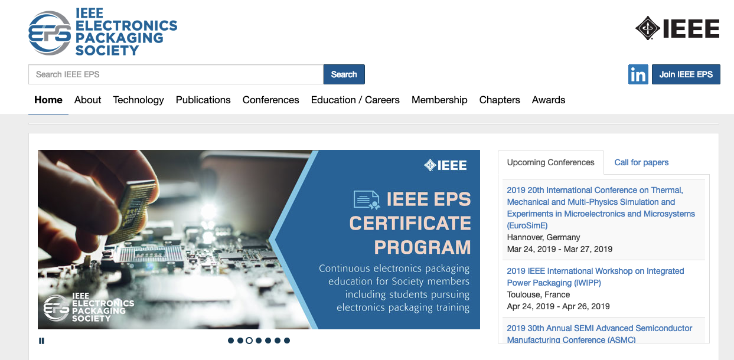
Electronic Packaging Society (EPS)
Representatives
  Professor Chris Bailey (University of Greenwich, UK)
  Professor Jose Schutt-Aine (University of Illinois, USA)
https://eps.ieee.org/

Slide 2

Electronics Packaging Society
Avram Bar-Cohen, Raytheon: EPS President
Denise Manning: EPS Executive Director
34 Chapters located in Asia/Pacific,
Europe, and the US
12 Technical Committees
2000+ members worldwide
250k Downloads/yr
4500 attendees at 25 Conferences and Workshops
6 Professional Awards
Peer Reviewed Transactions
Notes:
ABC2:
I am updating this chart for ALL the Conferences – so 4500 attendees (a bit inflated but defensible – since often the IEEE name brings in the papers and people).
DM: This is probably overstated since it is based on budgeted rather than actual attendees. If a Conference Organizer does not provide the actuals, the information is not in the database. Technically co sponsored conferences do not need to provide the post finance report.
2017 data:
Financially sponsored - ~2,600 attendees
Technically sponsored ~ 3,700
2016 data:
Financially sponsored - ~3,100 attendees
Technically sponsored ~ 4,600
Is the number of Conferences – 25 – correct?
DM: It depends on the year since some conferences are not held each year
In 2017 – 24 financial and technical events
In 2016 – 28 financial and technical events
Yes for downloads – let’s go with the annual number of Transactions and Conference downloads.
DM: Transactions Total downloads in 2016 for 2016 articles: 36,963
Conferences: 2016 downloads for 2015 events ~92,900
Would be good to also figure out the Annual citations – for the transactions and Conference papers.
DM:
Transactions – 2016 total cites: 5,021
Conferences – this data isn’t readily available. I have requested the Indexing group to provide some information
Corrected to 35 Chapters. Right? Yes
DM: The 6 Professional Awards included the 3 Regional Awards as 1. We can break them out and put a total of 9 Awards.
ABC:
1, Need to check estimate of Conference Attendance ….let’s include the co-sponsored as best we can…. Based on estimated attendees (don’t have a full number of actual attendees if conference does not submit the info) Financial sponsored
2. Need to check downloads…want to include all Transactions and Conference Proceedings… Do we want to pull the number of downloads per year for all conferences held in year X?

Slide 3
Packaging – Example Technologies (SiP)
Source: ASE

Slide 4
EPS Technical Committees
Materials & Processes
High Density Subtrates & Boards
Electrical Design, Modeling & Simulation
Thermal & Mechanical
Emerging Technology
Nanotechnology
Power & Energy
RF & Thz Technologies
Green Electronics
Photonics - Communication, Sensing, Lighting
3D/TSV
Reliability

Slide 5
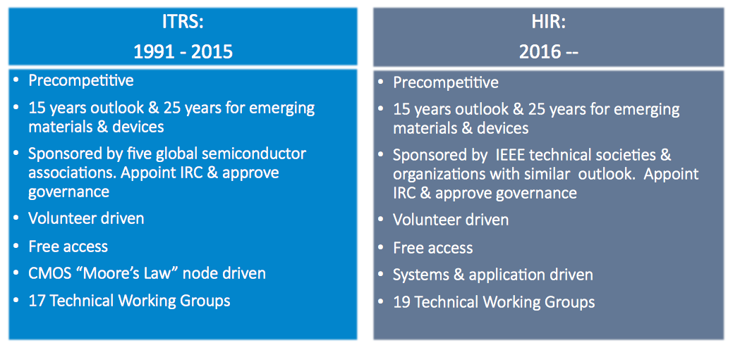




Heterogeneous Integration Roadmap
https://eps.ieee.org/technology/heterogeneous-integration-roadmap.html

Slide 6
2018/19 Status
2018: Technical co-sponsor for EDPS
  Contributions to technical programe in packaging and manufacturing
2019: Professor Jose Schutt-Aine joins Prof Bailey as EPS representatives
2019: HIR Roadmap
  Professor Bailey – Modelling and Simulation chapter
  Professor Schutt-Aine – Co-Design chapter
  Participation from CEDA members in technical working groups welcome

