Slide 1
Finance
Cristiana Bolchini

Slide 2
2018 Revenues
Periodical & Conferences
 | 2017 Net | 2018 Net | 2019 Budget
TCAD | 181K | 183.3K | 212.3K
ESL | 37.8K | 51.2K | 40.0
D&T | -24.1K
Conferences | 238K | 396.7K | 349.5K
TCAD
40% increase in editorial costs
+20K Press Work-Printing
+16K Services editorial
-14K subscriptions / + 13K overlength
Conferences:
-55K cancelling DAC 2021
-16K (DAC 2016 / ICCAD 2016)

Slide 3
2018 Main expenses
Administration: ~135K
Committee: ~330K
Technical activities: ~110K
Local chapters: 31K
Dist. Lecturer Program: 46K
Contests: 9.2K
Awards: 13K
Salaries ~ 100K
Travelling costs ~ 90K
From previous years: 30K
2018 Net : ~ +100K
Notes:
Salaries: 43.5 + 58.6
Travels: 90.5

Slide 4
2019 Activities
Local chapter funding (15 chapters – 7 active)
Distinguished Lecturer Program
Awards
Contests (SMACD, ICCAD, DATE)
Student support (DATE, LATS, ESWEEK)
CEDA Luncheon Talks
Projects
Diversity in EDA
IoT Summer School
CPS Summer school

Slide 5
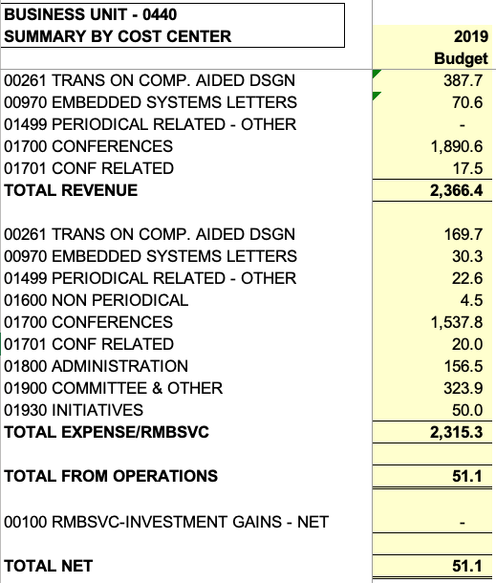
2019 Budget
Maintain supported technical activities
Keep close control on expenses
Keep expenses in the fiscal year

