Slide 1
IEEE CEDA
Executive Committee Meeting
March 19, 2018
Dresden, Germany
David Atienza – President
president@ieee-ceda.com
david.atienza@epfl.ch

Slide 2
Finance
Cristiana Bolchini
vp.finance@ieee-ceda.com

Slide 3
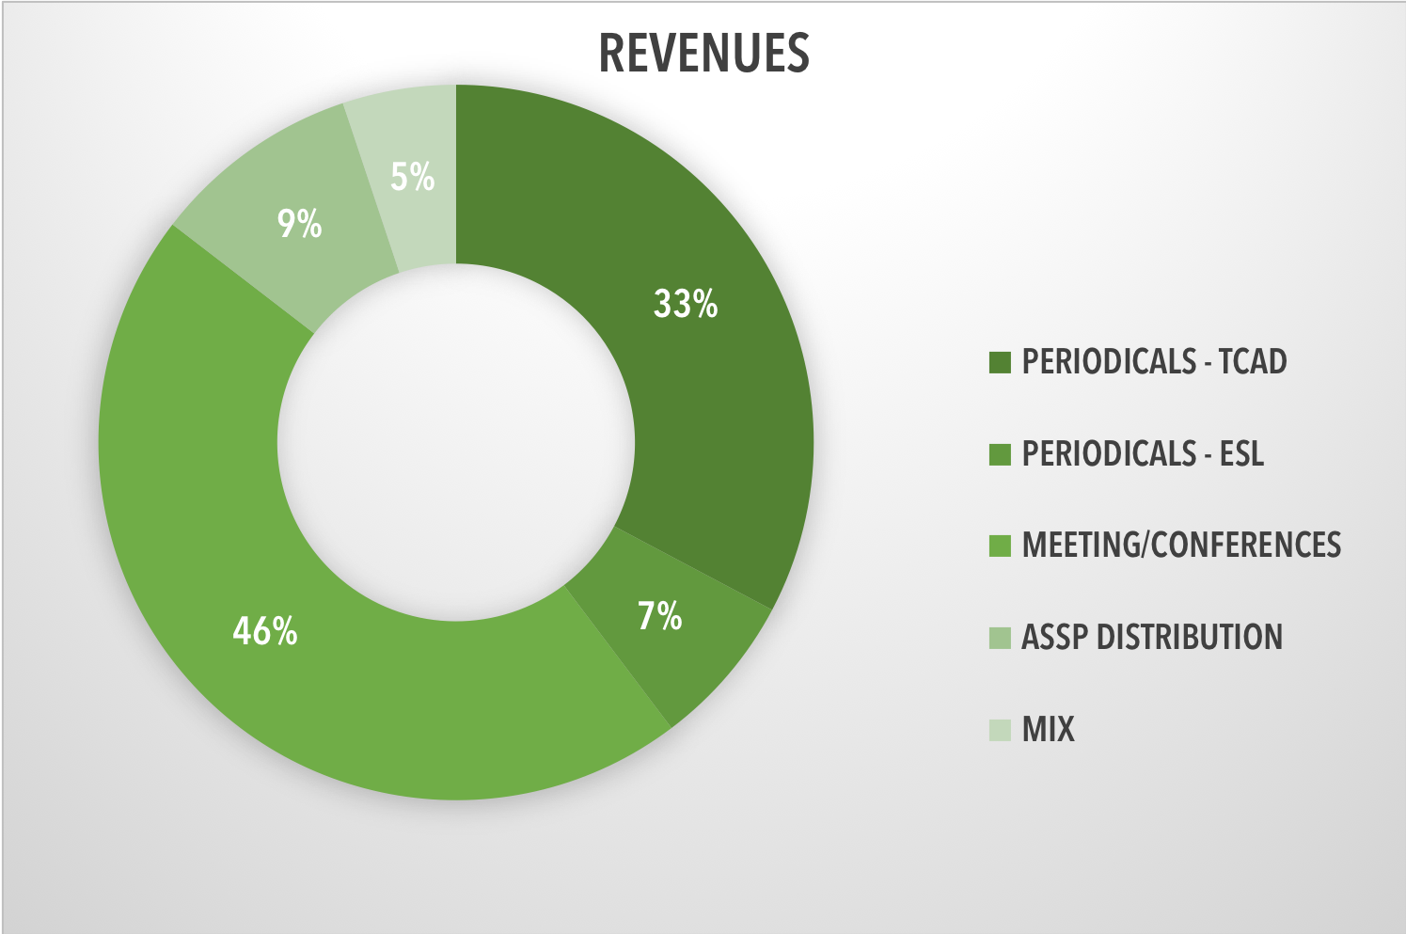
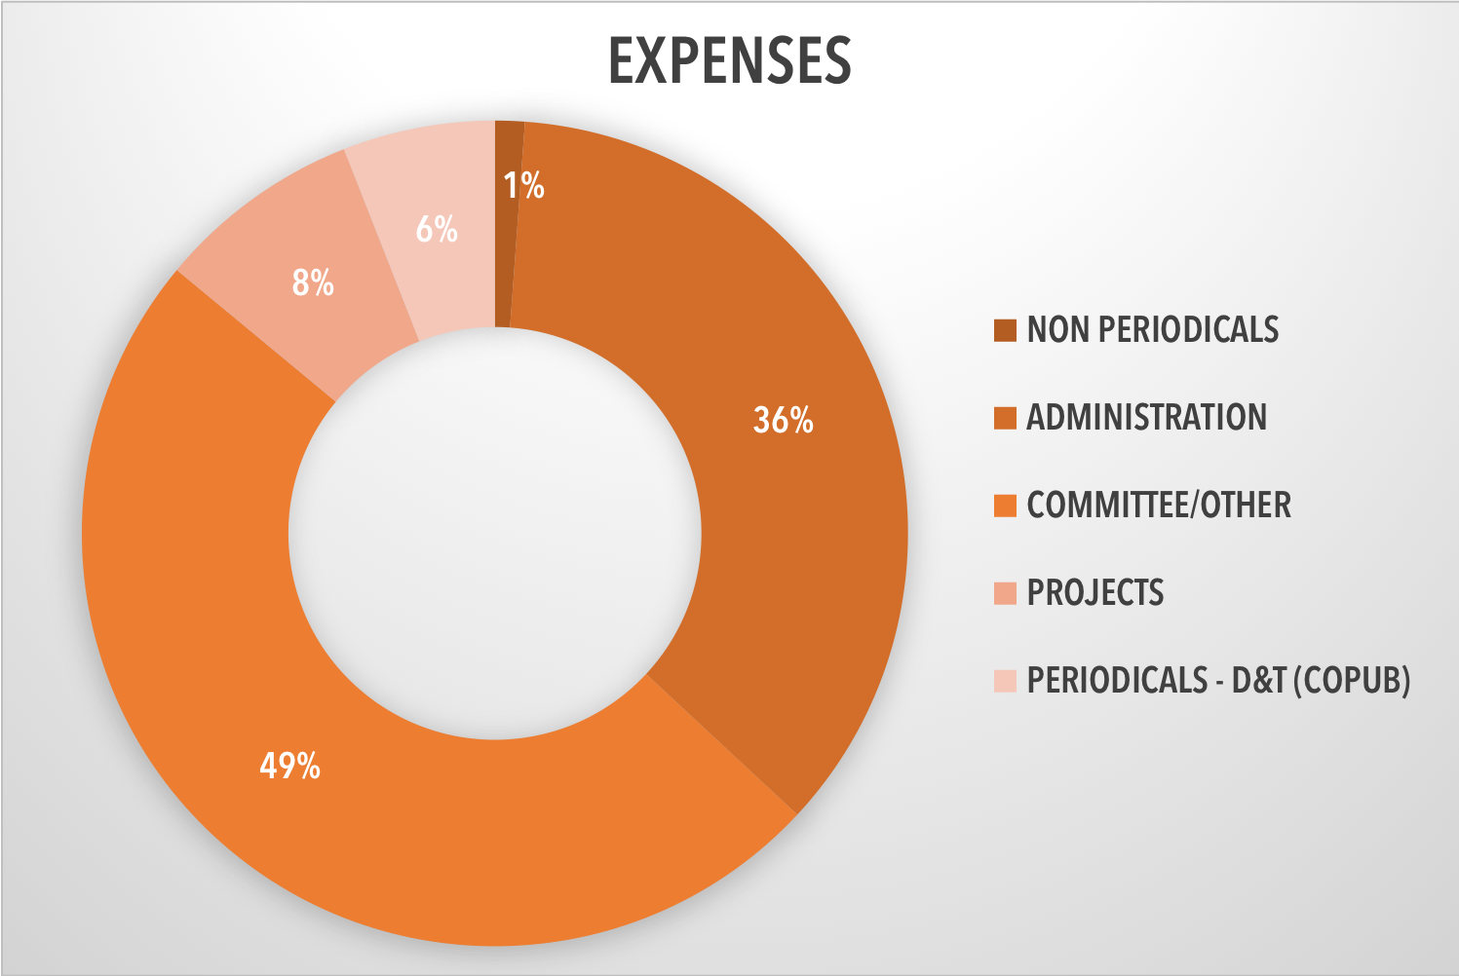
Revenues and expenses - 2017
Net: 130k US$
534.2k US$
404.6k US$

Slide 4
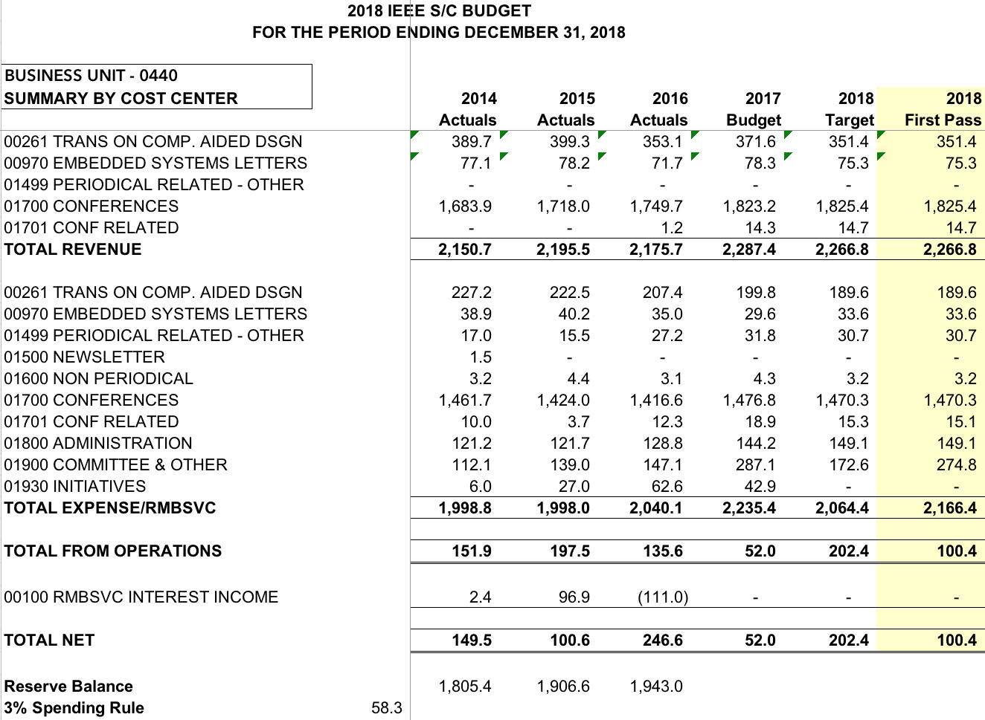
Budget 2018
Net: 130k US$

Slide 5
2017: Periodicals & Conferences
TCAD: $181k (~ $140k over-length page charges)
ESL: $37.8k (~ $1k over-length page charges)
D&T (co-sponsor): -$24.1k
Conferences: $238k
2017: main expenses
Administration: $144.7
Committee & Other (includes awards, DLP): $198.6

Slide 6
2018 budget
Initiatives
Local chapter funding (15 chapters): $3k per chapter
Outreach program: $15k
Diversity in EDA @ DATE: $10k
Distinguished Lecture Program: $34.5k
Awards: $37.5k
Contests/Workshop support: $29k

Slide 7
Budget 2018 - comments
Confirms 2017 trend, reducing a little expenses related to committees/others
Devotes more funding to projects and initiatives
Notes:
There are “leftovers” from previous years … we should be a little bit more prompt in closing things within the year of reference
Local chapters: set a soft deadline for requests to have a comprehensive view of requests

