Slide 1
Conferences
VP-Conferences, Yao-Wen Chang (National Taiwan University)

Slide 2
Stable Projections in Conferences
Conferences projections look stable, but not easy growth coming
  IEEE projections match ours, but large conferences shrank/were stable in 2015
  Main income is still from DAC
Year: 2015 | % Sponsor | Society Share of Conference
Conference Name |  | Revenue | Expense | Net
52nd ACM/EDAC/IEEE Design Automation Conference (DAC) | 33.3% | 1,085,487 | 1,037,031 | 48,456
Design, Automation & Test in Europe Conference & Exhibition (DATE) | 27% | 164,101 | 162,015 | 2,086
Eight IEEE/ACM International Symposium on Networks-on-Chip (NoCS) | 40.0% | 28,400 | 22,000 | 6,400
13th International Forum on Embedded MPSoC and Multicore (MPSoC) | 33.0% | 26,730 | 26,235 | 495
11th Int’ Conf. on Formal Methods and Models for Codesign (MEMOCODE) | 15.0% | 2,715 | 2,310 | 405
IEEE/IFIP 21st Int’l Conference on VLSI and System-on-Chip (VLSI-SoC) | 25.0% | 22,600 | 21,375 | 1,225
9th Embedded Systems Week (ESWeek) | 25.0% | 21,800 | 20,300 | 1,500
IEEE Computer-Aided Network Design Workshop (CANDE) | 100.0% | 35,000 | 34,500 | 500
IEEE/ACM International Conference on Computer-Aided Design (ICCAD) | 46.6% | 95,735 | 93,867 | 1,868
IEEE/ACM Asia and South Pacific Design Automation Conference (ASP-DAC) | 25%/12.5%/16% | 195,000 | 190,000 | 5,000 (12,582 in 2016)

Slide 3
Growth in Cooperation with IEEE Bodies and ACM
Added 5 new conferences in 2015 & 3 in 2016: Only accept very few conferences that can show added value and new links with EDA/ES
Sponsor IEEE/ACM/EDAA PhD Forum at DATE since DATE 2016
Try to reach out to other regions (outreach activities in South America)
Conference | Characterization | CEDA %
IEEE Latin America Test Symp. (LATS) | Main testing conference in South America with EDA component | 30%
IEEE European Test Symp. (ETS) | Main European test conference with EDA component | 25%
IEEE Latin America Symp. on Circuits and Systems (LASCAS) | Flagship conference of IEEE CASS in South America, technical sponsorship of CEDA for EDA and embedded systems components | 20-25%
IEEE Int. On-Line Testing Symp. (IOLTS) | Focused on on-line testing in Europe, part of the 1st IEEE Federative Event on Design for Robustness (FEDfRo) | 100%
22nd Int’l Mixed-Signal Testing Workshop (IMSTW) | Targeted workshop on new technology on mixed-signal design and test in South and Eastern Europe, part of FEDfRo | 100%
Int’l Verification and Security Workshop | New event on verification and security in Europe, part of FEDfRo | 100%
26th Great Lakes Symp. on VLSI (GLSVLSI) | Focused on broad areas of VLSI and hardware design & EDA/ES | Technical
29th Symp. on Integrated Circuits and Systems Design (SBCCI) | Dedicated to integrated circuits and systems design, test and EDA, held annually in Brazil | Technical

Slide 4
Top Goals
Continue to be the preferred organizer and sponsor for high-value conferences in EDA and ES related areas
Increase CEDA’s influence and visibility in growing areas related to EDA and ES

Slide 5
Key Strategies
Collaborate with other societies/organizations in all main conferences in EDA/ES and make CEDA more influential in related growing areas with CEDA activities/financial support
  Financially sound, but need to keep growing
Provide needed help (documentations, financial supports, etc.) to conference organizers
  Further enahnce on-line sponsorship application support
Make CEDA a key reference for young researchers and nurse EDA/ES new blood
  Young Faculty Workshop at DAC, IEEE Rebooting Computing Competition at DAC, IEEE CEDA IoT competition at DATE, Ph.D. Forum at DATE, CAD Contest at ICCAD
Outreach to other geographical regions and emerging areas
    Grow in other geographical areas: South America (e.g., SBCCI), Asia (e.g., ATS), etc. (outreach programme and CEDA Distinguished Lecturers)
    Grow in key topics: WF-IoT (10% until 2017, 20% after), rebooting computing, security
Collaborate with IEEE to add values to the community
  1st CEDA Author Education Initiative Talk at DAC'16

Slide 6
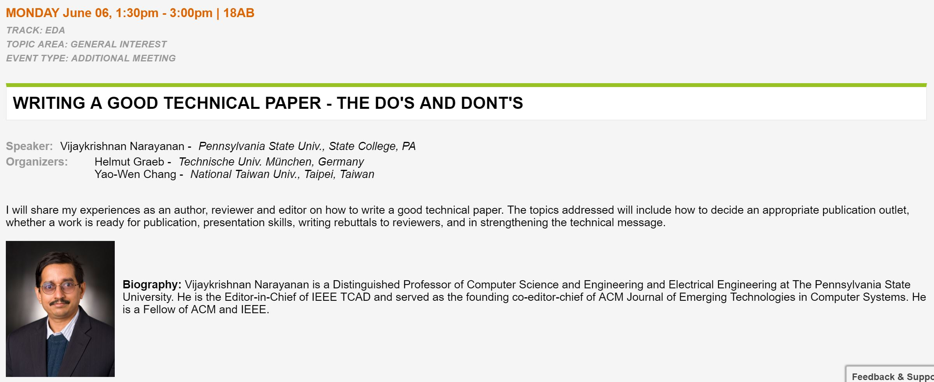
IEEE Author Education Initiative
1st CEDA Author Education Initiative Talk at DAC'16

Slide 7
Conferences Summary
CEDA conferences have developed well
  Good percentages in all major EDA/ES conferences
  Recognized as highly selective for small-medium size events
CEDA vision related to conferences
  Enhance IT support and services for organizers to keep reputation
  Need growth in other areas (IoT, RC, security, etc.)
  Expand visibility to other regions (outreach prog. in South America, Asia, etc.)
  Encourage young researchers to “join” IEEE CEDA
    Young Faculty Workshop at DAC, IEEE Rebooting Computing Competition at DAC, IEEE CEDA IoT competition at DATE, Ph.D. Forum at DATE, CAD Contest at ICCAD

