Slide 1
IEEE Technical Committee on Cyber-Physical Systems: Current Status
For IEEE CEDA BoG Meeting on March 26, 2017
Professor Shiyan Hu

Slide 2
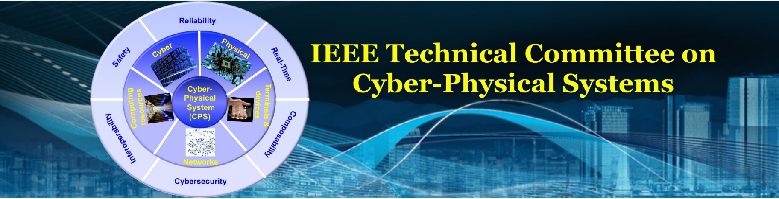
IEEE Technical Committee (TC) on Cyber-Physical Systems (CPS) is an IEEE constituency overseeing all technical activities related to designs, implementations and operations of CPSs. Currently a TC in IEEE Systems Council.
http://www.ieee-cps.org
CPS addresses the close interactions and feedback loop between the cyber sensing components and the dynamic physical components, using big data analytics
Example CPSs include smart energy CPS, automotive CPS, medical CPS, cyber-human system, etc.
2

Slide 3
TC Missions
Promote CPS related research
Organize journal special issues and conference special sessions
Establish new CPS journals
Establish new CPS workshops
Establish new CPS related IEEE Standards
Publish CPS newsletter
Establish new awards for CPS activities
Promote educational activities related to CPS
3

Slide 4
TC Research
The design, implementation and operation of CPS systems need the consideration of multiple aspects such as computational constraints, performance, energy, user experience, security, reliability, fault tolerance, flexibility and extensibility.
To build optimal and reliable CPS, there is a great need for design automation techniques such as large-scale analytical modeling, complex stochastic optimization, statistical machine learning, formal methods and verification, and real-time intelligent control.
It is highly desirable to develop innovative interdisciplinary techniques that can address unique CPS challenges such as the fast increase of system scale and complexity, the close interactions with dynamic physical environment, and the significant uncertainties in sensor readings.
It is also imperative to bridge CPS research to a variety of emerging domains including smart energy systems, automotive CPS, smart health, smart cities, etc.
4

Slide 5
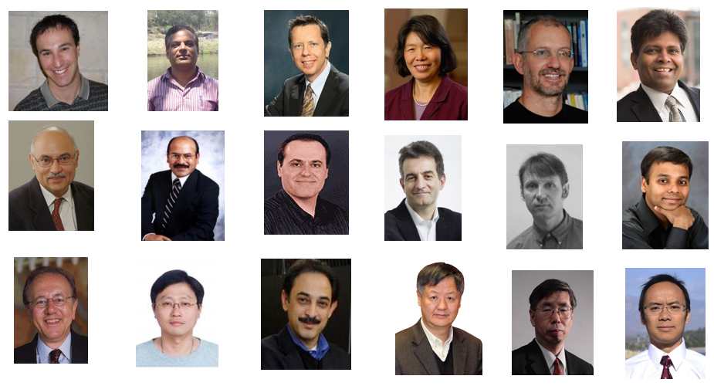
Existing TC Members
45 members from universities and organizations world wide such as Stanford, UC Berkeley, Harvard, Caltech, Carnegie Mellon, University of Sydney, University of Tokyo, National Taiwan University, and Karlsruhe Institute of Technology.
22 IEEE Fellows, and 15 current or former Editors-In-Chief for premier IEEE/ACM Transactions.
5

Slide 6








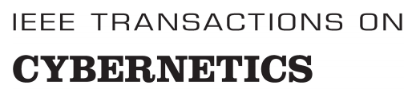
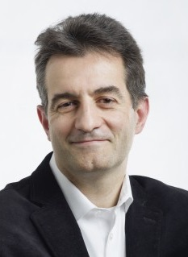
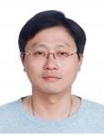
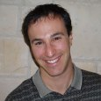
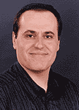
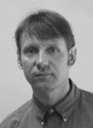
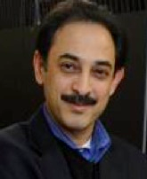
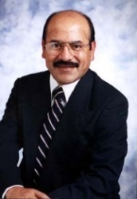
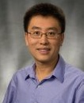

IEEE/ACM Transactions Editor-In-Chiefs
6

Slide 7
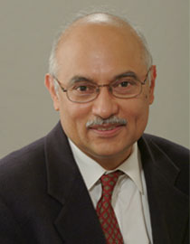
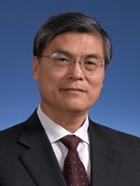
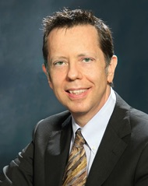
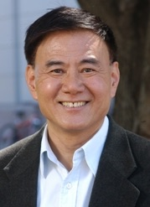
TC Advisory Board
M. Jamal Deen
President of Academy of Sciences, Royal Society of Canada
McMaster Univ.
Canada
P. R. Kumar
US NAE member
Texas A&M Univ.
USA
Yunhe Pan
Vice President of
Chinese Academy of Engineering
P.R. China
Vincenzo Piuri
IEEE Former Vice President for Technical Activities
Universita’ degli Studi di Milano
Italy
Yinyu Ye
K. T. Li Chair Professor of Engineering
Stanford University
USA
7

Slide 8
TC Members Come From Many Societies/Councils
8

Slide 9
Summary of Recent Activities
Launched a new journal: IET Cyber-Physical Systems: Theory & Applications, where many TC members are on the editorial board.
Launched two workshops: one at DAC and the other one at INFOCOM
Organized a few journal special issues: TCAD, TC, etc
Organized a few conference special sessions: DAC, ICCAD, etc
Financially/technically co-sponsored a few conferences: NVMDA 2017 (jointly with TCRTS), RTCSA 2017 (jointly with TCRTS), etc
Launched a CPS newsletter
Established several TCCPS awards
9

Slide 10
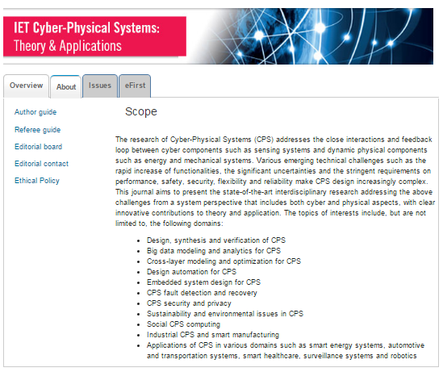
IET Cyber-Physical Systems: Theory & Applications
IET is formerly known as IEE, the UK counterpart of IEEE.
  Currently, it has more than 180,000 members, being the second largest engineering society in the world.
  Editorial board consists of many TC members
10
10

Slide 11
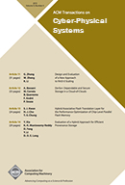

Major CPS Journals
There are only two CPS dedicated major journals: ACM TCPS and IET CPS.
EiC of ACM TCPS is Tei-Wei Kuo, an executive committee member of TCCPS.
EiCs for IET CPS are Shiyan Hu and Albert Zomaya.
At the EiC level, the two journals are collaborative.
ACM TCPS focuses more on the computing aspect of CPS, and IET CPS focuses more on the broader non-computing aspects of CPS.
11

Slide 12
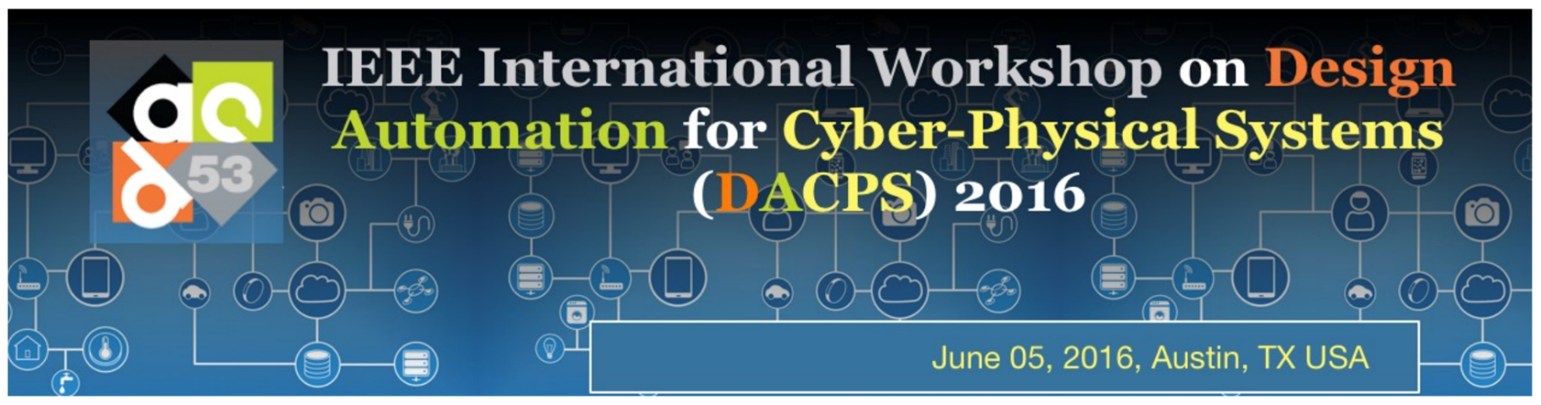

Workshops (DACPS 2017 is approved by DAC)
12

Slide 13
Journal Special Issues
Proceedings of the IEEE, special Issue on Design Automation for Cyber-Physical Systems
IEEE Transactions on CAD, special issue on CAD for Cyber-Physical System
IEEE Transactions on Computers, special issue on Smart City Computing
IEEE Transactions on Multi-Scale Computing Systems, special issue on Hardware Software Crosslayer Technologies for Trustworthy and Secure Computing
IEEE Transactions on Sustainable Computing, special issue on Sustainable Cyber-Physical Systems
IEEE Transactions on Big Data, special issue on Big Data for CPS
ACM Transactions on Cyber-Physical Systems, special issue on Smart Homes, Buildings and Infrastructure
Integration, The VLSI Journal, special session on Hardware Assisted Techniques for IoT and Big Data Applications
More to come.....
13

Slide 14
Conference Special Sessions
ISVLSI-2016 Special Session on Cyber-Physical Systems: Architecture and Security in Smart Buildings and Autonomous Driving
ISVLSI-2016 Special Session on Emerging Devices for Hardware Security: Fiction or Future
ICCAD-2015 special session on The Landscape of Smart Buildings: Modeling, Management and Infrastructure
ICCD-2015 special session on Cyber-Physical Integration and Design Automation for Microfluidic Biochips
DAC-2015 special session on Securing Cyber-Physical Systems: From Surveillance to Transportation and Home
DAC-2015 special session on The Researcher Who Cried Wolf
More to come …..
14

Slide 15
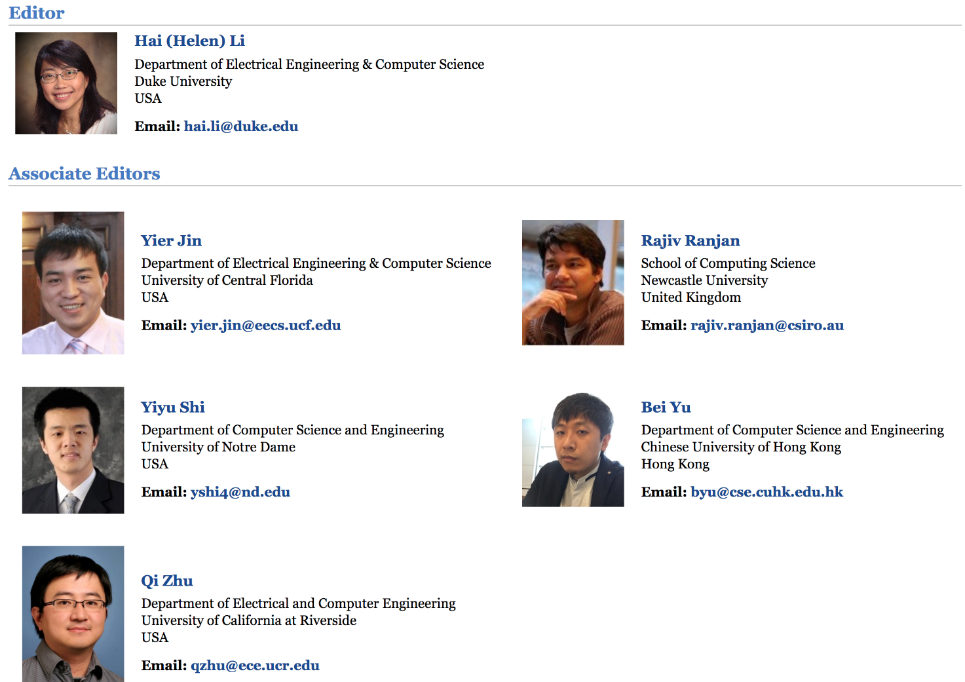
CPS Newsletter
http://www.ieee-cps.org/letter.html
Three issues have already been published online
15

Slide 16
TCCPS Awards
Technical Achievement Award
Awardees: 2017: Alberto Sangiovanni-Vincentelli, University of California at Berkeley.
Distinguished Leadership Award
Awardees: 2017: Tei-Wei Kuo, National Taiwan University.
Early-Career Award
Awardees: 2017: Qi Zhu, University of California at Riverside.
16

Slide 17
Comments on ICCPS and TCRTS
Many TC members (advisory board members) are heavily involved in ICCPS such as Prof. Kumar (general chair, 2014), Sharon Hu, Tei-Wei Kuo, Na Li, Mohammad Faruque, etc.
Within the scope of CPS, TCRTS dedicates more to its computing perspectives, while TCCPS reaches out to broader audiences in multiple areas such as power systems, aerospace systems, control systems, I&M, industrial electronics, SMC, etc.
In fact, TCCPS and TCRTS are collaborating on sponsoring activities (such as NVMSA 2017 and RTCSA 2017).
17

Slide 18
Thanks

