Slide 1
New Initiatives
Jose Ayala – UCM (Madrid, Spain)

Slide 2
Design Automation for Power Electronics - DAPE
First time organized workshop in collaboration with IEEE PELS
Understand the current state-of-the-art in design automation for power electronics
Describe emerging needs → driven by WBG technologies

Slide 3
Design Automation for Power Electronics - DAPE
GOALS
A clear identification of the common ground and synergy between power electronics and design automation
An understanding of the limits of the current design automation technology and tools
Capture the needs for future work

Slide 4
Workshop organization
Single track event
Two sessions with 5 speakers, followed by a round table
In each session speakers from Academia, Industry and EDA Companies
Around 120 registered attendees (approximately 20 no shows)
Academia speakers:
  Professor Dushan Boroyevich, Virgina Tech
  Professor Johann Kolar, ETH
  Professor Frede Blaabjerg, Aalborg University
Industry speakers from General Motors and Boeing
EDA Companies speakers from Mathworks, ANSYS, Typhoon HIL, Mentor Graphics and Synopsys

Slide 5
Workshop organization
Total Budget for the workshop $15.000
  $10.000 by IEEE PELS
  $5.000 by IEEE CEDA
As it is organized for the first time the registration was free!
  It helped a lot to attract audience…
  … nevertheless, it should be changed in the future
It was organized one day before a big Power Electronics Conference (IEEE ECCE)
  In future it should be bind to another important conference
  This approach brings people for sure!

Slide 6
Workshop demos
Great idea as it give a better visibilty to companies
Four companies have decided to make demos during the breaks
Realy well accepted by the attendees
Great possibility for networking!

Slide 7
DAPE – questions and future organization
It was a successful event! Without any doubt → should be
organized once again
We are still waiting for survey results
  If you fill out the survey you can download the workshop material
The 90% of attendees were people that came due to the next day
conference
  How to make it as a wide accepted event?
Place for the next workshop
  Europe, Asia or USA?
  Which conference should be used as a “piggy back ride”?
More speakers from CEDA must be involved
  Some problems were clearly defined – Power Electronics Design Flow
  CEDA has more experience then PELS in tackling these problems
  We should bring speakers from both worlds!

Slide 8
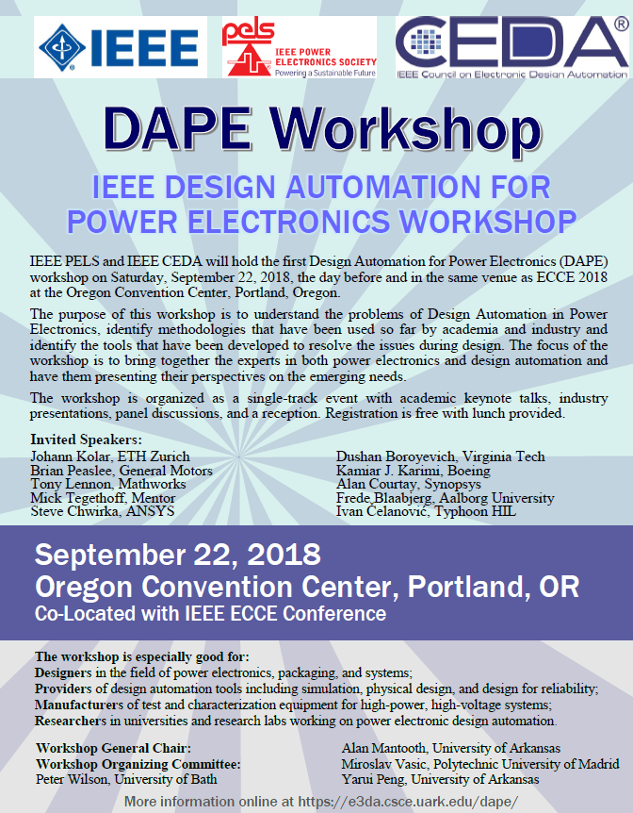
DAPE – questions and future organization
What CEDA can learn from these events?
How to increase the visibility and impact?
  We have published a web page, one booklet and one advertisement (Bodo’s Power System)

Slide 9
DAPE – questions and future organization
The attendees were mostly from academia world:
  How to make it attractive for companies
Should we keep it in this format?
  Single day event? Demos? Number of presentations?
In the next 10-15 days there will be a conference call to discuss some of these issues

Slide 10
IEEE IoT Initiative - Status of Activity
New Orleans will host WF-IoT 2020 (CEDA tried to prepare a bid, but we could not get the people at the last minute)
WF-IoT 2019 preparation is sufficiently good. Some minor organizations problems with the registration process, though. CEDA participates with a track chair and there are main topics related with CEDA activities.
IoT Initiative will end within 140K and 190K USD loss this year because of WF-IoT 2018, mainly. Societies will assume the loss. WF-IoT 2019 should have a surplus of 60K. Heiner Stuettgen assumes the direction of the IoT Board after the resignation of Adam Drobot
New regulations for voting. As a result CEDA has right to vote this last quarter in 2018 in the IoT Board
IoT Magazine will be launched at the end of this year. It includes advertising of societies, including CEDA. They welcome contributions and sponsors

Slide 11
Future Directions…
New working group to prepare event strategy “IEEE IoT Activities Board Future Event Strategy Planning” and make both the IoT initiative known and profitable

Slide 12
IEEE Smart Cities Initiative
Healthy status of accounts
Looking for strong involvement of smart cities through contact with majors
ISC2 2018 well valuated by attendees, but low participation. CEDA has been involved in panel by presenting the activities of the council
ISC2 2019 will be held in Morocco. Detailed organization plan has been submitted. CEDA President of the Morocco chapter will interact with general and program chairs

Slide 13
IEEE Smart Cities Initiative
Newsletter Schedule - articles will be published on the SC website as they are approved - once 4-6 are published we will distribute the “newsletter”. Articles will be on the SC website for 10 weeks, after this period they will be available in the SC Resource Center.
Input from Society Representative - request for articles
Will be reaching out to ISC2 attendees asking them to submit articles
Looking for engagement from other IEEE societies
Evaluating participation in Smart City Expo World Congress

