Slide 1
MTT-S Report
José Rayas-Sánchez
November 1, 2020

Slide 2

MTT-S Report
MTT-S Inter-Society Committee
MTT-S Technical Committee on Design Automation (MTT-2)
New IEEE Journal of Microwaves
Upcoming MTT-S conferences related to CEDA

Slide 3
MTT-S Inter-Society Committee
MTT-S Inter-Society Committee is in charge of cultivating relationships with IEEE Councils and other technical societies
Inter-Society Committee is aiming at encouraging a stronger participation of MTT-S in IEEE Councils
MTT-S currently has official representation in 7 councils

Slide 4


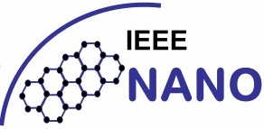

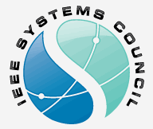
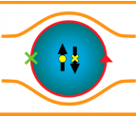

Councils Memberships in MTT-S
Sensors
Jan. 2020
Apr. 2020
Sep. 2020
RFID
Nanotechnology
Electronic Design Automation
Systems
Total MTT-S memberships: 10418 (as of Sep. 2020)
Superconductivity
Biometrics

Slide 5
MTT-S Tech. Committee on Design Automation
MTT-S has 26 technical committees
The MTT-S Technical Committee on Design Automation (MTT-2) is the closest to CEDA; it focuses on:
  Modelling and simulation of devices, circuits, and systems
  Non-linear analysis
  Optimization techniques
  Multi-physics modelling
MTT-2 regularly organizes technical events/initiatives on CAD and EDA
https://mtt.org/technical-committees/mtt-2-design-automation-committee/

Slide 6
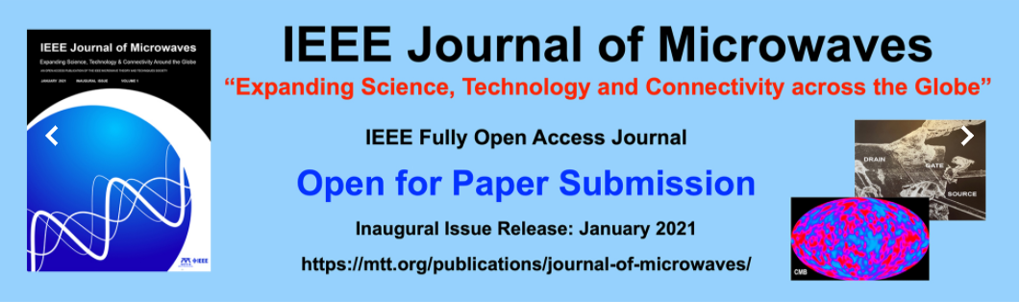
First MTT-S Open Access Journal

Slide 7
IEEE Journal of Microwaves
Inaugural issue of this journal will include two articles emerged from MTT-2, closely related to CEDA:
Simulation and Automated Modeling of Microwave Circuits: State-of-the-Art and Emerging Trends
Advanced RF and Microwave Design Optimization: a Journey and a Vision of Future Trends

Slide 8
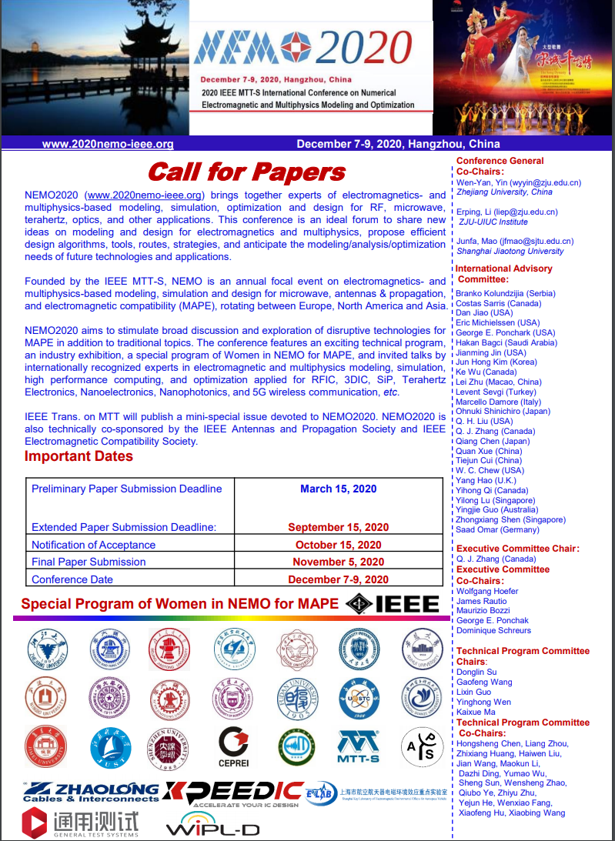
CEDA-related Upcoming MTT-S Conferences
2020 IEEE International Conference on Numerical Electromagnetic and Multiphysics Modeling and Optimization (NEMO 2020)
August 1-3, 2020 (originally), Hangzhou, China
Postponed to December 7-9, 2020
http://nemo-ieee.org/

Slide 9
Thanks
José Rayas-Sánchez
IEEE MTT-S Representative for CEDA

