Slide 1
Publications
L. Miguel Silveira, INESC-ID / IST - U Lisboa, Portugal
Naehyuck Chang, School of Electrical Eng., KAIST, South Korea
Luigi Carro, Dept. Informatics, UFRGS, Brazil
Sachin Sapatnekar, Dept. ECE, U Minnesota, USA
Rajesh Gupta, Dept. CSE, UC San Diego, USA, (EiC TCAD)
Joerg Henkel, Embedded Systems, KIT, Germany, (EiC D&T)
Sri Parameswaran, Schold of CSE, UNSW, Australia, (EiC ESL)
L. Miguel Silveira, INESC-ID/IST - U Lisboa, Portugal (CEDA VP Pubs)
Publications Committee

Slide 2
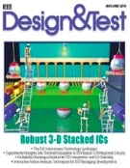


CEDA Participation in Periodicals
Financial co-sponsor:
  Design & Test magazine
Sole financial sponsor:
  Embedded Systems Letters (ESL)
  Trans. Computer-Aided Design (TCAD)
Technical co-sponsor:
  TMSCS
  JxCDC
  TSUSC
Ceased publication
In flux, TBD here

Slide 3
Ongoing & Upcoming Activities
D&T
  Intermediate PRAC for D&T: Approved
  “Search“ for “new“ EiC for D&T: Renewed mandate for Joerg Henkel
  D&T is on a new cycle; finances to be monitored closely
  Emphasis on special issues can be driven topic-wise
  Focus on embedded software to be pushed (CEDA, CASS, SSCS ok)
ESL
  ESL received impact factor from Clarivate
  Seeking special issues and perspective papers
  Quick turnaround time
TCAD
  Discussion on publication models: Print and/or online, relation to conferences
  ESWeek papers published on TCAD in 2018 (every two years)

Slide 4
Ongoing & Upcoming Activities
TMSCS
  Computer Society dropped sponsorship altogether
  Discussions to attempt to maintain journal were unsuccesful
  ... Journal is ending
JxCDC
  Computer Society and Nanotechnology Council dropped sponsorship
  Solid-State Circuits picked up responsibility but open to new sponsors
  CEDA can upgrade sponsorship to financial: TBD
TSUSC
  Doing well but limited visibility from CEDA
Flexible and Printed Electronics
  New Transactions proposed, under discussion

Slide 5
Timeline of focus activities

Slide 6

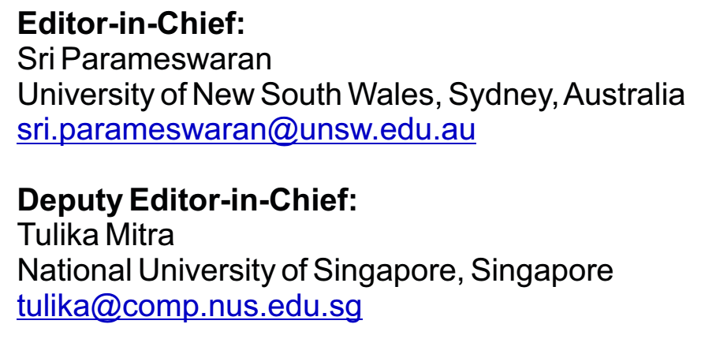
ESL - Introduction
Financial sponsor: CEDA
Started in 2009
Received approximately 150-175 submissions a year
Four pages only
Four issues per year
Strives for quick turnaround
Room to grow: initiatives underway
Finance, size, attention (click counts), submission-to-publication times, publication dates: healthy/stable

Slide 7
ESL – Average Times
Manuscript Type | No | %
Letters to the Editor | 3 | 2.0%
Original Manuscripts | 97 | 64.2%
Response Manuscript | 5 | 3.3%
Reviews | 3 | 2.0%
Special Issue on Embedded Security Challenge | 8 | 5.3%
Special Issue on Emerging Topics in Secure and Trustworthy Cyber-Physical Systems | 17 | 11.3%
Special Issue on Real-Time Technologies in CPS | 18 | 11.9%
Total: | 151 | 100.0%

Slide 8
ESL - Updates
Successfully went through PRAC earlier last year
In 2016 was included in
  Clarivate Analytics’ Emerging Sources Citation Index (formerly Thomson Reuters IP and Science)
In 2018 included in
  Science Citation Index Expanded (also known as SciSearch®)
  Journal Citation Reports/Science Edition
  Current Contents®/Engineering Computing and Technology
Less than 20% acceptance rate
Calls for perspective papers and special issues circulated quarterly

Slide 9

Design & Test
Financial sponsors: SSCS, CASS, CEDA
Technical sponsor: TTTC
Mostly composed of Special Issues, Surveys
and Tutorial papers
  Regular paper submissions are negligible
Very popular department articles
  Considerable work but does not account for impact factor / reputation
  generates cost
Using CEDA mailing list for increased reach
Editor in Chief:
Jörg Henkel
Karlsruhe Institute of Technology (KIT), Karlsruhe, Germany
henkel@kit.edu
Associate EiC:
Partha Pande
Washington State University, WA, U.S.A.
pande@eecs.wsu.edu

Slide 10
D&T: Intermediate PRAC
Fall 2018
Timeliness issues mostly solved
  run on a much tighter schedules,
  special issues with clearly defined deadlines.
Acceptance and interest over content has clearly improved
  Number of submissions more than doubled from 82 in 2013 to 182 in 2017
  number of accepted papers tripled..
Impact factor more than doubled from a 0.778 in 2014 to 1.538 in 2017 (data from Clarivate)
  Number of downloads has increased.
Finances steady in spite of moving to color printing and digital screen publishing
  Relevant loss (40K-50K), needs close monitoring

Slide 11
D&T: EiC Appointment
Current team leading the magazine since 2016
Oversaw several positive changes, overhauled the magazine
Proposed to reappoint Joerg Henkel for a 2nd term as EiC of D&T
  Publications Committee consulted and in full agreement
  Steering Committee (SSCS, CASS, TTTC) consulted and in agreement
Monitor more closely growth (members? downloads!) and finances!
Emphasis on special issues can be driven topic-wise
  Focus on embedded software to be pushed (CEDA, CASS, SSCS ok)

Slide 12
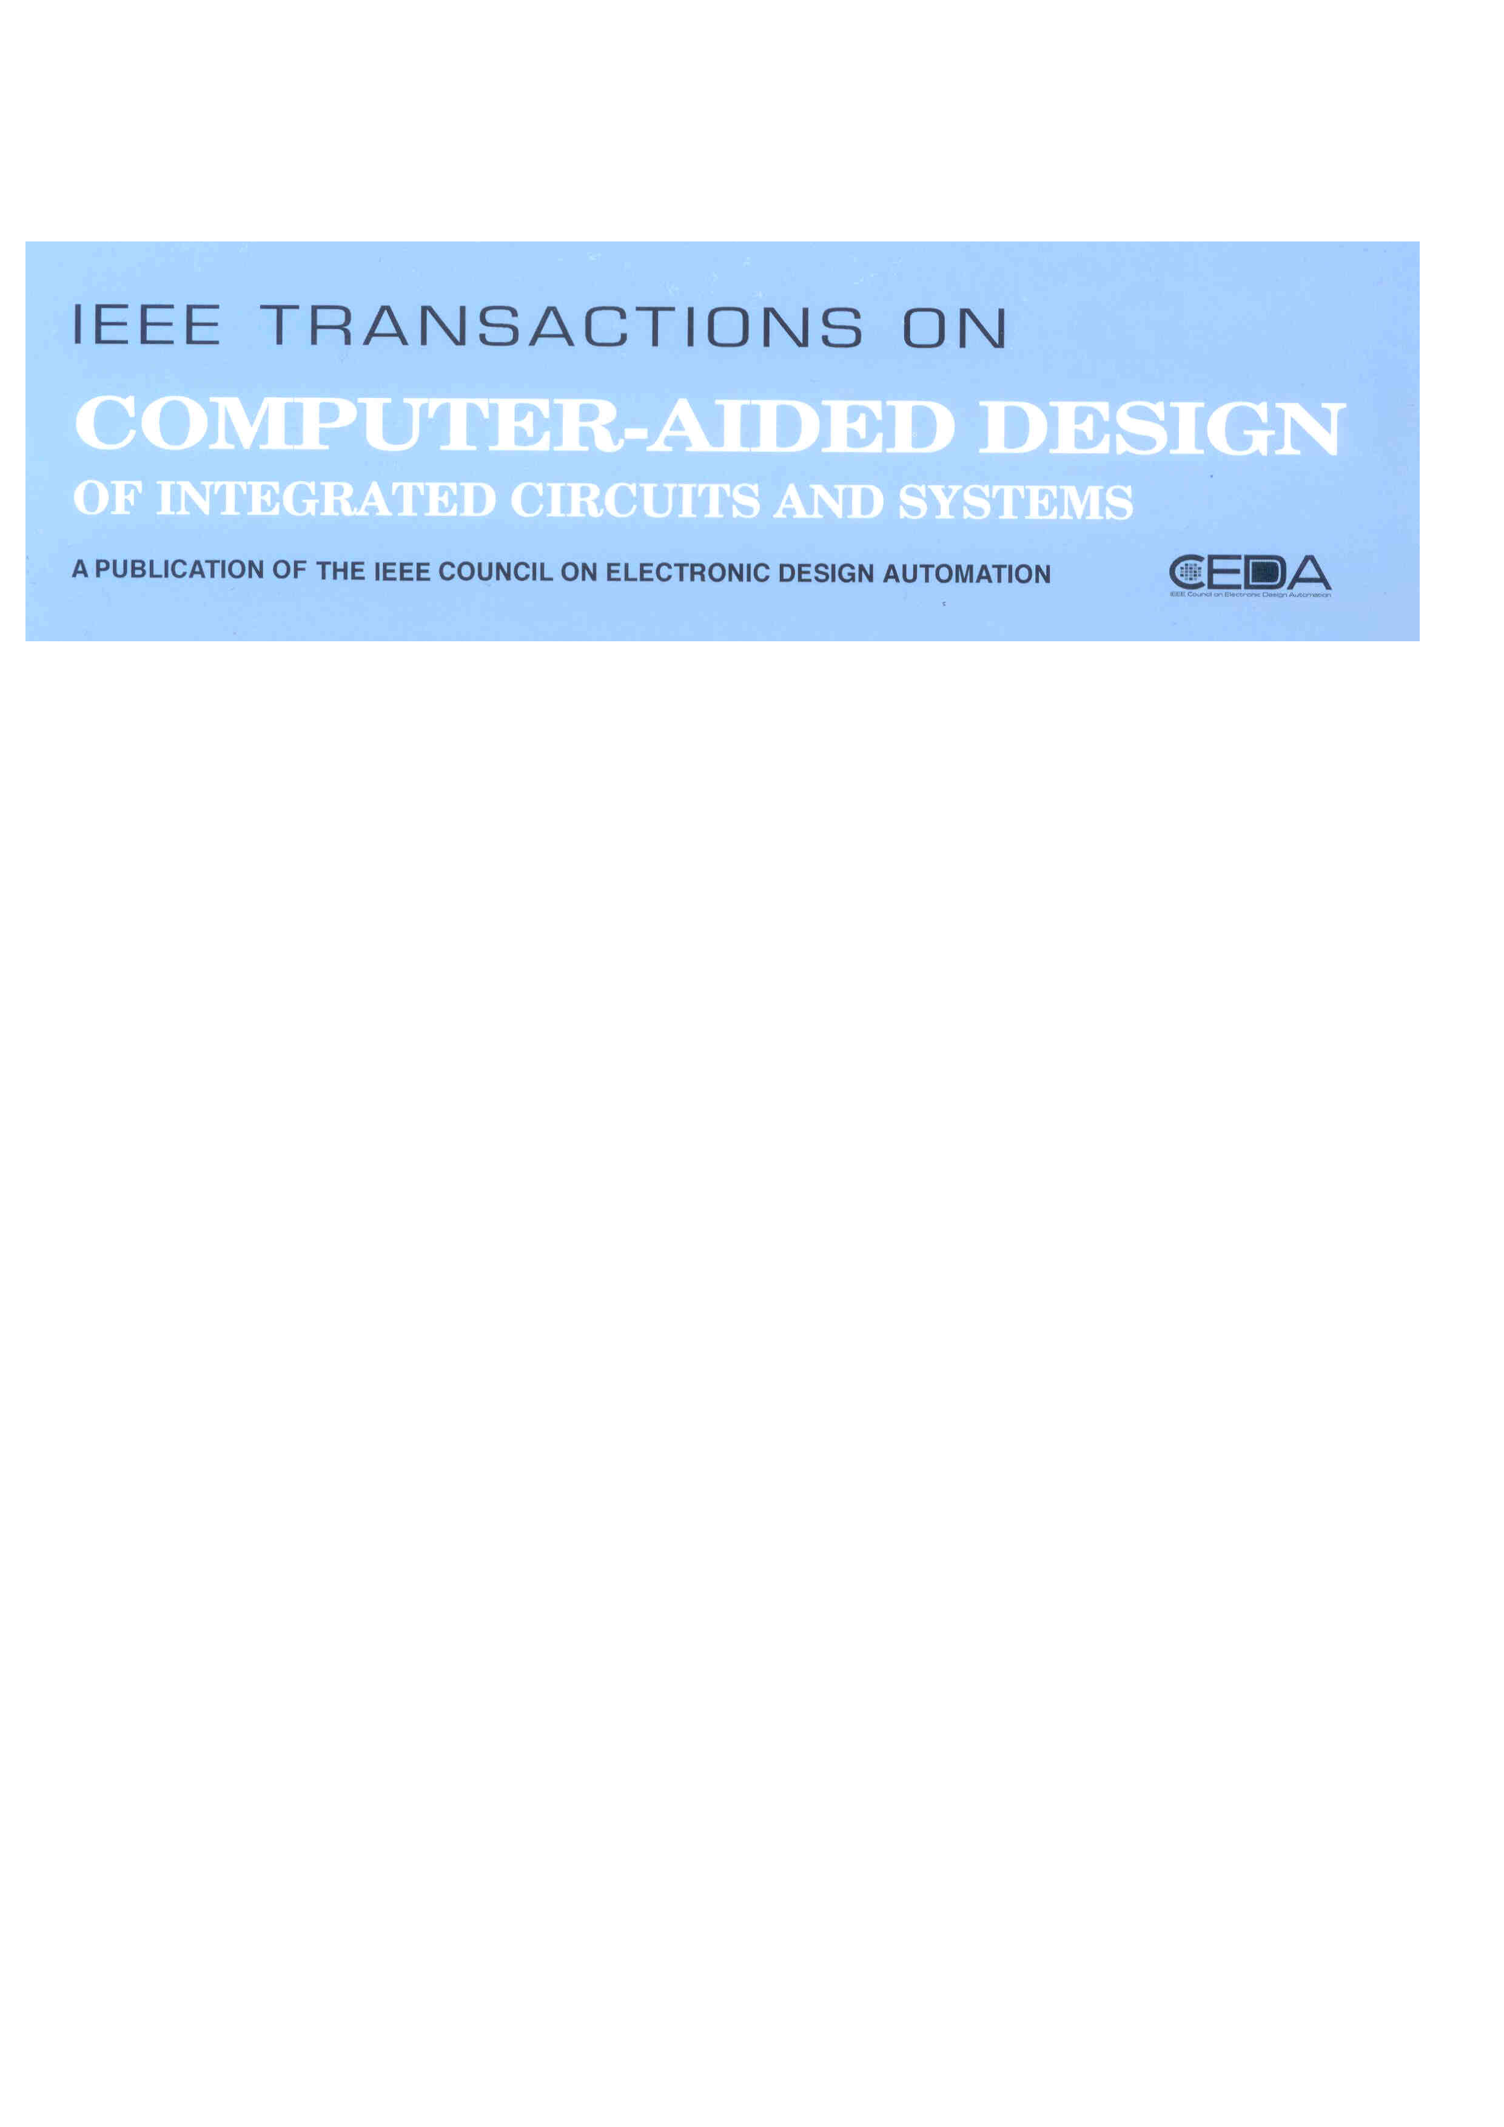
TCAD - Trans. On
Computer-Aided Design
Financial sponsor: CEDA
Finance, size, attention (click counts), submission-to-publication times, publication dates: healthy/stable
New EiC and Editorial Board in place
  Strengthened CPS/IOT/Embedded.
Assessment and discussions started about publishing models:
  Outlet for target Conferences
  Print/online
Editor in Chief:
Rajesh Gupta
University of California San Diego, CA, U.S.A.
rgupta@ucsd.edu
Deputy EiC:
Xin Li
Duke University, NC, U.S.A.
xinli.ece@duke.edu

Slide 13
TCAD & ESWeek
Approved page budget of 3,300 for 2018 including 900 pages for ES Week
  Backlog starting to go down with page increase; Average of 16 regular papers per issue. Page charges remain issue with some authors.
ESWeek issue out (huge issue!)
  66 papers, plus editorial, total of 775 pages (11.75 average)
  Waived extra page charges (lost income close to USD$ 32K but similar conditions TECS)
Signed new MoU to publish ESWeek, 5 year period (ACM & IEEE)
  ACM TECS publishes odd years, no extra page charges (25pp, roughly 12-13 TCAD)
  TECS does not print its ESWeek issue; only online
  IEEE does not currently allow this mixed model: model is fixed for all issues
  Ensure we remain tightly coupled with ESWeek and avoid TECS taking over

Slide 14
TCAD Update
Papers Submitted
  2018: 853: 478 (original), 375 (revised). Max: Emerging tech., Modeling/Sim
    3 KN papers, 3 SI (ESWeek, ISPD, Emb Security)
    732 manuscripts accepted in this period
  2017: 899: 515 (original), 384 (revised). Max: Emerging Tech, Modeling/Sim, Test
    5 KN papers, 3 SI (IOT, Cross-layer Rel, Physical Design)
  2016: 818: 527 (original), 291 (revised). Max: Emerging Tech, Modeling/Sim
    11 KN papers, 4 SI (CPS, IOT, Cross-layer Rel, Physical Design)
Current Acceptance Ratio (prior 12 months): 183/405 or 45.2%.
  Pending manuscripts: 151. Oldest manuscript in the system: 2018-0169 (310 days)
  Acceptance Rate: 36%-49%, IF: 1.94 [TODAES: 0.85, TVLSI: 1.7, TCAS-I: 2.4, D&T: 1.4]
Approved page budget:
  2200 (2019). 3,300 (2018 including 900 pages for ES Week)
  Average of 16 regular papers per issue. Page charges remain issue with some authors.

Slide 15
TCAD Update:
Administrative & Others
TCAD Best Paper Process Refined, Restarted for 2019.
  Currently gathering nominations, analytics for auto-nominated papers.
Special Issues and Keynote papers present challenges
  Lack of uniformity in procedures for Special Issues
    Do we have special issue for a conference or for a topic?
    Some conferences are more important than the others: ISPD, ESweek, ICCAD?
  Keynote Papers limited by solicitation reach -- not broadly solicited.
TCAD administrative assistance is a critical issue
  IEEE workflow will not work for TCAD processes.
For internal discussion (throughout 2019)
  Production cost is high; discuss with IEEE a mixed print/online scheme on a per issue basis, or go online entirely

Slide 16

IEEE TMSCS
Financial Cosponsors Technical Cosponsors
  IEEE Computer Society (75%) IEEE CEDA
  IEEE Nanotechnology Council (20%)
  IEEE Communications Society ( 5%)
Started in 2015, 1st EiC
Initial PRAC in Feb 2018
CS and Nano have withdrawn support.
  Scheduled for closure
There might be opportunities in this area in the future!
Editor in Chief:
Partha Pande
Washington State University, WA, U.S.A.
pande@eecs.wsu.edu
Associate EiC:
Radu Marculescu
Carnegie-Mellong University, PA, U.S.A.
radum@ece.cmu.edu

Slide 17

JxCDC
Explore materials, devices and computation circuits to enable Moore’s law to continue beyong a 10-15year horizon with associated density scaling and improved energy efficiency
Financial sponsors (until 2019):
  Solid-State Circuits Society (66.25%) Magnetics Society (11.25%)
  Circuits and Systems Society (11.25%) Nanotechnology Council (11.25%)
Technical co-sponsors:
  CEDA, Council on Superconductivity, CS Society, Electron Devices Society
Open Access: authors pay USD$1350 per article, freely available
EiC: Ian Young (Intel)
CEDA rep@SC: Krishnendu Chakrabarty

Slide 18
JxCDC
First issue: Dec. 2015. 12 papers
  1 issues in 2016 and 2017 (7+12 papers), 2 issues in 2018 (12 papers)
Planned 3 issues in 2019, 24-30 articles
  Regular papers and 3 special issues
32 days average decisions time from submission;
  then available on IEEEXplore
53% acceptance ratio
Added co-EiC – Prof. Aazd Naeemi, Georgia Tech
Striving to get an Impact Factor
2017 Year End - JxCDC loss: $7.1K
2018 Year End - JxCDC loss: < $5.0K (est.)

Slide 19
JxCDC
Sponsorship changes:
  CS and Nanotech dropped sponsorship, SSCS assumed difference
CEDA proposed to become a financial sponsor: 11.25%
  SSCS accepted in principle this proposal (vote in JxCDC SC & CEDA BoG)
  Financial risk is small ($5K 2018 / 5 papers; 20-24 would balance)
  Considerable interest in CEDA’s community to cover such topics
  CEDA members already published there; good feedback; quick, well run
Representation/dynamics
  Krishnendu Chakrabarty (SC rep) requested to be replaced
  Yiran Chen, Duke U is willing to take up position
  EiC open to new AE nomination, guest editors

Slide 20

TSUSC
Financial sponsors:
  Computer Society (90%) Communications Society (10%)
Technical co-sponsor: CEDA
Established in early 2016.
Running a healthy queue of regular papers and special issues.
Hybrid access (traditional + open access)
Inaugural EiC: Albert Y. Zomaya, University of Sydney, 2nd term
Targeting index by ISI, Scopus, and other indexing services
  to be completed before the end of the EIC’s second term in 2020

Slide 21
TSUSC
TSUSC has targeted special issues on timely topics related to sustainable computing. These are important for a new journal, since they bring a lot of visibility and free publicity when these calls get circulated by many email groups. This, in turn, makes the journal known to a wider range of potential authors/contributors.
TSUSC publishes online issues twice per year (which is 4 issues/year). Subscribers also receive Colloquium, a digest of abstracts from across the Computer Society’s portfolio of journals. Archival CDs are also delivered to ASPP library subscribers.
Goal: Get TSUSC indexed by ISI, Scopus, and other indexing services since TSUSC is currently only indexed by DBLP (to be completed before the end of the EIC’s second term in 2020).

Slide 22
IEEE Trans. on Flexible and Printed Electronics
Proposed by EDS recently; Open Access journal
  Strong connection to IoT; targets fabrication, testing, characterization, applications materials and processing, modeling and simulation
Letter of intent still under discussion; possibility to merge with another proposed publication
  CAS showed interest in being a financial sponsor
  Sponsorship list still very unclear, scope could change slightly
Area of High potential
  Smaller subset of CEDA “members” working in related areas
  Will required a more directed and concerted effort: need proactive plan!
Would like to consider financial sponsorship around 10-15%
  Low risk, but should consider a timing horizon

Slide 23
Accelerated Open Access Initiative
Influential funding agencies pushing for 100% Open Access
Coalition S is growing, presented Plan S (13 countries in Europe, plus EU)
  Funding agencies will start to enforce open access for publications derived from their funded research
  Demanding compliance by January 1st 2020
  Do not accept hybrid models which have been pushed forth
  Mirror journals are also disallowed
  OA publication fees are capped
TAB Mgt Committee developing recommendations for each S/C
  Not having a 100% Gold OA journal poses a risk
  IEEE Task Force pushing for swift changes
  By 2020 every society/council must have at least one Gold OA outlet

Slide 24
Accelerated Open Access Initiative
Data gathering started in Aug 2018; S/C warned in October, 1s mtg Nov 2018
Webinars with each S/C, presenting options, outlining plan
Between Dec 2018-Feb 2019 each S/C should define a specific approach
Feb 2019 initial decisions
June 2019 start developing new journals, adapting others
IEEE willing to expedite approvals in any scenario
IEEE staff conducted analysis specific to each S/C looking at multiple data
  #OA articles, growth in area, journal IF, scope, OA in field, landscape
  OA funding, #EU authors, hence exposure, sub-to-pub time, backlog

Slide 25
Accelerated Open Access: 5 scenarios for S/C
SC1 – create one topical 100% OA journal for each S/C
  Journal is fully APC-based (author publication fees)
  Need to get its own impact factor (IF), a 3-year process, long
SC2, 3 – mirror versions of each/some subscription journals through IEEE Access
  Inherits Access IF immediately
  Loses visibility, loses time if later goes for SC1
SC4 – Flip existing hybrids to 100% Gold OA
  Compliant, retains IF
  Considerable financial risk unless already at 30%+ OA
SC5 – Wait and See – Option not available initially
  Risk of non-compliance
  Possible only if exposure small

Slide 26
Accelerated OA: CEDA recommendations
Analysis focused on 5 main considerations
  OA article volume Health of full-scope journal
  Financial health of S/C Subscription distribution and financial risk
  Execution risk: sub-to-pub time, backlog
Analysis showed that
  OA article volume is still small
  Journal IF considerable, top in field, consolidated position, risky to change
  Execution tricky, backlog considerable, difficult to reduce sub-to-pub time
  Risk of being overun by competition small (OA in competition equally small)
  Presence in IEEE Access negligible
  Autorship from EU relevant but stable (around 25%-30%)
  Submission rates strong and very stable
  Journals and society in healthy financial situation

Slide 27
Accelerated OA: CEDA recommendations
Recommended Wait and See approach
Enables CEDA to watch if demand for Open Access increases in field
  Also if it becomes relevant in other parts of the globe (e.g. Asia, US)
  All other options still available
There is a risk of losing time or falling behind
  Very important to be aligned with affiliate societies
  One option is to launch new OA publications jointly
  Need to continue to monitor relevant parameters and be open to take action in the near future
Revisit setting in 2019-H2

Slide 28
Strategic Tasks 2019-2020
ESL growth, Impact Factor/Thomson Reuters metrics
TCAD development, embedded and cyberphysical systems topics
  Developping relation with ESWeek
  Further analysis of model
D&T financial turnaround and increased visibility
  Increased focus on embedded software
Readership enhancement
Consider new possibilities in areas of growth
2019 – 2020: Accelerated Open Access Initiative

