Slide 1
IEEE CEDA
Executive Committee &
Annual Board of Governors’ Meetings at DAC 2016
Austin Convention Center, Austin, TX
June 5th, 2016

Slide 2
Strategy Discussion: Status and Development Needs
David Atienza – President Elect
EPFL
david.atienza@epfl.ch
david.atienza@ieee-ceda.com

Slide 3
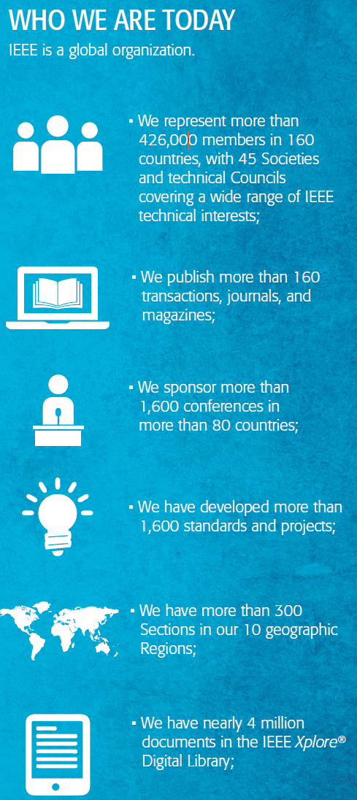
IEEE Strategic Plan (2015-2020): Goals
Enable dynamic, nimble, flexible, diverse, communities to help individuals from around the world to share, collaborate, network, debate, and engage together.
Provide technically vital forums for discussion, development, and dissemination of authoritative knowledge related to traditional technologies, while focusing more of our resources towards professionals working on emerging/disruptive technologies.
Lead humanitarian efforts around the world to use technology to solve the world’s most challenging problems.
Leverage IEEE’s technology-related insight to provide governments, NGOs, and the public with innovative, practical recommendations to address public policy issues.

Slide 4
IEEE Strategic Plan (2015-2020):
Key Initiatives Supporting the Goals
Provide more opportunities, products, and services aimed at increasing our value to professionals working in the industry, particularly younger professionals and entrepreneurs.
Ensure the vitality and relevance of our core activities in standards, conferences, education, and publications while providing increased value to our members.
Develop programs in public service focused on knowledge and technology in our fields of interest related to public policy and humanitarian efforts.
Evaluate and adapt organizational structures and processes to meet the demands of a changing environment while managing the financial and sustainable health of IEEE.

Slide 5
CEDA Impact on Scientific Community:
“Strategy is about predicting a future and charting out a path to it”
Strategy Committee: Donatella Sciuto, Nanni De Micheli, Subhasish Mitra and Sachin Sapatnekar
  Identify key development needs for CEDA, 1-2 key (active) people in Asia?
  Assess CEDA EC proposals
Key focus identified by committee: Expand CEDA community
  Often mentioned as “Efficient group dealing with EDA (part of CS/CASS)”
Key elements to develop in 2016-2019
  CEDA operation: activities for community (conf., pubs., tech. activities, etc.)
  CEDA growth: new areas where its “members” are interested
Notes:
What are the goals that you are driving to (or an ideal state)
What is the current state of affairs
How do you measure progress
What help do you need (no restrictions on what you can ask for)

Slide 6
CEDA – Creating the EDA/Design Automation Opportunity for the future (Shishpal’s term expanded)
Industry evolving and consolidating rapidly. Classical EDA is behind us (at main scientific level).
Consolidate existing efforts for visibility in IEEE
CEDA must enter into multiple (new) domains at system-level to have future. CEDA to enable and provide resources for such initiatives
Institute an operations/measurement philosophy to chart our progress. Resources “to try things” available.

Slide 7
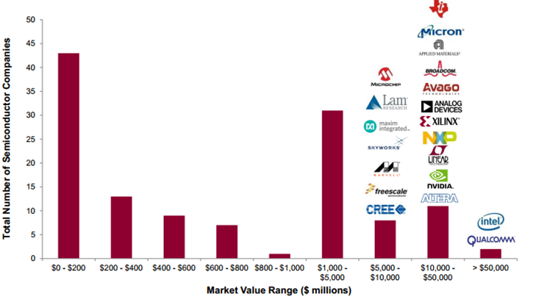
Consolidation Limits Opportunities in “Classical” EDA Industry
Diversity shrinking in semiconductor universe: Number of public companies going down
Technology growth in developing countries: China and Africa, but how do we link to them?
Application growth at system-level: IoT, bio-engineering design, smart power grid, etc., but how do we get to know the best people/IEEE OU in those areas?
[Source: Factset Research Systems]

Slide 8
System Design: Becoming A Necessity
Most successful companies cover stack (Apple, Google, Cisco, HTC, etc.)
  Others going there: Intel, Microsoft, …
Professionals starts requiring more versatile education: HW-SW knowledge, societal challenges, etc.
  Our possible pool of volunteers will have this background, attract them!
  DAC focus seems to need re-evaluated: where are scientists going?
  DATE 2017 topics: IoT, bio-medical systems design, and cloud computing
    CEDA Meeting in Lausanne proposal
    CEDA Luncheon (revamp)
Software
Software
Systems
Architecture/Sys
Firmware
More classical EDA knowledge
Firmware
Microarchitecture
Microarchitecture
On-chip fabrics
Main areas of possible expansion for CEDA
On-chip fabrics
Power delivery
Power delivery
AMS
AMS blocks
Digital
Logic blocks
Cells
Cells
Interconnect
Interconnects
Devices
Devices

Slide 9


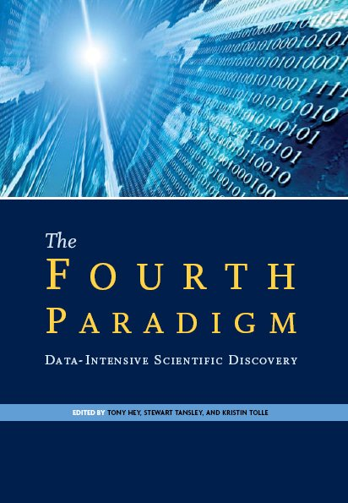
Big Data: Data Collection and Processing Driven by EDA Evolution
4.4ZB
44ZB
2013
2020
[source: Microsoft Research]
[source: Economist]
Data growth in 2015 = 100x in ten years [IDC 2012]
  Population growth = 10% in ten years
Monetizing data for commerce, health, science or services
  Big Data is shaping society… Value in its integration in whatever we do!

Slide 10
CEDA Community: Visibility and Identity
Key issue by not having “real members” to consolidate community
  CEDA Mailing List
  List of interest (affiliates?) from IEEE registrations:
CEDA web visibility, as important as other activities (conf, pubs, etc.)
  Website: central point of operations
    Revitalize website uses/services
  Additional CEDA IT support: Facebook, Twitter, LinkedIn, App, etc.
    Check number of followers, need for (many) active volunteers
  Webinars/online conferences/discussions of new topics covered
    IEEE WF-IoT debate IN 2015: 35K visits in 1 month!
Notes:
What are the goals that you are driving to (or an ideal state)
What is the current state of affairs
How do you measure progress
What help do you need (no restrictions on what you can ask for)

Slide 11
Add Value and Help Community with IEEE CEDA Events
Interface with IEEE Headquarters
  Not clear which fees are charged and why (specially for Conferences, new policy)
  Develop full sponsoring process supervision on CEDA website (1st version of sponsoring submission form ready).
  Revise/shorten manual for conference sponsoring process on CEDA website
Development of Extra Services to help conference/community building.
  Proposed proc. preparation supplier (as ACM SIGDA with Sheridan, but cheaper: iTEK CMS for DATE 2015-2016).
  Negotiate hotel offers (IEEE Conference Unit through IEEE CS support, but significantly cheaper).
  Admin support for joint sponsorship events (as ACM), discussions raised for joint events with CASS.

Slide 12
Make CEDA Visible to Young Researchers and Professionals
Engage students with new events in CEDA-sponsored conferences: DATE and ASP-DAC
  CEDA IoT Students Team Competition at DATE 2017 ($8K as support: prizes and Food-logistics support), try to maximize participation (José in Charge)
  CEDA Luncheon at DATE 2017: IoT or Smart bio-medical devices
  Keep PhD Forum at DATE, develop similar approach for latin-america with TTTC
CEDA in Emerging Areas: Active Local Chapters in Africa, Asia and Latin America
  CEDA officers travel, present brochures, slides @ conference plenaries ($10K-$15K)
  Develop CEDA DLP Fast, but limited number of local chapters to travel today!
  Africa on-going: Morocco, Tunisia and Egypt, difficult due to language issues
  No chapter in Europe! ...CASS/CS “dominate”, grow linked to DATE possible, volunteers?
Notes:
What are the goals that you are driving to (or an ideal state)
What is the current state of affairs
How do you measure progress
What help do you need (no restrictions on what you can ask for)

Slide 13
Strategy Discussion: Technical Activities
Peng Li – VP for Activities
Texas A&M University
pli@tamu.edu p.li@ieee-ceda.com

Slide 14
Future Directions for Activities: Top Goals for 2016
Chapters: 10
  Beijing, Brazil, Central Texas, Hong Kong, India, Japan, Korean, PA, Shanghai, Taiwan
Establishment of new CEDA chapters
  Illinois, Canada/Montreal, Southern California (near future)
  UAE (1-2 years)
  Turkey and Africa (2-3 years)
New CEDA Distinguished Lecturer Program
  In addition to the DL programs of parent societies
  Up to 10 CEDA distinguished lecturers; 2-3 lectures per DL per year

Slide 15
Future Directions for Activities: Top Goals for 2016-2017
Continuous support of young DA professionals
  DAC Young Faculty Workshop
  DAC CEDA Career Perspectives Panel: $8K
    A new event at DAC 2016; possible continuation and restructuring after 2016
Chapter activities
  Continued support with engagement and financial support
  Chapter of the Year Award: one chapter per year: a plaque
  CEDA Local Chapter Best Student of Year Award:
    Presented to one student from each chapter with a certificate
    Recipients give a 5-min presentation at a CEDA student workshop, possibly co-located with the DAC TAC meeting
    $150/award with a certificate; ~$2K in total per year

Slide 16
Future Directions for Activities: Key Strategies
Expansion into new areas where DA may play an important role
  Joint workshops and initiatives
  Cyber-physical systems:
    IEEE SMC/Technical Committee on Cybernetics for Cyber-Physical Systems (CCPS); Qi Zhu/UC Riverside
  Bio Design Automation/IWBDA
    Natasa Miskov- Zivanov/CMU
  RF/Microwave circuit design/modeling/simulation
    IEEE MTT; Roni Khazaka/McGill University

Slide 17
Future Directions for Activities: Key Strategies – Open Questions
Student/Academia/Industry interactions
  How to engage EDA/Design industry to better interact with students and academic research?
  Can we go beyond student internships in EDA companies?
  Can EDA/Design companies offer student research awards?
  Establish an EDA/Design firm sponsored program to support faculty to visit companies and give talks?
    Solicit speakers from local chapters

Slide 18
Strategy Discussion: Conferences
Yao-Wen Chang – VP for Conferences
National Taiwan University
ywchang@ntu.edu.tw

Slide 19
CEDA (Conferences) Strategy/Goals 2016
The Goal Continue to be the preferred organizer and sponsor for high-value conferences in EDA and ES related areas Increase CEDA’s influence and visibility in growing areas related to EDA and ES | Key Strategies Collaborate with other OUs in all main conferences in EDA/ES and make CEDA more influential in related growing areas with CEDA activities/financial support Provide needed help (documentations, financial supports, etc.) to conference organizers Make CEDA a key reference for young researchers and nurse EDA/ES new blood Outreach to other geographical regions/emerging areas Collaborate with IEEE to add values to the community
Top Goals for 2016 Grow in other geographical areas: South America, Asia, etc., add CEDA activities/financial support Grow in key topics (IoT, RC, security, energy, ...) Add on-line resources to increase support and services for conference organizers Help young researchers to “join” CEDA and organize CEDA Events | Dependencies/Key Issues 1. Budget 2. Volunteers recruitment
Yao-Wen Chang

Slide 20
Key Strategies Update (June 2016)
Grow in other geographical areas: Asia, Africa, South America, etc. (joint work with CEDA chapters and distinguished Lecture programs)
Grow in key emerging topics (IoT, rebooting computing, security, energy, etc.)
Add on-line resources to increase support and services for conference organizers
Help young researchers to “join” CEDA and organize CEDA events

Slide 21
Strategy Discussion: Publications
Helmut Graeb – VP for Publications
Technical University of Munich
graeb@tum.de

Slide 22
CEDA Publications Strategy/Goals 2016
The Goal CEDA participates (technically/financially) in or initiates itself new periodical proposals in its topical area of electronic design methodology and automation. Typical for a council, CEDA-related developments and topics arise and mature across IEEE units. Convergence of software and hardware design is an example of such a development. | Key Strategies Grow ESL Maintain TCAD Extend D&T to SSC, CAS and EDA areas Start up TESS Engage excellent people in periodicals´ editorial and steering boards
Top Goals for 2016 Lead the Trans. Embedded Systems and Software Proposal IEEE-internally to successful approval Start off TESS EiC search Continue to turn around D&T Prepare growth of ESL | Dependencies/Key Issues 1. Cooperation with CASS, SSCS, CS 2. New formats/business models not used to in IEEE (ESWeek Example)
Helmut Graeb
3/8/16

Slide 23
Key Strategies Update (June 2016)
Conference integration into periodicals
Switch D&T to color print and add digital screen publishing
Reach out to periodicals subscribers
Achieve TESS phase 2 approval in June

Slide 24


Questions?
Suggestions and other ideas are welcome, too!
Thank You

Slide 25
Distinguished Lecturer Program
Ulf Schlichtmann / TUM
David Pan / UT Austin
Naehyuck Chang / KAIST

Slide 26
Status of Activity
First two DLs on board:
  Giovanni De Michel, EPFL
  Jason Cong, UCLA
Announcements at CEDA DAC Luncheon (Tuesday, June 07)
Detailed “Bylaws” still TBD

Slide 27
Next steps…
Further announcements / publicizing:
  CEDA Newsletter
  Dedicated mailing with easy response form to CEDA members (like CAS)
Set up website for DL requests (or simple mailing form?) to ensure consistent information from requesters
Recruit further DLs
  2 more in 2016 (target: propose to CEDA EC for announcement at ICCAD)
  4 more in 2017
  Transition to nomination system then in 2018
Learn from experience (e.g. how much lead to time to require etc.)

