Slide 1
Strategy Committee
President-elect, Yao-Wen Chang
Committee:
Giovanni De Micheli
Sani R. Nassif
Shishpal S. Rawat
Sachin Sapatnekar
Donatella Sciuto

Slide 2
CEDA Vision and Mission
Vision: To be the leading provider of technical information and community services in Design and Automation of Electronic and Embedded Systems
Mission: The purposes of the Council shall be scientific, literary, and educational in character. The Council shall strive to advance the theory, practice, and application of methodologies, tools and technology for the design and development of Electronic and Embedded Systems. The Council shall promote cooperation and exchange of technical information among its members in workshops, conferences, contests and publications.

Slide 3
CEDA Strategy Aligned with IEEE Strategy (2015-2020)
Provide more opportunities, products, and services aimed, particularly, young professionals and entrepreneurs
Ensure the vitality and relevance of our core activities in standards, conferences, education, and publications
Adapt to “post-Moore” world: must broaden our EDA scopes
Develop programs in public service focused on knowledge and technology promotion for emerging areas and humanitarian efforts
Handle organizational structures & processes to meet the demands of a changing environment while managing the financial health of IEEE
Changes in CEDA EC and BoG structure and operation
Promote author education for academic ethics/integrity enhancement
Also for conference PC members
Notes:
Sani: On page 3, second bullet, on EDA’s focus. I think we can say that EDA is still EDA, but that the industry is in a different “post-moore” phase where technology priorities and design methods have changed. So the funding model (at least in the US) is now quite different from how it used to be. This is causing EDA people to broaden their scopes and apply their training in adjacent areas. So EDA is still EDA, but EDA’s people are broadening their focus?

Slide 4
CEDA Strategy Goals for 2018-2019
CEDA must enter into new domains to have future & provide enough resources for such initiatives, three selected fields
Cyber-Physical Systems (CPS), IoT, and security: Join forces with CPS week in 2018, consolidate IoT in major CEDA events (DAC, DATE, ESWEEK)
Nano-technologies and devices: Develop design tools & methodologies (e.g., aligned with EU FET Flagship projects in graphene, quantum computing, and nano-systems)
Machine learning based optimization: Need to justify our values in this area to show our contributions (e.g., hardware acceleration/security, etc.); EDA for AI & AI for EDA
Enhance CEDA visibility
Keep CEDA industrial link development (e.g., Cadence Global Collaboration Framework)
Create new chapters/activities to foster visibility with scientific community
Cooperate with CEDA founding societies (e.g., young professionals and outreach programs)
Keep growth of CEDA “community” and measure progress and success
Make CEDA conferences financially stable
ESDA is getting absorbed by SEMI, uncertainty for DAC exhibits
Notes:
aligned with EU FET Flagship projects, 1B Euro in graphene, quantum computing, and nano-systems
Consolidate growth of CEDA “community” and measure progress and success
Make committees more active than now: VPs define position with an objective/topic to focus on; define goals within first 3 months, evaluation of performance each year

Slide 5
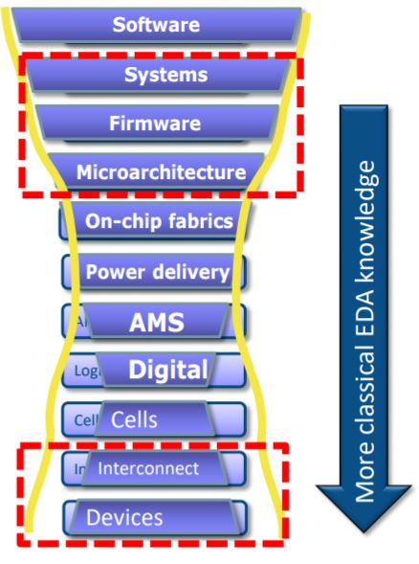
Old/New Fields for CEDA – Growth and Visibility
DAC focus needs re-evaluation: even less submissions than usual (only growth in machine learning, embedded system, security)
Advanced verification, advanced device modeling, EM, Platform EMI, packaging, 3D IC's, and smart manufacturing
Other new fields and events
South America: SBCCI (25-30% financial in 2018) & LASCAS
China: EDA Symposium, etc.
ICRC: Rebooting computing
WF-IoT: CEDA growth?
ATS & ITC-Asia: testing conferences in general
NVMSA: Emerging memory design (with RTCAS: Real-time system)
New
areas
for expansion
Work with parent societies for these expansions
New
areas
for expansion

Slide 6
Development of CEDA’s Visibility
Keep growing with new CEDA chapters: Africa, South America, Asia, and Europe
Africa: Morocco and Tunisia already incorporated (Egypt, no follow up, somewhere else?)
Expand in South America (beyond Brazil) and Asia
Europe: New one in Spain, target in France, Germany, Switzerland, and Italy
CEDA Distinguished Lecturer Program (DLP) and Luncheon Keynotes
Clear increase of visibility for CEDA, move program up: 6 new CEDA distinguished lecturers this year; suitable # for the future?
Consolidate CEDA luncheon keynotes “branding” in major events and invited sessions in key events (EDA/ML at ISCAS 2018, and new TA group in CASS about “new EDA”)
Development of student activities and promotion in social media
CEDA is present in Ph.D. forums of ASP-DAC, DAC, and DATE
Student competitions: CAD Contest at ICCAD, IoT Competition at DATE, DAC?
Summer schools: Physical design summer schools in Brazil/Taiwan
Member/affiliate promotion support
Senior/Fellow/Life membership, program committee, journal editorial board

Slide 7
New Models for CEDA Publications
Conference integration into periodicals is becoming a reality
Done for ESWEEK 2017, outcome positive (suggestions to improve??)
If/Which conferences to suggest this model (ICCAD, others)?
Recognition issues: DAC EC keeps pushing for “the best of..” journals
“Best of DAC”: Discussions with IEEE TCAD and ACM TECS journals
“Best of EDA”: Re-focused papers from EDA conferences for magazines (D&T, etc.)
“Best/Most influential papers”: Evaluation of highest impact after 5-10 years
Fields where CEDA publications can be proposed: Nano-technologies and CPS
TESS rejected (refocus on CPS)
Need to collaborate with related societies/councils to resolve area overlapping problems

Slide 8
Existing Academic Ethics/Integrity Issues
Existing issues with conference PC members
Clusters of PC members helped each other to get their papers accepted
PC members promoted their friends’ papers even with self-review comments from the authors
Existing issues with authors
Typically “good,” but incorrect results to mislead the reviewers; even data fabrication
Potential solutions??
Work with the IEEE, SIGDA, and conference organizers to handle these problems
Diversify the subcommittee organization (geographic, demographic, etc.)
Provide author & PC member education talks with real integrity-violating cases
Request program/subcommittee chairs to watch for these issues
Assign PC members to check suspicious results before acceptance (overheads?)
Ask authors of accepted papers to release their binary codes or data (IP rights??)
Create some platform like PubPeer
Request authors to upload code and sample data to cloud for peer review
Penalty: Inform superintendents of the authors for their unethical behavior

