Slide 1
IEEE CEDA Technical Committee on Cyber-Physical Systems: Activities in 2018
For IEEE CEDA Meeting on March 25, 2019
Professor Shiyan Hu, TCCPS Chair

Slide 2
TC Membership Growth
The membership page is at http://www.ieee-cps.org/member.html
In 2017, there were only 40+ members.
We now have more than 60+ members-at-large (from all of the world such as US, Canada, UK, Switzerland, Germany, Italy, Sweden, Denmark, France, Belgium, Turkey, Australia, China, Japan, etc), and the number of total members (see http://www.ieee-cps.org/list.html) reaches 120+. We are 3X bigger now.
30+ IEEE Fellows
About 15 current or former Editors-in-Chief of IEEE/ACM Transactions in different fields
Our members span different societies and councils within IEEE such as CEDA, Systems Council, Computer Society, Industrial Electronics Society, Power and Engineering Society, SMC, Control Systems Society, etc.

Slide 3
Journal/Conference Activities in 2018
Organized special Issue on Design Automation for Cyber-Physical Systems in Proceedings of the IEEE, published in September 2018, where all of the four guest editors Alberto Sangiovanni-Vincentelli, Shiyan Hu, Xin Li, and Qi Zhu are TC members (or advisory board member).
Organized DAC Workshop on Design Automation for Cyber-Physical Systems (DACPS), 2018, chaired by Qi Zhu. DACPS workshop was founded by the TC since 2016 and 2019 DACPS chair is Mohammad Al Faruque.
IEEE ICESS 2019 (technical co-sponsor) will be collocated with DAC 2019 and chaired by Qi Zhu, our TC conference chair.
IEEE AsianHost 2018, technical co-sponsor.
IEEE NVMSA 2018, financial co-sponsor.
IEEE RTCSA 2018, technical co-sponsor.
3

Slide 4
Outreach
General impact: the TC is becoming very popular in the broader CPS academic community. The visit to our TCCPS website since 2017 reaches 35,458 (as of March 17, 2019). The counter is shown in the main page of the TC at http://www.ieee-cps.org/index.html, maintained by Bei Yu, our web chair and newsletter editor.
For outreach to CPS-IoT Week, the TC conference chair Qi Zhu is the program chair for First Workshop on Design Automation for CPS and IoT (DESTION) 2019 at CPS-IoT Week. The general chairs are Alberto Sangiovanni-Vincentelli and Janos Sztipanovits, and a few TC members are in the TPC including Xin Li, Rolf Dresler, Shiyan Hu, Miroslav Pajic, etc. As of March 15, DESTION has the second most registrations among the 13 workshops in CPS-IoT Week 2019. In the future, DESTION will be in CPS-IoT Week while DACPS workshop will be in DAC. The details of how we can grow these two “sister workshops” are under discussion.
We are strengthening the collaboration with IET where Shiyan Hu is Editor-in-Chief of IET CPS: Theory & Application and a number of TC members are AEs. We are thinking of the possibility to establish IEEE/IET joint conferences.
We are strengthening the collaboration with ACM Transactions on CPS. Its Editor-in-Chief is Kei-Wei Kuo, who is one of the five executive committee members of our TC.
We are establishing the close collaboration with IEEE IES Technical Committee on Industrial Cyber-Physical Systems chaired by Prof. Armando Walter Colombo (our TC member-at-large), esp. in their initiatives of Cyber-Physical-Systems-of-Systems.

Slide 5
Awards
Several CPS related awards have been established by since 2017. These include Technical Achievement Award, Distinguished Leadership Award, Middle Career Award, Early Career Award, Most Influential Paper Award, and Industrial Excellence Award. Experts who received the distinctive recognition (in various categories) include Alberto Sangiovanni-Vincentelli, Tei-Wei Kuo, David Atienza, Alex Bayen, Qi Zhu, Mohammad Al Faruque, etc.
TCCPS Award Chairs:
2019: Prof. Xin Li
2018: Prof. Jamal Deen (President of Royal Society of Canada, Academy of Science for 2015-2017, he is a TCCPS advisory board member)
2017: Prof. Xin Li
Professor Edward Lee has been nominated for the 2019 Technical Achievement Award and he has agreed to attend DAC 2019 to receive the award if elected.
5

Slide 6
Task Force
Through our collaboration with IEEE power and engineering society (PES), we have established a task force (i.e., a working group) under the umbrella of TCCPS, called Smart Distribution and Utility Task Force. See http://www.ieee-cps.org/task-force-sdu.html. This group of people have already published a white paper titled “The Active Control Theory of Safe Operation for Self-healing Power Distribution Networks” and they plan to actively perform more activities (e.g., organizing task force level workshops) in 2019.
We are discussing with a couple of groups of experts to establish more task forces.

Slide 7
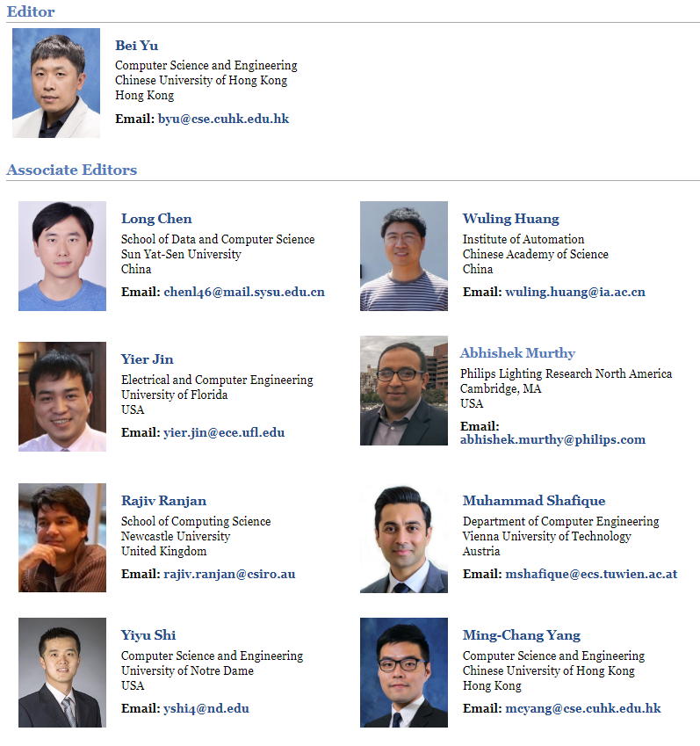
CPS Newsletter
http://www.ieee-cps.org/letter.html. The newsletter is published twice a year since 2016. The former Editors-in-Chief are Xin Li and Helen Li. Its new Editor-in-Chief is Bei Yu.
7

Slide 8
Thanks

