Slide 1
IEEE CEDA Executive Committee & Annual Board of Governors’ Meetings at DAC 2018
Moscone Center West, San Francisco, CA June 5th, 2016

Slide 2
Conferences
Luca Fanucci, University of Pisa
Committee Members
Ayse Coskun (DAC rep)
Donatella Sciuto (DATE rep)
Gi-Joon Nam (ICCAD rep)
Masanori Hashimoto(ASP-DAC rep)
Yao-Wen Chang (past VP)

Slide 3
Status of Conferences
Longlasting CEDA Conferences: DAC, ASP-DAC, ICCAD, DATE, ESWeek
34 additional sponsored conferences: 18 Financial and 17 Technical
Added 4 new conferences in 2016, 3 in 2017 and 4 in 2018 (so far):
7th Non-Volatile Memory Systems and Applications Symposium, Hakodate, Japan, August 28-31, 2018 (Financial 50%)
27th Asian Test Symposium, Hefei, Anhui, China, October 15‐18, 2018 (Financial 50%)
Asian-Host: Asian Hardware Oriented Security and Trust Symposium, Hong Kong, December 2018 (Technical)
23rd Conference on Design of Circuits and Integrated Systems, Lyon, France, 14-16 November 2018 (Technical)

Slide 4
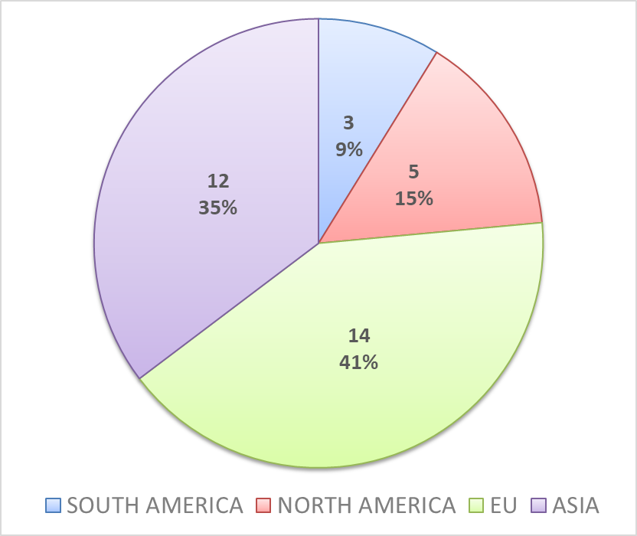
Status of Conferences – Geographical Coverage (2018)
Europe most represented
Few conference in USA
No conference in Africa

Slide 5
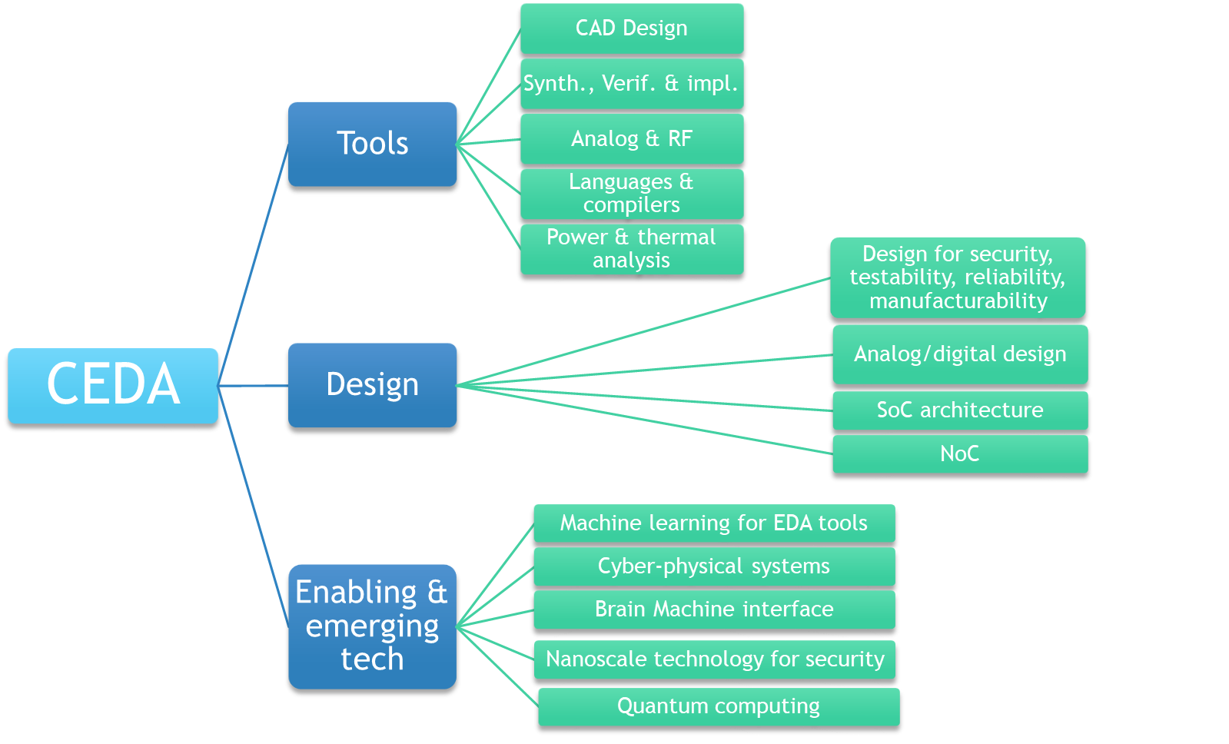
Status of Conferences – Topics Coverage (2018)

Slide 6
Future Directions…
Support Conference with Publicity to promote paper submission especially for the ones with high acceptance rate.
Support Conference with competitive access to IEEE registration tool including full set up, IEEE member check, VAT invoice creation, name badges, wire transfer fees, substitutions, etc
Expand CEDA visibility to other regions (such as Africa and South America) and support their conferences.
Explore new areas of CEDA interest such EDA for Internet of Things (IoT), EDA for bio-electronic systems design, and artificial intelligence for EDA.
Stimulate healthy CEDA technically sponsored conference to apply for CEDA financial sponsorship
Supporting student participation at CEDA sponsored conferences especially the ones from developing countries or those with a verified need by establishing a “CEDA Travel Grant Program” in the same spirit as ACM SIGDA: http://archive.sigda.org/travelgrants.html

