Slide 1
Finance Report
Gi-Joon Nam

Slide 2
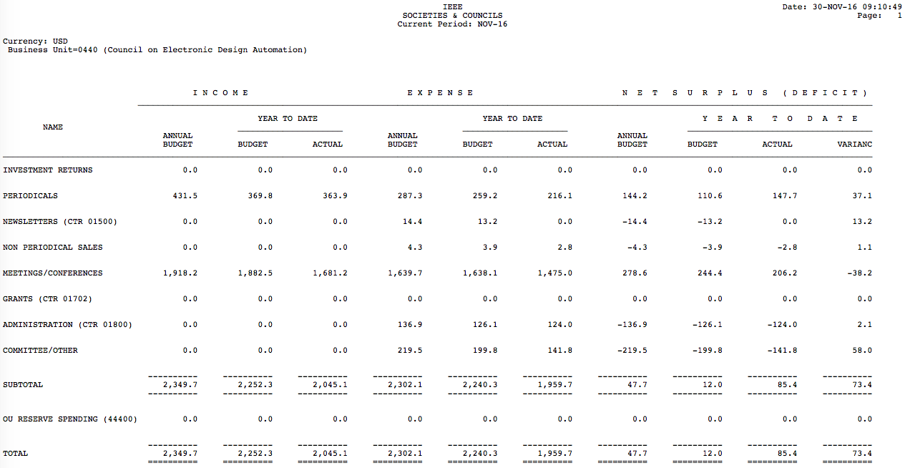
Finances 2016 Nov. update: Forecast Summary

Slide 3
2017 Budget
2017 IEEE S/C BUDGET
FOR THE PERIOD ENDING DECEMBER 31, 2017
BUSINESS UNIT - 0440
SUMMARY BY COST CENTER |  | 2010 | 2011 | 2012 | 2013 | 2014 | 2015 | 2016 | 2017
 |  | ACTUALS | ACTUALS | ACTUALS | ACTUALS | ACTUALS | ACTUALS | BUDGET | BUDGET
00261 TRANS ON COMP. AIDED DSGN |  | 492.3 | 445.9 | 437.9 | 473.8 | 389.6 | 399.4 | 349.4 | 371.5
00970 EMBEDDED SYSTEMS LETTERS |  | 74.4 | 58.6 | 71.8 | 80.9 | 77.1 | 78.1 | 82.1 | 78.3
01499 PERIODICAL RELATED - OTHER |  | 0.0 | 0.0 | 0.0 | 0.0 | 0.0 | 0.0 | 0.0 | 0.0
01500 NEWSLETTER |  | 0.0 | 0.0 | 0.0 | 0.0 | 0.0 | 0.0 | 0.0 | 0.0
01600 NON PERIODICAL |  | 0.0 | 0.0 | 0.0 | 0.0 | 0.0 | 0.0 | 0.0 | 0.0
01700 CONFERENCES |  | 1,587.9 | 1,811.7 | 1,656.6 | 1,720.8 | 1,683.8 | 1,718.1 | 1,904.2 | 1,823.2
01701 CONF RELATED |  | 12.6 | 10.3 | 10.4 | 0.0 | 0.0 | 0.0 | 14.0 | 14.3
01800 ADMINISTRATION |  | 0.0 | 0.0 | 0.0 | 0.0 | 0.0 | 0.0 | 0.0 | 0.0
01900 COMMITTEE & OTHER |  | 0.0 | 0.0 | 0.0 | 0.0 | 0.0 | 0.0 | 0.0 | 0.0
01930 INITIATIVES |  | 0.0 | 0.0 | 0.0 | 0.0 | 0.0 | 0.0 | 0.0 | 0.0
TOTAL INCOME |  | 2,167.2 | 2,326.6 | 2,176.7 | 2,275.5 | 2,150.6 | 2,195.6 | 2,349.7 | 2,287.3
00261 TRANS ON COMP. AIDED DSGN |  | 272.7 | 252.0 | 268.4 | 270.9 | 227.3 | 222.2 | 225.7 | 199.8
00970 EMBEDDED SYSTEMS LETTERS |  | 39.1 | 44.8 | 47.2 | 48.4 | 39.1 | 40.1 | 32.0 | 29.7
01499 PERIODICAL RELATED - OTHER |  | 3.8 | 9.3 | 14.6 | 28.8 | 17.1 | 15.5 | 29.5 | 31.8
01500 NEWSLETTER |  | 0.7 | 0.0 | 0.0 | 0.0 | 1.5 | 0.0 | 14.4 | 0.0
01600 NON PERIODICAL |  | 3.9 | 8.2 | 6.3 | 3.5 | 3.2 | 4.4 | 4.3 | 4.3
01700 CONFERENCES |  | 1,296.1 | 1,555.5 | 1,442.0 | 1,468.9 | 1,461.7 | 1,424.0 | 1,621.0 | 1,476.8
01701 CONF RELATED |  | 3.7 | 6.9 | 40.0 | (4.1) | 10.0 | 3.7 | 18.7 | 18.9
01800 ADMINISTRATION |  | 130.0 | 122.4 | 136.1 | 127.6 | 120.9 | 121.7 | 137.0 | 144.2
01900 COMMITTEE & OTHER |  | 80.8 | 104.6 | 145.6 | 94.4 | 112.0 | 138.9 | 175.5 | 287.2
01930 INITIATIVES |  | 0.0 | 0.0 | 0.0 | 0.0 | 6.0 | 27.1 | 44.0 | 42.9
TOTAL EXPENSE/RMBSVC |  | 1,830.8 | 2,103.7 | 2,100.1 | 2,038.5 | 1,998.9 | 1,997.4 | 2,302.0 | 2,235.5
TOTAL FROM OPERATIONS |  | 336.4 | 222.9 | 76.5 | 237.0 | 151.7 | 198.2 | 47.7 | 51.8
00100 RMBSVC INTEREST INCOME |  | (49.6) | 96.8 | (79.5) | (288.6) | 2.4 | 96.9 | 0.0 | 0.0
TOTAL NET |  | 386.0 | 126.2 | 156.1 | 525.6 | 149.3 | 101.3 | 47.7 | 51.8
Reserve Balance |  |  |  |  | 1,656.2 | 1,805.4 | 1,906.6
3% Spending Rule | 57.2

Slide 4
2016/2017 Finance Comments
Surplus of $127K from operations as of Sep 2016
All CEDA sponsored conferences including DAC, DATE, ICCAD ended with surplus
Conservative expense controls
By “50% Spending Rule”, $112.7K was available in 2016
The Reserves exiting 2015 is $1.913M
Similar amount (or slightly more) is expected by the end of 2016
$100K
2011
2012
2013
2014
2015

Slide 5
2016/2017 Finance Comments (cont.)
2016 Initiatives projects summary
CEDA local chapter funding: $20K
DATC activity for “OpenDesign Flow”: $10K
Next generation EDA workshop : $20K
SVDTC activity : $5K
CEDA/EDA promotional video production: $10K
CEDA website upgrade: $25K
Initiatives: total budget $42.9K in 2017
DATC “OpenDesign Flow” project: $6K
Distinguished lecturer program: $15K
Geographical outreach program (for Africa, Asia, Latin America) : $15K
Diversity in EDA: $6.9K
Local chapter support is absorbed into regular budget: $64K ($13K in 2016)
Regular “distinguished lecturer” budget : $32K ($22.7K in 2016)

Slide 6
2016/2017 Finance Comments (cont.)
Periodicals
TCAD (Sole financial sponsor)
Embedded Systems Letters (Sole financial sponsor)
Design & Test Magazine (Financial co-sponsor)
Net:
Net:
Income:
Expense:
Net:

Slide 7
Initiative funds
Each IEEE OU can spend money on key new initiatives
One-time spend, not for regular expenses or head-count
“50% rule”
Can spend 50% of previous operating year’s surplus [minus investment gains]
$112.7K is allocated in 2016
“3% rule”
Can spend up to 3% of reserves of past year
2016 reserves at $1.91M ➔ up to ~$57.2K is available in 2017
Looking for creative ideas to fund in 2017

Slide 8
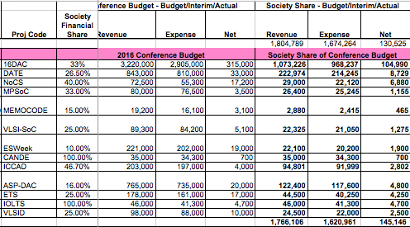
2016/2017 Finance Comments (cont.)
Meetings/conferences
Surplus of ~$145K from 2016 conferences
DAC 2016 has the biggest surplus of ~$100K as usual
2016 Surplus: ICCAD ($2.8K), ASP-DAC ($4.8K), DATE ($8.7K)
Some CEDA sponsored conferences not reflected in CEDA finance spreadsheet

Slide 9
2016/2017 Finance Comments (cont.)
Technical Activities
Quite significant improvement in CEDA local chapter activities in 2017
5 active chapters (Central Texas, Japan, Taiwan, China-Beijing, China-Shanghai)
4 stable chapters (Korea, PA, India, HongKong)
New or less active chapters (Illinois, Canada, Brazil, Morocco)
Education activity supports in 2017
ICCAD CAD contest
PhD forum events at DATE / ASP-DAC / LATS
IEEE CEDA IoT Competition at DATE 2017
Career Perspective Panel @ DAC
Professional Development workshop @ DAC
Distinguished lecture series and luncheon keynote presentations

Slide 10
CEDA Finance Strategy/Goals in 2017
The Goal
Continue to keep the healthy balance spreadsheet with marginal net surplus
Fund long term initiatives with high dividends
Key Strategies
Provide needed help to activity organizers (technical, conference, initiatives etc.)
Top Goals in 2017
Tracking all CEDA sponsored conferences
Fostering local chapter activities
Continue to support D&T
Dependencies / Key Issues
Creative ideas for ”Initiative” projects

