Slide 1
CEDA Standards Committee
Dennis Brophy
1 November 2020

Slide 2
Agenda
Industry Affiliate Network
Connection with global industry
IEEE Open Source
Connection with CEDA Chapters
CEDA Standards Sponsor Committee
Official sanctioning to support standards connection

Slide 3
Industry Affiliate Network (IAN)
The Industry Affiliate Network (IAN) is a broad-based growth platform formed and constituted by the IEEE Standards Association’s Corporate Advisory Group (CAG)
Instantiated over the last 2+ years
IAN provides an open and strategic framework for IEEE SA to identify and actively engage consortia, and industry communities
Significant membership growth opportunities, expanding beyond traditional industry participation
Increased SA revenue opportunity
Potential ISTO collaboration alignment
IAN provides strategic value to both IEEE SA and partner industry communities
Foster strategic activities with industry communities and consortia to achieve greater impact on Standards Deployment Ecosystem
Adopt existing market-relevant specifications from industry communities & consortia
Enable the creation and release of new market-relevant standards
Global market visibility through SA distribution of dual branded industry standards
Potential New market-driven technologies not historically part of IEEE Portfolio

Slide 4
Industry Affiliate Network (IAN), cont.
Sample List of Industry Affiliates

Slide 5
Industry Affiliate Network (IAN), cont.
Case Study: Accellera Systems Initiative
Accellera Systems Initiative is a not-for-profit organization dedicated to create, support, promote and advance system-level design, modeling and verification standards for use by the worldwide electronics industry.
Accellera Systems Initiative was born from VHDL (IEEE 1076) and Verilog (IEEE 1364) standardization, adoption and promotion efforts.
More than 20 specifications sent to IEEE SA for standardization and ongoing maintenance.
Cited reasons for working with IEEE-SA
IEEE SA brings Accellera standards worldwide recognition & reach
IEEE SA recognized globally as a leading standards-development organization for a broad range of technical areas
IEEE SA’s standards development process is rigorous, open, fair, peer-reviewed and comprehensive
Standards are robust, and resultant stability and longevity of a standard encourages rapid, widespread adoption
IEEE SA Dual-Logo Relationship with IEC promotes further trusted global adoption
IEEE SA standards based on Accellera documents are broadly acceptable to a global audience
SystemVerilog | IEEE Std. 1800™ Example
2005: Migrated Verilog (IEEE Std. 1364™) to SystemVerilog
2007: SystemVerilog market adoption from 6-companies and 9-products to 137-companies and >350 products
2009: SystemVerilog Standard Revised
2011: Dual-Logo approved – IEC 62530

Slide 6
Open Source Committee (OSCom)
Opportunity for connection with Academic Community
Introduce IEEE SA Open to local chapters at virtual meetups
DA use today
VHDL 1076 Packages
VHDL Verification Methodologies
OSVVM
UVVM

Slide 7
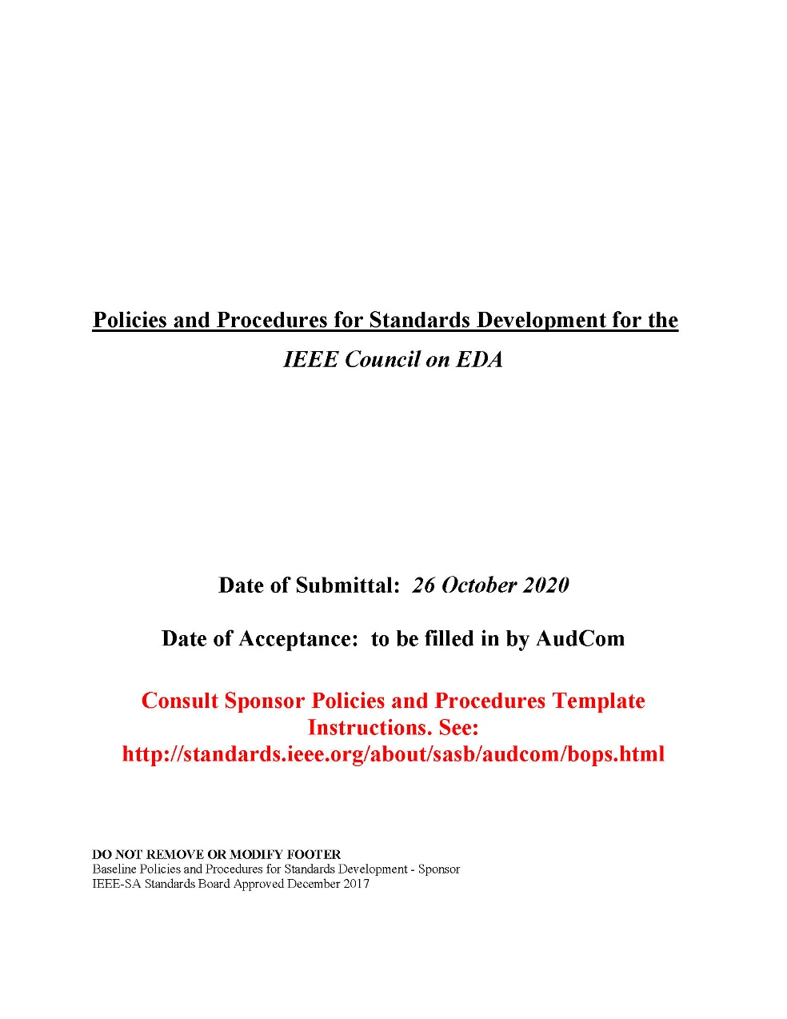
CEDA Standards Committee
Council on EDA approved formation at Dresden meeting
Cannot location minutes with approval
IEEE Council on EDA Standards Committee will require minutes of action to form
Template P&P’s are changing
Dresden meeting indicated months away
Still not updated
Won’t change until 2021 or early 2022

Slide 8
Motion
Approve creation of IEEE Council on EDA Standards Committee using IEEE SA Baseline Policies and Procedures for Standards Development – Standards Committee*
Pros:
Establish a group for multi-Society standards development
Build standards awareness in academic community via local CEDA chapters by leveraging IEEE SA Open
Do what other’s are not yet doing
Cons:
Yet another Standards Sponsor
Financial Implications: None
*2017 Baseline located at: https://standards.ieee.org/content/dam/ieee-standards/standards/web/governance/audcom/baseline_sponsor_2017.doc

Slide 9
END

