Slide 1
Technical Activities
Tsung-Yi Ho
October 31, 2020

Slide 2
Report Overview
Chapters
Technical Committees
Technical Activities

Slide 3
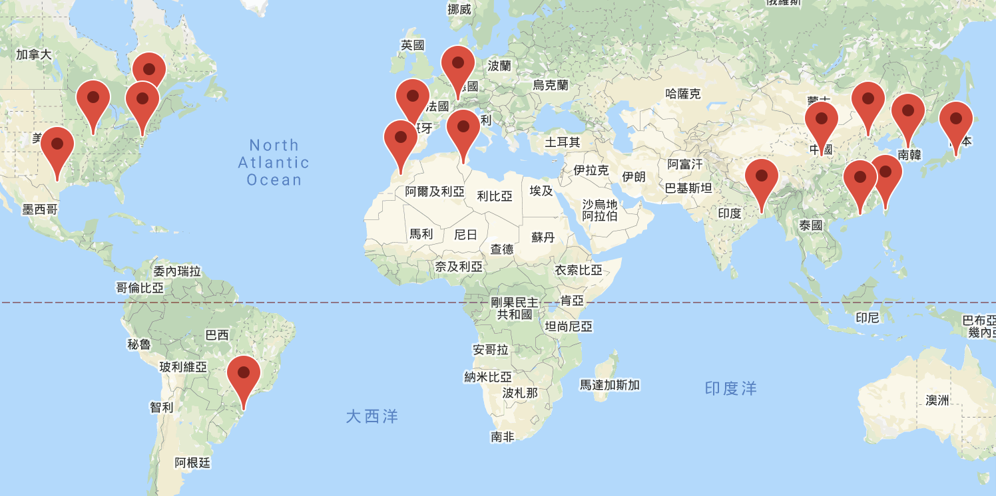
CEDA Chapters
Chengdu
17 Chapters

Slide 4
CEDA Chapter Meeting (July 16)
Chapter Name | Chapter Chair
Beijing | Huazhong Yang
Hong Kong | Wei Zhang
Central Illinois | Deming Chen
South Brazil | José Luís Güntzel
India | Susmita Sur-Kolay
Japan | Kazutoshi Wakabayashi
Montreal | Roni Khazaka
Pennsylvania | Baris Taskin
Shanghai | Xuan Zeng
Taipei | Jie-Hong Roland Jiang
Central Texas | Raju Balasubramanian
Tunisia | Chafaa Hamrouni
Seoul | Kyoungwoo Lee
Spain | Francisco V. Fernandez
Morocco | Mounir Ghogho
Switzerland | Burg Andreas
Chengdu | Letian Huang
Chapter Report
Budget Allocation
  Special event: contest, awards, etc.
  General expense: banner, local travel, souvenir, etc.
  Support 6 Chapters with 10K
CEDA Zoom Account (up to 500 ppl)
Role Rotation
  Chair, Vice Chair, Treasurer/Secretary
  Term of service
Notes:
Brazil 1,5K
Spain 1K
Taipei 4K
HK 1.95K
Japan 1K
Beijing 0.5K

Slide 5
CEDA Technical Committees Meeting (Aug. 27)
DATC (Design Automation Technical Committee)
  Chair: Iris Hui-Ru Jiang, National Taiwan University
SVDTC (System Validation and Debug Technology Committee)
  Chair: Chinna Prudvi, Intel Inc.
TCCPS (Technical Committee on Cyber-Physical Systems)
  Chair: Shiyan Hu, University of Southampton
TTTC (Test Technology Technical Council)
  Chair: Yervant Zorian, Synopsys Inc.
Hardware Security and Trust Technical Committee (HSTTC)
  Chair: Gang Qu, University of Maryland
Awards, Tools, Standards, Outreach, etc.

Slide 6
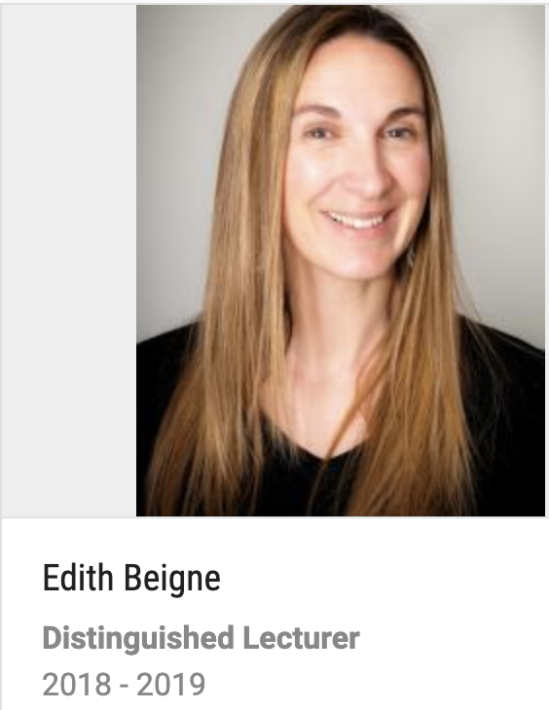
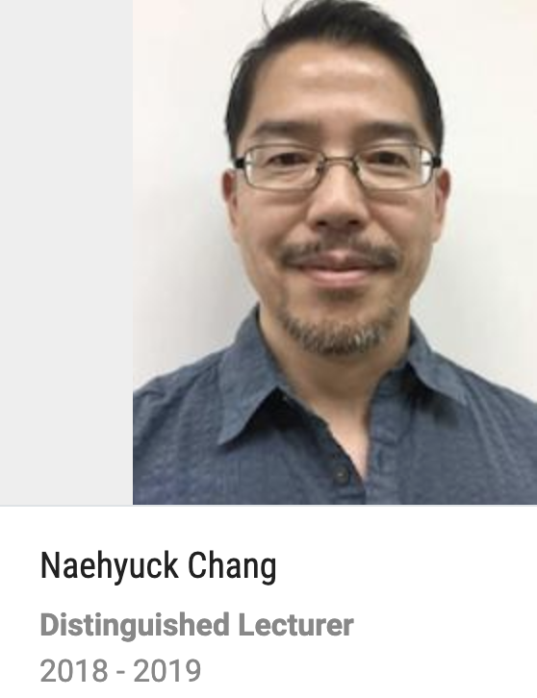
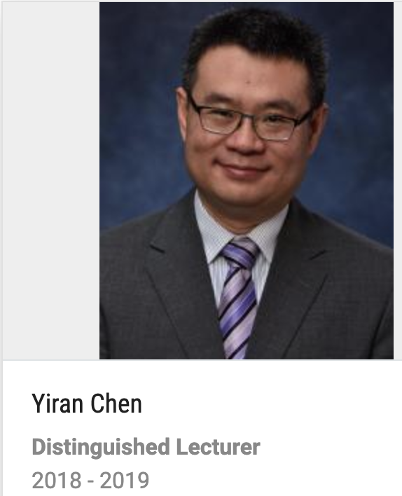
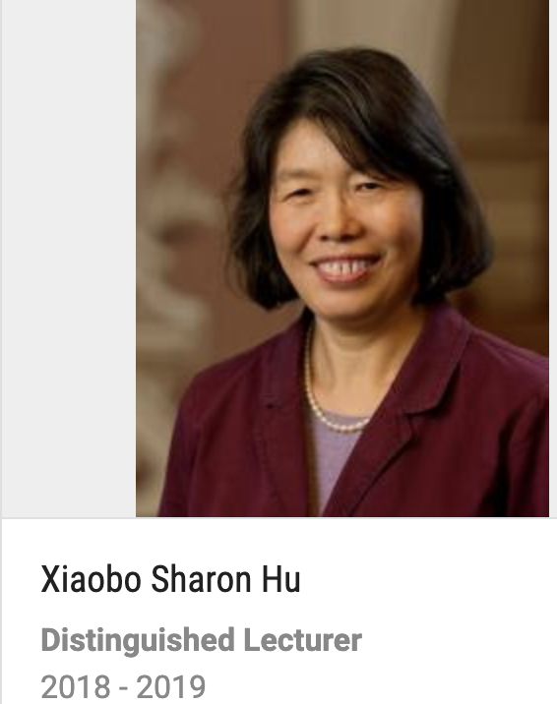
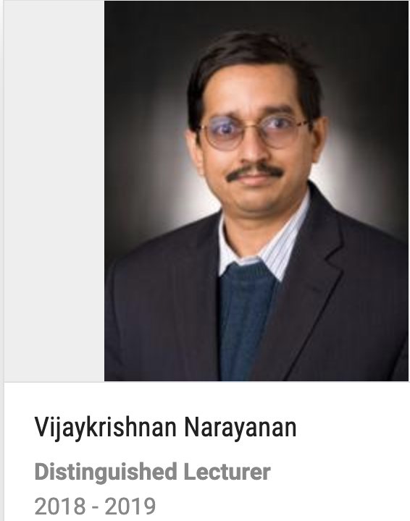
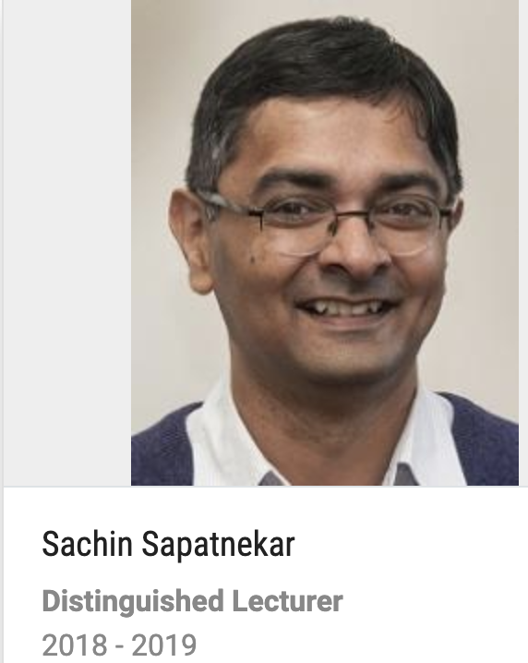
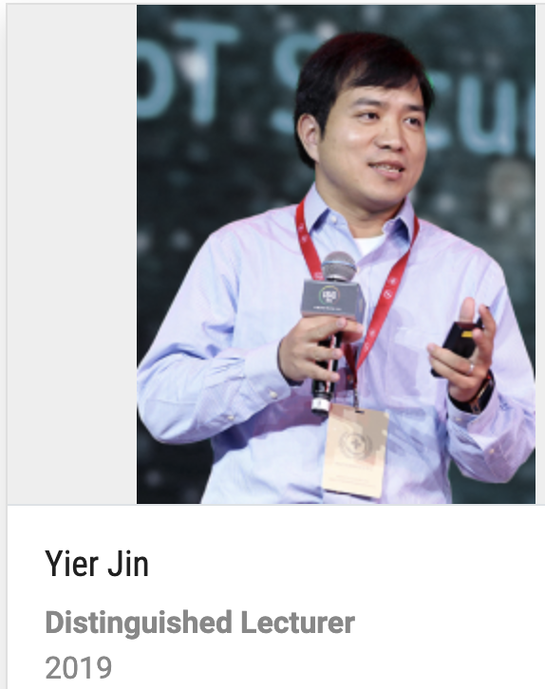
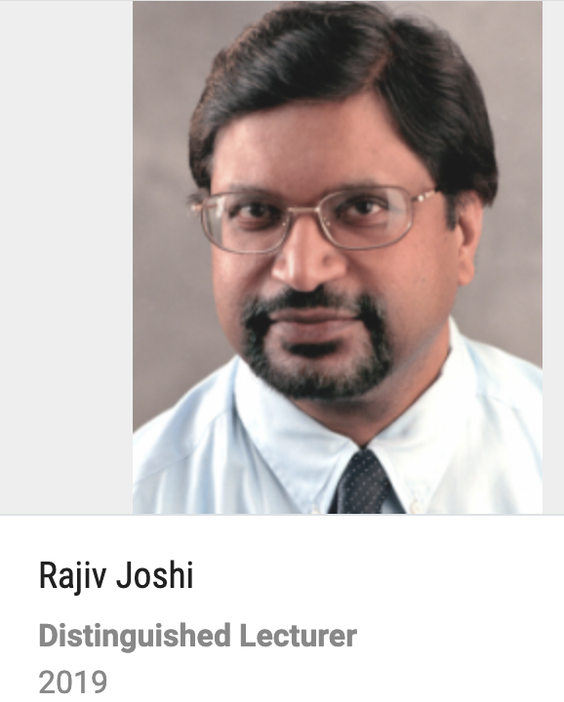
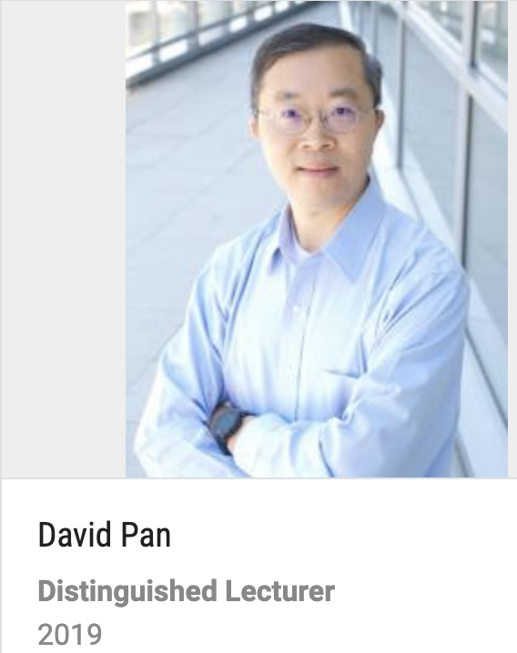
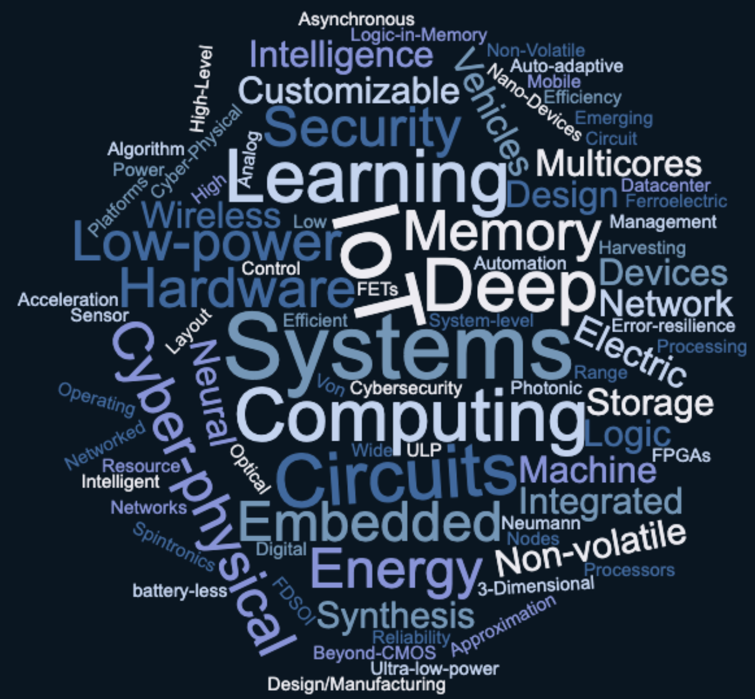
Current CEDA Distinguished Lecturers

Slide 7


Design Automation WebiNar (DAWN)
EVENT 1 (May 7) – 300+
Machine Learning for EDA
Source: Medscape
EVENT 2 (June 23) – 130+
Fireside Chat: Career Development for Scholars in EDA Research
EVENT 3 (August 24) - 120+
Automatic Implementation of Secure Silicon (AISS)
EVENT 4 (September 28) – 140+
Publishing in EDA Transactions, Journals, and Magazines

Slide 8
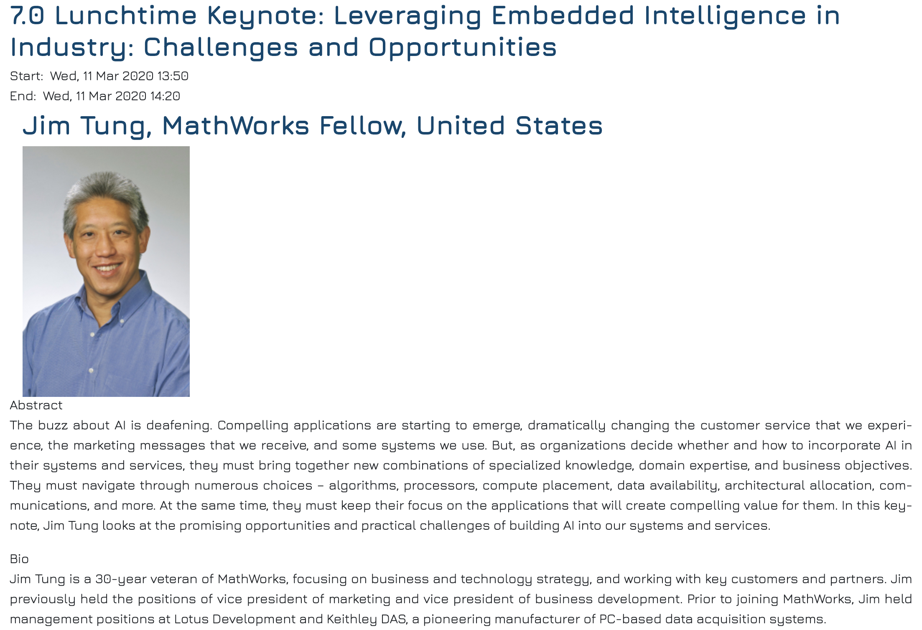
DATE Luncheon Keynote Talk 2020

Slide 9
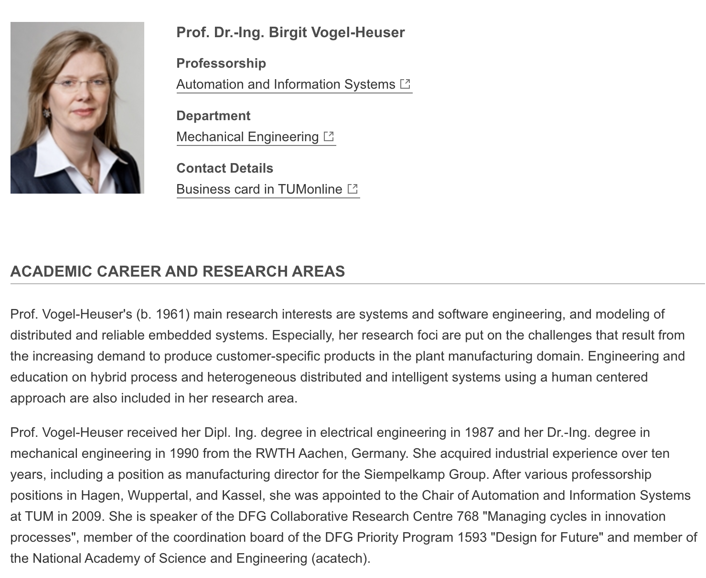

ICCAD Luncheon Keynote Talk 2020
Thanks for the recommendation from Enrico Macii

