Slide 1
Conference
Luca Fanucci
31st October 2020

Slide 2
Current Status & Achievements
5 Long-lasting CEDA Conferences: DAC, ASP-DAC, ICCAD, DATE, ES WEEK
24 additional sponsored conferences: 13 Financial and 11 Technical
To date we added 2 new conferences in 2020:
International Conference on Omni-layer Intelligent systems (COINS), Barcelona, Spain, July 27-29 2020 (Technical)
International Workshop on System-Level Interconnect Problems and Pathfinding (SLIP^2), co-located with ICCAD (Financial 50%)

Slide 3
Challenges
COVID-19
Following the advice of local authorities, most of 2020 IEEE conferences and some in early 2021 have already been postponed or replaced with virtual (hybrid) meetings.

Slide 4
Conf. from 03/20 to 10/20
Postponed
Hybrid
Virtual
NVMSA 2020
WEN, AUG 19, 2020
IEEE NVMSA 2020

Slide 5
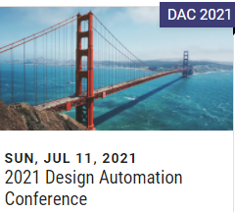
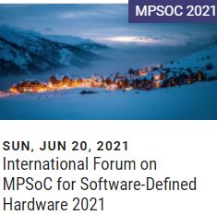
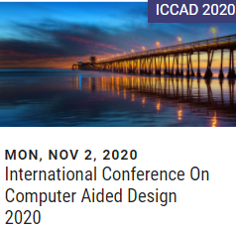
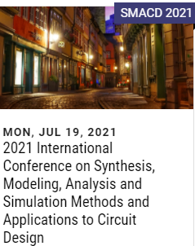
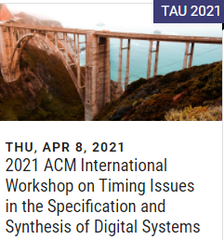
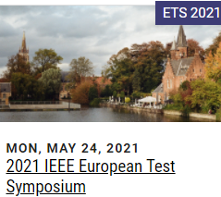
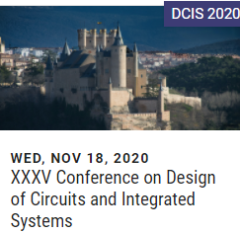
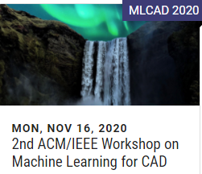
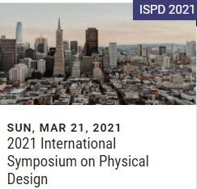
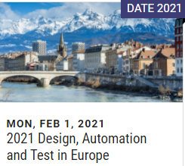
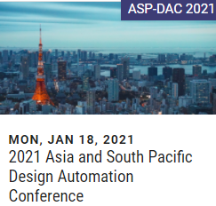
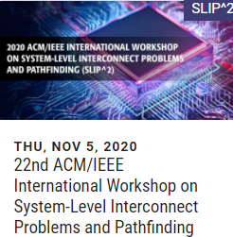
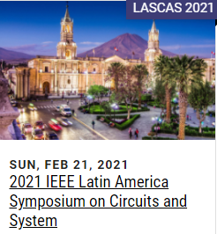
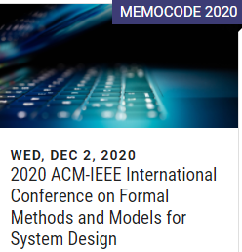
Conf. from 11/20 to 07/21
In presence
Postponed
Virtual

Slide 6
Motion(s)
To Approve Symposium on Integrated Circuits and Systems Design (SBCCI) Request for CEDA’s 5% Financial Sponsorship
Venue & Dates: Hotel Premium, Campinas – SP, Brazil, 5, August 23 to 27, 2021
Web site: sbcci.org.br
General Chair: Jacobus Swart, State University of Campinas, Campinas, Brazil
Background: SBCCI is an international forum dedicated to integrated circuits and systems design, test and electronic design automation (EDA), held annually in Brazil, in the last week of August. The scope of the symposium includes technical sessions, tutorials and panels, and working group meetings as well. .
Notes from the Conferences Committee:
The symposium topic is strongly relevant to CEDA community.
CEDA has been technical co-sponsor of this symposium since several years.
CEDA has been contributing to SBCCI technical program every year with keynote talks
Symposium is financially healthy and 5% is a very low financial risk. Shared 20% with IEEE CASS, 25% with ACM-SIGDA, 25% Brazilian Computer Society and 25% Brazilian Microelectronics Society.
The annual meeting of the CEDA Brazilian chapter is co-located with SBCCI
Additional Documents sent via email
Call for Paper
CEDA Sponsorship Request Form

