Slide 1
Finance
VP: Cristiana Bolchini
VP Assistant: Marina Zapater

Slide 2
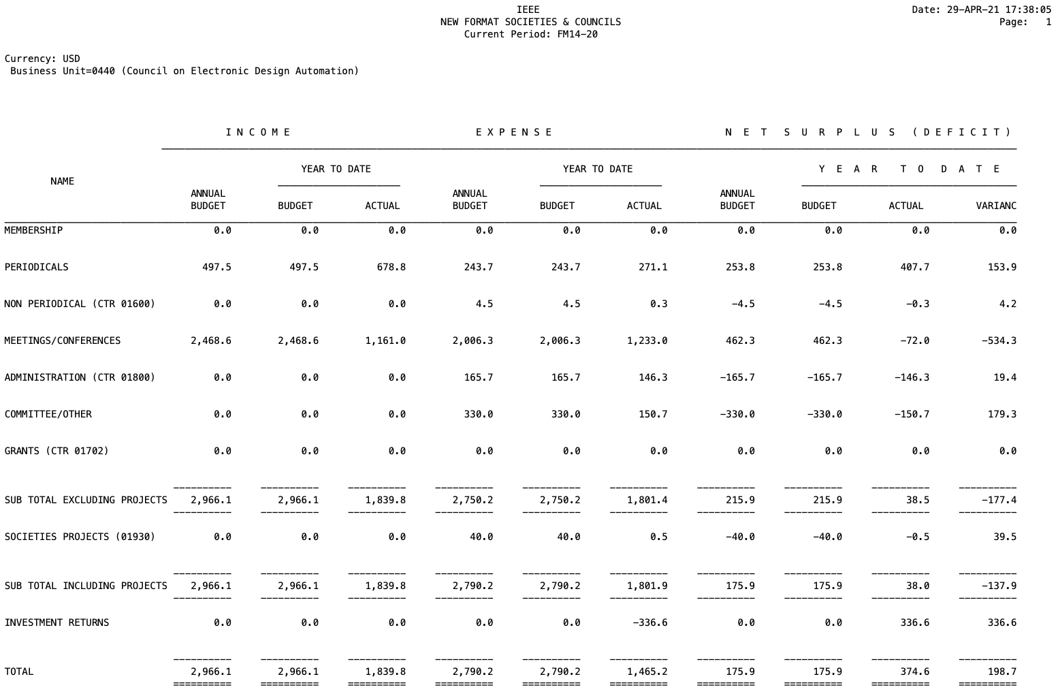
2020 Final situation

Slide 3
2020 Net – almost final
Periodical & Conferences
 | 2017 | 2018 | 2019 | 2020
TCAD | 181K | 141.9K | 283K | 343K
ESL | 37.8K | 36.3K | 65K | 72K
D&T | -24.1K |  | -17.5K | -5.6K
Conferences | 238K | 239.4K (DAC ~170K) | 175K (DAC ~130K) | -72K (DAC ~ -454K)
… of which Pub. Dist. | ~160K | ~170K | 253K | 360K
  TCAD
    + 40K subscriptions
    + 60K overlength
    +18K Open access
Conferences:
MPSOC 2020: -31K

Slide 4
2020 Main expenses
Administration: ~170K
Committee: ~155K
Technical activities: ~31K
  Conference presence: ~15K
  Local chapters: 7.7K
  Dist. Lecturer Program: .5K
  Contests: 20K
  Awards: 3K
  Salaries ~52K
  Travelling costs ~10K
  Web: ~10K
Notes:
Salaries: 43.5 + 58.6
Travels: 90.5

Slide 5
2021 Activities – in stand by
Local chapter funding (15 chapters – 7 active)
Distinguished Lecturer Program
Awards
Contests (SMACD)
CEDA Luncheon Talks
Projects
  Student support
  Diversity in EDA
  CPS Summer school

Slide 6
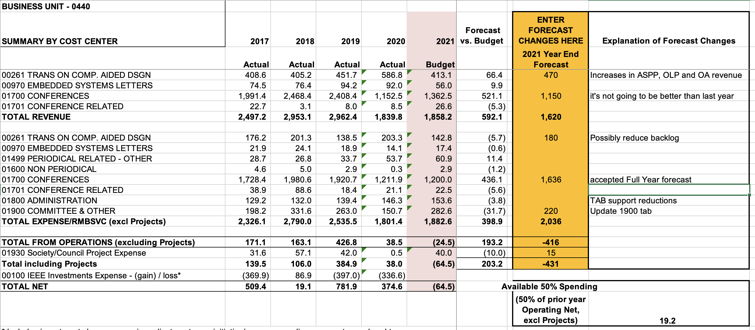
2021 Budget update
Notes:
~$193k

Slide 7
2021 budget expenses
Contractors (Editorial services): ~53K
Conference Catalyst: 62K (secretary) + 10K (web)
Volunteer Travel: 30K
CEDA EC/BoG meeting expenses: 7K
Local Chapters: 15K
DL: 10K
CEDA Luncheons: 43K
Technical Committees (DATC / SVDTC / TCCP): 22.5K
Contests/Competitions/Demos (DATE / DAC / ICCAD CAD / SMACD): 25K
Awards (A. R. Newton / Early Career / Dist Serv / TCAD D. O. Peterson / W. J. McCalla / Outstanding Service / DL Award @ CEDA Luncheon): 16K
Advertising: 10K
Sponsorships:
IoT: 29K
Smart Cities: 20K
Notes:
Outstanding Service Award: given to ASP-DAC / DAC / DATE / ESWEEK / ICCAD General chair

Slide 8
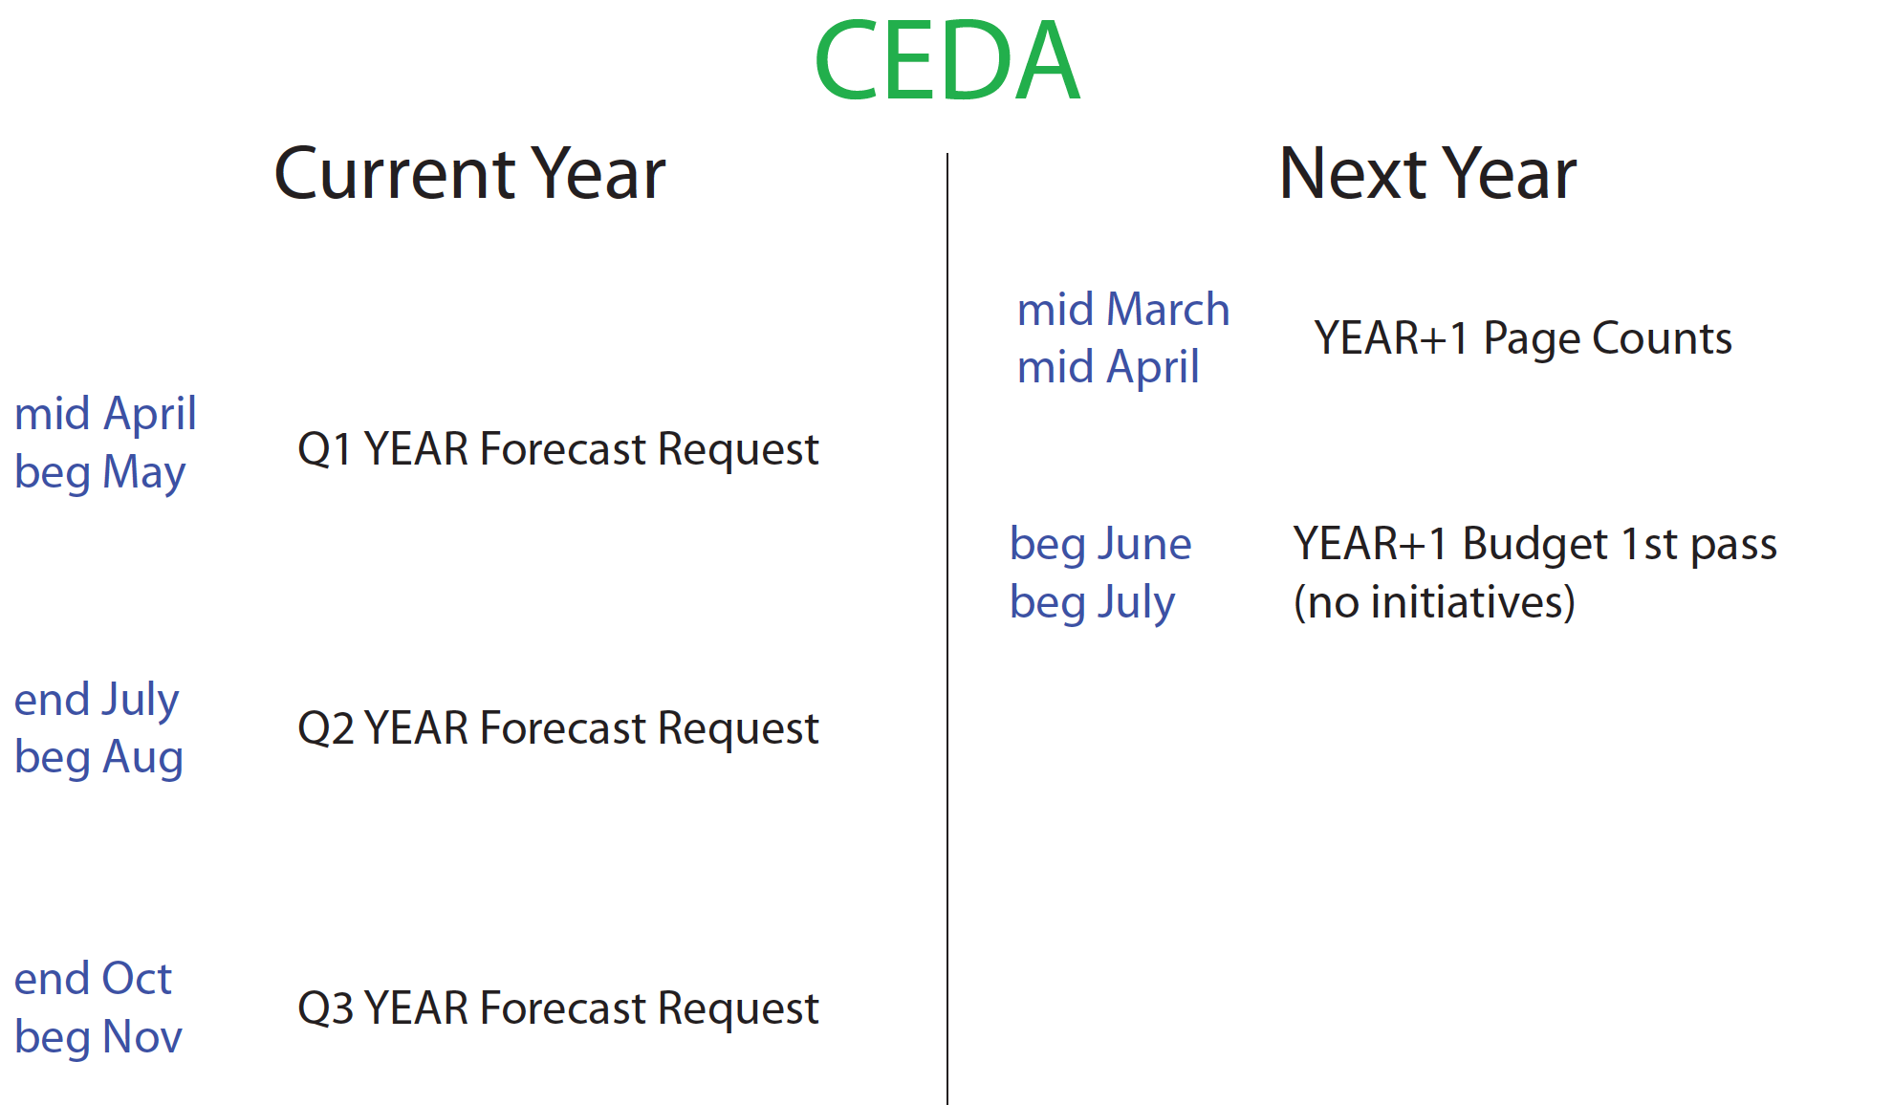
upcoming deadlines

