Slide 1
Activities
Gi-Joon Nam (IBM Research)
IEEE CEDA VP for Activities

Slide 2
CEDA Activity Overview
CEDA Luncheon Keynote at DAC, DATE, ICCAD
CEDA Sponsored Conference Activities and Workshops
Distinguished Lecturer Program
Local Chapters
Member Technology Organizations

Slide 3
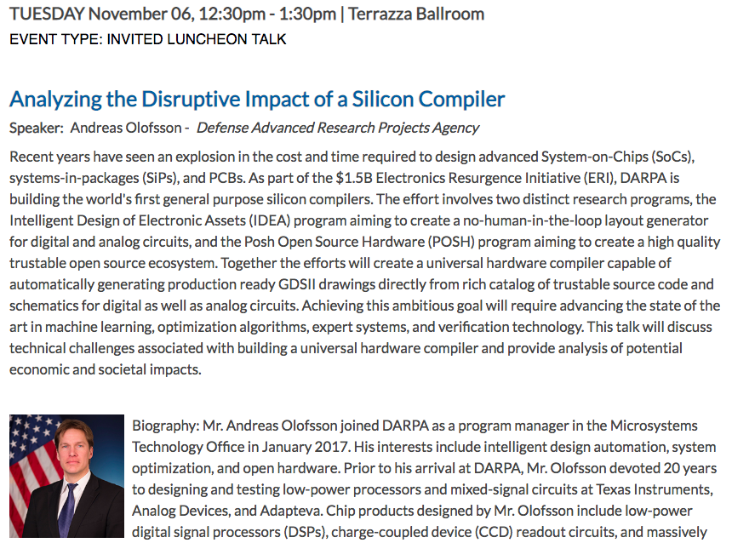

Slide 4
2. CEDA Sponsored Conference Activities & Workshops
Special Session 3D: 2018 CAD Contest at ICCAD
Monday 4:15 – 5:45 pm
Chair: Mark Po-Hung Lin – National Chuang Cheng Univ.
Problem A: Smart EC: Program-Building for Name Mapping
Problem B: Obstacle-Aware On-Track Bus Routing
Problem C: Timing-Aware Fill Insertion
DATC RDF – An Academic Flow From Logic Synthesis to Detailed Routing

Slide 5
3. CEDA Distinguished Lecturer Program
Chair: Tsung-Yi Ho, National Tsing Hua University, Taiwan
http://ieee-ceda.org/pages/distinguished-lecturer-program
2018 Lectures
Prof. Giovanni De Micheli, “New Horizons for Electronic Systems: Devices, Design Methods and Applications”, Feb, 2018, @ The Chinese University of Hong Kong, hosted by IEEE CEDA Hong Kong Chapter
Prof. Edith Beigne, “The Future of Low Power Circuits and Embedded Intelligence: Emerging Devices and New Design Paradigms”, Aug, 2018, @ National Tsing Hua University, hosted by Taipei Chapter
Prof. Naehyuck Chang, “Self-Powered Smart Devices: Storage-Less and Converter-Less Maximum Power Point Tracking and SmartPatch”, Aug, 2018 @ National Taiwan University, hosted by Taipei Chapter
Prof. Sharon Hu, “A Cross-Layer Perspective for Energy Efficient Processing – From beyond-CMOS Devices to Deep Learning”, Nov. 2018, @ Tsinghua University, hosted by Beijing Chapter

Slide 6
CEDA Distinguished Lecturer Program
CEDA proudly announces the addition of the following Distinguished Lecturers in 2018:
Edith Beigne, Reearch Director at CEA-LETI, France | New technologies like 3D, RRAM, FDSOI, nero-inspired, asynchronous, GALS
Naehyuck Chang, KAIST, South Korea | Low-power cyber-physical systems, Design automation of electric vehicles, Energy harvesting and storage for CPS and IoT
Yiran Chen, Duke Univ. | Emerging memory and storage technologies, Embedded systems and mobile applications, Neuromorphic computing, Deep learning and system security
X. Sharon Hu, Univ. of Notre Dame | Power, temperature and reliability aware system-level design, Circuit and architecture design for beyond-CMOS devices, Design and analysis of embedded and real-time systems
Vijaykrishnan Narayana, Penn State Univ. | Power-aware systems, Reliable and secure computing systems, Design and Optimization of On-chip interconnects, Application specific architectures, System design using emerging devices
Sachin Sapatnekar, Univ. of Minnesota | Deeply scaled CMOS and. Post-CMOS technologies, Aging / reliability issues

Slide 7
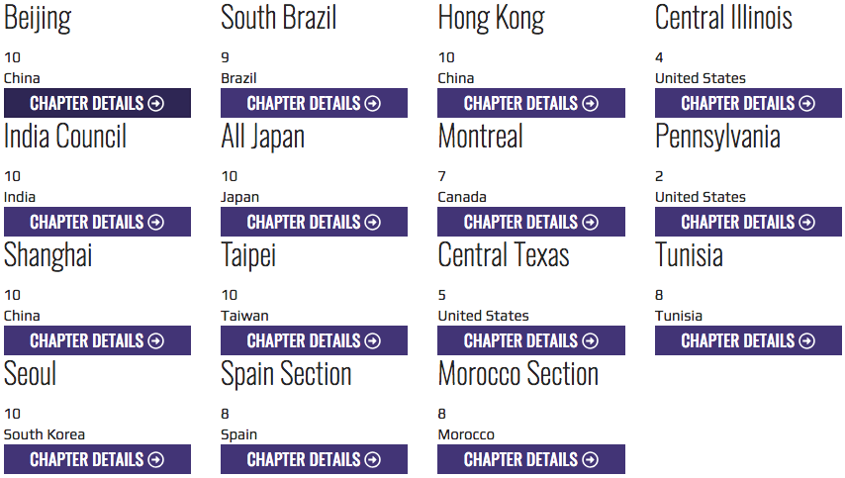
4. Local Chapters & Outreach Programs

Slide 8
Regional EDA Summer Schools
International Seasonal School on Physical Design Automation, July 16-20, 2018, National Chung Cheng University, Chaiyi, Taiwan
Seasonal School on Logic Synthesis, July 30-Aug 3, co-sponsored with IEEE CAS
Georgia Tech Internet-of-Things (IoT) Summer School, Aug 6-9, 2018
http://wolf.ece.gatech.edu/georgia-tech-internet-of-things-iot-summer-school/
Plan to host it again in Europe in 2019

Slide 9
5. Member Technology Organizations
DATC (Design Automation Technical Committee)
Chair: Iris Hui-Ru Jiang (huiru.jiang@gmail.com), National Chiao Tung University
SVDTC (System Validation and Debug Technology Committee)
Chair: Darshan Patra (ppatra@ieee.org)
TCCPS (Technical Committee on Cyber-Physical Systems)
Chair: Shiyan Hu (shiyan@mtu.edu)
TTTC (Test Technology Technical Council)
Chair: Yervant Zorian (Yervant.Zorian@synopsys.com)

