Slide 1
IEEE CEDA Executive Committee & Annual Board of Governors’ Meetings at ICCAD 2018

Slide 2
Publicity
Vasilis Pavlidis, University of Manchester, UK
Sudeep Pasricha, Colorado State University, CO, US

Slide 3
Status of Activity
All activities continue in this term
Newsletter, email distributions, ad hoc requests
Email distributions are handled a bit differently
Participation in events (sponsored by CEDA)
Recommendations of events for promoting CEDA are welcome
Area of concern
Contributions other CFPs are rather scarce
With the exception of few Ex Com members
Action to be taken
Incentivize local chapters to disseminate more their upcoming activities/events
Social Media Campaign launched
Per a recent motion, a FB campaign took place to promote ESW

Slide 4
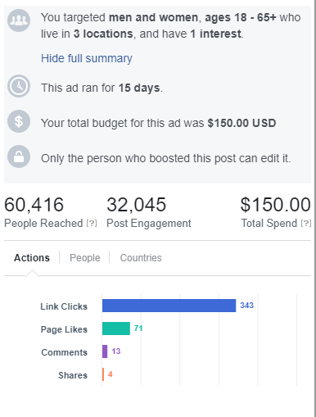
ESWEEK Facebook Campaign Results
Over 60k people reached!
The campaign ran for 2 weeks
Cost only $150
Reaching 400 ppl per $1
Results indicate a useful outcome worth continuing!
Should we offer it as a service to our sponsored evetns?
Any feedback?

Slide 5
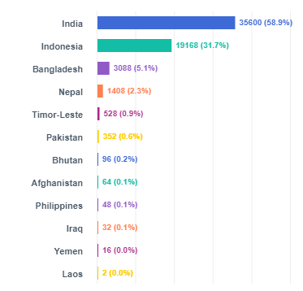
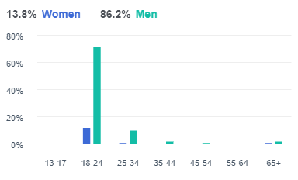
Campaign Demographics

