Slide 1
CEDA Technical Activities
Ian O'Connor
June 23rd, 2024

Slide 2
Agenda
CEDA Chapters
One-off event sponsorship
Distinguished lecturer program
  Class 2023-2024 + 2024-2025
  VDL schedule
Luncheon Keynote speakers: DAC, ICCAD

Slide 3
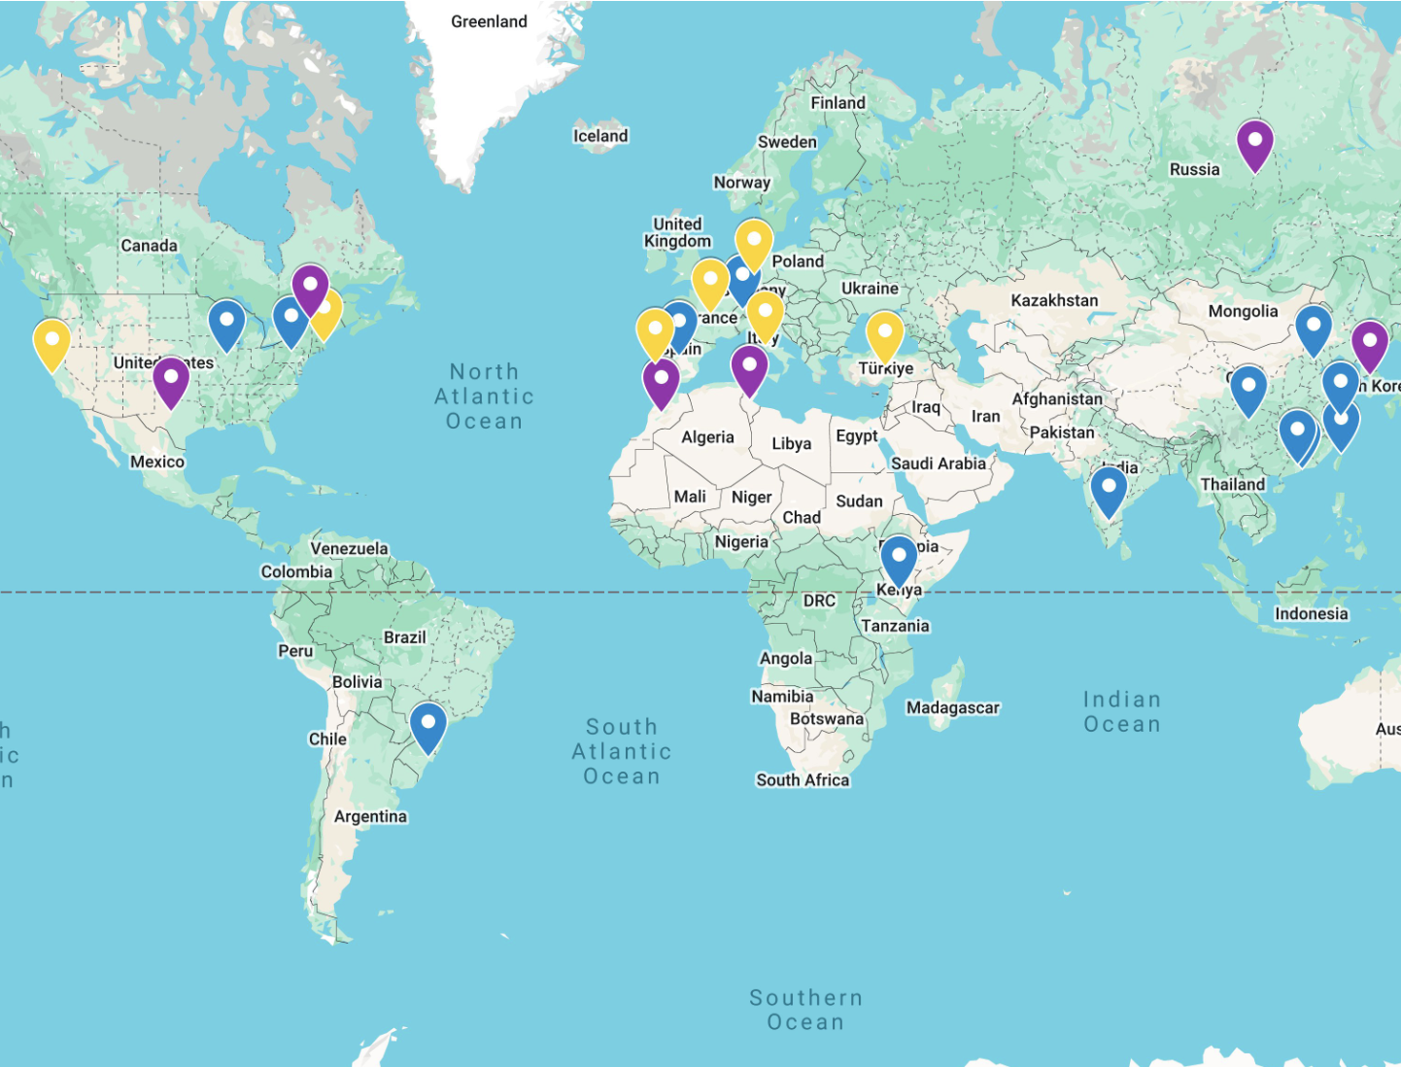
CEDA Chapters
Central Texas
Japan
Montreal
Morocco
Russia
Seoul
Tunisia
13 active Chapters
Dormant Chapters (no 2024 funding)
2023
2024
Bangalore
Beijing
Central Illinois
Chengdu
Guangzhou
Hong Kong
Japan
Pennsylvania
Russia
Shanghai
South Brazil
Spain
Switzerland
Taipei
Tunisia
Kenya
Bangalore
Beijing
Central Illinois
Chengdu
Central Penn.
Guangzhou
Hong Kong
Kenya
Shanghai
South Brazil
Spain
Switzerland
Taipei
Potential new Chapters?
Boston
San Francisco Bay area
France – 2025 ?
Belgium – 2025 ?
Germany
Italy
Portugal
Turkiye

Slide 4
CEDA Chapters
Financial Sponsor
  Support 10 proposals (6 in 2022)
Chapter Report
  vTools
Budget Allocation
  Group event: seminars, meetings, summer course, DL, etc.
  Special event: contest, awards, etc.
  General expense: banner, local travel, souvenir, etc.
Role Rotation
  Chair, Vice Chair, Treasurer/Secretary
  Term of service

Slide 5
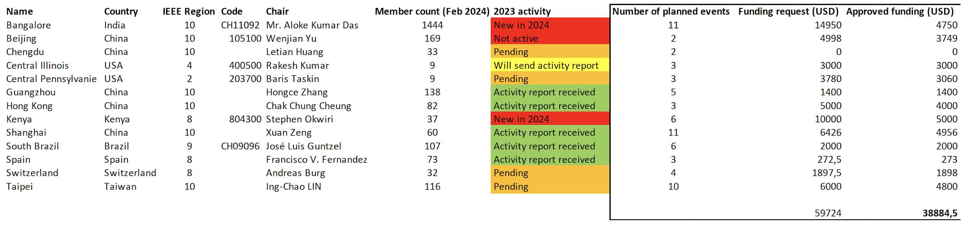
Chapter budget
Funding guidelines:
  New chapters – funding capped around 5k$ (maximum for active chapters)
  Funding reduction for events that can be funded through other means
Total funding for all chapters around 40k$ - wiring process completed

Slide 6
Chapter update meeting
Monday June 24th 5pm-7pm PDT
On-site: Intercontinental Hotel (888 Howard St, San Francisco, USA): Telegraph Hill room, 4th floor
Online: https://ec-lyon-fr.zoom.us/j/95697384387?pwd=bUWwapGaQ0zdL5t5YoXyigrqFzZGHk.1
Attendees:
  Skanda Raghavendra
  Zhiyao on behalf of Ray Cheung (Hong Kong Chapter)
  Yangdi Lyu (Guangzhou Chapter) (remote)
  Wenjian Yu (Beijing Chapter) (remote)
  Baris Taskin (Pennsylvania Chapter) (remote)
separate online meeting in July for absent chapters (e.g. Spain, Switzerland, Morocco for which timeslot doesn't work)
Report 2024 activities and spending
Plan 2025 activities and budget
Flag any issues

Slide 7
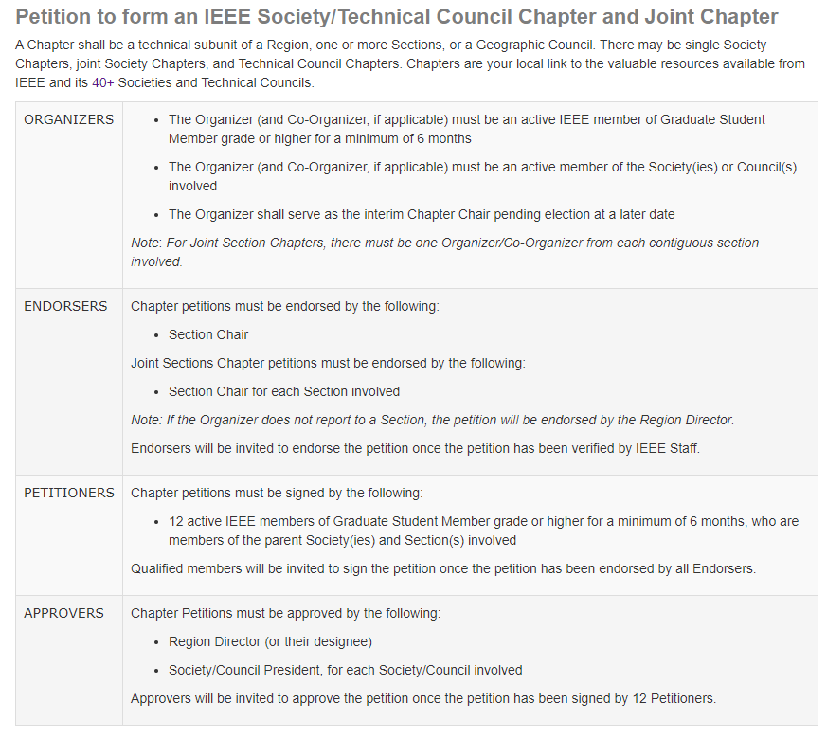
Chapter formation
Member & Geographic Area resources:
  Formation : https://mga.ieee.org/volunteer-hub/geographic-unit-operations/formations-and-petitions#changechapter
  Application (with IEEE member acct): https://live.runmyprocess.com/live/2215365968/appli/233967?P_mode=LIVE&P_version=

Slide 8
Chapter of the Year Award
Description: To recognize the CEDA Chapters with the best yearly activities in the categories of chapter-sponsored technical activities. Award will recognize their contribution with consideration of quantity and quality of the activities implemented by the chapters.
Prize: $1000 and Certificate to the Chapter of the Year. Presented to the chapter chair and must be used to fund chapter activities.
Funding: Funded by the IEEE CEDA. Award is funded via CEDA Award Fund in the IEEE Foundation.
Presentation: Annually at ICCAD
Basis for Judging: The awards criteria include number and quality of chapter activities, percentage of attending sponsored events, membership development activities and chapter growth, local conferences/symposia/workshops, participation in the Distinguished Lecturer Program, involvement of students and YP members, contributions to newsletter, and timeliness of reporting of prior year.
Eligibility: The winning chapters must be IEEE CEDA chapters. Self-nominations are allowed.
Nomination Details: Previous winners of are not eligible for the same award within 3 years from the receiving the last award.

Slide 9

Call for Proposals 2025
Seed Grants
A Seed Grant is for funding innovative or pilot projects that require US$40,000 or less and take 12 months or fewer to complete.
Innovation Seed Grant Opportunity
An Innovation Seed Grant is for projects that require higher levels of funding than the US$40,000 typically associated with Seed Grants. Projects that have a high potential to have a positive impact across the entire IEEE are welcome to submit an application for Innovative Seed Grant funding for experimental, pilot projects and initiatives of up to US$100,000. These projects typically take 12 months or less to complete.
New Initiatives
Typical New Initiatives are large-scale projects that are in line with IEEE’s strategic direction, support the vision and mission of IEEE, and require significant funding. These proposals typically require funding of US$100,000 or more for up to three 12-month periods.
See Initiatives presentation
Activity Planning Proposal for 2025
  https://ieee-ceda.org/activities/chapters/chapter-resources
  Due: January 2025
  Please send to Ian and Amanda/Laura

Slide 10
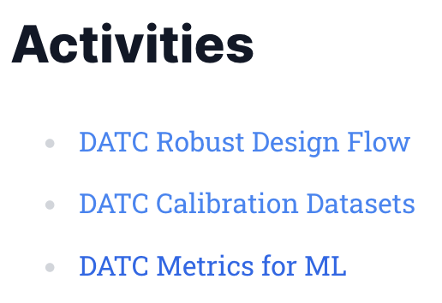

CEDA Technical Committees
DATC (Design Automation Technical Committee)
  Chair: Jinwook Jung, IBM (cannot attend)
SVDTC (System Validation and Debug Technology Committee)
  Chair: Chinna Prudvi, Intel Inc. (remote)
TCCPS (Technical Committee on Cyber-Physical Systems)
  Chair: Shiyan Hu, University of Southampton (no response)
TTTC (Test Technology Technical Council)
  Chair: Peilin Song, IBM (cannot attend)
Hardware Security and Trust Technical Committee (HSTTC)
  Chair: Gang Qu, University of Maryland (remote)
Awards, Tools, Standards, Outreach, etc.

Slide 11
Member Technology Organization updates
TTTC Test Technology Technical Council (TTTC) – Peilin Song (not attending)
HSTTC Hardware Security and Trust Technical Committee (HSTTC) – Gang Qu (virtual) / Yier Jin (alternate) (no response)
SVDTC System Validation & Debug Technology Committee (SVDTC) – Chinna Prudvi (virtual)
TCCPS Technical Committee on Cyber-Physical Systems (TCCPS) – Shiyan Hu (no response)
DATC Design Automation Technical Committee (DATC) – Jinwook Jung (not attending)
DAC Design Automation Conference – ?
DATE Design Automation and Test in Europe Conference – ?
ICCAD International Conference on Computer-Aided Design – ?
ESL Embedded System Letters – ?
TCAD Transactions on Computer-Aided Design of Integrated Circuits & Systems – ?
D&T Design & Test Magazine – ?
DTC Design Technology Council – ?

Slide 12
One-off event sponsorship
SWEAT 2024, Bangalore, June 28th 2024 (1000USD) - Symposium-cum Workshop on Emerging AI/ML Trends www.sweat.ieee bangalore.org (organized by newly-formed CEDA Bangalore section). Prominent visibility for CEDA material, funding event lunch, remote CEDA address (Ian)
DSD 2024, Paris, August 28-30 2024 (1000USD) - 7th Euromicro Conference Series on Digital System Design (potential future CEDA France Chapter). CEDA exposure through various channels (signage, printed materials, website listings, social media mentions, and email marketing campaigns)

Slide 13
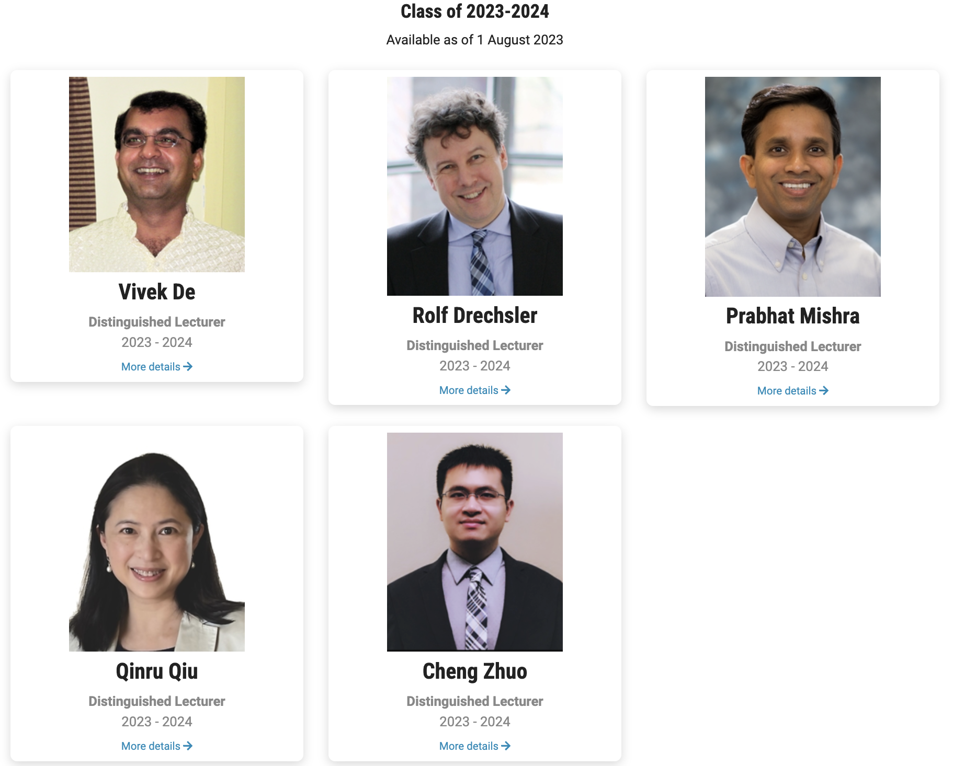
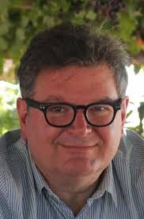
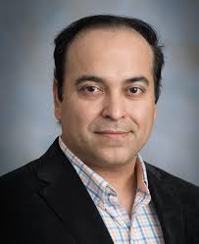
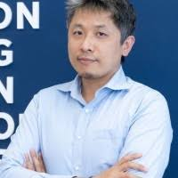
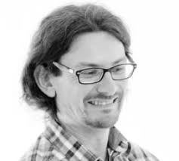
Distinguished Lecturer Program
Class of 2024-2025
To be available as of 1 August 2024
Prof. Ricardo Reis
UFRGS, Brazil
Seminars: Physical Design Automation of Transistor Networks / Trends on EDA / Visualization Tools
Tutorials : Low power challenges in IoT and IoE / Trends on EDA (extended) / Physical design, from past to future
Prof. Sudeep Pasricha
Colorado State University, USA
Seminars: Artificial Intelligence at the Speed of Light / Robust and Secure Design for Connected and Autonomous Vehicles / Sustainability Challenges with Computing: from Internet-of-Things to Datacenters
Tutorials : Optical Computing for AI Acceleration / Machine Learning for Smart Indoor Navigation / Green and Sustainable Cloud Computing
Ass. Prof. Bei Yu
CUHK, Hong Kong
Seminars : Machine Learning in EDA: When and How / Large Scale VLSI Mask Optimization / Large Language Model in EDA ; Tutorials : Enabling Large Language Models in EDA
Prof. Alberto Bosio
ECL, France
Seminars : AI Hardware Accelerator for Safety-Critical Applications / Trustworthy AI: The role of the Hardware
Tutorials : Approximate Fault-Tolerant Neural Network Systems / Early System Reliability Analysis for Cross-layer Soft Errors Resilience in Microprocessor Systems

Slide 14
CEDA VDL Program
5DLs class of 2023-2024 + 4 DLs class of 2024-2025
roughly monthly VDL webinars (Thursdays at 9:00 AM ET) hosted by TY
start in September 2024
  September 26 2024
  October 10 2024
  November 14 2024

Slide 15
DAC 2024 CEDA Luncheon Keynote
Scheduled for Tuesday June 25th 2024 12:00pm-1:30pm
Prof. Andrew Kahng
  Distinguished Professor of CSE and ECE, UC San Diego
  https://vlsicad.ucsd.edu/~abk/
  "AI for EDA and Disruptive Innovation"

Slide 16
ICCAD 2024 CEDA Luncheon Keynote
Scheduled for Tuesday October 29th 2024 12:00pm-1:30pm
Prof. Sachin Sapatnekar
  Distinguished Professor and Robert and Marjorie Henle Chair, Dept ECE, U Minnesota
  https://www.ece.umn.edu/users/sachin/
  automated layout generation for analog circuits, design of ML HW, ML algorithms for EDA
complementarity to ICCAD keynotes already scheduled (Leon Stok, IBM / Philip Wong, Stanford / Dilma Da Silva, US NSF)

Slide 17
CEDA representation in Women in Engineering
Seeking replacement for Prof. Shao-Yun Fang (NTUST, TW)
  CEDA representative in the IEEE Women in Engineering (WIE) initiative
  Diversity and Inclusion Chair of CEDA

