Slide 1
Welcome to the IEEE CEDA
Board of Governors meeting!
Sunday, 23 June 2024
WiFi: IHG ONE REWARDS
Password: Encore

Slide 2
CEDA Board of Governors Meeting
Sunday, 23 June 2024

Slide 3
Agenda
Welcome and Call to Order
Roll Call
Approval of June Agenda
President’s Report
Finance
Publications
Conferences
Initiatives
Publicity
Education Activity & Engagement
BREAK
Awards
Activities
Young Professionals
Technical Committees
Member Societies
Strategy and 20th Anniversary
All Other Business
Admin/Action Item Review
DINNER

Slide 4
Welcome/President’s Report - Silveira
Roll Call
Approval of June Agenda

Slide 5
Finances
Marina Zapater

Slide 6
Outline
Closing numbers 2023
Status 2024
Budget 2025

Slide 7
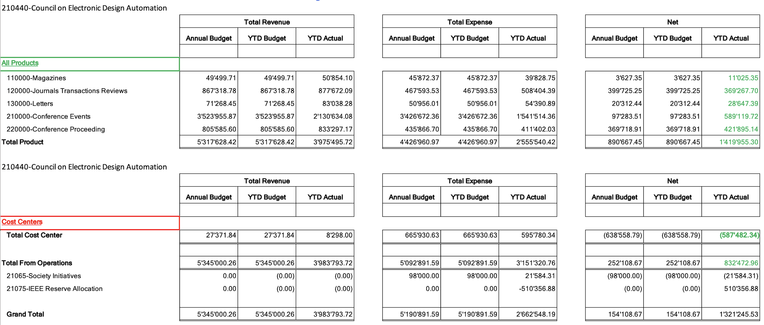
Closing numbers 2023

Slide 8
A closer look into expenses 2023
DATC, SVDTC, TCCPS, HSTTC
Overspending in contests, but underspending in DL program (online)
Expected overspending, due to costs of volunteer travel and venues (compensated, so ok)
Expected underspending, but impacted 2024

Slide 9
Reserve status 2023
Good news, improving 2021 numbers!
2021 Reserves: ~4.2M$, P&L 53k$, Investment loss of 484k$
2022 Reserves: ~3.7M$, P&L 811k$, Investment gains of 545$
2023 Reserves: 5.01M$

Slide 10
Finance Status 2024
More expenses than last year (ok!)
265k vs 165k in 2023
Still some underspending
Contests, DL program:
Ramping up again
Costs are higher than before, but final numbers should be ok
Initiatives:
Travel grants doing better
All other initiatives are underspending

Slide 11
Budget 2025
Legend: Black: same than last year
Red: requesting an increase
Contractors (Editorial services): ~67K
Operational - Conference Catalyst: 88k (secretary + web) + 2K (Zoom)
Meetings venue expenses : 13K
Volunteer travel : 70k (52k in 2023, increase due to 3 EC meetings instead of 2)
CEDA Luncheons ~ 56K DATE, DAC, ICCAD, ASP-DAC
Distinguished Lecturer ~ 26K
Contests ~ 50K PhD Forum, Univ. Demo (DATE, DAC, …)
Awards ~ 28K
Local Chapters 40K
Technical committee ~ 15K DATC, SVDTC, TCCPS, HSTTC
MoU Initiatives (Smartcities, IoT): 60K
Marketing & Advertising: 25K
Standards commitee: 5K (budget for meetings and traveling)
Publications: 5K (face-to-face journal meeting/luncheon with editorial board)

Slide 12
Motions
Approval of Budget 2025
Forecasts for 2025 needs to be submitted on August 8th
In preliminary version still until it is double-checked with IEEE

Slide 13
Finance
Backup slides

Slide 14
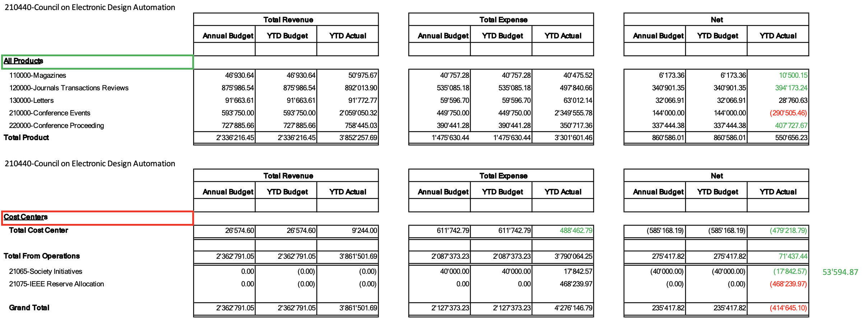
Closing numbers 2022

Slide 15
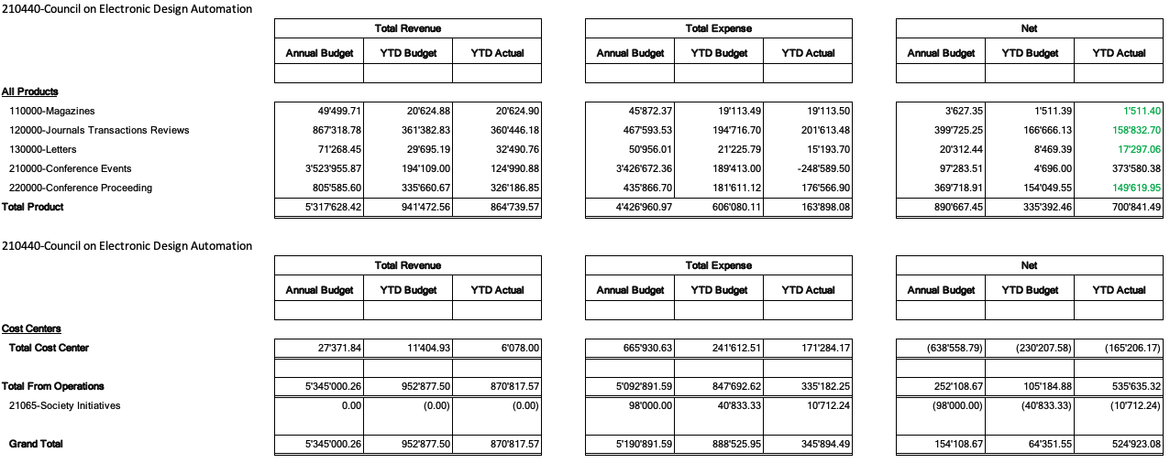
Finance Status 2023 (end of May)

Slide 16
Report Overview
Status reports:
TCAS-AI (Yiran Chen)
D&T (Partha Pande)
ESL (Aviral Srivastava)
TCAD (David Atienza)
T-SPI (Jun Fan)

Slide 17
IEEE TCAS-AI Update
EiC: Yiran Chen

Slide 18
TCAS-AI
Editorial Board has been created:
including one EiC, two Associate EiC (one from CEDA and one from SSCS), and 14 Associate Editors (8:4:2 for CASS/CEDA/SSCS).
Management committee formed
The submission portal and management websites have gone alive on May 17th, 2024.
TCASAI has arranged 16 invited papers from prestigious scholars to be published on the inaugural issue of the transactions.
TCASAI has received 35 submissions (including 16 invited ones) since May 17th, 2024, or 1 submission per day on average.

Slide 19
IEEE Design&Test Update
EiC: Partha Pande

Slide 20
Overview
Issues in 2024
Future issues
New initiatives
Publication Statistics

Slide 21
Issues in 2024
Jan/Feb: SI: Ethics in Computing (4 plus editorial), 4 general interest, 1 tutorial, 2 Reports, Last Byte, From the EiC
Mar/Apr: SI: 2021 Workshop on Top Picks (6 plus editorial), 3 general interest, 2 Reports, Last Byte, From the EiC
May/Jun: 7 general interest, 2 Reports, Last Byte, From the EiC
Jul/Aug: SI: Silicon Lifecycle Management (6 plus editorial), Interview, Last Byte, From the EiC
Sept/Oct: SI: Post-Quantum Cryptography for Internet-of-Things
Nov/Dec:

Slide 22
New Special Issues
Open-Source Silicon
Wearable IoT Devices
Top Picks 2022
tinyML

Slide 23
New Initiatives
Top Pick on Reliability and Test
First edition was completed and selected
First round selected (12 out of 30+ submissions) and presented at Top Picks Workshop collocated with ITC 23
The top picks selected (6) and now invited for publication in SI
2nd edition is being planned
New SIs related to Test
Silent Data Corruption (SDC): In planning
GEs: Dimitris Gizopoulos (U Athens), Sriram Sankar (Meta), Mehdi Tahoori (KIT), Yervant Zorian (Synopsys)
Design and test aspects of advanced packaging
In planning

Slide 24
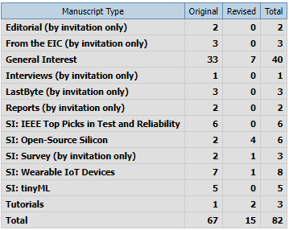
Submission Statistics

Slide 25
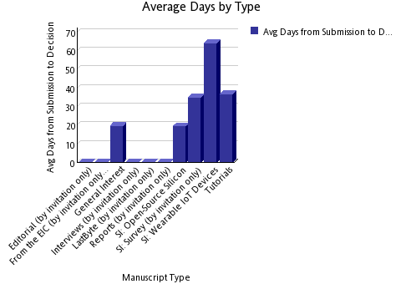
Submission to Decision Time

Slide 26
Challenges
The most important challenge is to increase the number of general interest papers
Also, improving the quality of general interest papers is necessary
Getting editors’ notes for accepted papers promptly

Slide 27
IEEE Design and Test (Video) Roundtables (Ramesh)
A series of quarterly events as D&T zoom-based video roundtables making it lively.
Plan for 3-4 roundtables (is this too many?)
Maybe open it to the public or keep it closed? (try both options?).
Share IEEE D&T roundtable videos via IEEE D&T website. (create a place for IEEE D&T roundtable videos; could be one of the free IEEE D&T resources?).
Each D&T roundtable may include 3 visionaries + moderator. 1-2 visionaries from industry; 1-2 from academia; last for 60 minutes. Q&A type format (similar to the current roundtables)
Sample topics:
Test vs Trust (Rob Aitken, Serge Leef, M. Tehranipoor and S. Mitra; Moderator Ramesh;
ML for EDA; Moderator Y. Chen or Hai Li.
Resurgence of High-Level Design Paradigms: Moderator Luca Carloni; HLS leads from Cadence, Synopsys and Mentor, Jason Cong UCLA
Any feedback?

Slide 28
IEEE Design and Test (Video) Roundtables (Ramesh)
A series of quarterly events as D&T zoom-based video roundtables making it lively.
Plan for 3-4 roundtables (is this too many?)
Maybe open it to the public or keep it closed? (try both options?).
Share IEEE D&T roundtable videos via IEEE D&T website. (create a place for IEEE D&T roundtable videos; could be one of the free IEEE D&T resources?).
Each D&T roundtable may include 3 visionaries + moderator. 1-2 visionaries from industry; 1-2 from academia; last for 60 minutes. Q&A type format (similar to the current roundtables)
Sample topics:
Test vs Trust (Rob Aitken, Serge Leef, M. Tehranipoor and S. Mitra; Moderator Ramesh;
ML for EDA; Moderator Y. Chen or Hai Li.
Resurgence of High-Level Design Paradigms: Moderator Luca Carloni; HLS leads from Cadence, Synopsys and Mentor, Jason Cong UCLA
Any feedback?

Slide 29
Perspectives (Mehdi)
Covers general interest topics, 4-8 pages, with very few references.
Retrospective and forward-looking
It is usually from senior people in academia and industry
Potential topics and authors
Reliability
Jacob Abraham
Ravi Iyer
Testing
Janusz Rajski 🡪 Done
John Hayes
Hans-Joachim Wunderlich
EDA
Giovanni DeMicheli 🡪 DONE
Masoud Pedram
Alberto Sangiovanni-Vincentelli
?

Slide 30
Interviews (Nicola)
Vishwani Agrawal (transcribed, with Vishwani for editing)
Janusz Rajski (published)

Slide 31
IEEE ESL Update
EiC: Preeti Panda

Slide 32
New Vision for IEEE ESL
To establish IEEE ESL as the top venue for
quick dissemination of early research results in
easily digestible format for the
embedded systems research community.

Slide 33
Current state and Targets
Quality Metric | In 2020 | In 2024 | By 2028
Impact Factor | 2.17 | 1.6 | 4
Submissions per year | 201 | 185 | 1000
Accepts per year | 45 | 27 | 200
Submission-to-final decision | 10.4 weeks | 5.2 weeks | 4 weeks
Submission-to-publication | 11 weeks | 9.6 weeks | 8 weeks
Main Goal: Get the impact factor of IEEE ESL to 4 by 2028.
Reduce submission-final-decision time to 6 weeks
Reduce submission-to-publication time to 8 weeks

Slide 34
Plan 1 – Change to bimonthly publication
Submissions have doubled over the last 2 years
Increased from about 200 in 2020 to > 450 in 2023.
Accepted articles have also doubled over the last 2 years
Increased from about 45 in 2020 to > 85 in 2023.
“Submission-to-publication time” is the most important metric for the authors of IEEE ESL.
Frequent publishing will enable fresh content to the readers
Frequent publishing will enable timely publication for researchers
Will increase IEEE ESL citations.
Especially important for short-form papers, which can be read/gleamed quickly.

Slide 35
Plan 2 – Streamline the review process
Accelerated Review Process
Associate Editors will directly review submitted manuscripts.
Improve the quality of reviews
Given the concise nature of the IEEE ESL manuscripts (4 pages)
It takes more time to find reviewers and get reviews from them, than direct review
To Address the diversity concerns, we plan to enlarge the Editorial Board
Promise IEEE ESL authors a one-month submission-to-decision time

Slide 36
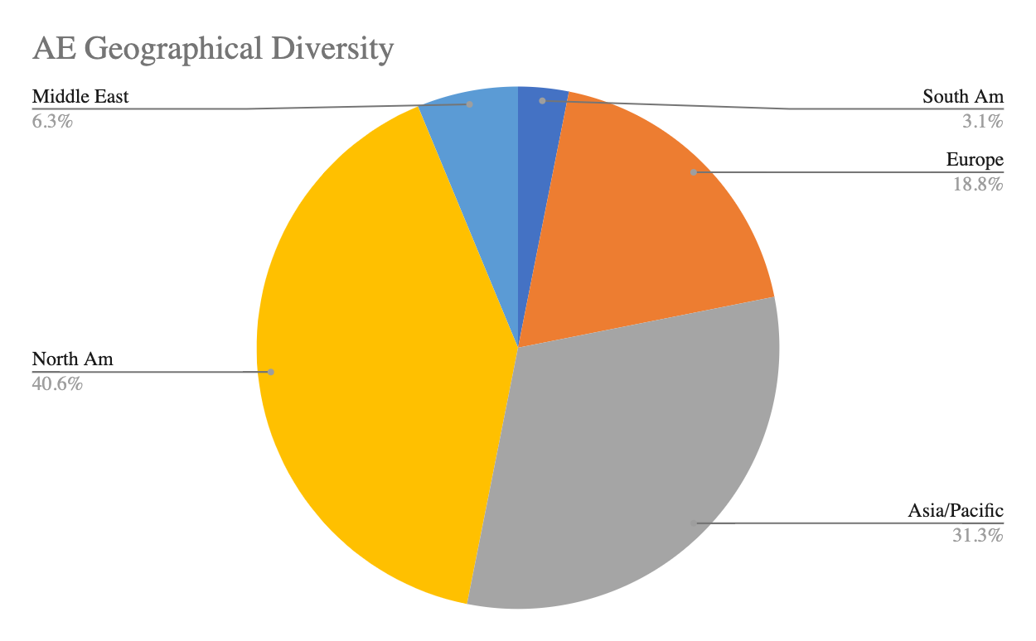
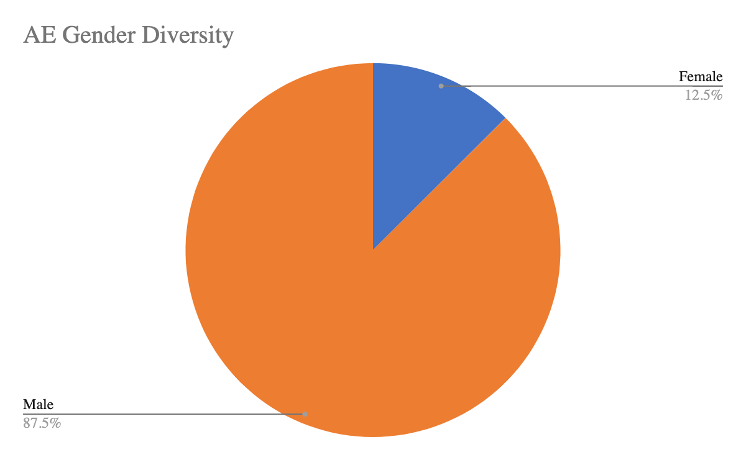
AE Diversity – Better matches the author diversity

Slide 37
Submissions

Slide 38
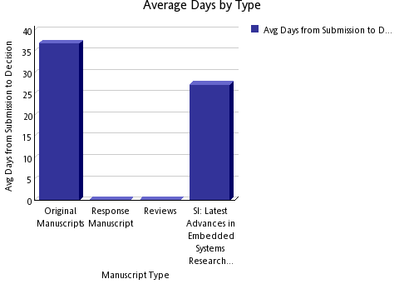
Processing

Slide 39
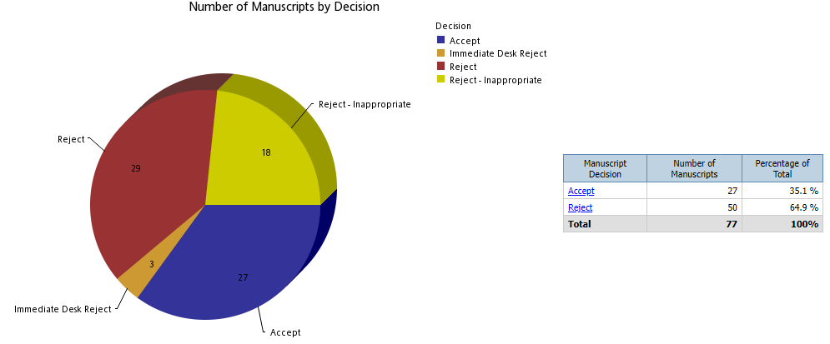
Decisions

Slide 40
Impact
Current Impact Factor: 1.6
5 Year Impact Factor: 1.589
Total Citations: 536
Downloads: 31,629

Slide 41
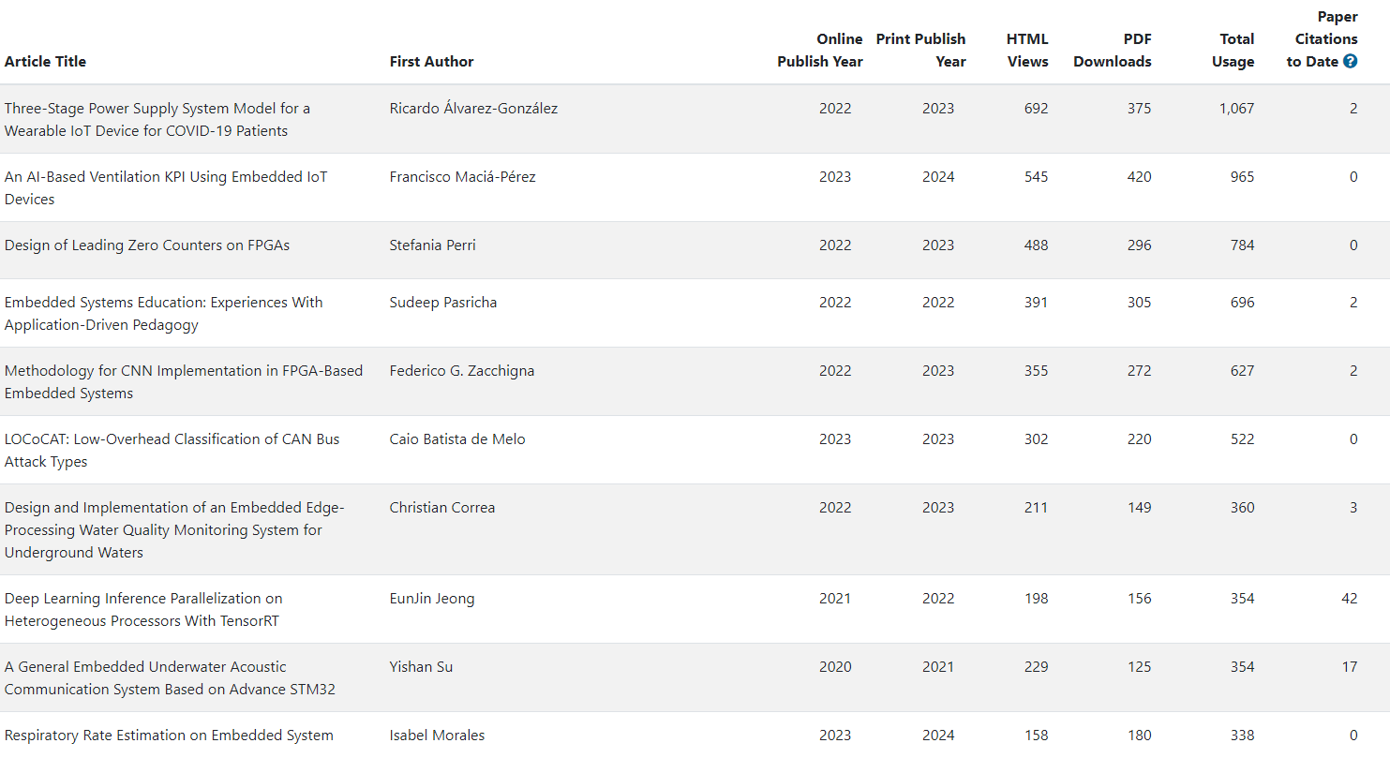
Top 10 Papers

Slide 42
IEEE TCAD Update
EiC: David Atienza

Slide 43
Current Status (1/2)
Current accept. rates (33-34%), top-tier journal for 4 consecutive quarters
Average decision time (1st revision): 71 days
Average final decision time: 84 days until May 2024
Submissions stabilizing (Sep. 2023 to May 2024)
Similar number of submissions vs. same period in 2022-2023
Accept Ratio: YTD is 37% so far, it was 39% in 2023, 2022 was 40.5%
Oldest manuscript without decision: 138 days (it was 203 days in 2021)
Optimized TCAD review process and publication timeline with IEEE HQ
Fast desk-reject policy of IEEE implemented (fast reject: <2 weeks, for low-quality papers)
Automation to reassign reviewers in revisions, identify reviewers/AEs with delays, etc.
IEEE has claimed to remove backlog/publication delay until March 2024 completely as agreed with IEEE HQ (more pages for TCAD) but still not done (50% of backlog remains)
Notes:
Currently there are 257 pending manuscripts

Slide 44
Current Status (2/2)
Editorial board renewed in 2024, 25 new AEs -> 28 new AEs
Limit of two terms (2 x 2 years) based on IEEE guidelines
Increased diversity (Region 10 – Asia and Pacific) and more industrial affiliated AEs (5 new AEs).
Editors-at-Large renewed - 40% women and 2 members replaced
IEEE TCAD Donald O. Pederson Best Paper Awards – 2 winners in 2024:
PACT: An Extensible Parallel Thermal Simulator for Emerging Integration and Cooling Technologies" by Zihao Yuan, Prachi Shukla, Sofiane Chetoui, Sean Nemtzow, Sherief Reda, and Ayse K. Coskun, which was published in IEEE TCAD, vol. 41, no. 4, pp. 1048-1061, April 2022.
An Open-Source Framework for FPGA Emulation of Analog/Mixed-Signal Integrated Circuit Designs, by Steven Herbst, Gabriel Rutsch, Wolfgang Ecker, and Mark Horowitz, which was published in IEEE TCAD, vol. 41, no. 7, pp. 2223-2236, July 2022.
But still authors-based/nominated papers are a very small pool (5 in 2023, 6 in 2023, 5 in 2022)

Slide 45
Key Points to Discuss: New Review Process
TCAD only requires two reviews (by default we suggest 3 to take a decision), AE can be a reviewer as well as decision taking if needed
If the paper is clearly “below bar” (no experiments, comparisons with SoA, etc.) it can be desk rejected: change to 0 reviewers, submit recommendation directly with clarification of why
TCAD must be strict – IEEE Request: unclear novelty or comparisons with SoA, direct reject
Papers as “Research Article With a Prior One or More Conference Publications” must clearly state what is new in the technical contribution (not just evaluation with a new data set or similar) and comparison with state of the art,

Slide 46
Key Points to Discuss: Revisions and Decisions
No two major revisions, authors must address all comments in the first round (except if new major issues arise by reviewers after the first revision)
Not possible to resubmit “as new” if paper is rejected
TCAD requires new publications (30% new research) with previous papers
Adding experiments or more text while contribution does not expand, it is not acceptable
IEEE Regulations does not allow plain verbatim copy (self-plagiarism) – We fixed 40% as rule
Papers submitted with prior conf. papers (last 12 months): 223 (212 in previous year)
50% acceptance rate, much higher than typical TCAD average rate today,
No “complaints” about policy (until exchanges with Yao-Wen Chang early this year)

Slide 47
Key Points to Discuss: Varia
IEEE Allows the use of AI for text editing (ChatGPT) as support tool (but does not encourage it), restrictions:
Acknowledgement to be added to the paper
Authors are responsible for the final text (including copyright issues)
Good cooperation with new IEEE journal on AI/ML side - TCASAI
Checking overlapping with scope
Excellent collaboration with EiC – Prof. Yiran Chen, very receptive to suggestions/proposals
Food for thought from TCAD Editorial Board Meeting at DATE’24: Innovative ways to “reward” the reviewers, ideas from the board
Offer one free page in TCAD published paper after 3 completed review processes
Offer conference registration discounts (e.g., at DATE, DAC, etc.) covered by CEDA

Slide 48
IEEE TSPI Update
EiC: Jun Fan

Slide 49
T-SIPI Editorial Board
Currently the alternative EIC for handling EIC COI is Prof. Tzong-Lin Wu. There are 12 AEs approved by the management committee. They are: Zhiping Yang, Chulsoon Hwang, Enxiao Liu, Joungho Kim, Ram Achar, Dan Jiao, Jai Narayan Tripathi, Dries Vande Ginste, Gabriela Ciuprina, Renato Rimolo Donadio, Erping Li, and Istvan Novak. I recommended two more AE candidates, Richard Gao and Siping Gao (both from Singapore), to the management committee. But the management committee has decided not to add more AEs until a later time.

Slide 50
T-SIPI Paper Statistics
Up to October 30, 2023
 | Submitted | Accepted | Rejected | Withdrawn | In Review Process or No Response
2021 | 7 | 4 | 1 | 0 | 2
2022 | 43 | 27 | 11 | 1 | 4
2023 | 26 | 3 | 9 | 0 | 14
Total | 76 | 34 | 21 | 1 | 20

Slide 51
IEEE Submission To Publication Report
Based on the Q2, 2023 report
 | Average Weeks Submitted to First Decision | Average Weeks Submitted to Online Post | Cumulative Average Weeks Submitted to First Decision for past 12 months | Cumulative Average Weeks Submitted to Online Post for past 12 months
T-SIPI | 8.0 | 33.0 | 7.7 | 31.0
T-EMC (for reference) | 7.6 | 24.1 | 7.8 | 26.5

Slide 52
Submission and Publication
T-SIPI doesn't use ScholarOne for paper submissions, although the review process is still completed in ScholarOne. Paper submissions to the T-SIPI are through the IEEE Author Portal (an IEEE account is required). Below is the link to the submission page: https://ieee.atyponrex.com/journal/TSIPI
T-SIPI is an e-publication only. Papers appear online as soon as the final manuscripts are accepted and edited by the IEEE.

Slide 53
Problems and Challenges
The biggest issue right now is to receive more contributions. We plan to reach more potential authors by sending out the Call for Papers through social media and organizing special sections on hot topics. More ideas and suggestions are welcome!

Slide 54
Conferences - Ho

Slide 55
Conferences
Tsung-Yi HO
June 23, 2024

Slide 56
Sponsored conferences/events (2024.1 ~)
Financial Sponsorship (17)
Technical Sponsorship (10)
MLCAD (50%) |  | ICCAD (46.67%) | ETS (25%)
DTTIS (25%) |  | VLSI-SoC (25%) | MPSoC (33%)
LAD (100%) |  | LATS (25%) | MEMOCODE (25%)
ISLPED (15%) |  | SIES (50%) | ITC-Asia (50%)
DAC (50%) |  | ASP-DAC (12.5%) | DDECS (25%)
CODAI (25%) |  | SBCCI (5%-7%) | ATS (25%-50%)
FMCAD | LASCAS
GLSVLSI | ICITES
ISPD | ISED
SMACD | AsianHOST
FDL | ISEDA
Notes:
• Is IEEE CEDA aware of this event and the request for 25% financial sponsorship? • Has IEEE CEDA agreed to grant 25% financial sponsorship for this event? • If so, who from IEEE CEDA will be the "champion" (accountable individual) and be involved in the event planning/development as well as be able to speak to the event's validity? • Is IEEE familiar with the non-IEEE co-sponsor (Aix-Marseille Université)? ——
EEE DTIS (International Conference on Design and Technology of Integrated Systems in nanoscale era), and IEEE DTS (International Conference on Design and Test of Integrated Systems).

Slide 57
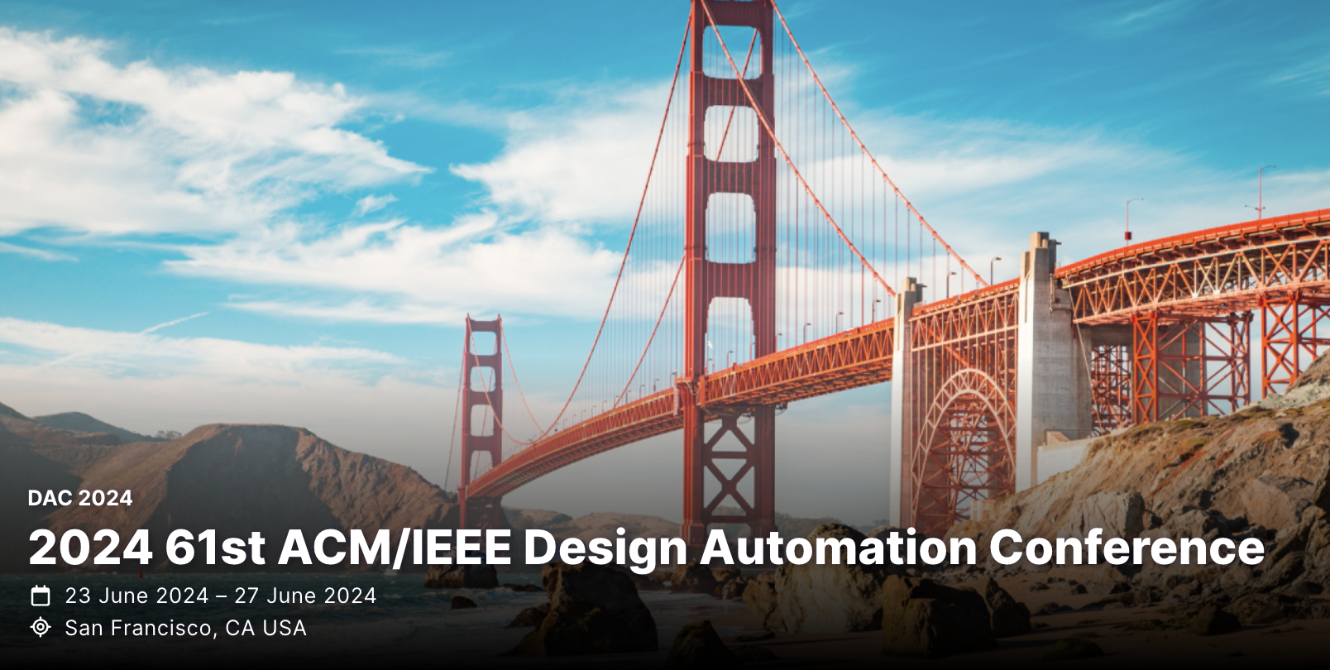
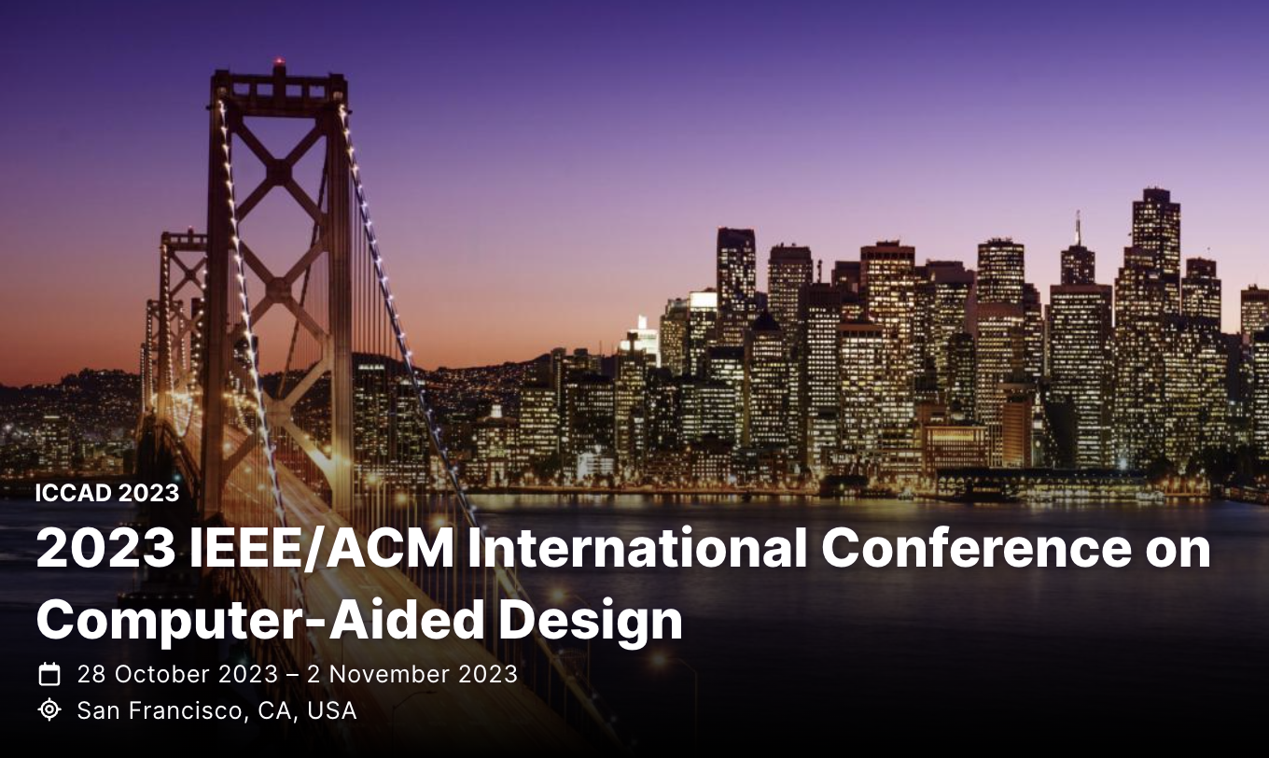
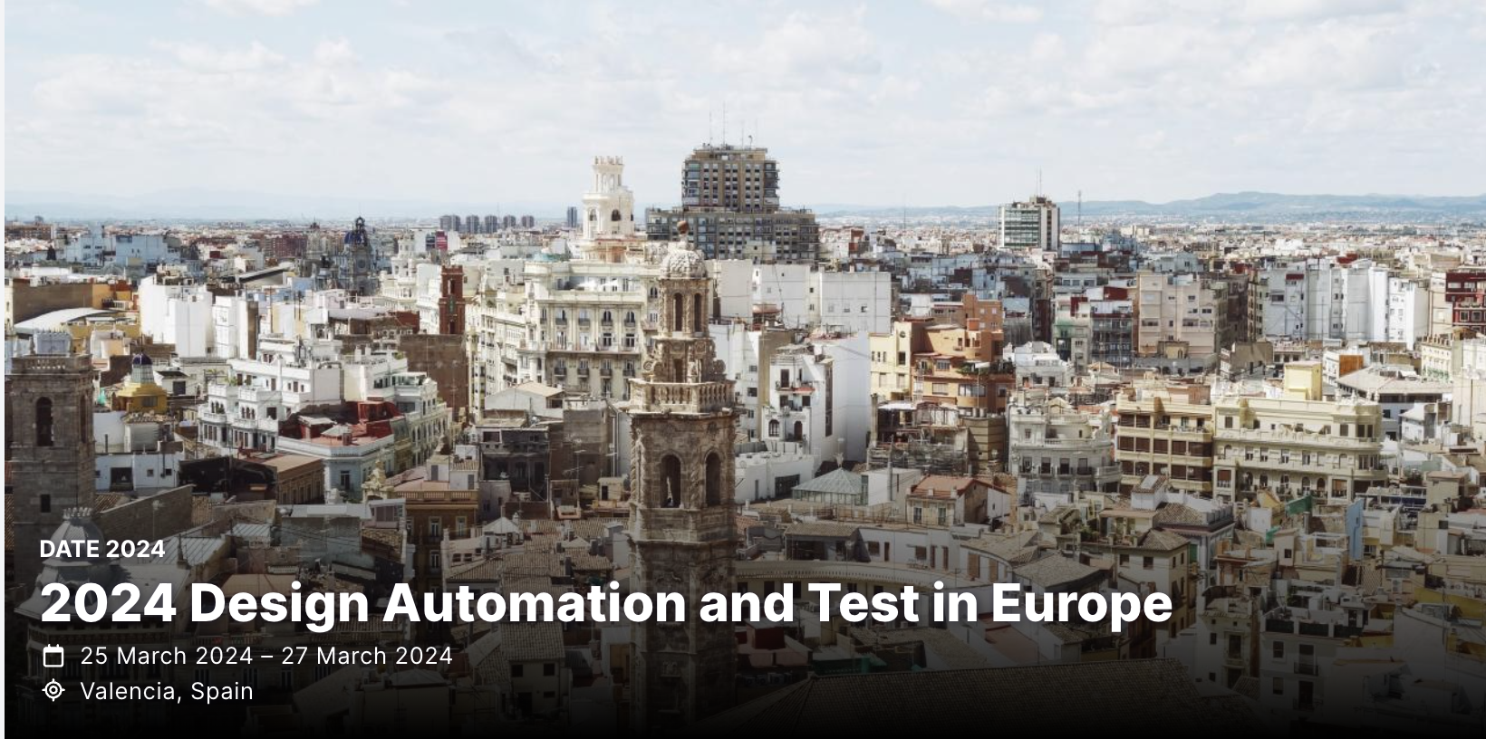
Flagship conferences

Slide 58
DAC Updates
Miguel Silveira
June 23, 2024

Slide 59
DAC 2024 - Record number of submissions
Record number of submissions: 2079 Abstracts, 1575 PDFs; 1545 final valid submissions after some withdrawing (cf. 1156 in 2023 => 34% increase)
TPC committee: 29 tracks, 34 track chairs, 356 TPC members (cf. 266 in 2023 => 34% increase)

Slide 60
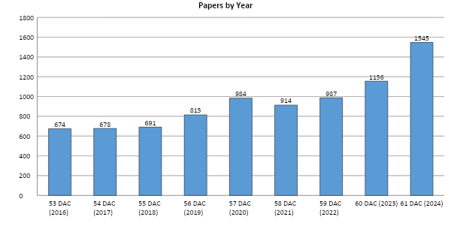
Research Paper Submission History
34% increase in submissions!
Clearly a lot of momentum in the Semiconductor, EDA, AI and Security areas.

Slide 61
Top tracks/topics in paper attraction
Track | #papers
AI1. AI/ML Algorithms | 80
AI2. AI/ML Application and Infrastructure | 74
DES3B-I. In-memory and Near-memory Computing Architectures, Applications and Systems - I | 58
DES3B-II. In-memory and Near-memory Computing Architectures, Applications and Systems - II | 60
DES4-I. AI/ML Architecture Design - I | 57
DES4-II. AI/ML Architecture Design - II | 53
DES9. Quantum Computing | 78
EDA3. Timing and Power Analysis and Optimization | 60
EDA5. Analog CAD, Simulation, Verification and Test | 54
EDA6. Physical Design and Verification | 71
EDA7. Design for Manufacturing and Reliability | 51
SEC1. Hardware Security: Primitives, Architecture, Design & Test | 63

Slide 62
Accepted Sessions by Country
2023
2024
337 submissions accepted
21.8% acceptance rate
(cf. 22.7% in 2023)
Most accepted submissions from China and US
153 papers (45%) with a primary author from China
82 papers (24%) from USA
Country | Percentage |  | Country | Percentage
China | 41.06% |  | China | 45.40%
United States | 30.42% |  | United States | 24.33%
Hong Kong | 6.46% |  | Korea | 7.12%
Korea | 5.70% |  | Hong Kong | 6.82%
Taiwan | 4.94% |  | Germany | 3.56%
Germany | 3.42% |  | Taiwan | 2.97%
Switzerland | 2.28% |  | Italy | 1.48%
United Kingdom | 1.90% |  | Singapore | 1.19%
Belgium | 0.76% |  | Japan | 0.89%
Italy | 0.76% |  | United Arab Emirates | 0.89%
Austria | 0.38% |  | United Kingdom | 0.89%
Canada | 0.38% |  | Austria | 0.59%
France | 0.38% |  | Canada | 0.59%
Greece | 0.38% |  | France | 0.59%
Japan | 0.38% |  | Greece | 0.59%
Singapore | 0.38% |  | Switzerland | 0.59%
 |  |  | Belgium | 0.30%
 |  |  | India | 0.30%
 |  |  | Luxembourg | 0.30%
 |  |  | Netherlands | 0.30%
 |  |  | Norway | 0.30%

Slide 63
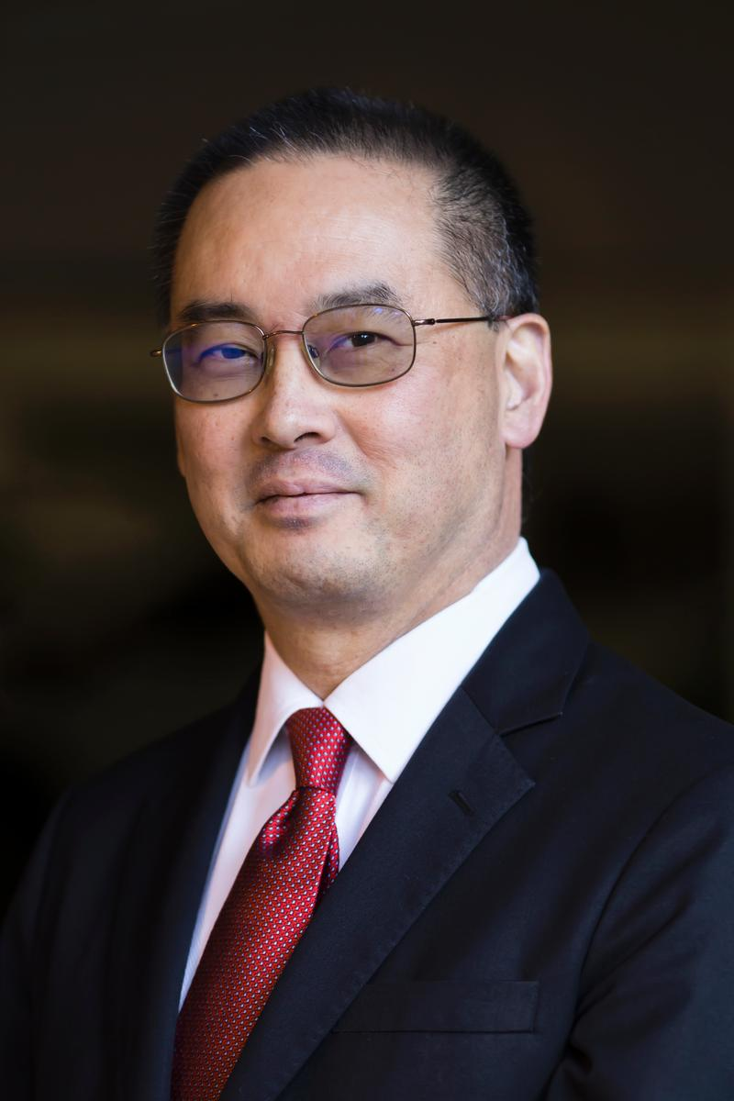
DAC 2024 – CEDA Distinguished Luncheon
Keynote:
Andrew B. Kahng: AI for EDA and Disruptive Innovation
Tuesday, 25th June, 12:00pm – 1:30pm

Slide 64
ICCAD Updates
Jiang Hu
June 23, 2024

Slide 65
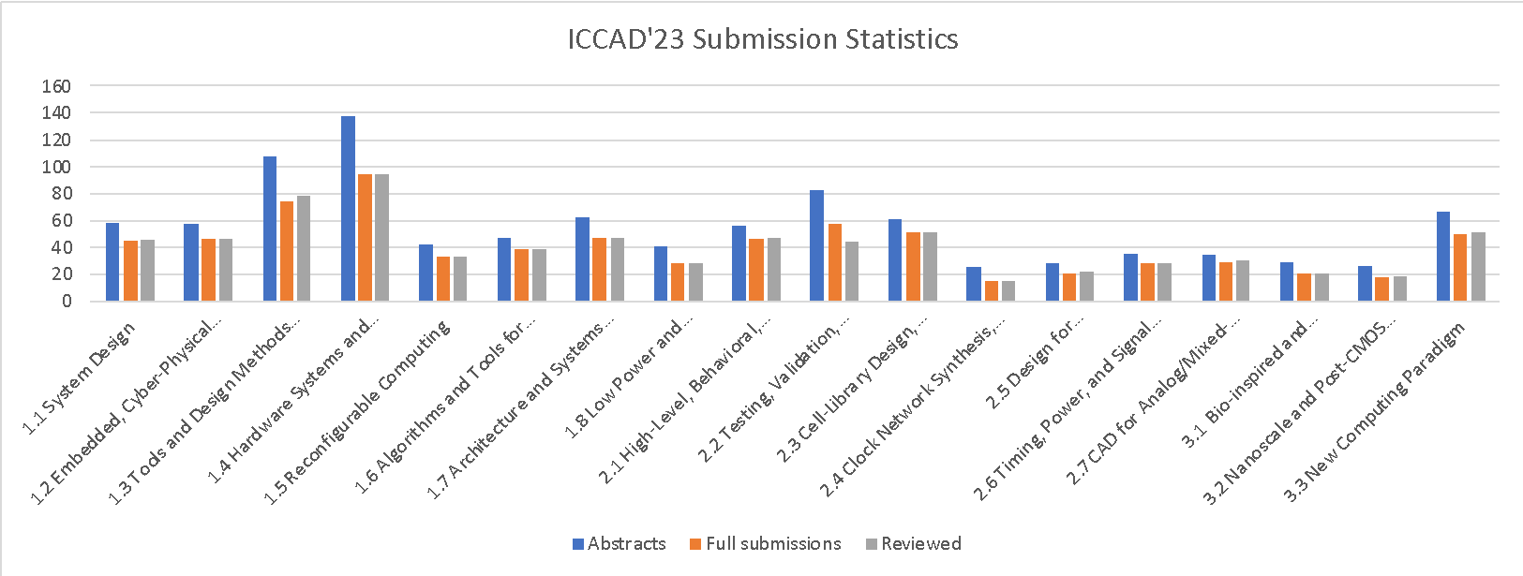
ICCAD Strengths
Submissions continue to have a healthy growth (~28% increase) from 2022
1006 abstract submissions, 750 full submissions (2 desk rejects)
172 papers accepted (~23% acceptance rate)
52 sessions: 40 regular, 9 special, 2 tutorials, 1 panel
(1109) Abstract submissions
(803) Full submissions
7% increase from last year.

Slide 66
Conference Statistics

Slide 67
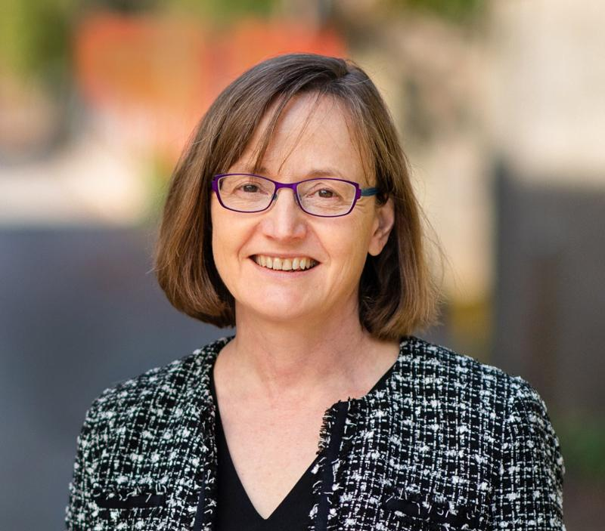
Tuesday IEEE CEDA Invited Keynote Luncheon
Mind the Gap: Challenges and Opportunities in Closing the Algorithms-to-Devices Gap in Quantum Computing
Margaret Martonosi
Professor of Computer Science
Princeton University

Slide 68
DATE Updates
Cristiana Bolchini
June 23, 2024

Slide 69
DATE 2024 in Valencia, Spain March 25-27
Location: Valencia, Spain
Dates: March 25-27, 2024
consolidating the 3-day format
no exhibition
flash presentations + videos

Slide 70
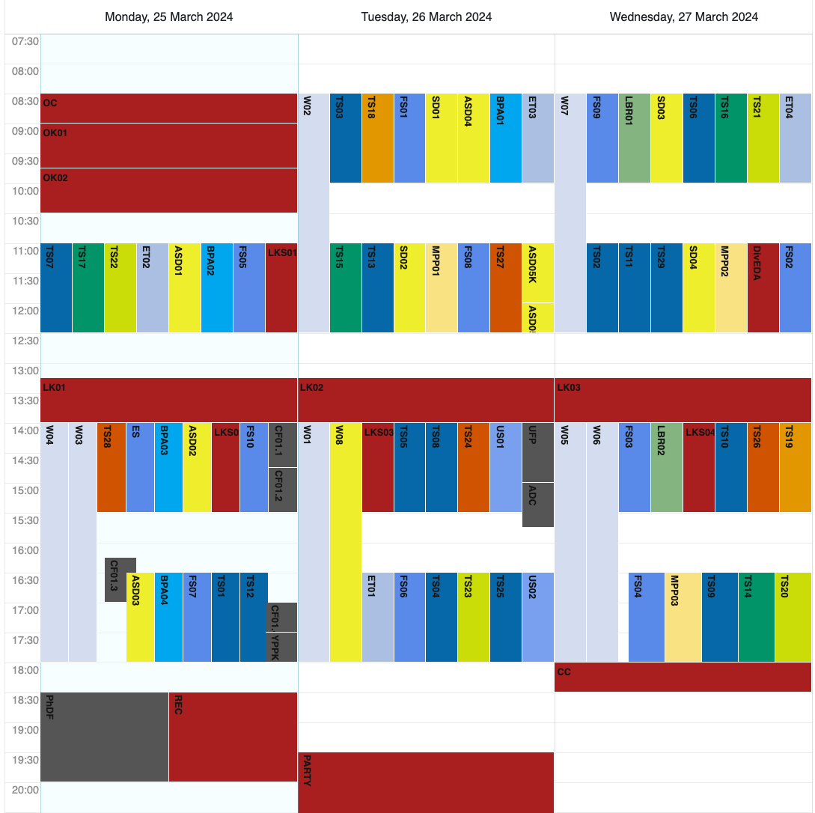
Program
scientific program
embedded tutorials
half-day workshops
focus sessions
late-breaking results sessions
multi-partner project sessions
special days
responsible and robust AI
sustainable computing
unplugged sessions
Autonomous System Design initiative
Young People Program
Diversity in EDA*
PhD Forum *
* CEDA sponsor

Slide 71
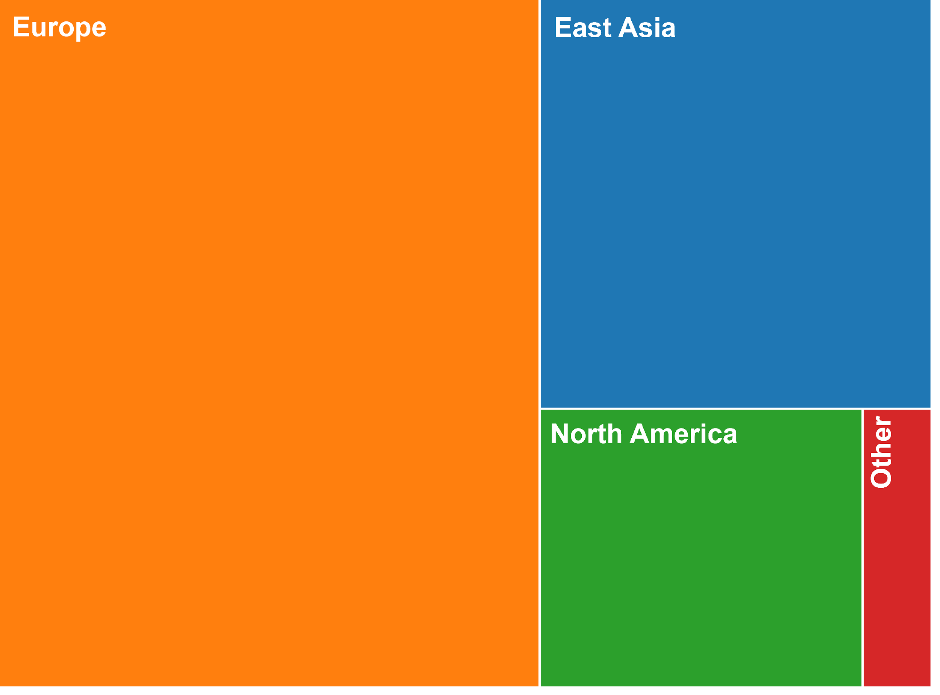
some numbers
+20% w.r.t. 2023 number of submissions/final papers
+36% w.r.t. 2022 number of submissions/final papers
more than 850 participants
attendees' country

Slide 72
DATE 2025
Location: Lyon, France
Dates: March 31 – April 2, 2025
General Chair: Aida Todri-Sanial, Eindhoven University of Technology, NL
Program Chair: Theocharis Theocharides, University of Cyprus, CY

Slide 73
ASP-DAC Updates
Kazutoshi Wakabayashi
June 23, 2024

Slide 74
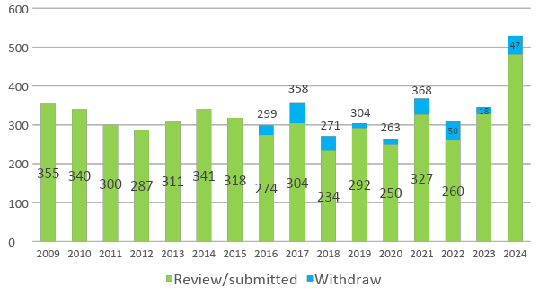
Paper Submission
529
346
310

Slide 75
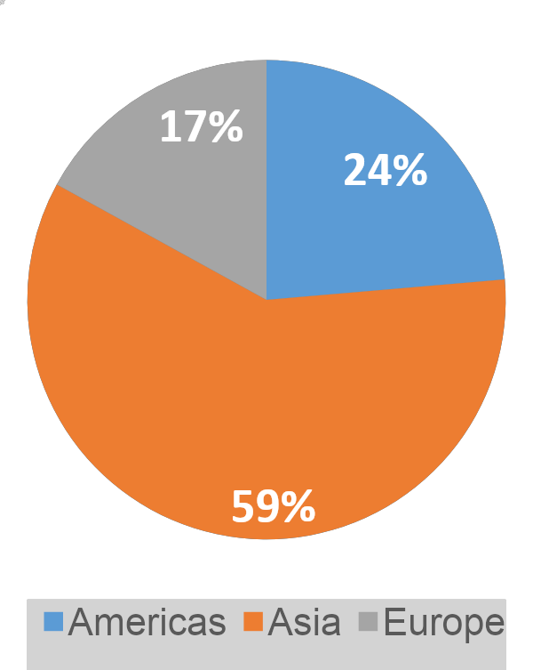
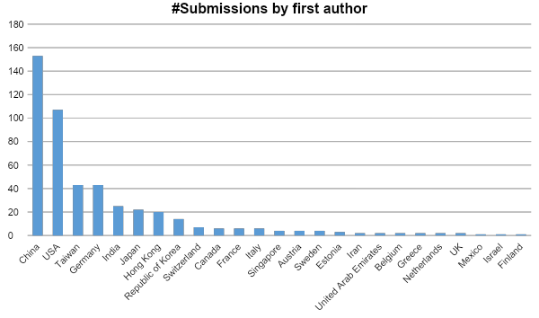
Submissions by Countries / Areas

Slide 76
Attendees (2023) (2021) (2019)
Total Number: 452 (🡨365) (🡨348) (🡨346)
Academia: 382 (🡨312) (🡨300) (🡨260)
(including 180 (🡨87) (🡨39) (🡨60)students)
Industries: 52 (🡨51) (🡨47) (🡨76)
Others: 18 (🡨2) (🡨1) (🡨3)
Tutorials: 94 (🡨68) (🡨50) (🡨60)
International participation
Korea: 187
Overseas: 265
ASP 176
Americas 53
EU 36
Notes:
Conference: paid 325 + free 12 (keynote 4, cadence 5, silvaco 1, ansys 1, opentext 1)
Academia: paid 294 + free 2
Industries: paid 26 + free 10

Slide 77
ESWeek Updates
Joerg Henkel
June 23, 2024

Slide 78
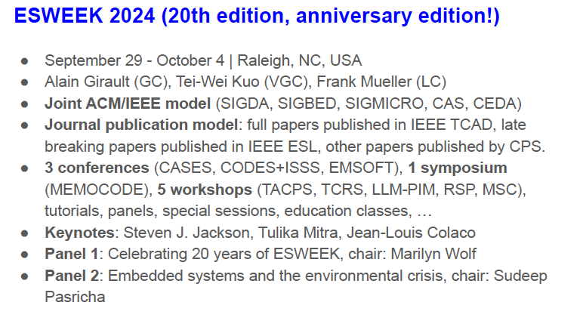
Notes:
Jorg till 21
David president elect from 2016

Slide 79
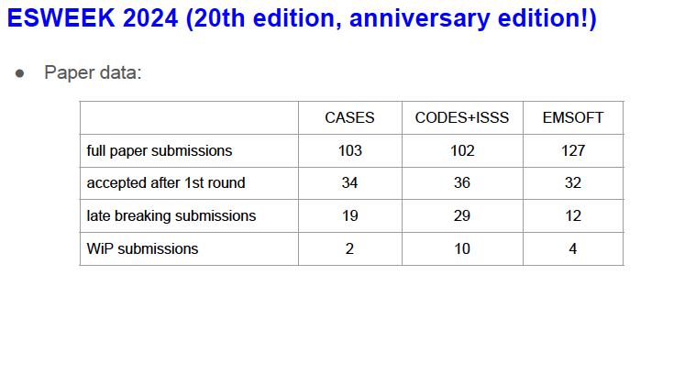
Notes:
Jorg till 21
David president elect from 2016

Slide 80
Conference Representatives
DAC
Gi-Joon Nam
Luis Miguel Silveira
ASP-DAC
Kazutoshi Wakabayashi
DATE
Cristiana Bolchini
David Atienza
ICCAD
Jiang Hu
ESWeek
David Atienza
Notes:
Jorg till 21
David president elect from 2016

Slide 81
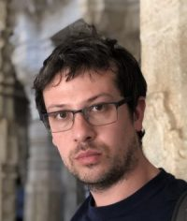
Motion: ESWeek Conference Representative
MOTION: Tsung-Yi HO moves to approve the appointment of Christian Pilato as the new CEDA ESWeek Representative started in July 2024.
Prof. Christian Pilato
Politecnico di Milano, Italy
Notes:
35 papers

Slide 82
Initiatives – Activities
Shared Machine Learning Infrastructure for EDA (SLICE)
Public domain training/test dataset
Interface between EDA and ML tools
Benchmark and testcases for EDA applications
Validation systems for ML EDA techniques
Extensible and privacy-preserving platform for community members to contribute
Team
Yiran Chen, Duke University
Vidya Chhabria, Arizona State University
Siddharth Garg, New York University
Jiang Hu, Texas A&M University
Andrew Kahng, UC San Diego
Sachin Sapatnekar, University of Minnesota
https://slice-ml-eda.github.io/

Slide 83
Initiatives – IEEE TCs
Continue the support of IEEE IoT TC
IEEE Smart Cities TC
Requesting a person from CEDA communication/outreach committee as a correspondent to their communication committee (providing access to Smart Cities social media channels for forwarding relevant information from CEDA)
Requesting two CEDA volunteers to work with them on technical tracks on cutting-edge cross-OU subjects
Other options on creating new common conferences/workshops
Since 6/1, IEEE Smart Grids program is under IEEE Smart Cities

Slide 84
Initiatives – IEEE New Initiative Program
https://www.ieee.org/about/corporate/initiatives/index.html
Areas seeking proposals
Increasing IEEE's connectivity to the industry
Engaging and recruiting members
Creating innovative education opportunities
Increasing the visibility of IEEE and its relevance to different communities
NIC seeks proposal topics that are in line with the IEEE Strategic Plan
Seed Grants
Typically $40K, within 12 months to complete
Innovation Seed Grant can go up to $100K, within 12 months to complete
New Initiatives
Typically $100K, within 12 months to complete

Slide 85
Publicity Update Sri Parameswaran
Website
Mail (Mailchimps)
Social Media
Conferences

Slide 86
Website
Migrated to Catalyze 2.0
Launched last month - May 2024
Featured posts on homepage
Announcements section
Upcoming events
Adding Member Society news/conferences to the website and in the newsletter
Looks Amazing

Slide 87
Mail
Standalone
Awards Call for Nominations
Kaufman Press Releases
Currents Newsletter - sent on the even months February
April
June
August
October
December
Community Calls - sent on odd months
January
March
May
July
September
November

Slide 88
Social Media
LinkedIn
Facebook
Twitter
YouTube
Possible Tiktoks of interesting excerpts?

Slide 89
Goals
Student Travel Grants
Engagement with students/YP and awareness of CEDA
Develop a platform to host tutorials, content, software, etc.

Slide 90
Future directions
Interviews with conference chairs / EiCs of Jounals / CEDA execs
Tried testing via zoom and teams –
Quality is varied
Quality is towards the lower end
A little monotonous
Any ideas?

Slide 91
Thank You

Slide 92
Standards - Dey

Slide 93
Electronics Design for Youngsters An IEEE CEDA Education & Engagement Initiative
Cristiana Bolchini, Enrico Macii
June 23, 2024

Slide 94
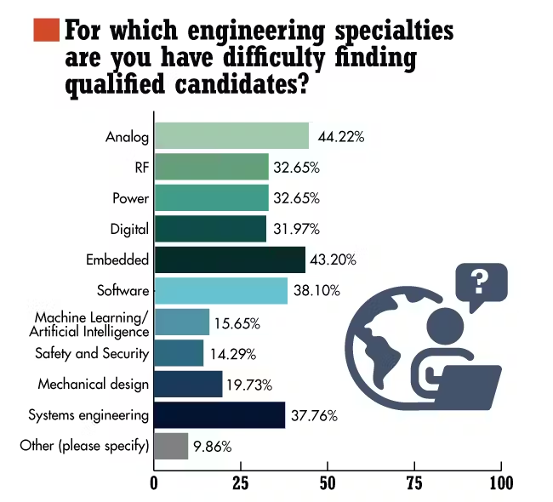
Shortage of design skills
Semiconductor industry needs hundred of thousands of new employees.
Circuits and systems designers are the most critical human resources to be found.

Slide 95
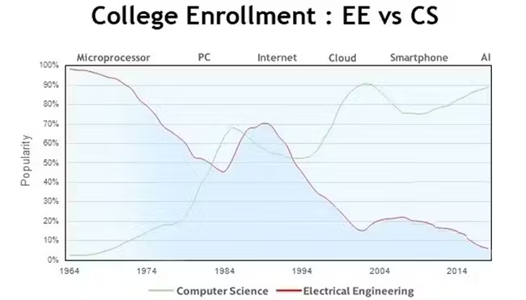
EE vocational crisis
The world is facing an electronics “vocational” crisis.
In the ICT domain, “electronics” is not as appealing as other subjects (e.g., AI, Data Science, Cloud, IoT).
Interest in EE curricula is steadily declining.

Slide 96
CEDA’s initiative
Develop an educational program to introduce high-school students to electronics design
Timeline
Phase 1: Program set-up (Nov 2023 - Sep 2024)
Phase 2: Pilot implementation (Oct 2024 – Mar 2025)
Phase 3: Assessment and improvement (Apr 2025 – Jul 2025)
Phase 4: World-wide delivery (Aug 2025 on-ward)

Slide 97
Report on Phase 1
The team:
Cristiana Bolchini, Fabrizio Ferrandi, POLIMI
Enrico Macii, Daniele Jahier Pagliari, Gianvito Urgese, POLITO
Achievements:
Preliminary definition of course organization and contents
Identification of design tools and case study, acquisition of FPGA boards
Hiring of a graduate student for material and lab development
Identification of 3 high-schools in Italy to host pilot delivery of the course

Slide 98
Report on Phase 1 (cont.)
Issues:
Selection of design tools
No licenses
Schematic entry of non elementary components
Simulation
Synthesis
Design exploration
Solution: The LATTICE Tool Suite (works with FPGA board, hidden to students)
Involvement of high-schools
Paper work
Timing

Slide 99
Course organization
30 hours, in presence, at university facilities or at high-school premises: lectures + labs
Activities spread over a period of max 1.5 months
Max 40 students per course
Instructors: Professors from POLITO and POLIMI

Slide 100
Course contents (preliminary)
Introduction to electronic technologies: overview and applications
What is a "chip", how it is made, how it works
The various types of "chips": calculation, storage, data transmission
The basic components, functional blocks, architectures, complex systems
How to design a “chip”: principles, methods, objectives, project phases
Project tools: how to describe, simulate, synthesize a “chip”
Industry testimonial: A professional designer shares his/her experience

Slide 101
Lab contents (preliminary)
Introduction to the LATTICE Tool Suite
Design examples of simple circuits
The concept of design exploration:
Practicing on a real case: Design of a "chip" capable of doing "Keyword Spotting“

Slide 102
BREAK

Slide 103
Awards - Chen

Slide 104
Awards - Chen

Slide 105
Activities - O’Connor

Slide 106
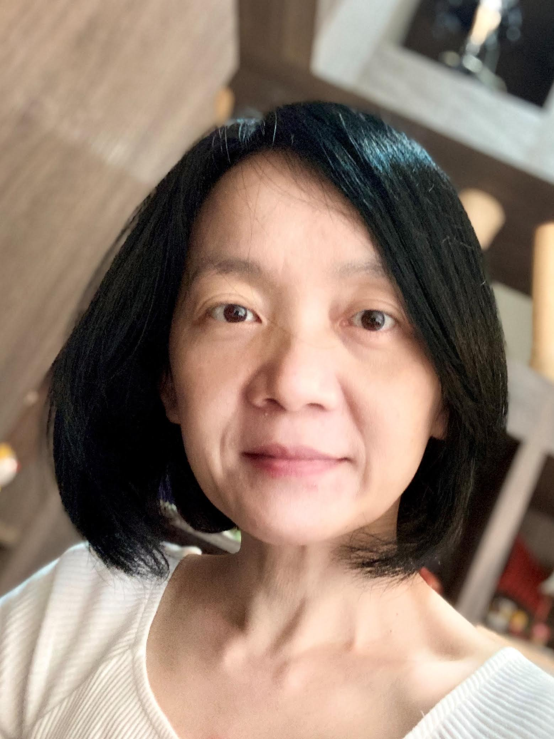
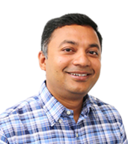
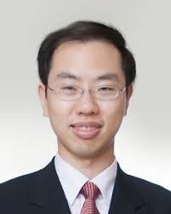
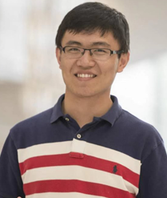
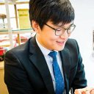
YP Activities
Young Professionals (YP) sub-committee
Conference activities for young professionals
Early Career Workshops
PhD Forums
University Demonstrations, Contests
Student travel grant program for CEDA-sponsored conferences and workshops
Iris Hui-Ru Jiang
NTU, Taiwan
Mohammad Al Faruque
UC Irvine, USA
Chung-Wei Lin
NTU, Taiwan
Meng Li
Meta, USA
Jinwook Jung
IBM Research, USA
Iris Hui-Ru Jiang

Slide 107
YP Activities – DAC
DAC Young Fellow Program is not included
Co-sponsor the YP events with SIGDA
Event |  | Lead
Early Career Workshop Organizers: Zhiding Liang (RPI), Rickard Ewetz (UCF), Mengxin Zheng (UCF), Ganapati Bhat (WSU) Speakers from LBNL, NYU, PNNL, JHU, NSF, Gatech, JHU, UW-Madison, UPenn, Northeastern University, Duke, UT Austin, UT Dallas, Argonne, Synopsys, JPMC, Microsoft. | R3016, 9am-5pm, Jun 23 | SIGDA
PhD Forum Organizers: Yingyan (Celine) Lin (Gatech), Vidya Chhabria (ASU), Guohao Dai (Shanghai Jiao Tong Univ.) | L2 Lobby, 7-9pm, Jun 25 | CEDA
University Demo Organizers: Umamaheswara Rao Tida (North Dakota State Univ.), Nan Wu (George Washington Univ.), Sumitha George (North Dakota State Univ.) | L2 Lobby, 7-9pm, Jun 25 | CEDA
System Design Contest Organizers: Meng Li (Peking Univ.), Qi Sun (Zhejiang Univ.), Sitao Huang (UC Irvine), Atefeh Sohrabizadeh (UCLA) |  | SIGDA

Slide 108
YP Activities – ICCAD / ESWEEK / SMACD
ICCAD
Co-sponsored YP events with SIGDA: SRC, CADathlon, … etc.
CEDA sponsored event: CAD Contest
ESWEEK
Co-sponsor with SIGDA: Fair and intelligent contest (led by SIGDA)
SMACD
EDA Competition approved in Feb. EC meeting

Slide 109
Student Travel Grants Plan
ESWEEK: proposing 6K (5K in 2023)
ICCAD: proposing 6K (5K in 2023) for student presenters
[proposing 5K (4.8K in 2023) for CAD contest winners]
DAC / DATE / ASP-DAC: merge with YP events
MLCAD 2024: 3K (approved in March)
Other workshops: planning up to 5K
Ad-hoc applications: planning up to 5K
https://ieee-ceda.org/ieee-ceda-student-travel-grant-program
Notes:
2023 ICCAD:
SIGDA provided 3K, CEDA provided 5K to support students travel to ICCAD to present their respective papers
SIGDA provided 16K for CADathlon, 9.2K for SRC
CEDA provided 4.8K for ICCAD contest

Slide 110
Technical Committees
HSTTC (Qu)
SVDTC (Prudvi)

Slide 111
Hardware Security and Trust Technical Committee (HSTTC) BoG Report
Gang Qu
InterContinental, San Francisco
June 23, 2024

Slide 112
Current Status
Conferences
Asian Hardware Oriented Security and Trust Symposium
Founded in 2016.
Taipei, Beijing, Hong Kong, Xi’An, Kolkata (virtual), Shanghai (hybrid), Singapore (hybrid), Tianjin.
Top Picks in Hardware and Embedded Security
founded 2018, co-located with ICCAD, special section in Design & Test magazine
Sustainable Hardware Security Workshop (SUSHI)
Founded 2022, sponsored by NFS, co-located with ICCAD.
Special sessions, tutorials, and panels.
CADforAssurance Webinars and Panels
Joint efforts with CADforAssurance.org (established in October 2020)
Online database of papers, benchmarks, and tools
Notes:
Please summarize your committee’s achievements here.

Slide 113
Achievement Highlights and Challenges
Conferences and workshops
AsianHOST’23: ~90 attendees, 60+ submissions to TCAS-I SI
SUSHI’22, ‘23: instant success
Contacted by other relevant conference/workshop for collaboration
Journal publication venues
AsianHOST: TCAD, TCAS-I
TopPicks: Design and Test
More volunteers
Advisory board and TC officers
How to incentive/motivate volunteers?
Notes:
Please summarize your committee’s challenges here.

Slide 114
Action Items
Continue supporting conferences
impact of AsianHOST
(near) future of SUSHI
HSTTC lead tutorials/special sessions
support of (new) conferences/workshops
HSTTC leadership
form the advisory board
appoint TC officers
One flagship in-person activity
students oriented
co-located with DAC/ICCAD/AsianHOST
Notes:
Delayed due to covid and unclear roles/responsiblities for the officers

Slide 115
Report Overview
Use “Rule of 7”
No more than 7 bullets per slide
No more than 7 words per bullet
Speaker notes contain what you say
Slide contains main points; clear graphics
~2 minutes average per slide presented
Save discussion for end of presentation

Slide 116
Motion(s)
Provide precise text that the EC is voting on.
Below the motion, please include pros, cons and any financial implications.
One slide per motion.
Example: To increase the budget for overlength page charges for 2019 to $125k.
Pros:
XYZ
Cons:
XYZ
Financial Implications: Amount in USD

Slide 117
SVDTC (System Validation and Debug Technology Council) Update (23rd June 2024)
Chinna Prudvi (President/Chair), Al Czamara (Vice President)
Eric Rentschler (Comms/Tech), Sankaran Menon (General Secretary)
BP Mathur (Coverage/AI WG Lead)

Slide 118
Current Status & Achievements
2023-2024:
IEEE P2929 Scan and Array Debug Standards WG: The Standards WG has been making steady progress in developing the Scan and Array Debug Standards. Team has been meeting every Thursday with ~15-20 highly motivated attendees on a regular basis. Meetings/Minutes distribution and iMeet site updates being done on a regular basis.
Scan and Array extraction chapters are 50% complete. Globals is 40% complete. Expect to complete by Mid to End of 2025.
Presented and discussed synergy with 1687.1 standard (IJTAG standard)
IEEE SVDTC AI/ML for Validation WG: This Work Group has been going on very well with about 8 to 10 attendees once every two weeks. Lots of interesting discussions are being held by attendees from various industries to improve the state of validation by using AI/ML techniques
Making progress on White-Paper on AI/ML for Validation
Exploring symbolic models for AI/ML based assertions both simulation and for use in silicon
2016 – 2023
Formed in 2016. ~70 members. ~25 active members. SVDTC Link
Met F2F at 2016/2017/2018 DAC. 2016 Student Awards & 2017 DAC tutorial on SVDTC topics
Completed 30-page SOC debug infra. white paper & published on SVDTC/CEDA website (2018)
Released white paper on “Scan and Array dump and extraction for debug”, Dec 2019. Post-Si Debug: Presented @ VTS’20 and MTV’19. Standardization work: Completed study group activities on Scan & Array dump.
Validation Coverage: Tutorial: “Extending validation continuum from Pre to Post-Si” VLSI conf, ’19 New Delhi, India.
Published coverage white paper in March 2021. Details published in the CEDA monthly newsletter.
IEEE P2929 scan & array debug standards WG approved by standards cmte. 3 Tiger teams formed and making good progress
AI/ML for post-silicon validation WG commenced April 2021. Three invited talks from AI academic & industry experts.

Slide 119
Challenges & Actions
Challenges:
Converge on a few problem statements for the AI/ML WG
Investigate GenAI in validation and debug space
Challenge is to scale and make it a bigger council with lots of members/activities
Explore more international participation (Outside US)
Actions:
Complete the AI/ML White-Paper
Increase academia and International participation in the AI/ML WG
Continue to make progress on P2929 standards
Expand SVDTC activities through adding additional activities outside US

Slide 120
Backup Slides

Slide 121
Scope and Purpose of IEEE P2929 (in PAR)
1. Scope:
Scope of proposed standard: This standard leverages existing standards-based test access mechanisms to capture and retrieve flip-flop and array/memory states. This standard defines a methodology for scan and memory/array debug data extraction for effective functional debug of System-on-Chip (SoC) and addresses other essential architectural modifications needed to support this, such as power-management changes. This standard provides a reliable and consistent methodology on trigger-based freezing of SoC scan and array states, and retrieval of those states.
2. Purpose:
Purpose: The methodology described allows simpler and quicker debugging of hardware and software, software testing, and performance analysis. Its output data format supports Machine Learning, Artificial Intelligence, and other efficient algorithms. Lastly, the methodology supports development of better Electronic Design Automation (EDA) tools to accomplish these tasks

Slide 122
Member Societies
APS (Okhmatovski)
CAS (Takahashi)
CS (Hemmady)
EPS (Schutt-Aine)
MTTS (Rayas-Sanchez)
SSCS (Tiwari)

Slide 123
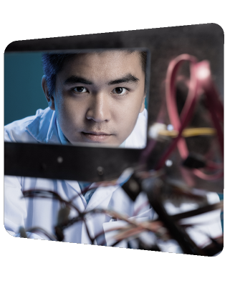
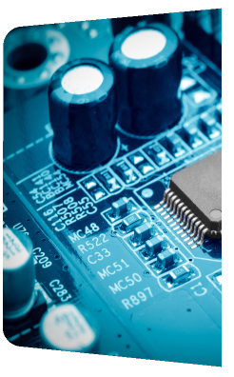
IEEE Electronic Packaging Society
CEDA Report 2024
Jose Schutt-Aine
Electronics Packaging Society

Slide 124
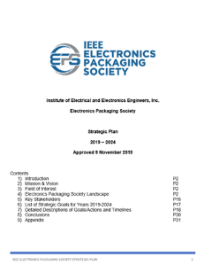
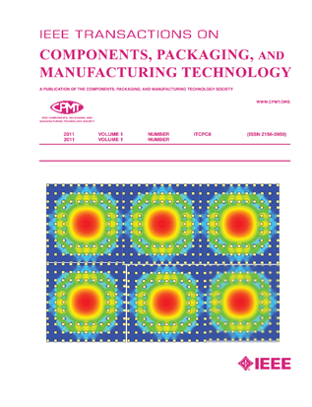
IEEE Electronic Packaging Society
Significant Worldwide Footprint
EPS is a small part of the IEEE organization, with just ~2800 members compared to the 400,000+ IEEE members worldwide
EPS has 43 Chapters, 36 Student/Branch Chapters
12 Technical Committees
Peer Reviewed Transactions
Supports Financially and/or Technically Sponsors /Cosponsors more than 25 Conferences
Solid Education Program
Heterogeneous Integration Roadmap
All the Above Supported by our Strategic Plan (2019 – 2024)
https://eps.ieee.org/

Slide 125
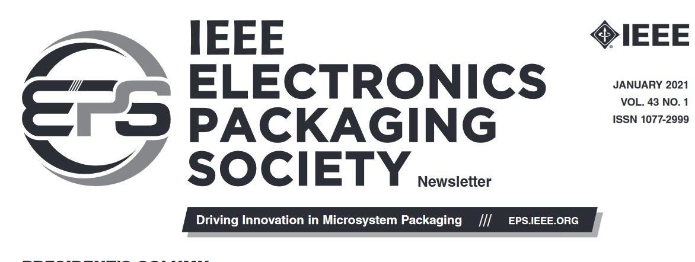
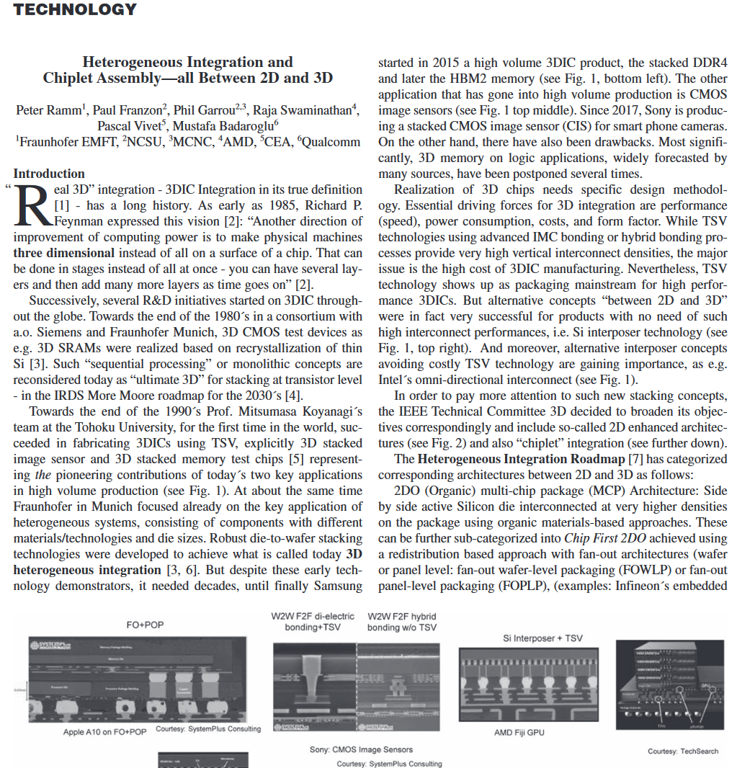
Technical Communities
Materials & Processes
High Density Substrates & Boards
Power & Energy
Electrical Design Modelling and Simulation
Nanotechnology
Photonics
Thermal & Mechanical
3D/TSV
Reliability
RF & TZ Technologies
Test
Emerging Technologies

Slide 126
https://cmte.ieee.org/eps-edms/

Slide 127
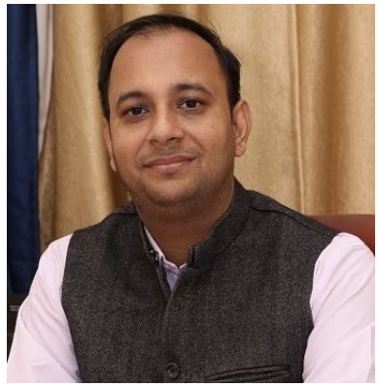
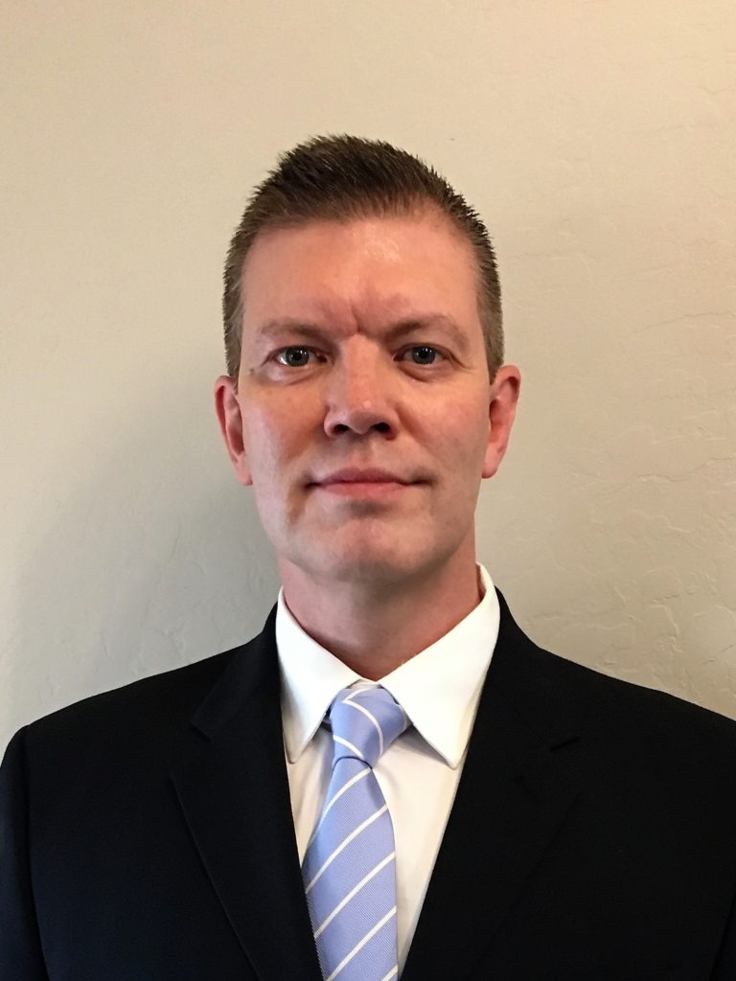
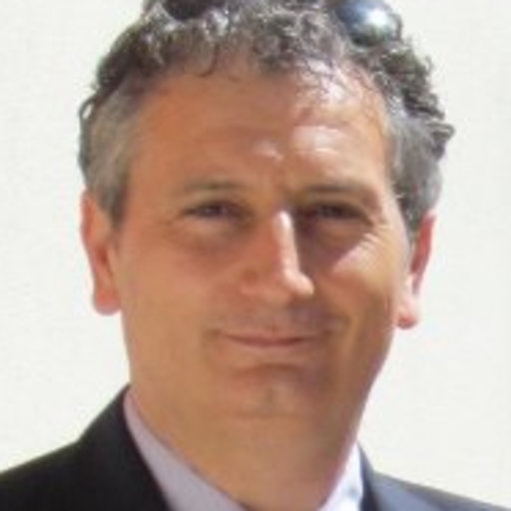
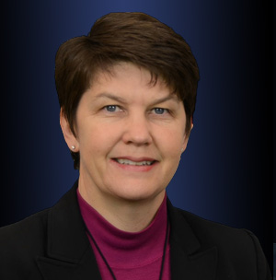
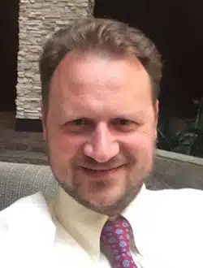
The Technical Committee
Leadership:
Prof. Rohit Sharma, Indian Institute of Technology Ropar, India (chair)
Dr. Kemal Aygun, Intel Corporation, Chandler, Az, USA (co-chair)
Prof. Antonio Maffucci, Univ. Cassino and South. Lazio, Italy (co-chair)
Subcommittee: Packaging Benchmarks
Dr. Heidi Barnes, Keysight (Chair)
Prof. Vladimir Okhmatovski, Univ. Manitoba, (co-Chair)
Three Benchmark subcommittees
Members – 78 on mailing list
Website: https://cmte.ieee.org/eps-edms/

Slide 128
Mission
The EDMS TC addresses the electrical aspects of package and system design.
The committee strives to balance industry and academic participation to guide the members of the EPS society in this area.
Activities
EDMS is involved in several chapters of the Heterogeneous Integration Roadmap, chairing two of them.
A benchmark subcommittee is providing designs for researchers to develop their electrical design methodologies.

Slide 129
EDMS Outreach Areas
IEEE Heterogenous Integration Roadmap (HIR):
HPC and Co-Design Chapters Leadership and Participation in others such as 2D/3D and simulation
Workshop and Seminar Presentations by members of TC-EDMS
https://eps.ieee.org/technology/heterogeneous-integration-roadmap/2023-edition.html
TCPMT Special Sections
“Advances in Electrical Modeling and Validation of Electronic Packaging and Systems” (Sept 2021, Guest Ed: Kemal Aygün, Intel and Xu Chen, UIUC): https://ieeexplore.ieee.org/xpl/tocresult.jsp?isnumber=9534856
EPS Newsletter articles
Available at: https://eps.ieee.org/publications/eps-newsletter.html
Packaging Benchmarks
Website launched with 4 peer reviewed benchmarks: https://packaging-benchmarks.org/
Distinguished Lecturers (DLs)
Wendem Beyene, Kemal Aygun, Ram Achar, José Schutt-Ainé, Rohit Sharma, Rajen Murugan
Complete list of EPS DLs at: https://eps.ieee.org/education/distinguished-lecturer-program.html
Conferences sponsored by IEEE EPS Society and TC-EDMS: SPI, EPEPS, EDAPS and DTMES

Slide 130
Education
Certificate Programs
Achievement
Distinguished Achievement for Technical Leadership and Expertise
Distinguished Achievement Certificate for Professional Engagement and Service
Webinars on Resource Center
Technical Committee webinars are held monthly
Professional Development Courses at conferences
Distinguished Lecturers
Student Competitions at conferences
Heat Sink Design Challenge
Itherm Student Poster competition

Slide 131
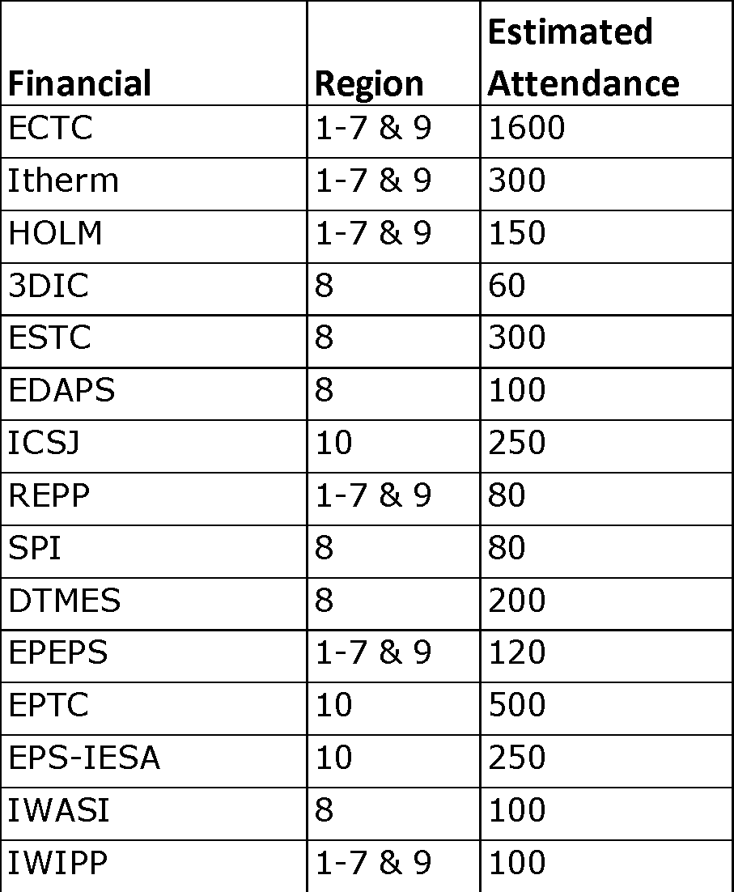
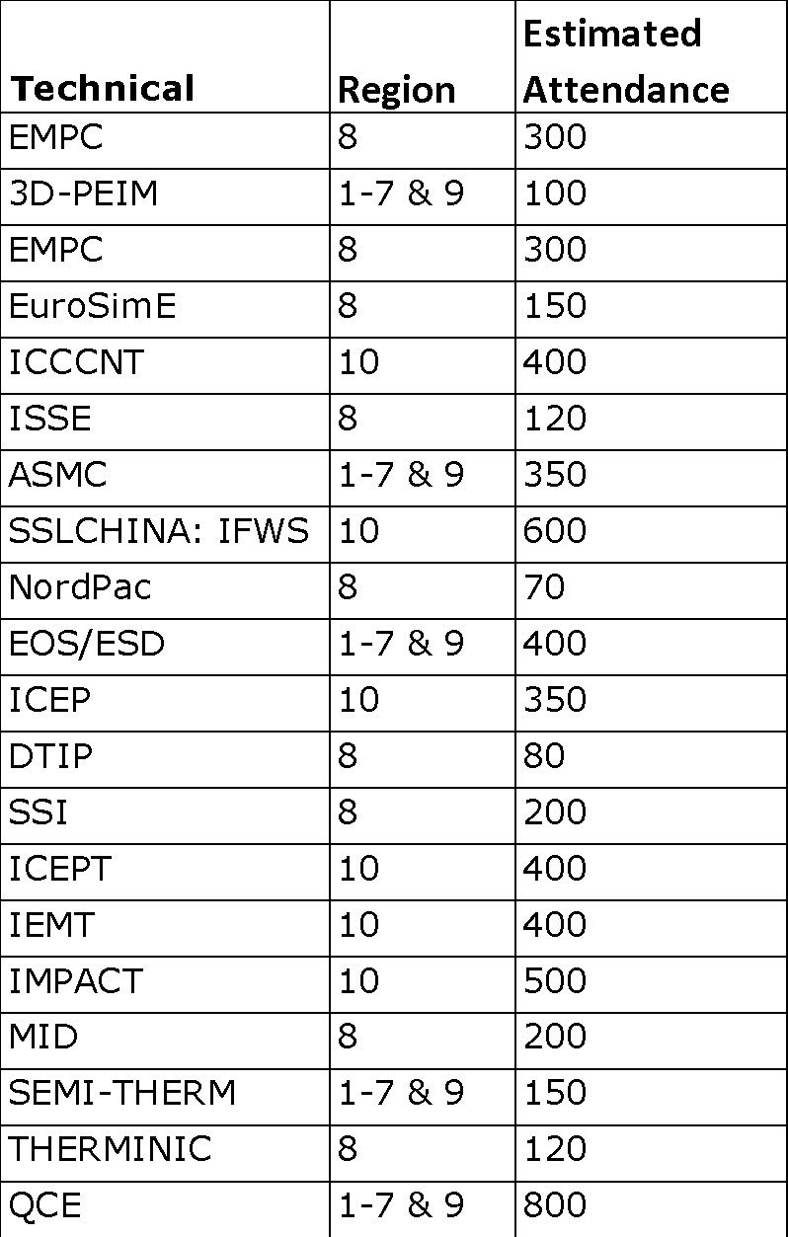
EPS Sponsored Conferences
DTMES – 3rd annual conference in Ethiopia
EPS-IESA – 2nd annual conference in India

Slide 132
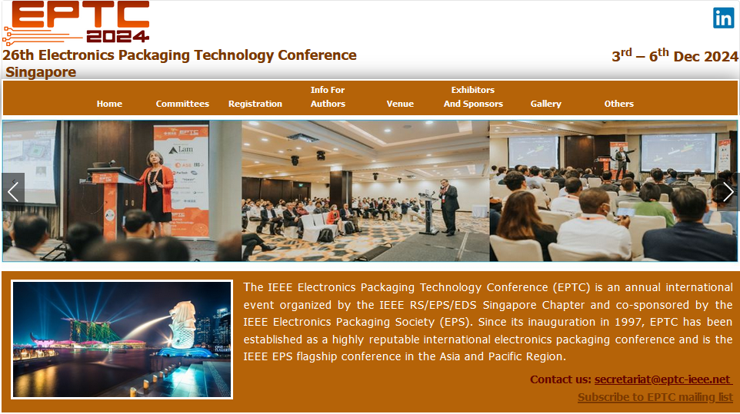
EPS Sponsored Conferences
ECTC
EPTC
ESTC

Slide 133
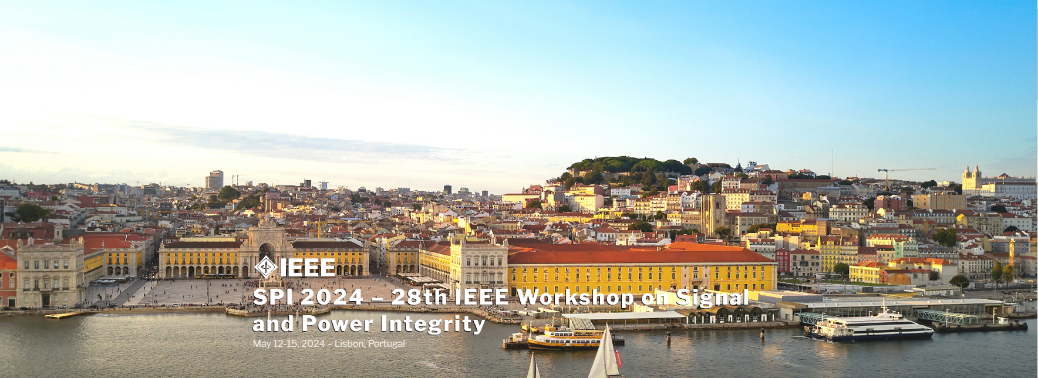
EPS Sponsored Workshops
SPI
EPEPS
DTMES
EDAPS

Slide 134
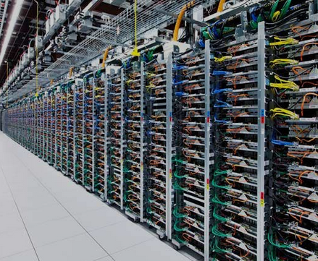
Packaging Main Focus: AI Energy Requirements
Data centers used 2.5% of US electricity in 2022
Projected to increase to 20% by 2030
Training a large language model like GPT-3 is estimated to use 1,300 megawatt hours (MWh) of electricity.
Solution: Advanced Packaging

Slide 135
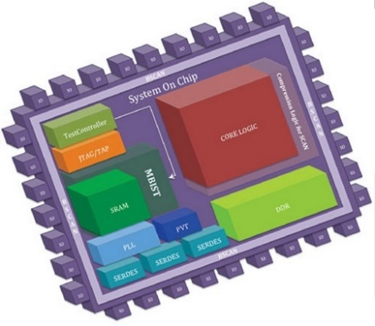
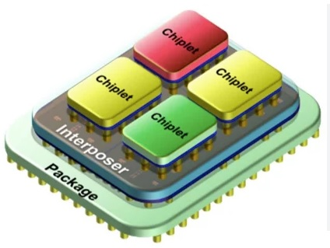
Need for: Heterogeneous Integration
Motivation: Ubiquitous materials and technologies
Die, interposer, substrate
Scaling is with wavelength rather than technology
Opportunity: New interconnect technologies
Increased density of I/Os, finer pitches
2.5D/3D integration
Performance objective: minimize energy and delay
Approach: Use chiplets
SOC
SiP
‹#›

Slide 136
Barriers to Heterogeneous Integration
Technical Challenges
problem size and complexity 🡺 computational bottleneck
design tools need more intelligent interfaces
Socio-Academic Challenges
lack of information sharing within entities (data)
lack of common standardized formats
lack of access to low-volume manufacturing for validation
lack of access to design tools for exploration purposes
lack of multidisciplinary curriculum in advanced packaging

Slide 137
MTT-S Report
José Rayas-Sánchez
San Francisco, CA
June 23, 2024

Slide 138
MTT-S Report
MTT-S Inter-Society Committee
MTT-S and CEDA recent collaborations
MTT-S Technical Committee on Design Automation (TC-2)
Recent TC-2 events
CEDA related MTT-S Conferences

Slide 139
MTT-S Inter-Society Committee
MTT-S Inter-Society Committee oversees cultivating relationships with IEEE Councils and other technical societies
Inter-Society Committee is aiming at encouraging a stronger participation of MTT-S in IEEE Councils
MTT-S currently has official representation in 7 councils

Slide 140
MTT-S Representation in 7 IEEE Councils

Slide 141
MTT-S and CEDA Recent Collaborations
The MoU between MTT-S and CEDA was recently renewed for 2024‐2026
Miguel Silveira, IEEE CEDA President (2024‐2025), was a special guest of the MTT-S AdCom meeting in Porto, Portugal (Sep. 2023)

Slide 142
MTT-S Tech. Committee on Design Automation
MTT-S has 29 technical committees (TC)
The MTT-S Technical Committee on Design Automation (TC-2) is the closest to CEDA; it focuses on:
Modelling and simulation of devices, circuits, and systems
Non-linear analysis
Optimization techniques
Multi-physics modelling
Machine learning and artificial intelligence for design automation
MTT-2 regularly organizes technical events/initiatives on CAD and EDA

Slide 143
MTT-S Tech. Committee on Design Automation
https://mtt.org/technical-committees/tc-2-design-automation-committee/

Slide 144
June 19, 2024
1:30pm – 3:10pm
Room 145AB

Slide 145
Recent TC-2 Invited Paper
(to be submitted by June 30, 2024)

Slide 146
June 16, 2024
1:30pm – 5:20pm
Room 206

Slide 147
CEDA-related MTT-S Conferences
2024 IEEE MTT-S Int. Conf. on Numerical Electromagnetic and Multiphysics Modeling and Optimization (NEMO’2024)
August 11 - 14, 2024, Montreal, Canada.
http://nemo-ieee.org/

Slide 148
LAMC 2025: San Juan, Puerto Rico, Jan. 22-24, 2025
Seven Main Technical Topics, one of them is on
CAD Techniques for RF and Microwave Engineering
Submissions from CEDA members are very welcome!
https://lamc-ieee.org/

Slide 149
Thanks
José Rayas-Sánchez
IEEE MTT-S Representative for CEDA

Slide 150
Solid State Circuits Society Report
Vivek Tiwari
June 23, 2024
Notes:
Bryan's additional activities:
Bryan was on the Fellow Committee & Constitution and Bylaws Committee

Slide 151
Report Overview
Joint Membership Stats
Quick summary of some key areas of focus
Backup material for reference – SSCS/CEDA joint activities

Slide 152
CEDA and SSCS - Background
Purpose of Engagement:
Solid state circuit design and electronic design automation are so interdependent that they rely on each other for their very existence. Engagement allows the latest knowledge to be shared at both the organizational and the individual contributor level
An opportunity for CEDA and SSCS members to share:
Most troublesome design methodology challenges faced by designers
Design opportunities created by latest tool developments
i.e.
What do designers need from toolmakers, What do toolmakers need from designers
Implement using: Co-sponsored Conferences, Publications and cross-visibility and cross-engagement for Workshop/forums, Webinars, Activities, Initiatives
CEDA membership is free of cost for SSCS members
Explore opportunities to increase benefits for SSCS members through CEDA

Slide 153
CEDA-SSCS Joint Membership Stats
Joint Membership Stats
Source: Adam Greenberg
Council on EDA | Active Members | Total Active SSCS Members | Pct. Active SSCS Members
June 2024 | 10,022 | 943 | 9.67%
(Feb 2024) | 11,542 | 1,143 | 9.9%
(June 2023) | 18,425 | 997 | 5.4%
(Feb 2023) | 16,594 | 1055 | 6.4%
(Dec 2021) | 10,500 | 693 | 6.6%
SSCS AdCom will regularly track joint membership stats for partner Councils and Initiatives
Looking for ideas for increasing joint membership
Increasing visibility about Councils with the SSCS members is an area of focus for the AdCom
Notes:
SSCS roughly same as CEDA last couple of years – 11K June 2023, 9757 June 2024
From Adam: June 2024
OU Analytics shows 9757 SSCS members and 10,022 CEDA participants as of today.
943 SSCS members participate in CEDA, so 9.67% of all SSCS members are CEDA participants and SSCS members account for roughly the same percentage (9.4%) of all CEDA participants.

Slide 154
Summary of Key Topics of Discussion (Updates from last BoG)
1. Increasing visibility of CEDA within SSCS community, leveraging various channels
SSCS magazine: Enhance the CEDA Newsletter insert with an introductory statement – Done. Starting Spring ‘24
SSCS magazine: Submit introductory article on CEDA and CEDA/SSCS collaboration – Done. Winter’23 Magazine
“News from Councils”: Looking to add a “news from Councils” sub-page to the SSCS CCI webpage – Dropped, for now
New: Increase publicity for member society conferences via a section on the Conferences page – SSCS will follow-up
New: Submit updates to be featured in the news section of Solid-State Circuits Magazine each issue – Need contact/help
Conferences: good example: CEDA Phil Kaufman award announcement at ISSCC’23/’24 Opening Session - Sustain
2. Technical collaboration in strategic areas for Circuits/EDA – Focused opportunity “Generative AI for Circuits”
Engagement and support for IEEE “LLM Aided Design” - SSCS very supportive. WIP on next steps
Start engagement with the Solid States Circuits Directions Committee – TBD. Other ideas?
3. Reinvigorate engagement on the Technical Co-Sponsorship conferences (DAC / DATE) and explore for others
Alignment for timely and consistent engagement model. DAC MoU executed till ‘26. ISLPED TCS renewed till ’29. Mutual commitment to move fast for any issues wrt conferences.
Increase ROI beyond “sharing of logos” for TCS conferences – Special Sessions, Design Contests, Workshops - Ongoing
Notes:
Alignment of MOUs for consistent engagement model.
As we are engaging with more conferences at TCS level, many of them ask to set-up SSCS sessions. We need to work on the mechanisms to make this possible. Here some ideas:
- Have specific call for papers for special sessions distributed through the SSCS channels.
- Understanding how we can have SSCS members as part of the conference TPC, at least to review the SSCS papers.
- Possibly having a SSCS member chair the special session, as this will help contacting possible speakers.
- Have a list of possible presenters (including topic) for either tutorials or invited papers (which will still have to go through the review process). This is important as many members of other societies may not have a strong network within the SSCS community.
TCS for DAC and DATE – Alessandro’s focus to increase the ROI of TCS for both conference and SSCS membership.
Discuss/brainstorm with CEDA leadership and help to get the conferences/collaboration fully engaged and plan to discuss further with SSCS.
Workshops/Contests on topics like AI/ML in design/production of designs resonated during our discussion as an interesting collaboration topics.
In the past had the Student Design Contest
One other point to add we discussed – that once we get the engagement with DAC and DATE reinvigorate – we should consider consistency/collaboration across the CEDA portfolio of conferences eg ASP-DAC

Slide 155
Action Items/Help Needed
Submit updates to be featured in the news section of Solid-State Circuits Magazine each issue: CEDA owner/contact?
CEDA owner?
“Generative AI for Circuit Design”
SSCS engagement and support for IEEE “LLM Aided Design” – Vivek with SSCS
Other ideas / CEDA owners?
Streamline conference collaboration beyond TCS
CEDA owner?
Notes:
SSCS may adopt the newsletter archive idea
Generative AI: setup call with SSCD asap (Payam Heydari, Kaushik Sengupta) –Looking for additional names from CEDA

Slide 156
Cross-visibility Opportunities
CEDA Currents Newsletter is published in Solid State Circuits Magazine
Request: Enhance the inclusion template to include :
“CEDA and SSCS have a strong mutually beneficial relationship. CEDA provides tools/networking/services for circuit designer to connect with the EDA community”
Contributed article on CEDA overview and opportunities for collaboration in circuit design community in SSCS Magazine Winter’24 https://ieeexplore.ieee.org/document/10410048/

Slide 157
CEDA Member Society Conferences Publicity
From: Laura Paul <lpaul@conferencecatalysts.com> Sent: Thursday, May 30, 2024 10:51 AM Subject: CEDA Member Society Conferences
Dear CEDA Member Society Representatives,
CEDA has recently launched a new website! If you have not yet had a moment to look it over, please visit at: https://ieee-ceda.org/
In an effort to increase publicity, we now have a section on the Conferences page for member society conferences.
If you would like your member society's flagship conferences included on the CEDA webpage, please complete the Google form at the link below. If your society has more than one flagship conference please submit this form for each event.
Form link: https://forms.gle/Gqetr2qczgJSReXE9
SSCS informed. Will be following-up

Slide 158
Request: CEDA Updates
From: Danielle Marinese <d.marinese@ieee.org> Sent: Thursday, June 20, 2024 5:00 AM Subject: Solid-State Circuits Magazine: Fall 2024 Issue
SSCS would like to invite council representatives to submit reports/updates to be featured in the news section of Solid-State Circuits Magazine each issue. We request that one representative volunteer.
The deadline to send any submissions for SSC-M: Fall 2024 is August 30.
Please respond to this email to let me know if you would like to submit an article.
Please include the below information upon submission: - Author name(s) - Author email address(es) - Author institutional mailing address(es) (not emails) - Author ORCID(s)
- Your submission must be kept at 1000 words + 1-3 photos in .doc format.
Let me know if you have any questions! Thank you, Danielle

Slide 159
PHIL KAUFMAN AWARD
CEREMONY & BANQUET
JOIN US TO HONOR—
ABOUT THE RECIPIENT
Dr. Pileggi is being recognized for his
significant contributions to the Electronic System Design Industry.
ABOUT THE AWARD
The Phil Kaufman Award honors individuals who have had a demonstrable impact on the field of electronic system design through technology innovations, education/mentoring, or business or industry leadership.
MORE INFO &
REGISTER HERE
Dr. Lawrence T. Pileggi
Coraluppi Head and Tanoto Professor of Electrical and Computer Engineering
Carnegie Mellon University
https://semiamericas.org/phil-
kaufman-award-banquet
February 22, 2024 | 6:30–9:30pm | The Glasshouse | San Jose, CA
Immediately following ISSCC on Thursday Evening

Slide 160
Exploring collaboration on AI/ML for Circuit Design/EDA
In last AdCom we talked about “LLMs for Circuits” as a topic that would be of particular interest at the intersection of Circuits and EDA and had talked about exploring organizing a workshop for this
Upcoming CEDA sponsored first ever “International Workshop on LLM-Aided Design” https://www.islad.org/
Appears to be the perfect venue for building SSCS interaction in this area with the EDA community
Expect this to continue and develop into a Symposium. Exploring TCS sponsorship for Wkshp/Symposium
Discussion with Prof Deming Cheng (CEDA VP of Awards) and Ruchir Puri General Chair of ISLAD
“ML use in design is a very interesting topic that is likely to significantly change the way we design and optimize circuits – please consider if there are opportunities for SSCS to collaborate and potently also be a sponsor of workshop.”
“CEDA welcomes SSCS's sponsorship toward this workshop too. ”
Other:
Collaboration with the CEDA Design Automation Technical Committee
See the DATC materials in backup for reference
Collaboration with System Validation and Debug Technical Committee
Active WG on AI/ML for Validation/Debug, White-paper is WIP

Slide 162
Conference Engagement/Collaboration Thoughts
As we are engaging with more conferences at TCS level, many of them ask to set-up SSCS sessions. We need to work on the mechanisms to make this possible.
Some ideas:
Have specific call for papers for special sessions distributed through the SSCS channels
Understanding how we can have SSCS members as part of the conference TPC, at least to review SSCS papers
Possibly having a SSCS member chair the special session, as this will help contacting possible speakers
Have a list of possible presenters (including topics) for either tutorials or invited papers (which will still have to go through the review process). This is important as many members of other societies may not have a strong network within the SSCS community.
Workshops/Contests on topics like AI/ML in design/production of designs resonated during our discussion as an interesting collaboration topic. In the past had the Student Design Contest
Once we get the engagement with DAC and DATE reinvigorated – we should consider consistency/collaboration across the CEDA portfolio of conferences eg ASP-DAC

Slide 163
Backup

Slide 164
CEDA: Summary Update (incremental update for Feb 2024)
Conferences – Return to in-person
DATE March ’24; DAC Jun ’24; ICCAD Nov ’24; ASP-DAC Jan’24, ESWEEK Sep-Oct’24
Great effort to attract attendees with new formats, new activities, sponsored activities for young people
Publications: Doing well, identified continued improvements being applied
TCAD: growth in submissions (Asia), focus on maintaining, improving metrics, EiB refreshed
D&T magazine: increase general interest topics - special editions, conference tie-ins
JxDC: awaiting Impact Factor in 2022; Paper solicitation is highest priority with focus on Special Topics
HW Security, AI/ML interest accelerating, Manufacturing, Semi Life Cycle – in line with prior strategic areas
Financials:
Expenses in 2022 slowly ramping-up to pre-COVID levels, some uncertainty about winter
Budget 2023 - conservatively going back to pre-COVID budgets
Priority for changes: Initiatives; Periodicals increased page counts
Strategy discussions:
Government investments across the world in Semiconductor Design and Tools
The world is facing an electronics “vocational” crisis, interest in EE curricula is steadily declining, not as appealing as other subjects (e.g., AI, Data Science, Could, IoT) – create outreach to high school students
Leverage the fact that AI/ML/Data Analytics can offer a “modern” look to design
Notes:
Revenues from periodicals and conference related publications
Slowly recovering pre-COVID levels for meetings and conferences.
Still conferences sponsorship lower than normal, We’ll see what happens 2nd half of the year
Periodicals – increased page counts to be managed Initiatives – Pending discussion on expected expenses for 2022 (and 2023)
Budget focus: Awards, Distinguished Lecturer Program, CEDA Luncheons, Local Chapters, Technical Committees, Contests, Young Professionals, Initiatives
2023 Initiatives focus: Cyber-physical systems summer school, Design Automation for Power Electronics (DAPE) wkshp support, Diversity in EDA, ML-CAD workshop, Student Travel Grant
ASP-DAC'23 was hybrid. All sessions ran as in-person events, but they also provided live zoom sessions with live / pre-recorded presentations for authors who couldn't attend in-person (for example, presenters from China etc).
ASPDAC’23 Tokyo, DATE’23 Antwerp
The ACM/IEEE International Conference on Computer-Aided Design was held in San Diego, California from 30 October-4 November. The event brought together over 500 attendees from around the world, both virtually and in-person. Attendees were able to witness three stimulating keynote talks, fifty-five technical sessions, seven different workshops, three different contests, the first ever job fair, and many other networking opportunities.
Strategic Areas:
RISC-V and open hardware – Architectures (HW and SW), tools, applications
Very hot in Europe
Edge AI – Toolchains for AI/ML automatic deployment of HW platforms
Industry 5.0 – Add social impact and sustainability to the I4.0 paradigm
Digital Twins – From data to models and DTs (automatically)

Slide 165
CEDA: Summary Update Feb 2024
Activities Summary:
Awards, Tools, Standards, Outreach through the Technical Committees; Goal to increase engagement and participation of Member Societies and representatives
Some highlights:
CAD for Assurance Webinar – initiated Feb’21; Two panels in ‘23 series.
May’23 panel “Microelectronics Supply Chain Security: What Can Save Us?”
Design Automation Webinars (DAWN) – initiated 2020 during COVID. April 11-12 2022, on website, Youtube
Distinguished Lecturer Program
Feb’23: Dr. Sheldon Tan Title: Data-Driven Deep Learning for Full-Chip Thermal & Power Estimation …”
Mar’23: Dr. Mohammad Abdullah Al Faruque Title: Cross-Layer Security of Embedded and Cyber-Physical Systems
April’23: Dr. Hai Li Title: On Device AI to Better Mobile and Implantable Devices in Healthcare
Registration is free for all webinars. If you are unable to attend the "live" virtual events, the presentations are available on the Presentation Library (as part of Virtual DL webinar series) and the CEDA YouTube channel after the event.
Philip Kaufman Award – 2023: Dr. Lawrence T Pileggi– Ceremony Feb 22, San Jose. Wally Rhines Moderator
Requesting publicity at ISSCC like in 2023
Young Professionals – DAC Early Career Workshops, PhD Forums, Univ Demos; Planning Contests, ICCAD events
Design Automation Technical Committee updated goals - Research foundations for IC Physical Design and ML-Enabled EDA (slides in backup)
System Validation and Debug TC – focus and progress on IEEE P2929; AI/ML for Validation WG and White-paper
Hardware Security and Trust Technical Committee – Asian HOST Singapore’22 (hybrid), Top Picks Wkshp ICCAD’22
Notes:
https://cadforassurance.org/
https://ieee-ceda.org/cad-assurance
https://ieee-ceda.org/dawn-webinars
https://ieee-ceda.org/distinguished-lecturers-program
https://ieee-ceda.org/presentations/grid
https://www.youtube.com/channel/UCtV0i4UH8cElzn4lgl7VrAw
https://www.ieee-hsttc.org/
IEEE P2929 scan & array debug standards

Slide 166
CEDA and SSCS Joint Activities
Current Formal Engagements:
Design & Test Magazine
Journal on Exploratory Solid-State Computational Devices and Circuits (JxCDC)
CEDA Currents Newsletter in Solid State Circuits Magazine
CEDA publishes SSSC news/conferences in Currents and monthly Community Calls upon request
Initiatives: Rebooting Computing Initiatives (& IOT and Brain Initiatives)
On-going/Future explorations:
Webcasts and Webinars
Cross-publicity of respective Webinars (utilize offline/archived viewing opportunities – accelerated by COVID era; free online content competition from ad-hoc sources);
Joint Webcasts on special topics (e.g. “Design challenges for advanced notes”);
SSCS Distinguished Lecturer Series - Currently EDA representation is low. Should we nominate some EDA speakers from CEDA and vice-versa?)
Leveraging publications like D&T Magazine and JxCDC better between the two communities
Increase cross-engagement on technical activities (DATC – benchmarks, datasets; HW Security, Semiconductors Device Modelling and Measurements)
CEDA members as Mentors in SSCS Mentoring Program
Strengthening cross-engagement in conferences. E.g. “Sponsored” special sessions/invited talks in conferences
Continue support for Intl Symposium on Low Power Electronics and Design – ISLPED for next 5 years (2025-2029). SSCS Conference Committee approved unanimously. I will be the ISPLED contact for SSCS.
Continue support for DAC and DATE as SSCS Technical Co-Sponsorship conferences. Any help needed to make contacts?
In the last SSCS Ad-com meetings we were discussing ways to increase awareness among Society members about the Councils
Phil Kaufman Award call-out at ISSCC
CEDA overview in SSCS Magazine
SSCS Workshop announcements on CEDA Current Newsletter and CEDA Workshop announcements on SSCS newsletter
E.g. IEEE SSCS Non-Traditional Computing Paradigms with Emerging Technologies for Energy Efficiency Workshop included in CEDA Currents October ’23
Requesting CEDA to consider sending these out via email
Notes:
DAC MOU is valid for 2024/25/26

Slide 167
SSCS TCS Conferences
Goals
Highlight and publicize leading topic forums to SSCS community: logo, magazine, newsletter, mail list
Widen participation from SSCS members: organizing, authoring, and attendance; registration discount
Increase cooperation with other IEEE Societies working on SSCS related topics
Continue great cooperation with EDS and MTTS; Improve cooperation with CASS and CS
Establish relationship with RS, PES, CS, COMM
Increase outreach of SSCS in underserved geographical areas and communities
Latin America (Region 9), Africa and Middle-East (Region 8), India, South Asia, Australia (Region 10)
Have SSCS contribute to the development of new interesting topics and emerging technologies
Energy, Sustainability, Smart Agriculture and Food Industry, Brain-Circuit Interface, …
Promote and exchange technical content
Tutorials, Educational Sessions, Invited papers, Student Best Paper exchange, Conference Highlights

Slide 168
TCS Conferences – Current Portfolio
9 TCS Conferences
Society
Technical Co-Sponsor

Slide 169
TCS Conferences – Future Portfolio
Society
Technical Co-Sponsor

Slide 170
SSCS TCS Conferences Mail Lists
SSCCONFCOMM-TCS@IEEE.org – Technically Co-Sponsored Conferences (TCS) Attendees
Needs Update!

Slide 171
CEDA strategy @ EC
Georges Gielen
June 23, 2024

Slide 172
Strategic initiatives: follow-up
provide additional value to members
🡪 harvesting more on tutorials/videos/recordings/DLP
expand targeted programs for youngsters / students / young members
🡪 design initiatives for youngsters (see Enrico’s presentation)
expand and be more active in more regions
🡪 create additional chapters & stimulating local activities
are we active in all emerging areas ?
🡪 additional (co-located) workshops ?
improve visibility of CEDA and its activities
🡪 more activity in social media …

Slide 173
20 years of the IEEE Council on Electronic Design Automation (CEDA)
Formed in 2005
20 years in 2025
Anniversary events/actions
Example :

Slide 174
Anniversary activities: brainstorm (1)
promo videos
3-minute videos of ~10 persons (senior and junior) about EDA and CEDA – using predefined set of questions - post them regularly and run them at conferences
add 3-minute pitch video about CEDA
interview webinars :
10 longer interviews about history of EDA…… 1 every month……. broadcasted live + recorded for later viewing
EDA Trivia :
5 installments (ASP-DAC, DATE, DAC, ESWEEK, ICCAD)
could issue a question every day during a few weeks before and 3 questions during each day of the conference - announce winner at end of the conference…..

Slide 175
Anniversary activities: brainstorm (2)
“Best of ….” (TCAD/DAC/DATE/ICCAD/ASP-DAC) collection….. to create visibility for CEDA …. virtual museum
panel at DAC 2025 ?
budget of 40K for the above actions (as part of the initiatives budget)
celebration reception with all former presidents, member societies and organisations, etc. e.g. at ICCAD ?
🡪 additional budget

Slide 176
All Other Business

Slide 177
Admin/Action Item Review - Paul

Slide 178
DINNER
Meet in the lobby of the InterContinental San Francisco
at 6:00 PM for rideshare.
Dinner is at 6:30 PM
Greens Restaurant
2 Marina Blvd., Building A
San Francisco, CA 94123

