Slide 1
Welcome to the IEEE CEDA
Executive Committee meeting!
Sunday, 23 June 2024
WiFi:
Password:

Slide 2
CEDA EC Meeting
23 June 2024

Slide 3
Agenda
Welcome and Call to Order
Roll Call
Approval of June Agenda
Approval of May Minutes
Publications
Standards
President’s Report
Finance
Education
BREAK
Conferences
Activities
Awards
Publicity
Initiatives
Strategy
Governing Docs
All Other Business
Admin/Action Item Review
LUNCH

Slide 4
Welcome - Silveira
Roll Call
Approval of June Agenda
Approval of May Minutes

Slide 5
CEDA Publications
- Report by VP Publications -
Jörg Henkel
San Francisco, June 23th 2024

Slide 6
Report Overview
Status reports:
  TCAS-AI (Yiran Chen)
  D&T (Partha Pande)
  ESL (Aviral Srivastava)
  TCAD (David Atienza)
  T-SPI (Jun Fan)

Slide 7
IEEE TCAS-AI Update
EiC: Ytiran Chen

Slide 8
TCAS-AI
Editorial Board has been created:
  including one EiC, two Associate EiC (one from CEDA and one from SSCS), and 14 Associate Editors (8:4:2 for CASS/CEDA/SSCS).
The submission portal and management websites have gone alive on May 17th, 2024.
TCASAI has arranged 16 invited papers from prestigious scholars to be published on the inaugural issue of the transactions.
TCASAI has received 35 submissions (including 16 invited ones) since May 17th, 2024, or 1 submission per day on average.

Slide 9
IEEE Design&Test Update
EiC: Partha Pande

Slide 10
Overview
Issues in 2024
Future issues
New initiatives
Publication Statistics

Slide 11
Issues in 2024
Jan/Feb: SI: Ethics in Computing (4 plus editorial), 4 general interest, 1 tutorial, 2 Reports, Last Byte, From the EiC
Mar/Apr: SI: 2021 Workshop on Top Picks (6 plus editorial), 3 general interest, 2 Reports, Last Byte, From the EiC
May/Jun: 7 general interest, 2 Reports, Last Byte, From the EiC
Jul/Aug: SI: Silicon Lifecycle Management (6 plus editorial), Interview, Last Byte, From the EiC
Sept/Oct: SI: Post-Quantum Cryptography for Internet-of-Things
Nov/Dec:

Slide 12
New Special Issues
Open-Source Silicon
Wearable IoT Devices
Top Picks 2022
tinyML

Slide 13
New Initiatives
Top Pick on Reliability and Test
  First edition was completed and selected
    First round selected (12 out of 30+ submissions) and presented at Top Picks Workshop collocated with ITC 23
    The top picks selected (6) and now invited for publication in SI
  2nd edition is being planned
New SIs related to Test
  Silent Data Corruption (SDC): In planning
    GEs: Dimitris Gizopoulos (U Athens), Sriram Sankar (Meta), Mehdi Tahoori (KIT), Yervant Zorian (Synopsys)
  Design and test aspects of advanced packaging
    In planning

Slide 14
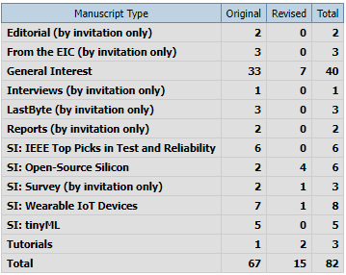
Submission Statistics

Slide 15
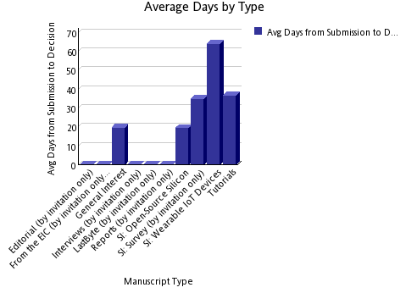
Submission to Decision Time

Slide 16
Challenges
The most important challenge is to increase the number of general interest papers
Also, improving the quality of general interest papers is necessary
Getting editors’ notes for accepted papers promptly

Slide 17
IEEE Design and Test (Video) Roundtables (Ramesh)
A series of quarterly events as D&T zoom-based video roundtables making it lively.
Plan for 3-4 roundtables (is this too many?)
Maybe open it to the public or keep it closed? (try both options?).
Share IEEE D&T roundtable videos via IEEE D&T website. (create a place for IEEE D&T roundtable videos; could be one of the free IEEE D&T resources?).
Each D&T roundtable may include 3 visionaries + moderator. 1-2 visionaries from industry; 1-2 from academia; last for 60 minutes. Q&A type format (similar to the current roundtables)
Sample topics:
  Test vs Trust (Rob Aitken, Serge Leef, M. Tehranipoor and S. Mitra; Moderator Ramesh;
  ML for EDA; Moderator Y. Chen or Hai Li.
  Resurgence of High-Level Design Paradigms: Moderator Luca Carloni; HLS leads from Cadence, Synopsys and Mentor, Jason Cong UCLA
Any feedback?

Slide 18
Perspectives (Mehdi)
Covers general interest topics, 4-8 pages, with very few references.
Retrospective and forward-looking
It is usually from senior people in academia and industry
Potential topics and authors
  Reliability
    Jacob Abraham
    Ravi Iyer
    ?
  Testing
    Janusz Rajski → Done
    John Hayes
    Hans-Joachim Wunderlich
    ?
  EDA
    Giovanni DeMicheli → DONE
    Masoud Pedram
    Alberto Sangiovanni-Vincentelli
    ?

Slide 19
Interviews (Nicola)
Vishwani Agrawal (transcribed, with Vishwani for editing)
Janusz Rajski (published)

Slide 20
IEEE ESL Update
EiC: Preeti Panda

Slide 21
New Vision for IEEE ESL
To establish IEEE ESL as the top venue for
quick dissemination of early research results in
easily digestible format for the
embedded systems research community.

Slide 22
Current state and Targets
Quality Metric | In 2020 | In 2024 | By 2028
Impact Factor | 2.17 | 1.6 | 4
Submissions per year | 201 | 185 | 1000
Accepts per year | 45 | 27 | 200
Submission-to-final decision | 10.4 weeks | 5.2 weeks | 4 weeks
Submission-to-publication | 11 weeks | 9.6 weeks | 8 weeks
Main Goal: Get the impact factor of IEEE ESL to 4 by 2028.
  Reduce submission-final-decision time to 6 weeks
  Reduce submission-to-publication time to 8 weeks

Slide 23
Plan 1 – Change to bimonthly publication
Submissions have doubled over the last 2 years
  Increased from about 200 in 2020 to > 450 in 2023.
Accepted articles have also doubled over the last 2 years
  Increased from about 45 in 2020 to > 85 in 2023.
“Submission-to-publication time” is the most important metric for the authors of IEEE ESL.
  Frequent publishing will enable fresh content to the readers
  Frequent publishing will enable timely publication for researchers
  Will increase IEEE ESL citations.
  Especially important for short-form papers, which can be read/gleamed quickly.

Slide 24
Plan 2 – Streamline the review process
Accelerated Review Process
  Associate Editors will directly review submitted manuscripts.
    Improve the quality of reviews
  Given the concise nature of the IEEE ESL manuscripts (4 pages)
    It takes more time to find reviewers and get reviews from them, than direct review
  To Address the diversity concerns, we plan to enlarge the Editorial Board
Promise IEEE ESL authors a one-month submission-to-decision time

Slide 25
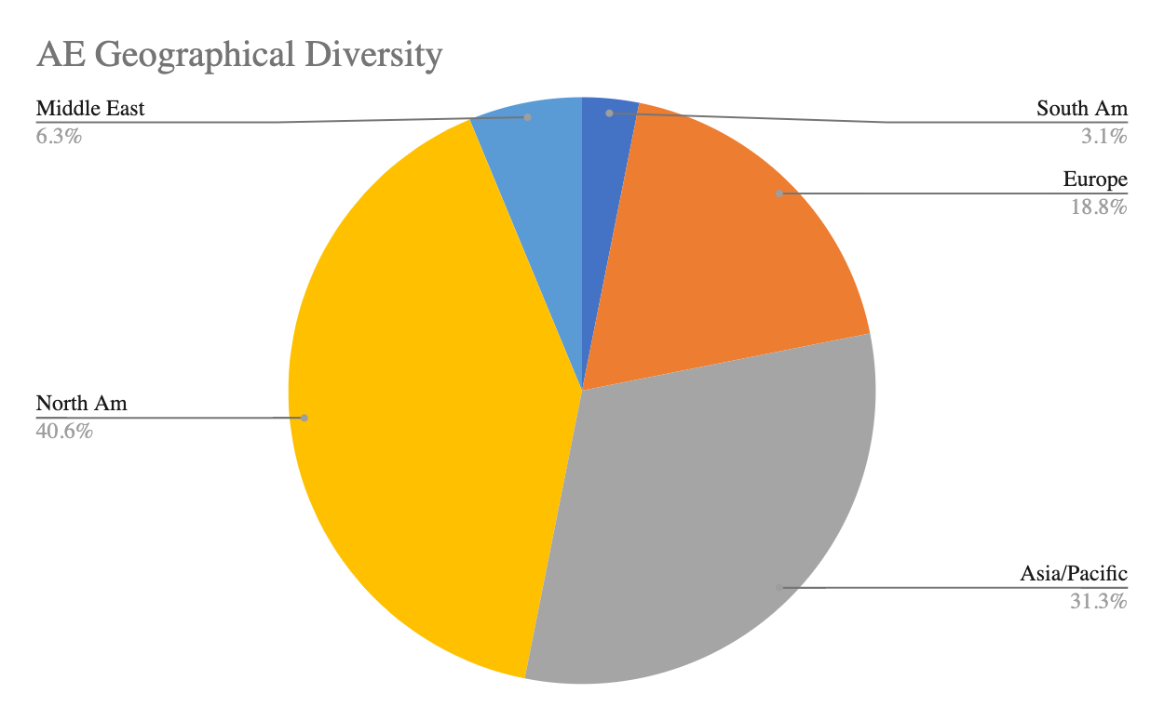
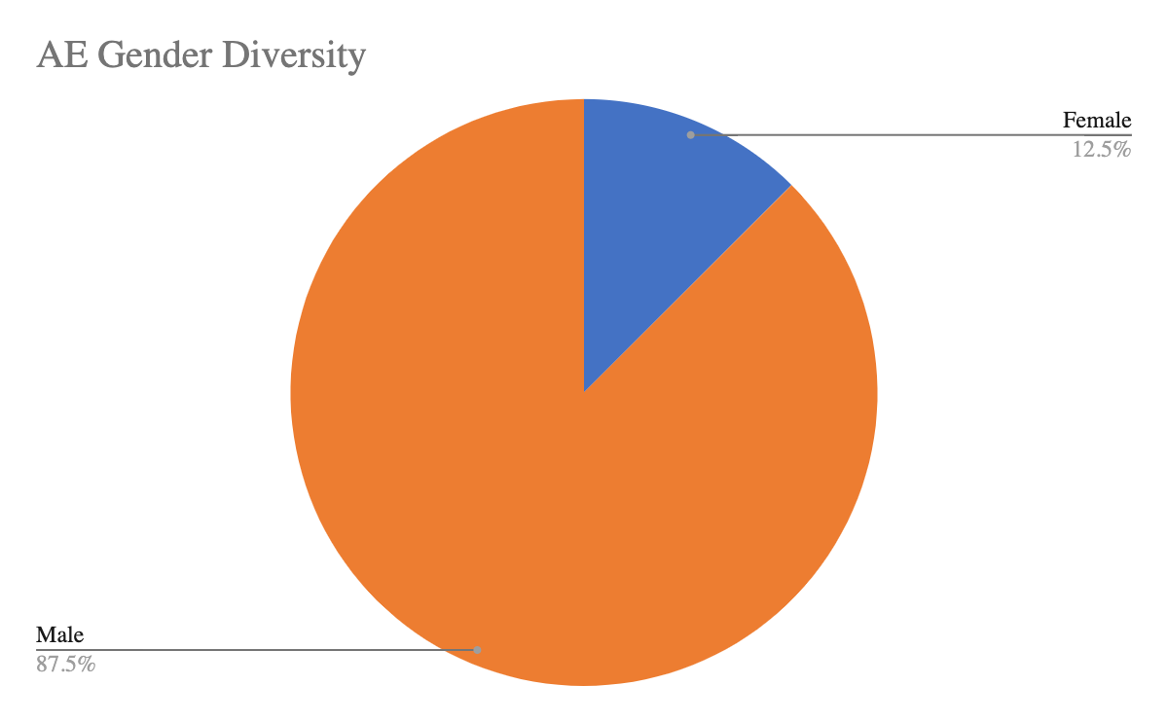
AE Diversity – Better matches the author diversity

Slide 26
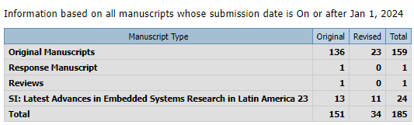
Submissions

Slide 27
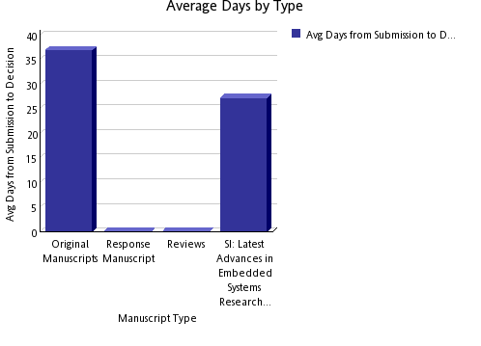
Processing

Slide 28
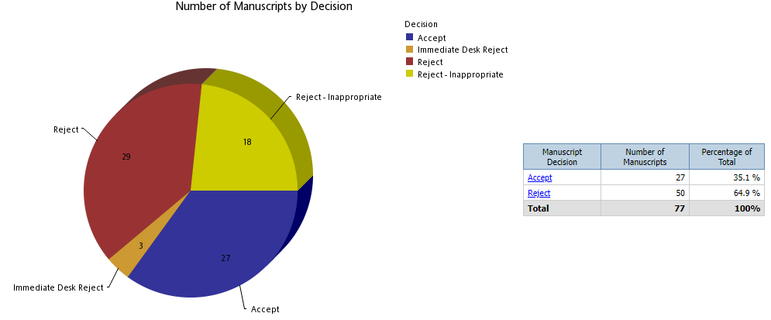
Decisions

Slide 29
Impact
Current Impact Factor: 1.6
5 Year Impact Factor: 1.589
Total Citations: 536
Downloads: 31,629

Slide 30
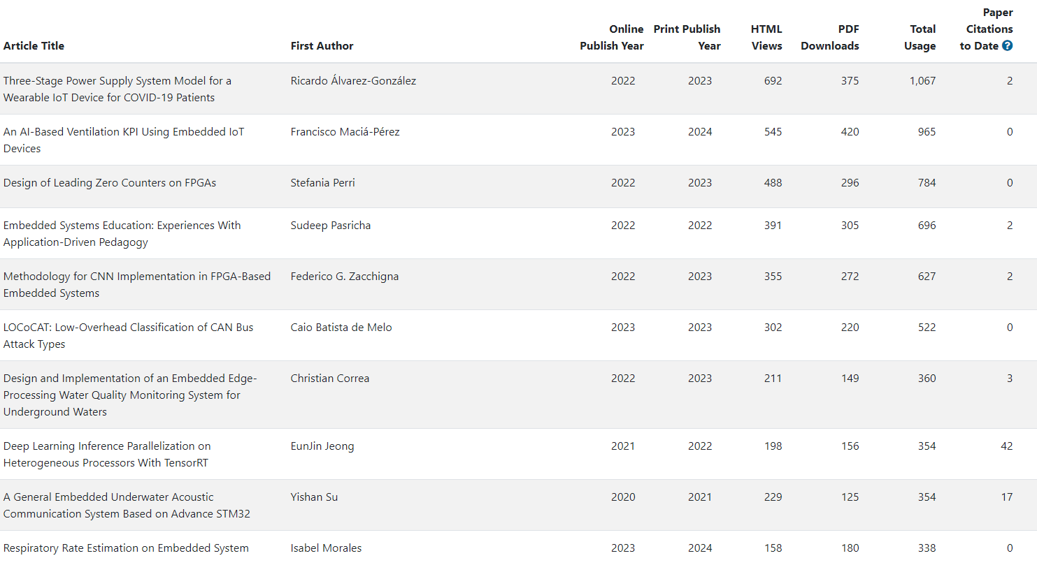
Top 10 Papers

Slide 31
IEEE TCAD – CEDA BoG Meeting
(DAC 2024)
David Atienza, TCAD EiC: 2022-2025
June 23rd, 2024

Slide 32
Current Status (1/2)
Current accept. rates (33-34%), top-tier journal for 4 consecutive quarters
  Average decision time (1st revision): 71 days
  Average final decision time: 84 days until May 2024
Submissions stabilizing (Sep. 2023 to May 2024)
  Similar number of submissions vs. same period in 2022-2023
  Accept Ratio: YTD is 37% so far, it was 39% in 2023, 2022 was 40.5%
  Oldest manuscript without decision: 138 days (it was 203 days in 2021)
Optimized TCAD review process and publication timeline with IEEE HQ
  Fast desk-reject policy of IEEE implemented (fast reject: <2 weeks, for low-quality papers)
  Automation to reassign reviewers in revisions, identify reviewers/AEs with delays, etc.
  IEEE has claimed to remove backlog/publication delay until March 2024 completely as agreed with IEEE HQ (more pages for TCAD) but still not done (50% of backlog remains)
Notes:
Currently there are 257 pending manuscripts

Slide 33
Current Status (2/2)
Editorial board renewed in 2024, 25 new AEs -> 28 new AEs
  Limit of two terms (2 x 2 years) based on IEEE guidelines
  Increased diversity (Region 10 – Asia and Pacific) and more industrial affiliated AEs (5 new AEs).
  Editors-at-Large renewed - 40% women and 2 members replaced
IEEE TCAD Donald O. Pederson Best Paper Awards – 2 winners in 2024:
  PACT: An Extensible Parallel Thermal Simulator for Emerging Integration and Cooling Technologies" by Zihao Yuan, Prachi Shukla, Sofiane Chetoui, Sean Nemtzow, Sherief Reda, and Ayse K. Coskun, which was published in IEEE TCAD, vol. 41, no. 4, pp. 1048-1061, April 2022.
  An Open-Source Framework for FPGA Emulation of Analog/Mixed-Signal Integrated Circuit Designs, by Steven Herbst, Gabriel Rutsch, Wolfgang Ecker, and Mark Horowitz, which was published in IEEE TCAD, vol. 41, no. 7, pp. 2223-2236, July 2022.
  But still authors-based/nominated papers are a very small pool (5 in 2023, 6 in 2023, 5 in 2022)

Slide 34
Key Points to Discuss: New Review Process
TCAD only requires two reviews (by default we suggest 3 to take a decision), AE can be a reviewer as well as decision taking if needed
If the paper is clearly “below bar” (no experiments, comparisons with SoA, etc.) it can be desk rejected: change to 0 reviewers, submit recommendation directly with clarification of why
TCAD must be strict – IEEE Request: unclear novelty or comparisons with SoA, direct reject
  Papers as “Research Article With a Prior One or More Conference Publications” must clearly state what is new in the technical contribution (not just evaluation with a new data set or similar) and comparison with state of the art,

Slide 35
Key Points to Discuss: Revisions and Decisions
No two major revisions, authors must address all comments in the first round (except if new major issues arise by reviewers after the first revision)
Not possible to resubmit “as new” if paper is rejected
TCAD requires new publications (30% new research) with previous papers
  Adding experiments or more text while contribution does not expand, it is not acceptable
  IEEE Regulations does not allow plain verbatim copy (self-plagiarism) – We fixed 40% as rule
  Papers submitted with prior conf. papers (last 12 months): 246 (212 in previous year)
    50% acceptance rate, much higher than typical TCAD average rate today,
    No “complaints” about policy (until exchanges with Yao-Wen Chang early this year)

Slide 36
Key Points to Discuss: Varia
IEEE Allows the use of AI for text editing (ChatGPT) as support tool (but does not encourage it), restrictions:
  Acknowledgement to be added to the paper
  Authors are responsible for the final text (including copyright issues)
Good cooperation with new IEEE journal on AI/ML side - TCASAI
  Checking overlapping with scope
  Excellent collaboration with EiC – Prof. Yiran Chen, very receptive to suggestions/proposals
Food for thought from TCAD Editorial Board Meeting at DATE’24: Innovative ways to “reward” the reviewers, ideas from the board
  Offer one free page in TCAD published paper after 3 completed review processes
  Offer conference registration discounts (e.g., at DATE, DAC, etc.) covered by CEDA

Slide 37
Current TCAD Submission Issues
Yao-Wen Chang, Deming Chen, Tsung-Yi Ho, Jiang Hu (?), Iris Hui-Ru Jiang (?), Gi-Joon Nam (?), Sri Parameswaran (?), Bei Yu, and Qi Zhu (?)

Slide 38
Motion
Motion: To remove the requirement “The submission material shall not have more than 40% total text overlap percentage with prior accepted/published versions of the work.”
  Nothing to do with the 30% new technical content rule set around 2002.
Reasons:
  The current TCAD checking system does NOT follow this rule: it checks the 40% text overlap by comparing all articles in the database, not just “prior accepted/published versions of the work,” resulting in self-contradictions in exercising this submission rule.
  All other related/competing journals, ACM TODAES, IEEE TVLSI, TPEL, JETCAS, TCAD-I, and TEC (more), do not have such a 40% overlap rule, which is unfavorable to attract TCAD submissions.
  Such an over-restricted rule is not healthy for the career establishment of our EDA new blood; they could just choose TODAES/TVLSI to build their publication record.
  Such an over-restricted rule would incur a counter-selection problem to TCAD because it makes regular 6-page DAC paper much harder to be eligible for TCAD submissions (the earlier 30% delta rule already makes 8-page ICCAD papers harder for TCAD submissions, especially also with TCAD’s 14-page limit), eventually hurting the TCAD quality.
    It is much easier for a 2-page DAC LBR or a non-prior accepted paper to satisfy the 40% overlap rule, which is often with lower quality than the regular DAC/ICCAD papers.
F. Policy on Self-Plagiarism
IEEE Publications has long indicated that verbatim copying another's work (plagiarism) is unacceptable author conduct. Moreover, the IEEE Board of Directors approved in November 2002 a new policy on Duplicate Publication and Self-Plagiarism. This policy is included in the IEEE Policies document, precisely in Sections 6.4.1B(f) and 6.4.1B(h). These two sections are indicated next:
(f) Plagiarism is unacceptable. The verbatim copying or reuse of one's own research) as indicated in paragraph "h" below) is considered another form of plagiarism or self-plagiarism; it is unacceptable.
(h) Except as indicated in Section 6.3.4 (Multiple Publication of Original Technical Material in IEEE Periodicals), authors should only submit original work that has neither appeared elsewhere for publication nor which is under review for another refereed publication. If authors have used their own previously published work(s) as a basis for a new submission, they are required to cite the previous work(s) and very briefly indicate how the new submission offers substantial novel contributions beyond those of the previously published work(s).

Slide 39
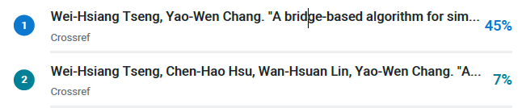
Motion
Motion: To remove the requirement “The submission material shall not have more than 40% total text overlap percentage with prior accepted/published versions of the work.”
  Nothing to do with the 30% new technical content rule set around 2002.
Reasons:
  The current TCAD checking system does NOT follow this rule: it checks the 40% text overlap by comparing all articles in the database, not just “prior accepted/published versions of the work,” resulting in self-contradictions in exercising this submission rule.
  All other related/competing journals, ACM TODAES, IEEE TVLSI, TPEL, JETCAS, TCAD-I, and TEC (more), do not have such a 40% overlap rule, which is unfavorable to attract TCAD submissions.
  Such an over-restricted rule is not healthy for the career establishment of our EDA new blood; they could just choose TODAES/TVLSI to build their publication record.
  Such an over-restricted rule would incur a counter-selection problem to TCAD because it makes regular 6-page DAC paper much harder to be eligible for TCAD submissions (the earlier 30% delta rule already makes 8-page ICCAD papers harder for TCAD submissions, especially also with TCAD’s 14-page limit), eventually hurting the TCAD quality.
    It is much easier for a 2-page DAC LBR or a non-prior accepted paper to satisfy the 40% overlap rule, which is often with lower quality than the regular DAC/ICCAD papers.
Yes, we do follow the rule. Papers are manually checked by Sara with actual publications, see example with 45% overlap with actual DAC paper:

Slide 40
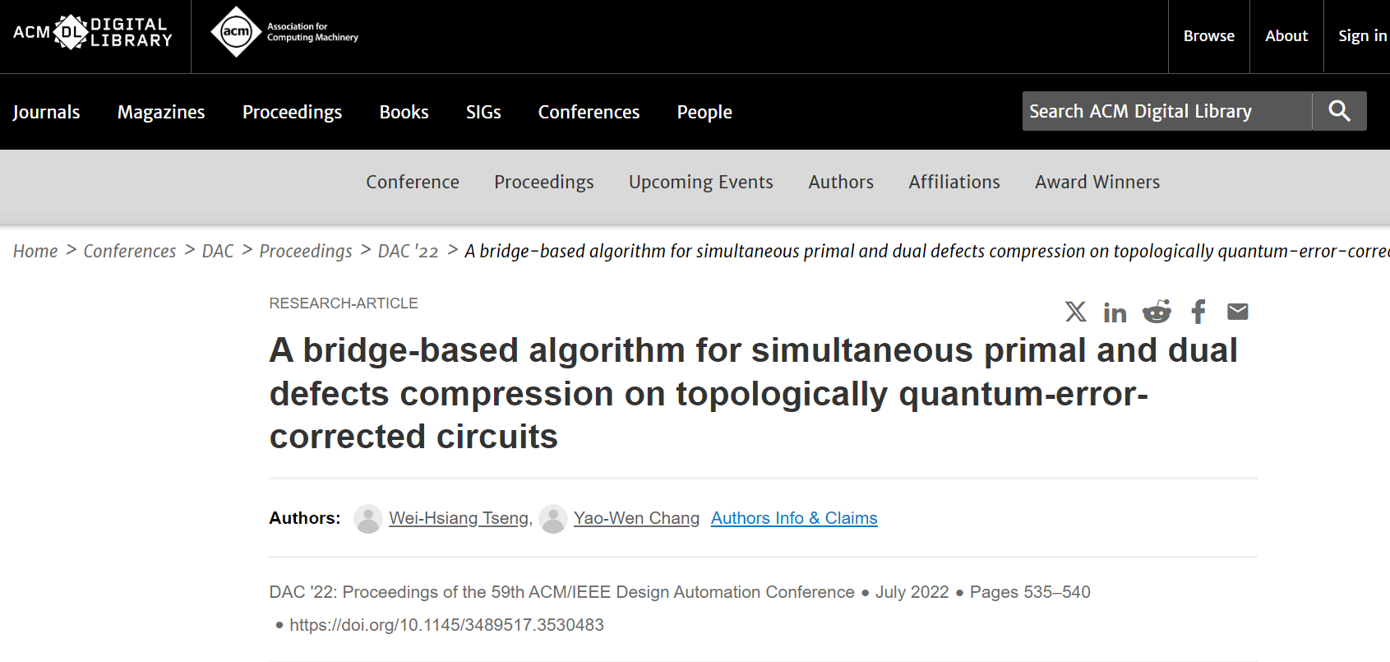
Critical Problems with the TCAD Checking System
The current TCAD checking system does NOT follow the rule specified by the TCAD office: it checks the 40% text overlap by comparing all articles in the database, not just “prior accepted/published versions of the work,” resulting in self-contradictions in exercising this submission rule.
See the example ReportFromTCAD.pdf: 61% Overall Similarity; the combined total of all matches, including overlapping sources, for each database: 11% Internet database, 60% Publications database, etc. (not comparing to the prior versions of the work, as described in the TCAD website)
See also the file named “Unreasonable_Inspection_Report.pdf” in Yao-Wen’s previous email on the similarity report provided by the TCAD office, where even the TCAD full name “IEEE TRANSACTIONS ON COMPUTER-AIDED DESIGN OF INTEGRATED CIRCUITS AND SYSTEMS”, “ACM/IEEE Design Automation Conference”, the page number “1”, and “shown in Figure 17 and Figure 18” are counted into similarity.
  Obviously, they match some descriptions from the database, not from Yao-Wen’s DAC’22 paper, because their DAC’22 paper does not have Figure 17 or Figure 18.
The new “40% total text overlap rule” is given by TCAD alone, not generally for IEEE journals! The IEEE set general guidelines in 2002 (by the IEEE Board of Directors in November 2002 for a policy on Duplicate Publication and Self-Plagiarism, included in the IEEE Policies document, precisely in Sections 6.4.1B(f) and 6.4.1B(h)), without this 40% requirement! Further, the 2002 guideline (leading to the 30% delta rule) is for technical content; however, the TCAD new 40% total text overlap is for “text”; the former is more reasonable/useful for academic advancement.

Slide 41
Critical Problems with the TCAD Checking System
The current TCAD checking system does NOT follow the rule specified by the TCAD office: it checks the 40% text overlap by comparing all articles in the database, not just “prior accepted/published versions of the work,” resulting in self-contradictions in exercising this submission rule.
See the example ReportFromTCAD.pdf: 61% Overall Similarity; the combined total of all matches, including overlapping sources, for each database: 11% Internet database, 60% Publications database, etc. (not comparing to the prior versions of the work, as described in the TCAD website)
See also the file named “Unreasonable_Inspection_Report.pdf” in Yao-Wen’s previous email on the similarity report provided by the TCAD office, where even the TCAD full name “IEEE TRANSACTIONS ON COMPUTER-AIDED DESIGN OF INTEGRATED CIRCUITS AND SYSTEMS”, “ACM/IEEE Design Automation Conference”, the page number “1”, and “shown in Figure 17 and Figure 18” are counted into similarity.
  Obviously, they match some descriptions from the database, not from Yao-Wen’s DAC’22 paper, because their DAC’22 paper does not have Figure 17 or Figure 18.
The new “40% total text overlap rule” is given by TCAD alone, not generally for IEEE journals! The IEEE set general guidelines in 2002 (by the IEEE Board of Directors in November 2002 for a policy on Duplicate Publication and Self-Plagiarism, included in the IEEE Policies document, precisely in Sections 6.4.1B(f) and 6.4.1B(h)), without this 40% requirement! Further, the 2002 guideline (leading to the 30% delta rule) is for technical content; however, the TCAD new 40% total text overlap is for “text”; the former is more reasonable/useful for academic advancement.

Slide 42
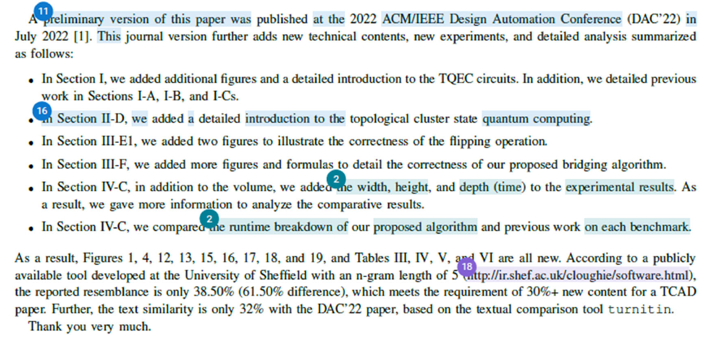
Survey: Rules of Other Competing Journals
Targets: ACM TODAES, IEEE TVLSI, TPEL, JETCAS, TCAD-I, and TEC
They only follow the 30% additional technical content rule; none have the 40% text overlap rule.
In the circuit design, power, microwave, and electromagnetic compatibility communities, their conference papers typically consist of only 2-4 pages, so it is much easier for them to add new content for IEEE trans. publications.
  Page numbers: 2 pages for an ISSCC paper, then for a JSSC journal one, top conference/journal in circuit design; 4 pages for an ISCAS conference paper for JETCAS and TCAD-I; 3 pages for electromagnetic compatibility, then for TEC; 2-4 pages for power electronics, then for TPEL, etc.
  TODAES: generally 25%/30% new technical content.
At CEDA, we always try to help our community with technological advancement and talent cultivation, especially for the young generation/researchers. TCAD's new rules would not only hurt TCAD itself (and EDA conferences) but also give our young EDA researchers a much more difficult time building up their publication records.

Slide 43
Decision on Papers with 40% overlap rule
In 2024: 20 papers / 560 (3.57% of total)
  Almost half also violated the 30% novelty, so real figure: 10 / 560 (1.78%)
Other journals allow more overlap, but CEDA ones do not (D&T has a threshold of 30% as maximum overlap in the latest special issue!)
Only one complaint from Yao Wen, but he lists this set of authors in his presentation:
  Yao-Wen Chang, Deming Chen, Tsung-Yi Ho, Jiang Hu (?), Iris Hui-Ru Jiang (?), Gi-Joon Nam (?), Sri Parameswaran (?), Bei Yu, and Qi Zhu (?)

Slide 44
IEEE TSPI Update
EiC: Jun Fan

Slide 45
T-SIPI Editorial Board
Currently the alternative EIC for handling EIC COI is Prof. Tzong-Lin Wu. There are 12 AEs approved by the management committee. They are: Zhiping Yang, Chulsoon Hwang, Enxiao Liu, Joungho Kim, Ram Achar, Dan Jiao, Jai Narayan Tripathi, Dries Vande Ginste, Gabriela Ciuprina, Renato Rimolo Donadio, Erping Li, and Istvan Novak. I recommended two more AE candidates, Richard Gao and Siping Gao (both from Singapore), to the management committee. But the management committee has decided not to add more AEs until a later time.

Slide 46
T-SIPI Paper Statistics
Up to October 30, 2023
 | Submitted | Accepted | Rejected | Withdrawn | In Review Process or No Response
2021 | 7 | 4 | 1 | 0 | 2
2022 | 43 | 27 | 11 | 1 | 4
2023 | 26 | 3 | 9 | 0 | 14
Total | 76 | 34 | 21 | 1 | 20

Slide 47
IEEE Submission To Publication Report
Based on the Q2, 2023 report
 | Average Weeks Submitted to First Decision | Average Weeks Submitted to Online Post | Cumulative Average Weeks Submitted to First Decision for past 12 months | Cumulative Average Weeks Submitted to Online Post for past 12 months
T-SIPI | 8.0 | 33.0 | 7.7 | 31.0
T-EMC (for reference) | 7.6 | 24.1 | 7.8 | 26.5

Slide 48
Submission and Publication
T-SIPI doesn't use ScholarOne for paper submissions, although the review process is still completed in ScholarOne. Paper submissions to the T-SIPI are through the IEEE Author Portal (an IEEE account is required). Below is the link to the submission page: https://ieee.atyponrex.com/journal/TSIPI
T-SIPI is an e-publication only. Papers appear online as soon as the final manuscripts are accepted and edited by the IEEE.

Slide 49
Problems and Challenges
The biggest issue right now is to receive more contributions. We plan to reach more potential authors by sending out the Call for Papers through social media and organizing special sections on hot topics. More ideas and suggestions are welcome!

Slide 50
IEEE CEDA Standards Committee
CEDA EC Meeting @ DAC
Aparna Dey
Vice-President of Standards
Chair –Standards Committee
23 June 2024

Slide 51
Agenda
AI Coalition Workshop Update
CEDA Standards Committee Update

Slide 52


IEEE Future Directions Committee Chair
Report to TAB
Christine Miyachi – FDC Chair, Samina Husain – FDC Vice Chair,
Dejan Milojicic – IAB Chair, Bruce Kraemer – Roadmaps Chair
Bill Tonti, Kathy Grise - Staff

Slide 53













2023 IEEE Future Directions Coverage
2024 IEEE Future Directions Coverage
Becomes Quantum TC managed by Computer Society in 2024
Wireless Power Technologies
Wireless Power Technologies**
**
AI Coalition
**
Global Semiconductors
Ad Hoc**
TechNav AI
TechNav AI
Global Semiconductors
Ad Hoc
**New in 2023
ieee.org/futuredirections

Slide 54







2024 Future Directions Committee
Progress to date
Technology Coverage
Industry Outreach and Engagement
Technology Megatrends Report
Technology Roadmaps
  SXSW
  Global Semiconductors
Collaborations
AI Coalition
Imagination in Action
Wireless Power Technologies

Slide 55
Artificial Intelligence Coalition meeting 6 June 2024
Held at the Microsoft New England Research and Development Center (NERD), Cambridge, MA
37 attendees and 28 in person
Analysis conducted for AI content across IEEE
  Looked for gaps in coverage
  Will form activities around those gaps
AI Policy presented by IEEE USA and European Office
Heard from volunteers and staff how IEEE is using AI as an organization
Discussed long term vision of the AI Coalition
Attended Imagination In Action at MIT on 7 June
Heard from our first project “TinyML”
Next Steps: Top gaps identified
  AI Technology - Advancing Hardware topics in AI
    Action: Work with Leadership Team to identify experts to lead this effort (Computer Society, CIS, etc)
  Social Implications, partner with Tech Ethics and SSIT
    Social implications related to implementation
    Responsible AI
    Technology to Verify AI Models and Data to build Trust and Understanding
    Action: Recruit leadership / form subcommittee
  Future Tech Forum / AI Coalition Event
    Nov 7, 8 2024 NERD Center Cambridge, MA
    Will invite Imagination in Action to collaborate
Notes:
Vistage
Technology trends for 2024 and beyond
https://www.vistage.com/research-center/business-financials/economic-trends/20231030-technology-trends-for-2024-and-beyond/#:~:text=As%20we%20look%20forward%20to,VR%2C%20and%20other%20emerging%20innovations.
CTA: AI “Al On”
https://www.ces.tech/articles/2023/october/ai-in-action-how-select-sectors-use-the-tech.aspx#:~:text=Increasing%20innovation%20in%20AI%20can,Register%20today

Slide 56
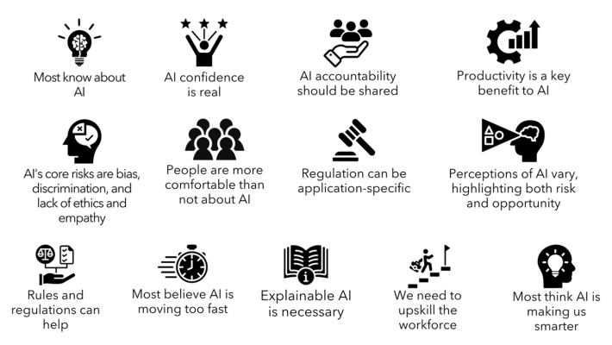
AI for Good – Survey Opinion Key Results
By UN ITU – Shared by Gustavo Gianattasio

Slide 57
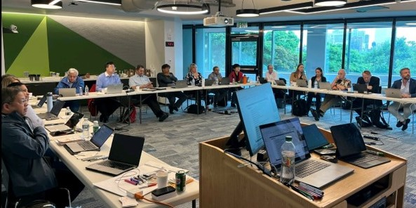
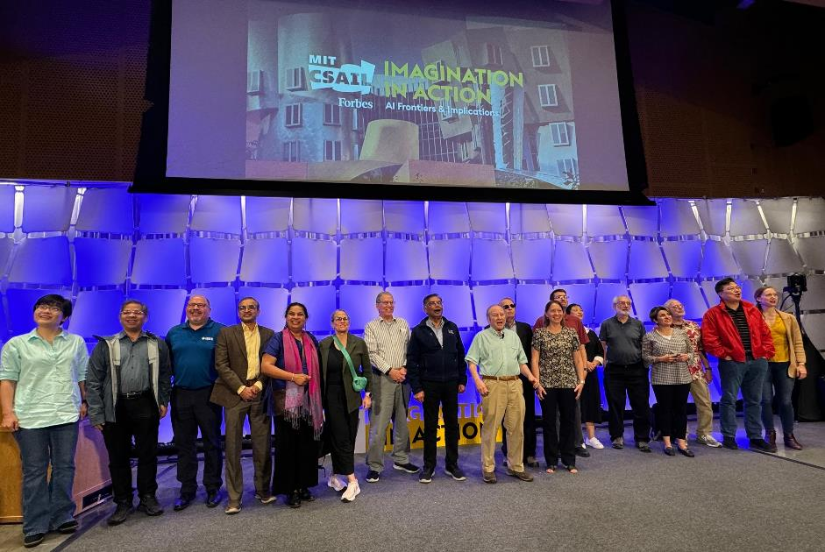
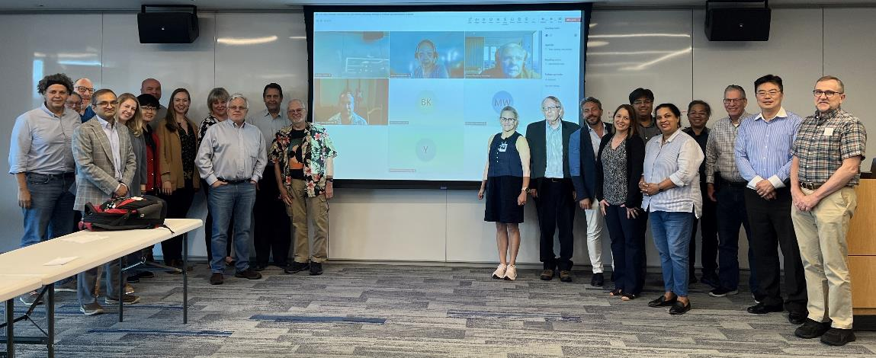
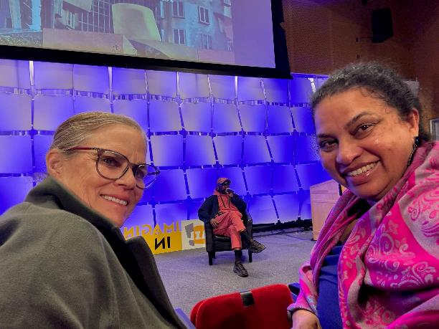
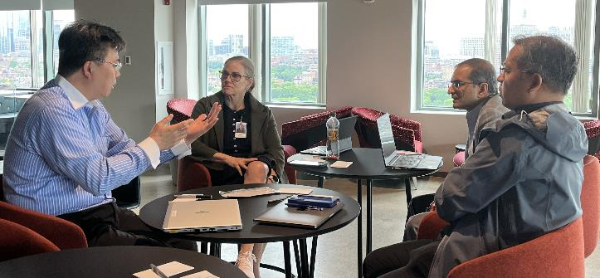
Notes:
Will discuss the gaps verbally here (will have more information when presentating)

Slide 58
SC Mission /Objectives
Drive Standardization in advanced EDA topics with focus on “research-based topics”
  Proposals from Academia, and Industry Adv. Research groups
  Collaborate/ Joint sponsor w/ IEEE DASC & other Industry Standards organizations/committees
  Leverage CEDA Events/Network/CEDA Standards site

Slide 59
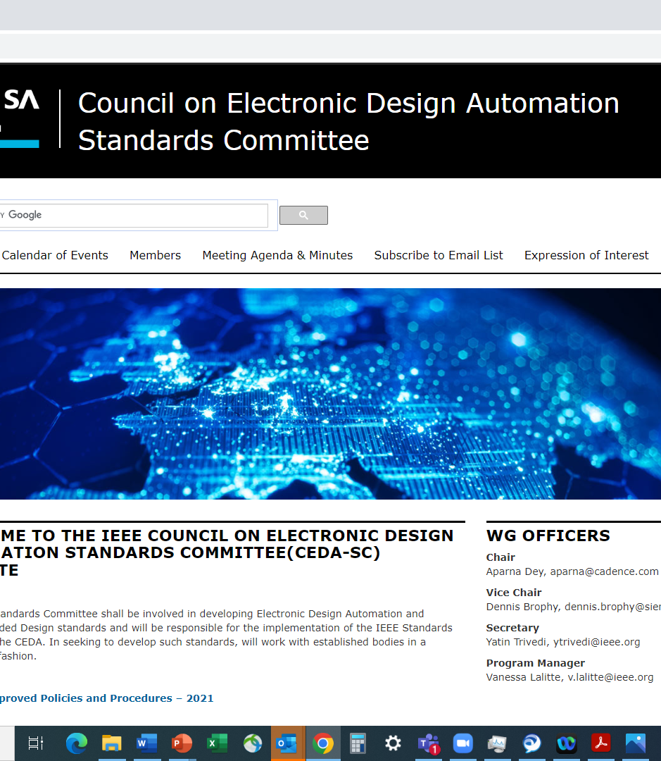
Current Status & Achievements
CEDA Standards Committee infrastructure -done active/updated
  https://ieee-sa.imeetcentral.com/ceda-sc/home
  CEDA SC public site : https://sagroups.ieee.org/ceda-sc/
23 new members. 3 EDA companies, User companies –Intel, Qualcomm, Ericsson, 3 Universities, e.t.c
Standards Committee kickoff -done
  Agenda, Invitation to participate, Request for proposal for PAR or study group in key EDA areas
CEDA Chapter meeting presentation – done 12/15
CEDA SC Open-Source Maintainer
  Discuss possible use of SA Open-Source platform for standard development
  Dennis Brophy

Slide 60
Standards Committee Kick-off Meeting -11/21/23
SC now open to accept standard proposals !!
Call to Order
Introduction and Affiliation Declaration
Establishment of CEDA SC Membership
Approval of Agenda
Review and Approval of CEDA SC Policies & Procedures (P&P) : Dennis Brophy
Appointment of Officers : Aparna Dey
IEEE Policies – Vanessa Lalitte
  IEEE SA Call for Patents
  IEEE SA Copyright Policy Presentation
  IEEE SA Participant Behavior – Individual Method
8. Presentation
  IEEE SA Standards Overview – Vanessa Lalitte
  CEDA SC Overview – Aparna Dey
Discussion/Action Plan
Future Meetings

Slide 61
Potential Areas for Standardization
AI/ML in EDA
3D/2.5D, Chiplets design, Standard Format
Photonics
Digital Twin
Functional Safety
Low Power
Thermal Constraints
Functional Verification
Simulation

Slide 62
Opportunities
Increasing relevant membership/participation from Academia and Industry
  Standards Committee promotion – chapter meeting, discussion with industry/academia
  Regular meeting schedule
  Define scope and encourage study groups/white papers in new areas – creating a research focus short list
Increasing CEDA/SC visibility with Industry & Academia
  Present at Academic Network meetings
  Promotions online and with other committees, industry events
Attracting differentiated Standardization proposals/ study group in advanced topics
  Discussion with Jiang Hu from T&M to start a new PAR for AI/ML infrastructure for EDA standards in CEDA standards. Potential contribution of a white paper to the study group.
  Potential for joint sponsorship with DASC and IEEE Standards Committee

Slide 63
Next Steps
Submission of Ideas, PARS, Proposals
SC WG Meeting regular Schedule
Working on potential ML Infrastructure proposal
Targeted SC Promotion in conferences, chapter meetings, Academia, Industry
Review of Proposals

Slide 64
President’s Report - Silveira

Slide 65
Finance - Zapater

Slide 66
Education - Macii/Bolchini

Slide 67
BREAK

Slide 68
Conferences
Tsung-Yi HO
June 23, 2024

Slide 69
Sponsored conferences/events (2024.1 ~)
Financial Sponsorship (17)
Technical Sponsorship (10)
MLCAD (50%) |  | ICCAD (46.67%) | ETS (25%)
DTTIS (25%) |  | VLSI-SoC (25%) | MPSoC (33%)
LAD (100%) |  | LATS (25%) | MEMOCODE (25%)
ISLPED (15%) |  | SIES (50%) | ITC-Asia (50%)
DAC (50%) |  | ASP-DAC (12.5%) | DDECS (25%)
CODAI (25%) |  | SBCCI (5%-7%) | ATS (25%-50%)
FMCAD | LASCAS
GLSVLSI | ICITES
ISPD | ISED
SMACD | AsianHOST
FDL | ISEDA
Notes:
• Is IEEE CEDA aware of this event and the request for 25% financial sponsorship?
• Has IEEE CEDA agreed to grant 25% financial sponsorship for this event?
• If so, who from IEEE CEDA will be the "champion" (accountable individual) and be involved in the event planning/development as well as be able to speak to the event's validity?
• Is IEEE familiar with the non-IEEE co-sponsor (Aix-Marseille Université)?
——
EEE DTIS (International Conference on Design and Technology of Integrated Systems in nanoscale era), and IEEE DTS (International Conference on Design and Test of Integrated Systems).

Slide 70


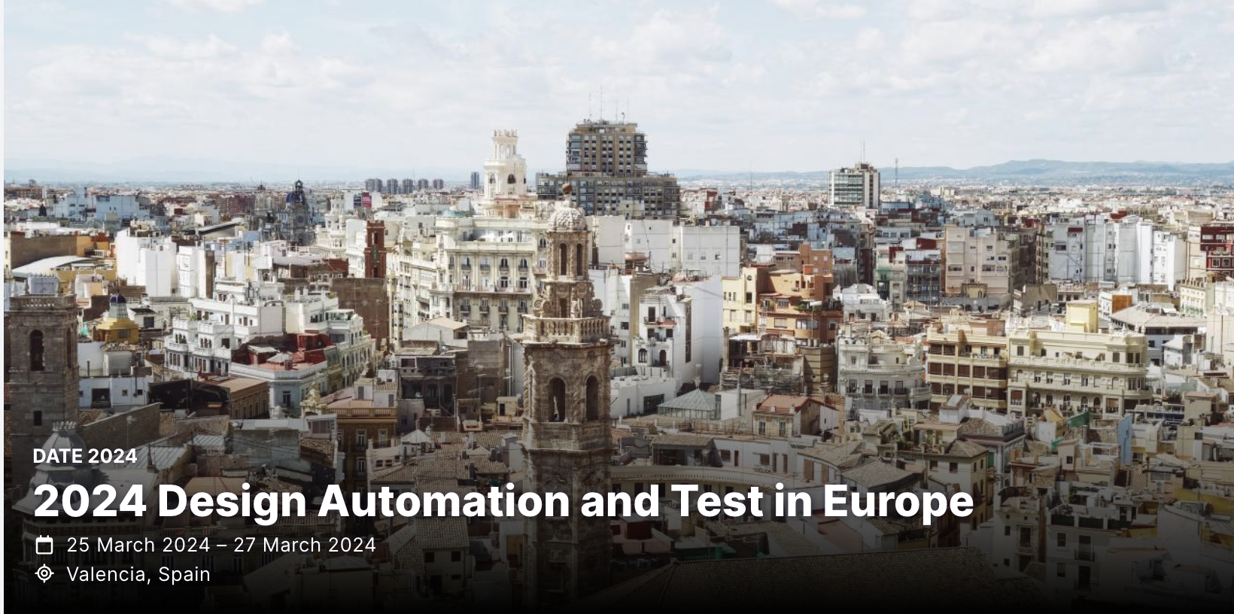

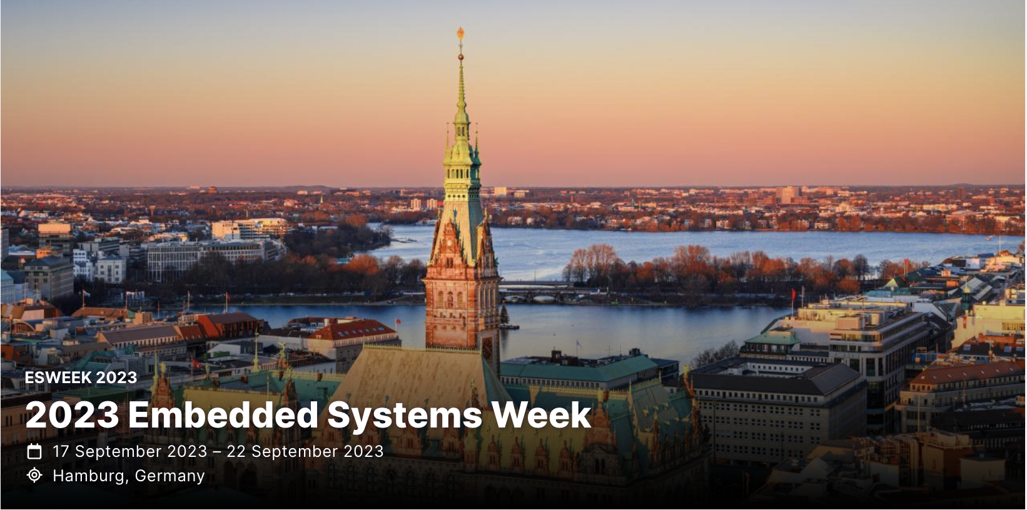
Flagship conferences

Slide 71
DAC Updates
Miguel Silveira
June 23, 2024

Slide 72
DAC 2024 - Record number of submissions
Record number of submissions: 2079 Abstracts, 1575 PDFs; 1545 final valid submissions after some withdrawing (cf. 1156 in 2023 => 34% increase)
TPC committee: 29 tracks, 34 track chairs, 356 TPC members (cf. 266 in 2023 => 34% increase)

Slide 73
Research Paper Submission History
34% increase in submissions!
Clearly a lot of momentum in the Semiconductor, EDA, AI and Security areas.

Slide 74
Top tracks/topics in paper attraction
Track | #papers
AI1. AI/ML Algorithms | 80
AI2. AI/ML Application and Infrastructure | 74
DES3B-I. In-memory and Near-memory Computing Architectures, Applications and Systems - I | 58
DES3B-II. In-memory and Near-memory Computing Architectures, Applications and Systems - II | 60
DES4-I. AI/ML Architecture Design - I | 57
DES4-II. AI/ML Architecture Design - II | 53
DES9. Quantum Computing | 78
EDA3. Timing and Power Analysis and Optimization | 60
EDA5. Analog CAD, Simulation, Verification and Test | 54
EDA6. Physical Design and Verification | 71
EDA7. Design for Manufacturing and Reliability | 51
SEC1. Hardware Security: Primitives, Architecture, Design & Test | 63

Slide 75
Accepted Sessions by Country
2023
2024
337 submissions accepted
21.8% acceptance rate
(cf. 22.7% in 2023)
Most accepted submissions from China and US
  153 papers (45%) with a primary author from China
  82 papers (24%) from USA
Country | Percentage |  | Country | Percentage
China | 41.06% |  | China | 45.40%
United States | 30.42% |  | United States | 24.33%
Hong Kong | 6.46% |  | Korea | 7.12%
Korea | 5.70% |  | Hong Kong | 6.82%
Taiwan | 4.94% |  | Germany | 3.56%
Germany | 3.42% |  | Taiwan | 2.97%
Switzerland | 2.28% |  | Italy | 1.48%
United Kingdom | 1.90% |  | Singapore | 1.19%
Belgium | 0.76% |  | Japan | 0.89%
Italy | 0.76% |  | United Arab Emirates | 0.89%
Austria | 0.38% |  | United Kingdom | 0.89%
Canada | 0.38% |  | Austria | 0.59%
France | 0.38% |  | Canada | 0.59%
Greece | 0.38% |  | France | 0.59%
Japan | 0.38% |  | Greece | 0.59%
Singapore | 0.38% |  | Switzerland | 0.59%
 |  |  | Belgium | 0.30%
 |  |  | India | 0.30%
 |  |  | Luxembourg | 0.30%
 |  |  | Netherlands | 0.30%
 |  |  | Norway | 0.30%

Slide 76
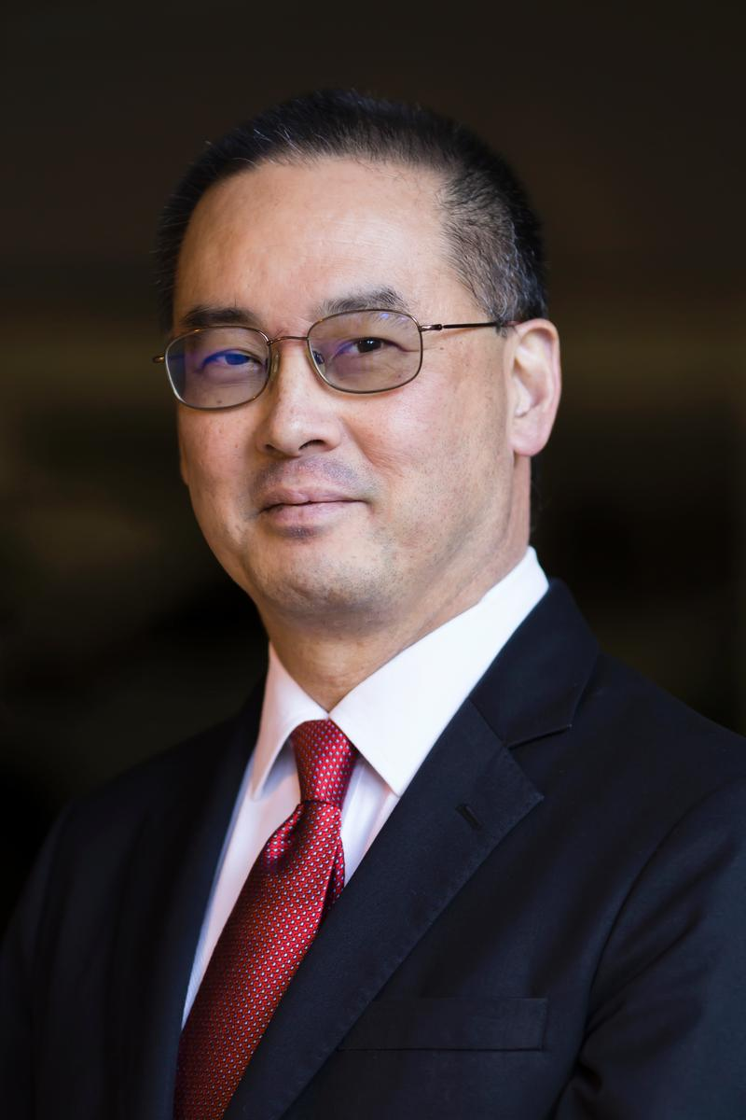
DAC 2024 – CEDA Distinguished Luncheon
Keynote:
Andrew B. Kahng: AI for EDA and Disruptive Innovation
Tuesday, 25th June, 12:00pm – 1:30pm

Slide 77
ICCAD Updates
Jiang Hu
June 23, 2024

Slide 78
ICCAD Strengths
Submissions continue to have a healthy growth (~28% increase) from 2022
1006 abstract submissions, 750 full submissions (2 desk rejects)
172 papers accepted (~23% acceptance rate)
52 sessions: 40 regular, 9 special, 2 tutorials, 1 panel
(1109) Abstract submissions
(803) Full submissions
7% increase from last year.

Slide 79
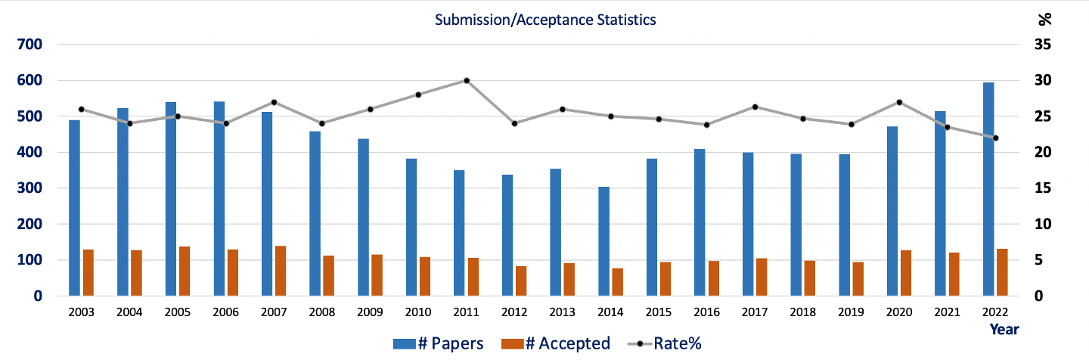
Conference Statistics

Slide 80
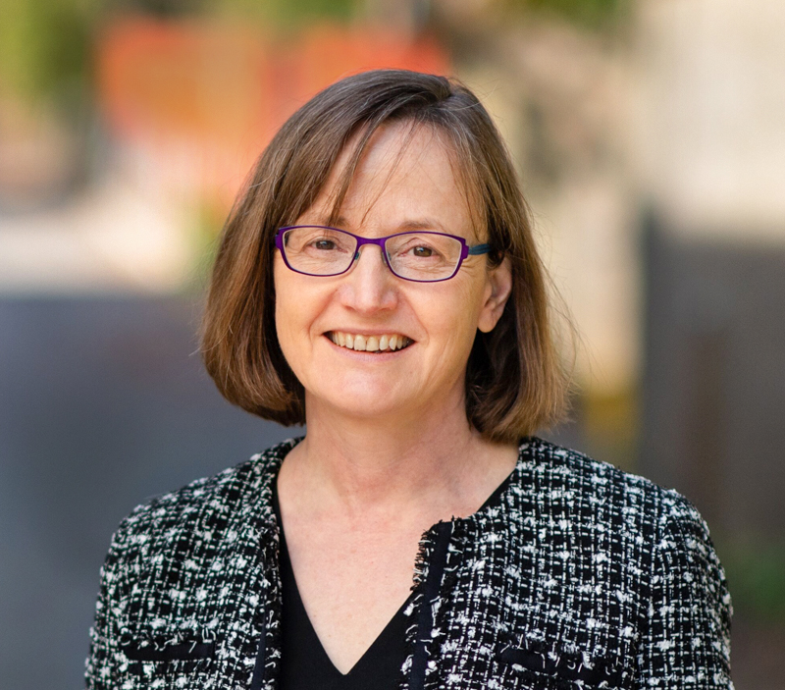
Tuesday IEEE CEDA Invited Keynote Luncheon
Mind the Gap: Challenges and Opportunities in Closing the Algorithms-to-Devices Gap in Quantum Computing
Margaret Martonosi
Professor of Computer Science
Princeton University

Slide 81
DATE Updates
Cristiana Bolchini
June 23, 2024

Slide 82
DATE 2024 in Valencia, Spain
March 25-27
Location: Valencia, Spain
Dates: March 25-27, 2024
consolidating the 3-day format
no exhibition
flash presentations + videos

Slide 83
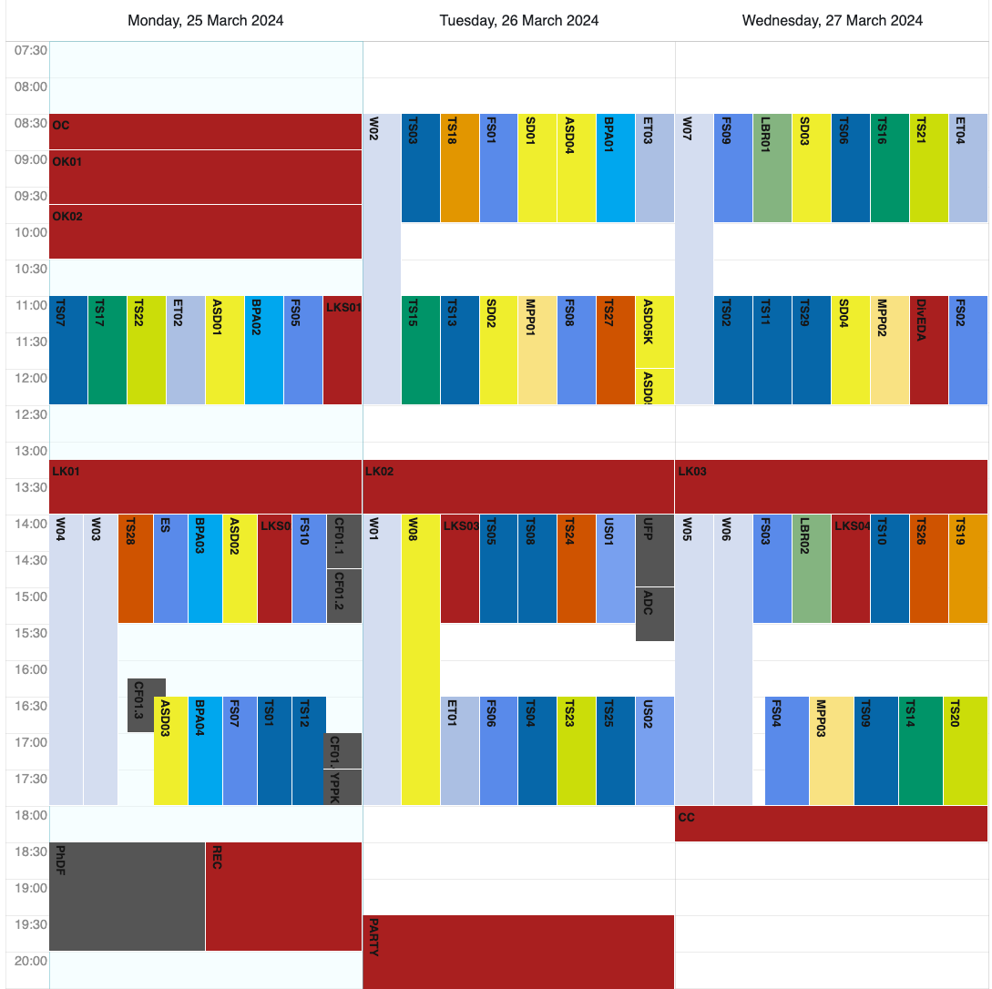
Program
scientific program
embedded tutorials
half-day workshops
focus sessions
late-breaking results sessions
multi-partner project sessions
special days
  responsible and robust AI
  sustainable computing
unplugged sessions
Autonomous System Design initiative
Young People Program
Diversity in EDA*
PhD Forum *
* CEDA sponsor

Slide 84
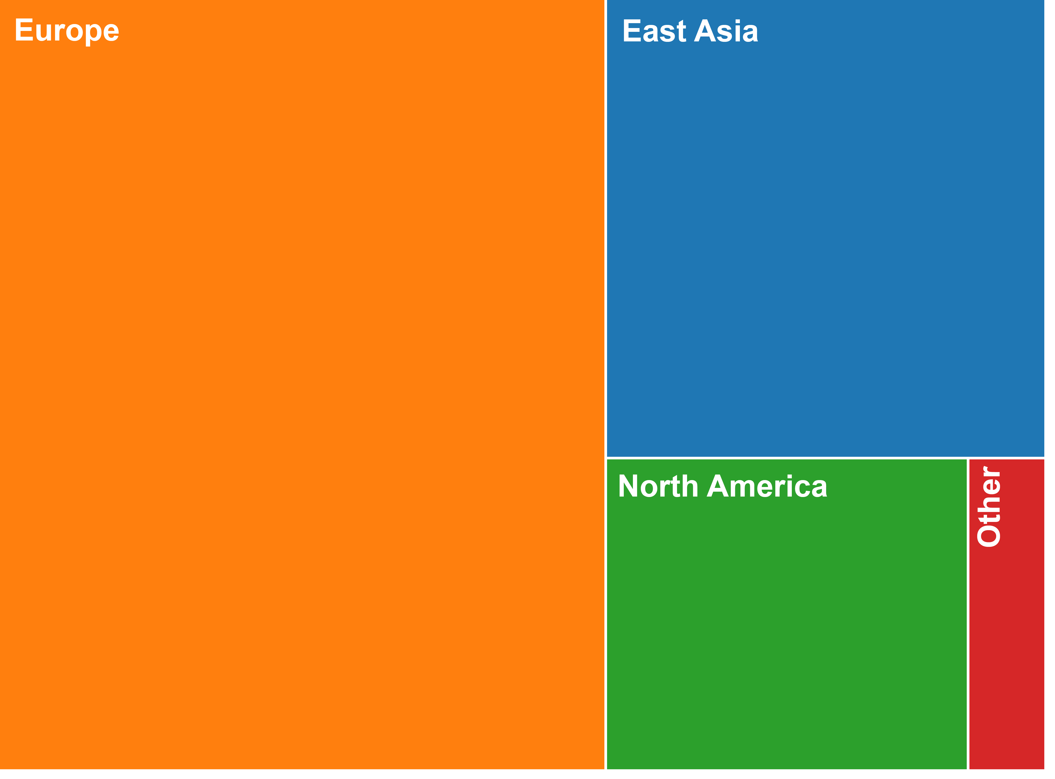
some numbers
+20% w.r.t. 2023 number of submissions/final papers
+36% w.r.t. 2022 number of submissions/final papers
more than 850 participants
attendees' country

Slide 85

DATE 2025
Location: Lyon, France
Dates: March 31 – April 2, 2025
General Chair: Aida Todri-Sanial, Eindhoven University of Technology, NL
Program Chair: Theocharis Theocharides, University of Cyprus, CY

Slide 86
ASP-DAC Updates
Kazutoshi Wakabayashi
June 23, 2024

Slide 87
Paper Submission
529
346
310

Slide 88
Submissions by
Countries / Areas

Slide 89
Attendees (2023) (2021) (2019)
Total Number: 452 (←365) (←348) (←346)
  Academia: 382 (←312) (←300) (←260)
    (including 180 (←87) (←39) (←60)students)
  Industries: 52 (←51) (←47) (←76)
  Others: 18 (←2) (←1) (←3)
Tutorials: 94 (←68) (←50) (←60)
International participation
  Korea: 187
  Overseas: 265
    ASP 176
    Americas 53
    EU 36
Notes:
Conference: paid 325 + free 12 (keynote 4, cadence 5, silvaco 1, ansys 1, opentext 1)
Academia: paid 294 + free 2
Industries: paid 26 + free 10

Slide 90
ESWeek Updates
Joerg Henkel
June 23, 2024

Slide 91
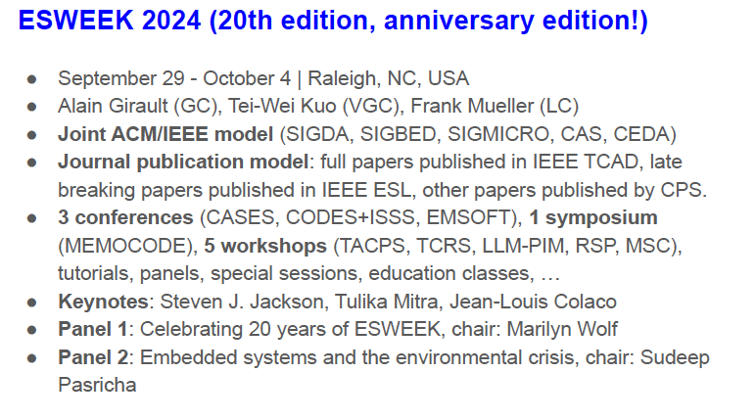
Notes:
Jorg till 21
David president elect from 2016

Slide 92
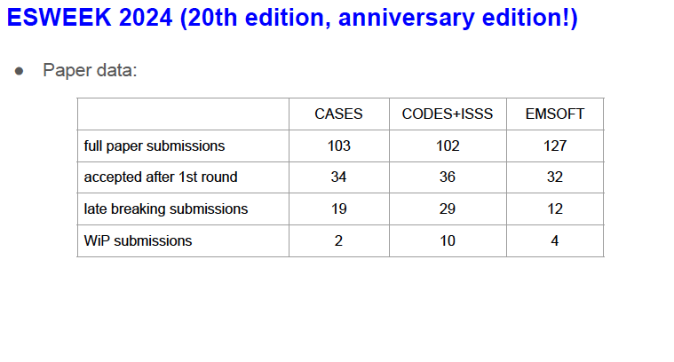
Notes:
Jorg till 21
David president elect from 2016

Slide 93
Conference Representatives
DAC
  Gi-Joon Nam
  Luis Miguel Silveira
ASP-DAC
  Kazutoshi Wakabayashi
DATE
  Cristiana Bolchini
  David Atienza
ICCAD
  Jiang Hu
ESWeek
  David Atienza
Notes:
Jorg till 21
David president elect from 2016

Slide 94
CEDA Technical Activities
Ian O'Connor
June 23rd, 2024

Slide 95
Agenda
CEDA Chapters: News, Chapter award
MTO CEDA Technical Committees
One-off event sponsorship
Distinguished lecturer program
  Class 2023-2024 + 2024-2025
  VDL schedule
Luncheon Keynote speakers: DAC, ICCAD
CEDA representation in Women in Engineering (WIE)

Slide 96
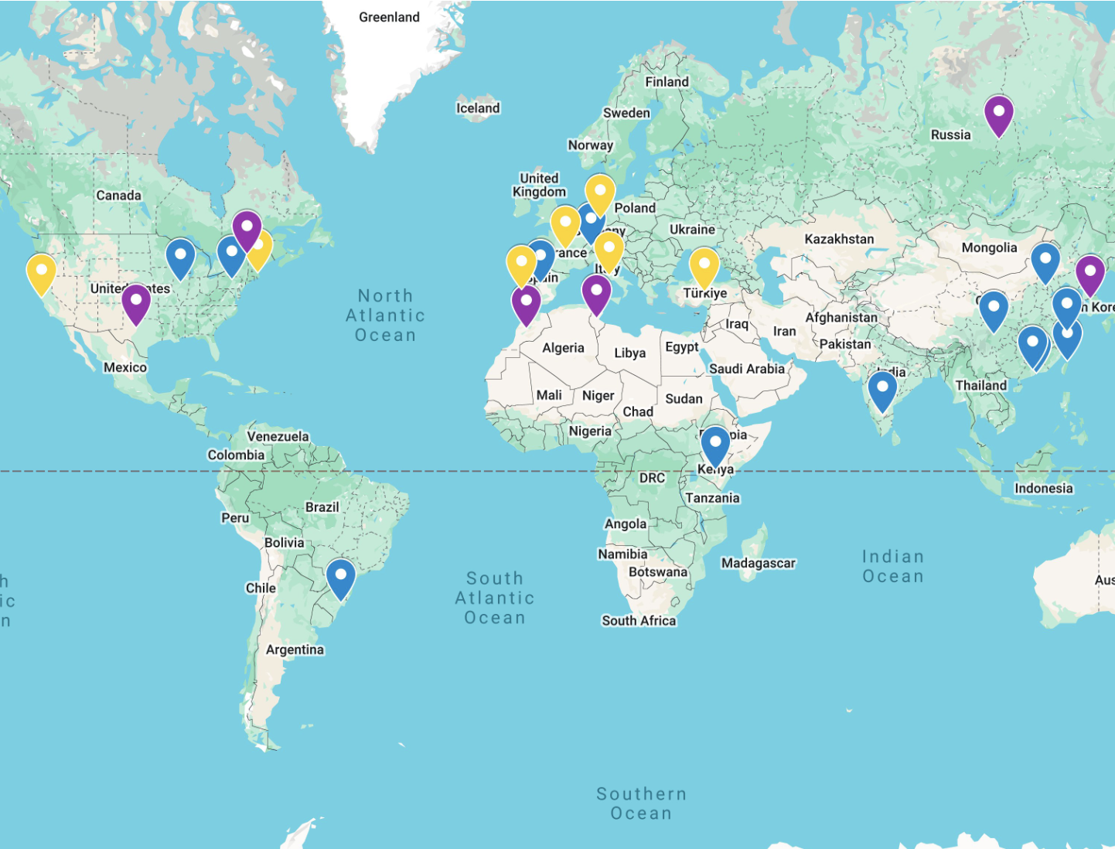
CEDA Chapters
Central Texas
Japan
Montreal
Morocco
Russia
Seoul
Tunisia
13 active Chapters
Dormant Chapters (no 2024 funding)
2023
2024
Bangalore
Beijing
Central Illinois
Chengdu
Guangzhou
Hong Kong
Japan
Pennsylvania
Russia
Shanghai
South Brazil
Spain
Switzerland
Taipei
Tunisia
Kenya
Bangalore
Beijing
Central Illinois
Chengdu
Central Penn.
Guangzhou
Hong Kong
Kenya
Shanghai
South Brazil
Spain
Switzerland
Taipei
Potential new Chapters?
Boston
San Francisco Bay area
France – 2025 ?
Belgium – 2025 ?
Germany
Italy
Portugal
Turkiye

Slide 97
CEDA Chapters
Financial Sponsor
  Support 10 proposals (6 in 2022)
Chapter Report
  vTools
Budget Allocation
  Group event: seminars, meetings, summer course, DL, etc.
  Special event: contest, awards, etc.
  General expense: banner, local travel, souvenir, etc.
Role Rotation
  Chair, Vice Chair, Treasurer/Secretary
  Term of service

Slide 98
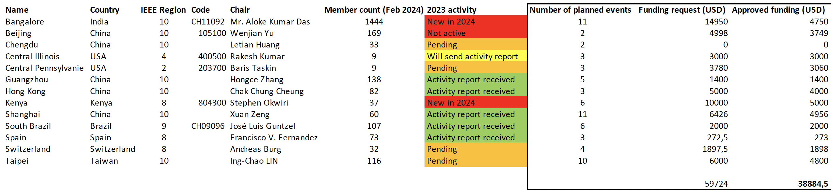
Chapter budget
Funding guidelines:
  New chapters – funding capped around 5k$ (maximum for active chapters)
  Funding reduction for events that can be funded through other means
Total funding for all chapters around 40k$ - wiring process completed

Slide 99
Chapter update meeting
Monday June 24th 5pm-7pm PDT
On-site: Intercontinental Hotel (888 Howard St, San Francisco, USA): Telegraph Hill room, 4th floor
Online: https://ec-lyon-fr.zoom.us/j/95697384387?pwd=bUWwapGaQ0zdL5t5YoXyigrqFzZGHk.1
Attendees:
  Skanda Raghavendra
  Zhiyao on behalf of Ray Cheung (Hong Kong Chapter)
  Yangdi Lyu (Guangzhou Chapter) (remote)
  Wenjian Yu (Beijing Chapter) (remote)
  Baris Taskin (Pennsylvania Chapter) (remote)
separate online meeting in July for absent chapters (e.g. Spain, Switzerland, Morocco for which timeslot doesn't work)
Report 2024 activities and spending
Plan 2025 activities and budget
Flag any issues

Slide 100
Chapter formation
Member & Geographic Area resources:
  Formation : https://mga.ieee.org/volunteer-hub/geographic-unit-operations/formations-and-petitions#changechapter
  Application (with IEEE member acct): https://live.runmyprocess.com/live/2215365968/appli/233967?P_mode=LIVE&P_version=

Slide 101
Chapter of the Year Award
Description: To recognize the CEDA Chapters with the best yearly activities in the categories of chapter-sponsored technical activities. Award will recognize their contribution with consideration of quantity and quality of the activities implemented by the chapters.
Prize: $500 and Certificate to the Chapter of the Year. Presented to the chapter chair and must be used to fund chapter activities.
Funding: Funded by the IEEE CEDA. Award is funded via CEDA Award Fund in the IEEE Foundation.
Presentation: Annually at ICCAD
Basis for Judging: The awards criteria include number and quality of chapter activities, percentage of attending sponsored events, membership development activities and chapter growth, local conferences/symposia/workshops, participation in the Distinguished Lecturer Program, involvement of students and YP members, contributions to newsletter, and timeliness of reporting of prior year.
Eligibility: The winning chapters must be IEEE CEDA chapters. Self-nominations are allowed.
Nomination Details: Previous winners of are not eligible for the same award within 3 years from the receiving the last award.

Slide 102

Call for Proposals 2025
Seed Grants
A Seed Grant is for funding innovative or pilot projects that require US$40,000 or less and take 12 months or fewer to complete.
Innovation Seed Grant Opportunity
An Innovation Seed Grant is for projects that require higher levels of funding than the US$40,000 typically associated with Seed Grants. Projects that have a high potential to have a positive impact across the entire IEEE are welcome to submit an application for Innovative Seed Grant funding for experimental, pilot projects and initiatives of up to US$100,000. These projects typically take 12 months or less to complete.
New Initiatives
Typical New Initiatives are large-scale projects that are in line with IEEE’s strategic direction, support the vision and mission of IEEE, and require significant funding. These proposals typically require funding of US$100,000 or more for up to three 12-month periods.
See Initiatives presentation
Activity Planning Proposal for 2025
  https://ieee-ceda.org/activities/chapters/chapter-resources
  Due: January 2025
  Please send to Ian and Amanda/Laura

Slide 103
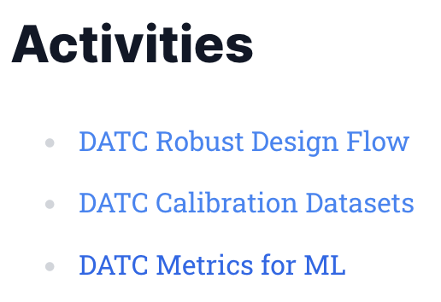

CEDA Technical Committees
DATC (Design Automation Technical Committee)
  Chair: Jinwook Jung, IBM (cannot attend)
SVDTC (System Validation and Debug Technology Committee)
  Chair: Chinna Prudvi, Intel Inc. (remote)
TCCPS (Technical Committee on Cyber-Physical Systems)
  Chair: Shiyan Hu, University of Southampton (no response)
TTTC (Test Technology Technical Council)
  Chair: Peilin Song, IBM (cannot attend)
Hardware Security and Trust Technical Committee (HSTTC)
  Chair: Gang Qu, University of Maryland (remote)
Awards, Tools, Standards, Outreach, etc.

Slide 104
Member Technology Organization updates
TTTC Test Technology Technical Council (TTTC) – Peilin Song (not attending)
HSTTC Hardware Security and Trust Technical Committee (HSTTC) – Gang Qu (virtual) / Yier Jin (alternate) (no response)
SVDTC System Validation & Debug Technology Committee (SVDTC) – Chinna Prudvi (virtual)
TCCPS Technical Committee on Cyber-Physical Systems (TCCPS) – Shiyan Hu (no response)
DATC Design Automation Technical Committee (DATC) – Jinwook Jung (not attending)
DAC Design Automation Conference – ?
DATE Design Automation and Test in Europe Conference – ?
ICCAD International Conference on Computer-Aided Design – ?
ESL Embedded System Letters – ?
TCAD Transactions on Computer-Aided Design of Integrated Circuits & Systems – ?
D&T Design & Test Magazine – ?
DTC Design Technology Council – ?

Slide 105
One-off event sponsorship
SWEAT 2024, Bangalore, June 28th 2024 (1000USD) - Symposium-cum Workshop on Emerging AI/ML Trends www.sweat.ieee bangalore.org (organized by newly-formed CEDA Bangalore section). Prominent visibility for CEDA material, funding event lunch, remote CEDA address (Ian)
DSD 2024, Paris, August 28-30 2024 (1000USD) - 7th Euromicro Conference Series on Digital System Design (potential future CEDA France Chapter). CEDA exposure through various channels (signage, printed materials, website listings, social media mentions, and email marketing campaigns)

Slide 106
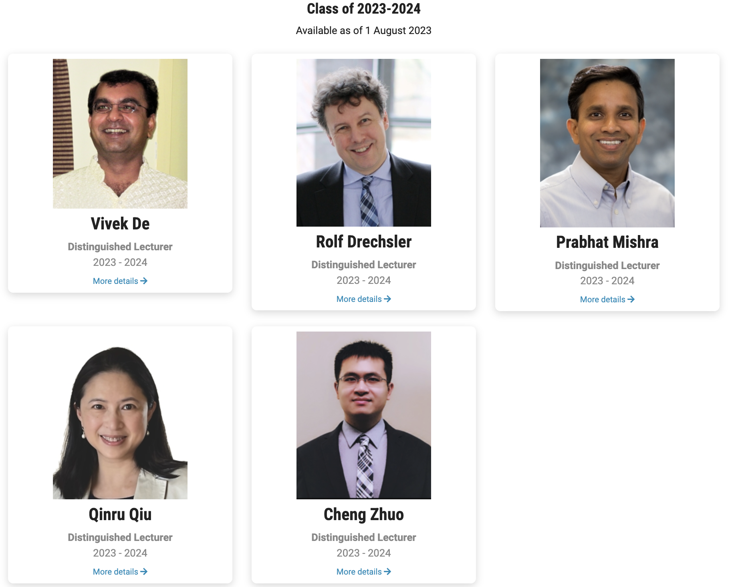
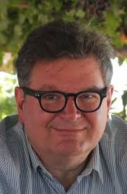
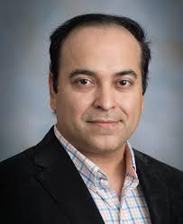
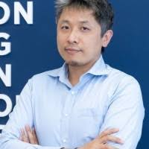
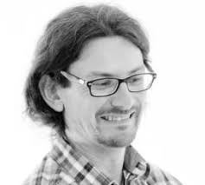
Distinguished Lecturer Program
Class of 2024-2025
To be available as of 1 August 2024
Prof. Ricardo Reis
UFRGS, Brazil
Seminars: Physical Design Automation of Transistor Networks / Trends on EDA / Visualization Tools
Tutorials : Low power challenges in IoT and IoE / Trends on EDA (extended) / Physical design, from past to future
Prof. Sudeep Pasricha
Colorado State University, USA
Seminars: Artificial Intelligence at the Speed of Light / Robust and Secure Design for Connected and Autonomous Vehicles / Sustainability Challenges with Computing: from Internet-of-Things to Datacenters
Tutorials : Optical Computing for AI Acceleration / Machine Learning for Smart Indoor Navigation / Green and Sustainable Cloud Computing
Ass. Prof. Bei Yu
CUHK, Hong Kong
Seminars : Machine Learning in EDA: When and How / Large Scale VLSI Mask Optimization / Large Language Model in EDA ; Tutorials : Enabling Large Language Models in EDA
Prof. Alberto Bosio
ECL, France
Seminars : AI Hardware Accelerator for Safety-Critical Applications / Trustworthy AI: The role of the Hardware
Tutorials : Approximate Fault-Tolerant Neural Network Systems / Early System Reliability Analysis for Cross-layer Soft Errors Resilience in Microprocessor Systems

Slide 107
CEDA VDL Program
5DLs class of 2023-2024 + 4 DLs class of 2024-2025
roughly monthly VDL webinars (Thursdays at 9:00 AM ET) hosted by TY
start in September 2024
  September 26 2024
  October 10 2024
  November 14 2024

Slide 108
DAC 2024 CEDA Luncheon Keynote
Scheduled for Tuesday June 25th 2024 12:00pm-1:30pm
Prof. Andrew Kahng
  Distinguished Professor of CSE and ECE, UC San Diego
  https://vlsicad.ucsd.edu/~abk/
  "AI for EDA and Disruptive Innovation"

Slide 109
ICCAD 2024 CEDA Luncheon Keynote
Scheduled for Tuesday October 29th 2024 12:00pm-1:30pm
Prof. Sachin Sapatnekar
  Distinguished Professor and Robert and Marjorie Henle Chair, Dept ECE, U Minnesota
  https://www.ece.umn.edu/users/sachin/
  automated layout generation for analog circuits, design of ML HW, ML algorithms for EDA
complementarity to ICCAD keynotes already scheduled (Leon Stok, IBM / Philip Wong, Stanford / Dilma Da Silva, US NSF)

Slide 110
CEDA representation in Women in Engineering
Seeking replacement for Prof. Shao-Yun Fang (NTUST, TW)
  CEDA representative in the IEEE Women in Engineering (WIE) initiative
  Diversity and Inclusion Chair of CEDA

Slide 111
Awards - Chen

Slide 112
Publicity Update
Sri Parameswaran
Website
Mail (Mailchimps)
Social Media
Conferences

Slide 113
Website
Migrated to Catalyze 2.0
  Launched last month - May 2024
  Featured posts on homepage
  Announcements section
  Upcoming events
  Adding Member Society news/conferences to the website and in the newsletter
  Looks Amazing

Slide 114
Mail
Standalone
  Awards Call for Nominations
  Kaufman Press Releases
Currents Newsletter - sent on the even months February
  April
  June
  August
  October
  December
Community Calls - sent on odd months
  January
  March
  May
  July
  September
  November

Slide 115
Social Media
LinkedIn
Facebook
Twitter
YouTube
Possible Tiktoks of interesting excerpts?

Slide 116
Goals
Student Travel Grants
Engagement with students/YP and awareness of CEDA
Develop a platform to host tutorials, content, software, etc.

Slide 117
Future directions
Interviews with conference chairs / EiCs of Jounals / CEDA execs
Tried testing via zoom and teams –
  Quality is varied
  Quality is towards the lower end
  A little monotonous
Any ideas?

Slide 118
Thank You

Slide 119
Initiatives - Zhu

Slide 120
Initiatives – Activities
Shared Machine Learning Infrastructure for EDA (SLICE)
  Public domain training/test dataset
  Interface between EDA and ML tools
  Benchmark and testcases for EDA applications
  Validation systems for ML EDA techniques
  Extensible and privacy-preserving platform for community members to contribute
Team
  Yiran Chen, Duke University
  Vidya Chhabria, Arizona State University
  Siddharth Garg, New York University
  Jiang Hu, Texas A&M University
  Andrew Kahng, UC San Diego
  Sachin Sapatnekar, University of Minnesota
https://slice-ml-eda.github.io/

Slide 121
Initiatives – IEEE TCs
Continue the support of IEEE IoT TC
IEEE Smart Cities TC
  Requesting a person from CEDA communication/outreach committee as a correspondent to their communication committee (providing access to Smart Cities social media channels for forwarding relevant information from CEDA)
  Requesting two CEDA volunteers to work with them on technical tracks on cutting-edge cross-OU subjects
  Other options on creating new common conferences/workshops
  Since 6/1, IEEE Smart Grids program is under IEEE Smart Cities

Slide 122
Initiatives – IEEE New Initiative Program
https://www.ieee.org/about/corporate/initiatives/index.html
Areas seeking proposals
  Increasing IEEE's connectivity to the industry
  Engaging and recruiting members
  Creating innovative education opportunities
  Increasing the visibility of IEEE and its relevance to different communities
  NIC seeks proposal topics that are in line with the IEEE Strategic Plan
Seed Grants
  Typically $40K, within 12 months to complete
  Innovation Seed Grant can go up to $100K, within 12 months to complete
New Initiatives
  Typically $100K, within 12 months to complete

Slide 123
Strategy - Gielen

Slide 124
CEDA Bylaws Issues & Changes
EC/BoG Meeting
(DAC 2024)
Gi-Joon Nam, Past President: 2024-2025
June 23rd, 2024

Slide 125
1. Removing MTOs
Remove lists -- the primary reasoning is that including the list creates an unnecessary administrative burden on the Council to update their Governing documents.
Maintain the list on the Council’s website
Previously approved changes by the BoG
What about ”Member Societies”?
  I propose to include them
  Other councils (like Sensors Council, Systems Council do NOT include these lists)
Notes:
Currently there are 257 pending manuscripts

Slide 126
2. Updates of DAC Representatives
Past President and President to increase the continuity and situation awareness
Previously approved changes by the BoG
Notes:
Currently there are 257 pending manuscripts

Slide 127
3. Standing Committees
Are the VPs actively engaging other volunteers to create these committees?
According to the Bylaws, this is the responsibility of the VPs to make a recommendation to the President who will appoint the members
  Awards - VP Awards +4 members
  Activities - VP Activities + 4 members
  Conferences - VP Conferences + 4 members
  Constitution and Bylaws - Secretary + 3 members
  Finance - VP Finance + 4 members
  Initiatives - Entire committee section is missing including duties and members. Recommend VP Intatiives + 4 members
  N&A - Past President+President-Elect+4 members (one must not be on the BoG, one must be a Member Society rep)
  Publications - VP Publications + 2 members + journal EiCs (AO: does this include all co-sponsored too?)
  Publicity - VP Publicity +4 members
  Standards - VP Standards + 3 members
  Strategy - VP Strategy + 4 members
Notes:
Currently there are 257 pending manuscripts

Slide 128
Periodical Distributions
Section VI.5. Subsequent Year Periodical Distributions
Unless otherwise specified, in the event of a distribution of a surplus or payment of a deficit during the second and third years of publication of a Council periodical, each member Society's share will be weighted in proportion to the number of years that Society has been a Member Society of the Council with all Member Societies with more than three years membership being counted equally.
These sections should be removed. The Member Societies do not receive surpluses as they no longer pay dues to the Council.
Notes:
Currently there are 257 pending manuscripts

Slide 129
A few rewording, removal of repetitions and corrections
Section IV.14. The Strategy Committee
IV.14.1. Duties
The Strategy Committee shall be responsible for the long-range planning for the Council. They will develop and maintain a Strategy document that covers all Council activities at a high level. The Strategy Committee shall supervise and coordinate the operation of the Technical Committees and integrate their activities with the Council’s strategy. CEDA’s strategy along with quantitative measures of progress shall be reviewed with the Board of Governors annually. The chair, with the participation of the Strategy Committee, shall develop and maintain a strategy and plan document for all CEDA activities. In addition, the chair shall work with the Technical Committees to develop plans for supporting the Technical Committee activities and integrating them into primary Council activities. CEDA’s strategy along with quantitative measures of progress shall be reviewed with the Board of Governors annually. CEDA President and CEDA President-Elect are members of the Strategy Committee.
Notes:
Currently there are 257 pending manuscripts

Slide 130
All Other Business

Slide 131
Admin/Action Item Review - Paul

Slide 132
LUNCH

