Slide 1
The IEEE Computer Society empowers, shapes, and guides the future of not only its members, but the greater computing community, enabling new opportunities to better serve our world.

Slide 2
IEEE COMPUTER SOCIETY
375,000+
A Global Reach
Community Members
157
Countries with Computer Society Members
For over 75 years, the Computer Society has empowered the people who advance technology by delivering resources and solutions that computing students and professionals need to achieve goals at all stages of their careers.
936
Global Chapters
30
Technical Communities

Slide 3
IEEE Computer Society Technical Communities
Broad and Deep Technical Expertise
Business Informatics and Systems
Cloud Computing
Computational Life Sciences
Computer Architecture
Computer Communications
Data Engineering
Dependable Computing and Fault Tolerance
Distributed Processing
High-Performance Computing
Intelligent Informatics
Internet
Learning Technology
Mathematical Foundations of Computing
Microprocessors and Microcomputers
Microprogramming and Microarchitecture
Multimedia Computing
Multiple-Valued Logic
Parallel Processing
Pattern Analysis and Machine Intelligence
Quantum
Real-Time Systems
Rebooting Computing
Scalable Computing
Security and Privacy
Semantic Computing
Services Computing
Software Engineering
Test Technology
Very Large Scale Integration
Visualization and Graphics
Technical Communities
are the focal point for the society’s activities within a technical discipline.
Technical Communities directly influence standards development, conferences, publications, and educational activities.

Slide 4
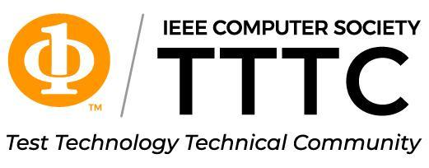
TTTC
IEEE CS Community for Test Technology Activities
Test Technology Technical Community (TTTC) provides educational programs which include conferences, symposia, workshops and tutorials offered worldwide
Maintains information and communication among TTTC members to include publications and newsletters.
Supports IEEE Design & Test magazine
Sponsors awards for technical achievement and service in test technology

Slide 5
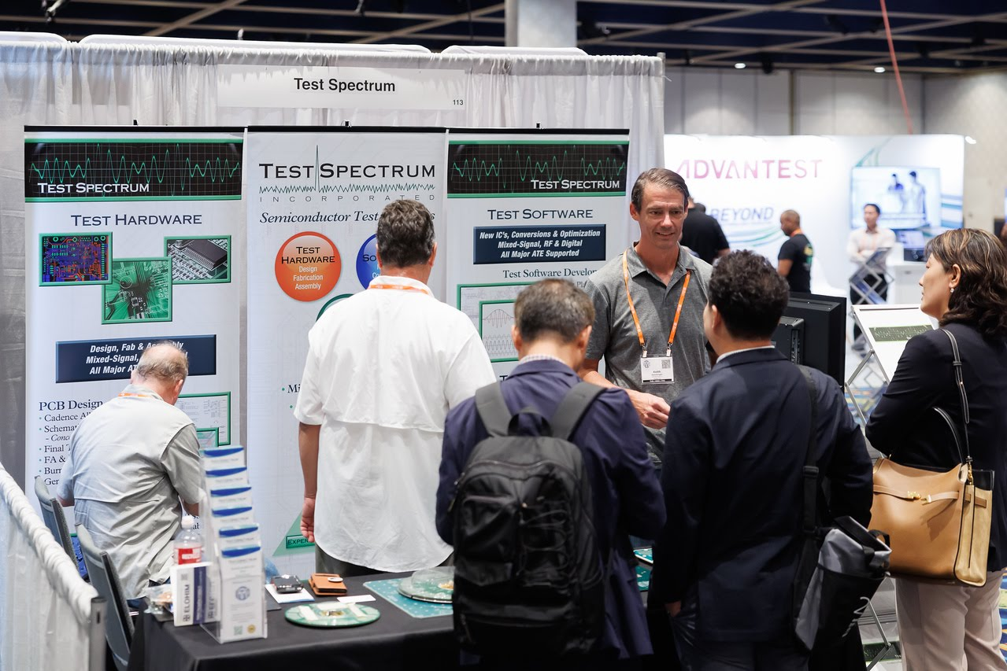
CS Organizes 195+ Technical Conferences a Year

Slide 6
Computer Society & CEDA Conference Cooperation
COINS (IEEE International Conference on Omni-layer Intelligent Systems)
DFT (IEEE International Symposium on Defect and Fault Tolerance in VLSI Systems)
DTTIS (IEEE International Conference on Design, Test, and Technology of Integrated Systems)
ETS (IEEE European Test Symposium)
IOLTS (IEEE Symposium on On-Line Testing)

Slide 7
200+ Working Groups Developing NEW Standards
Standards Activities-Sponsored Committees
Artificial Intelligence Standards
Blockchain and Distributed Ledger Standards
Cloud Computing Standards
Cybersecurity & Privacy Standards
Data Compression Standards
Design Automation Standards
Functional Safety Standards
LAN/MAN (IEEE 802) Standards
Learning Technology Standards
Microprocessor Standards
Online Gaming Standards
Simulation Interoperability Standards Organization SAC
Smart Manufacturing Standards
Software & Systems Engineering Standards
Standards Activities Board (SAB) Standards
Test Technology Standards

Slide 8
IEEE CS Standards Committees in the EDA area
Design Automation Standards Committee (DASC) manages standardization of Design Automation related standards with a focus on language based design and verification standards stemming from the key HDL standards VHDL and Verilog. From these have flowed standards for timing, synthesis, math routines, and test.
Test Technology Standards Committee (TTSC) promotes the development of standards in the Test industry beneficial to IC designers, ATE tool and equipment vendors, and developers and users of automation tools

Slide 9
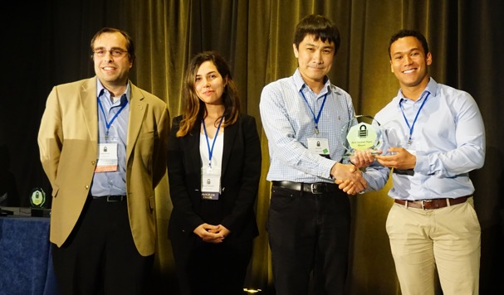
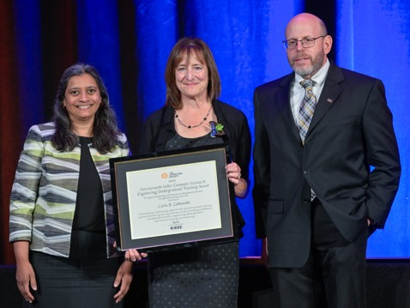
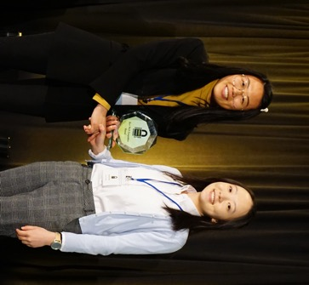
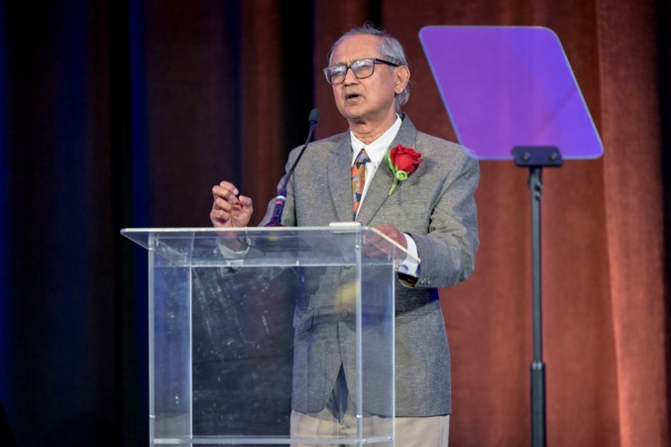
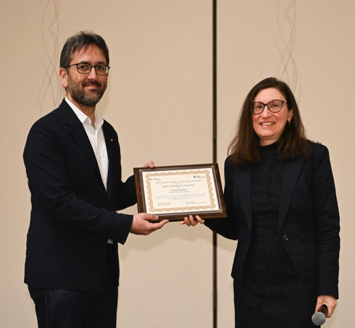
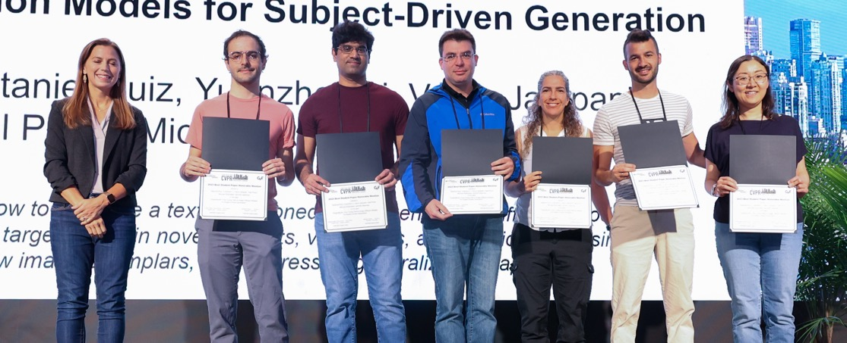
IEEE Computer Society Offers Awards for Technical Achievement and An Award for Standards Development that have honored Outstanding Professionals in Design Automation & Test Technology

Slide 10
Addendum

Slide 11
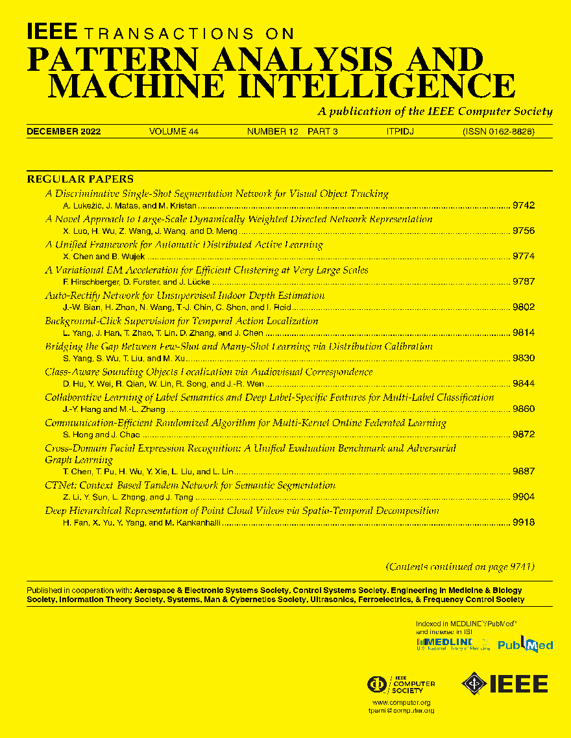
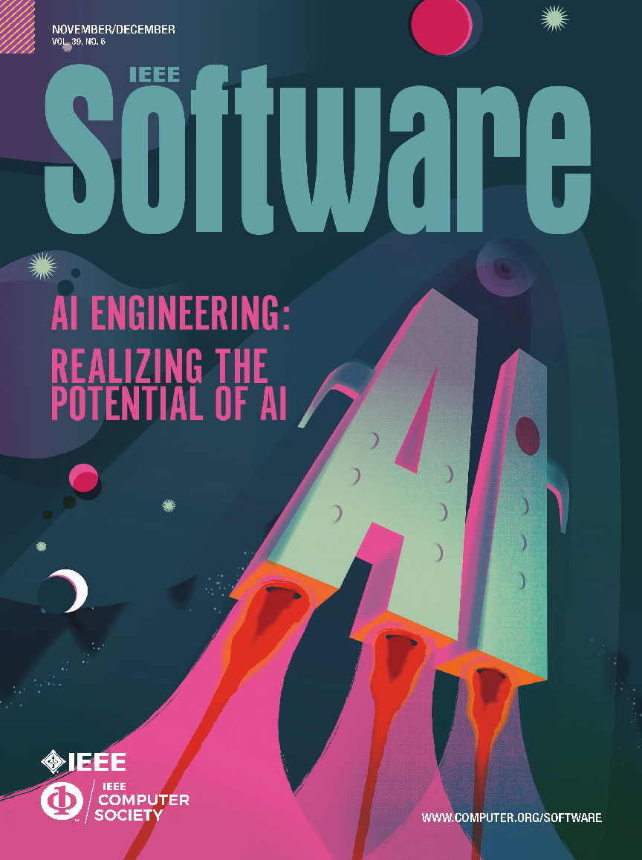
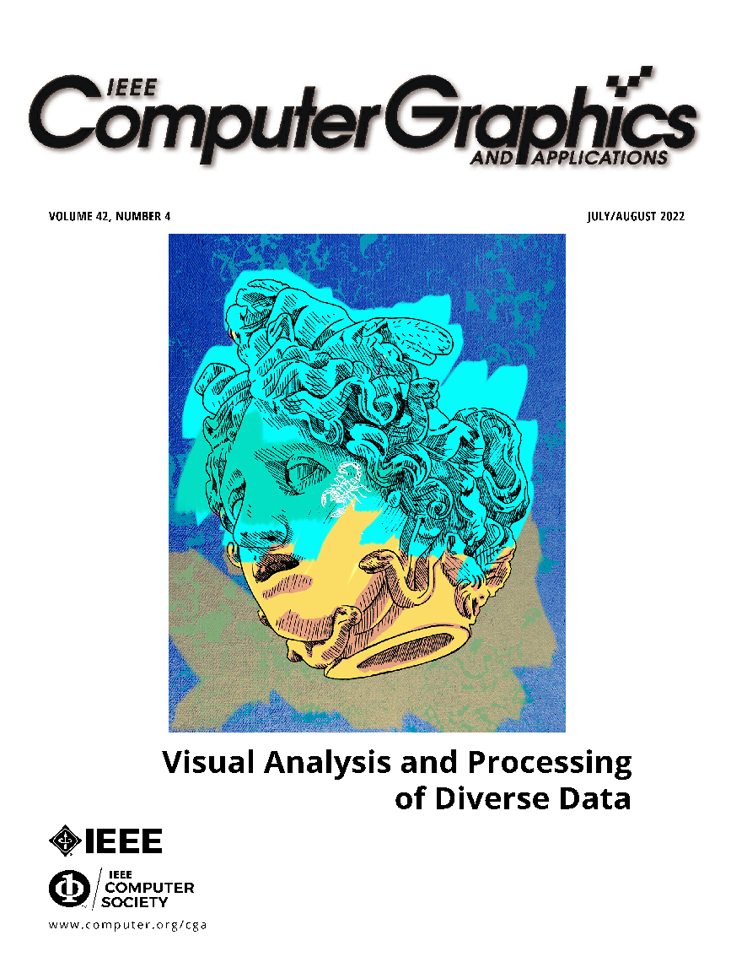
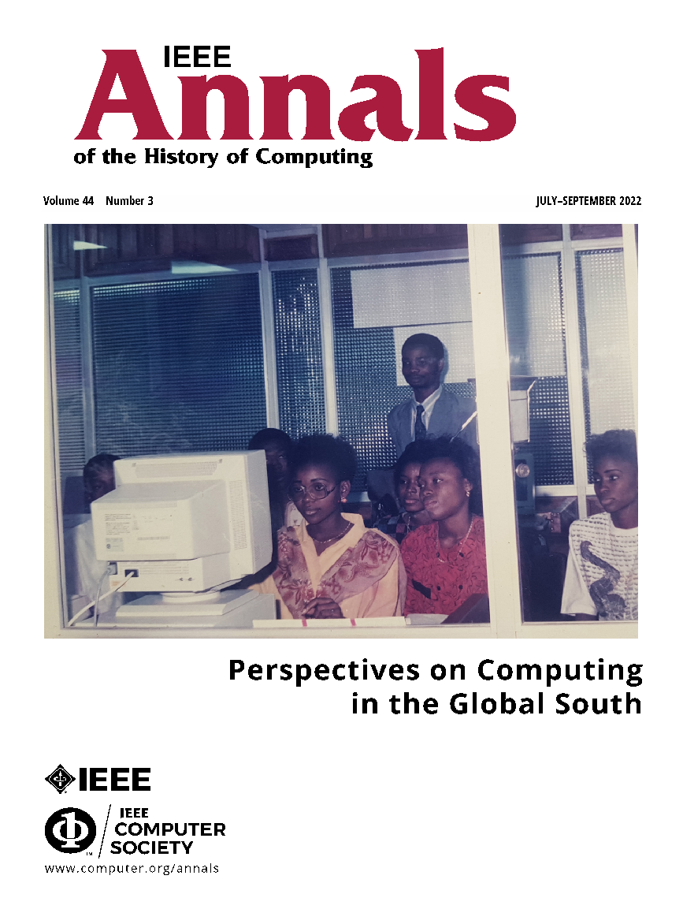
Renowned Publications
12 of the top-cited magazines in computer science and engineering
37 peer-reviewed journals featuring cutting-edge research
One monthly digest featuring timely, trusted content from our magazines

Slide 12
Magazines
Journals
Computer
Computing in Science & Engineering
IEEE Annals of the History of Computing
IEEE Computer Graphics and Applications
IEEE Intelligent Systems
IEEE Internet Computing
IEEE Micro
IEEE MultiMedia
IEEE Pervasive Computing
IEEEE Security & Privacy
IEEE Software
IT Professional
Transactions
IEEE Transactions on Affective Computing
IEEE Transactions on AI
IEEE Transactions on Big Data
IEEE Transactions on Cloud Computing
IEEE Transactions on Computers
IEEE Transactions on Dependable and Secure Computing
IEEE Transactions on Emerging Topics in Computing
IEEE Transactions on Knowledge and Data Engineering
IEEE Transactions on Mobile Computing
IEEE Transactions on Parallel and Distributed Systems
IEEE Transactions on Pattern Analysis and Machine Intelligence
IEEE Transactions on Services Computing
IEEE Transactions on Software Engineering
IEEE Transactions on Sustainable Computing
IEEE Transactions on Visualization and Computer Graphics
IEEE/ACM Transactions on Computational Biology and Bioinformatics
Letters
IEEE Computer Architecture Letters
Open Access Journal
IEEE Open Journal of the Computer Society
IEEE Transactions on Privacy

Slide 13
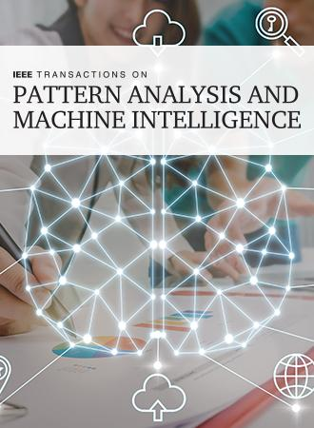
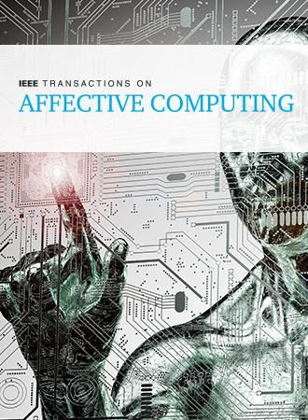
Top Five Computer Society Transactions
8.1
Impact
factor
8.9
Impact
factor
24.6
Impact
factor
11.2
Impact
factor
7.9
Impact
factor

Slide 14
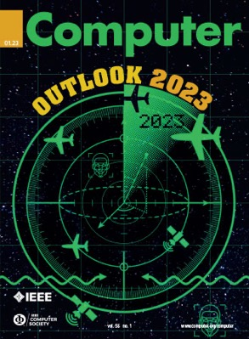
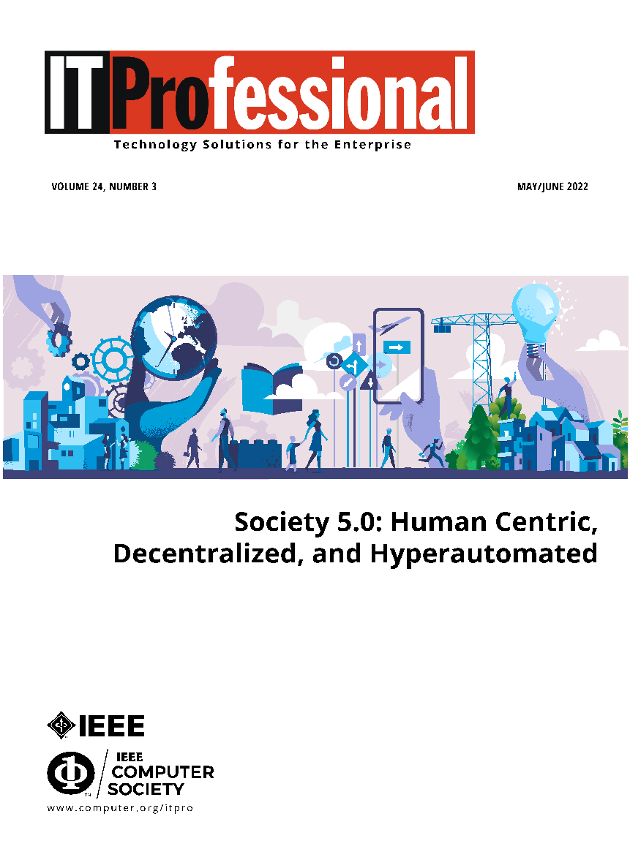
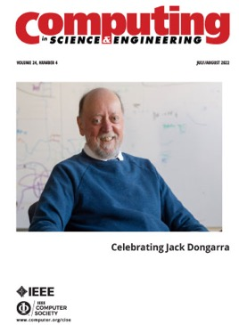
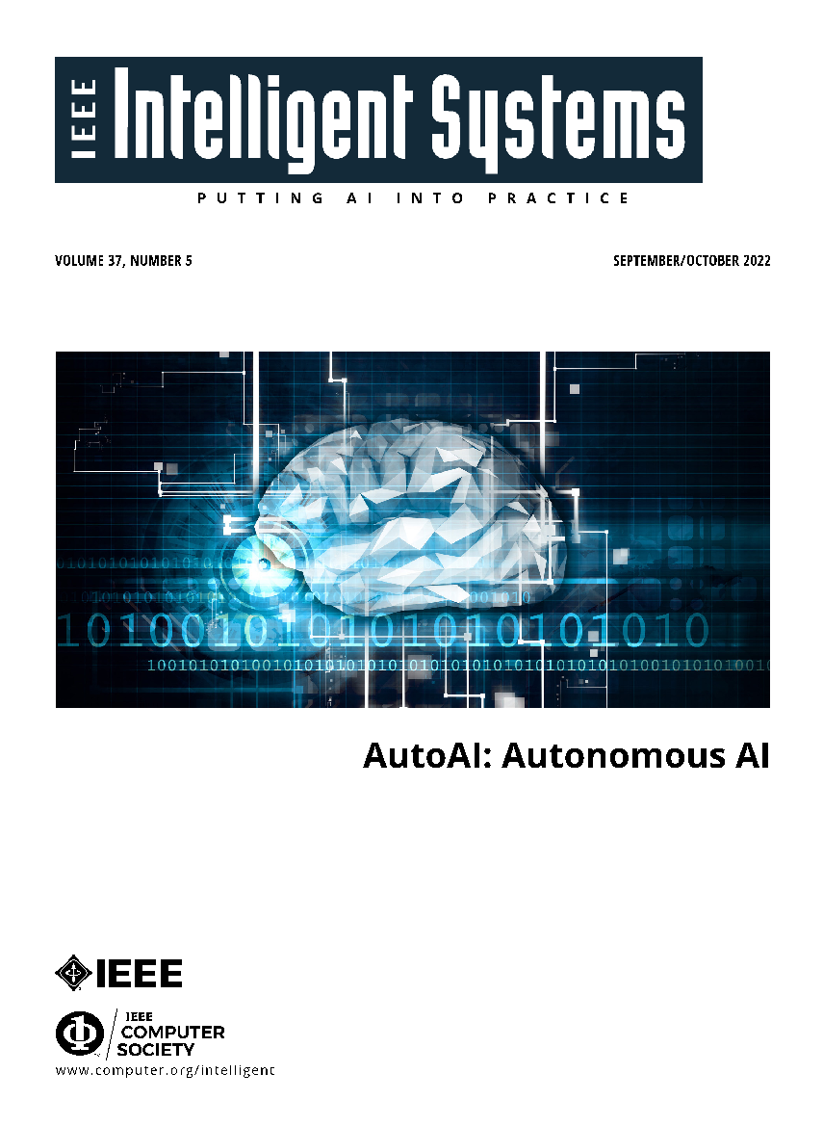
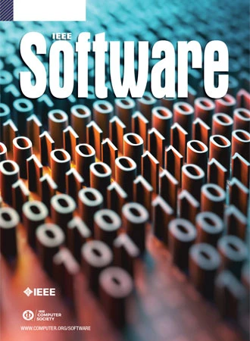
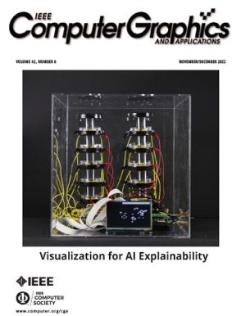
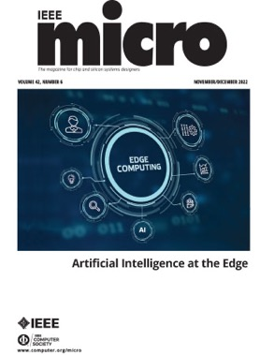
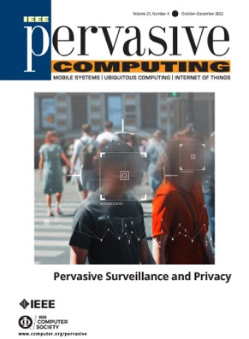
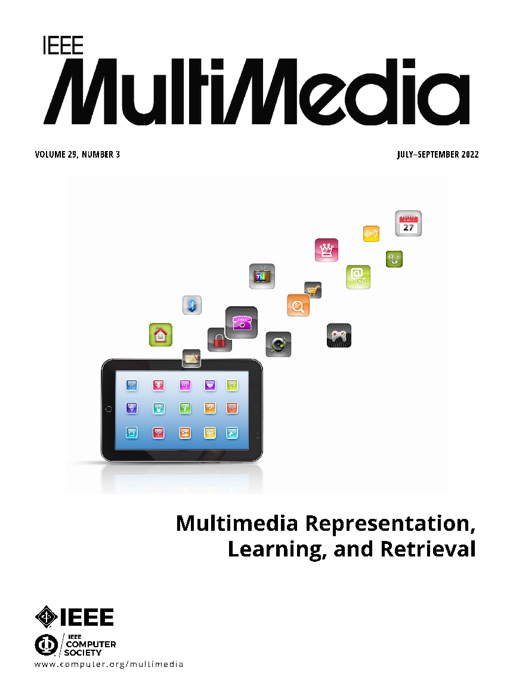
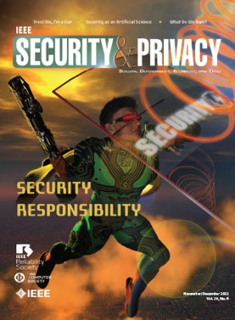
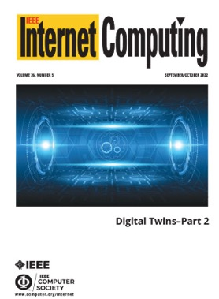
Top Quality Magazines
6.4
Impact
factor
3.3
Impact
factor
3.6
Impact
factor

Slide 15
The Computer Society is a Trusted Source of Education and Continuous Learning
70 Professional Courses on 13 Topics
Artificial Intelligence
Big Data
Cloud Computing
Cybersecurity
DevOps
Embedded Systems
Healthcare Cybersecurity
Internet of Things
Multi-core
Risk-Based Security
Security
Software Engineering
Wearables

Slide 16
47
New Standards
241
Active Standards

