Slide 1
Conferences
Tsung-Yi HO
June 23, 2024

Slide 2
Sponsored conferences/events (2024.1 ~)
Financial Sponsorship (17)
Technical Sponsorship (10)
MLCAD (50%) |  | ICCAD (46.67%) | ETS (25%)
DTTIS (25%) |  | VLSI-SoC (25%) | MPSoC (33%)
LAD (100%) |  | LATS (25%) | MEMOCODE (25%)
ISLPED (15%) |  | SIES (50%) | ITC-Asia (50%)
DAC (50%) |  | ASP-DAC (12.5%) | DDECS (25%)
CODAI (25%) |  | SBCCI (5%-7%) | ATS (25%-50%)
FMCAD | LASCAS
GLSVLSI | ICITES
ISPD | ISED
SMACD | AsianHOST
FDL | ISEDA
Notes:
• Is IEEE CEDA aware of this event and the request for 25% financial sponsorship?
• Has IEEE CEDA agreed to grant 25% financial sponsorship for this event?
• If so, who from IEEE CEDA will be the "champion" (accountable individual) and be involved in the event planning/development as well as be able to speak to the event's validity?
• Is IEEE familiar with the non-IEEE co-sponsor (Aix-Marseille Université)?
——
EEE DTIS (International Conference on Design and Technology of Integrated Systems in nanoscale era), and IEEE DTS (International Conference on Design and Test of Integrated Systems).

Slide 3


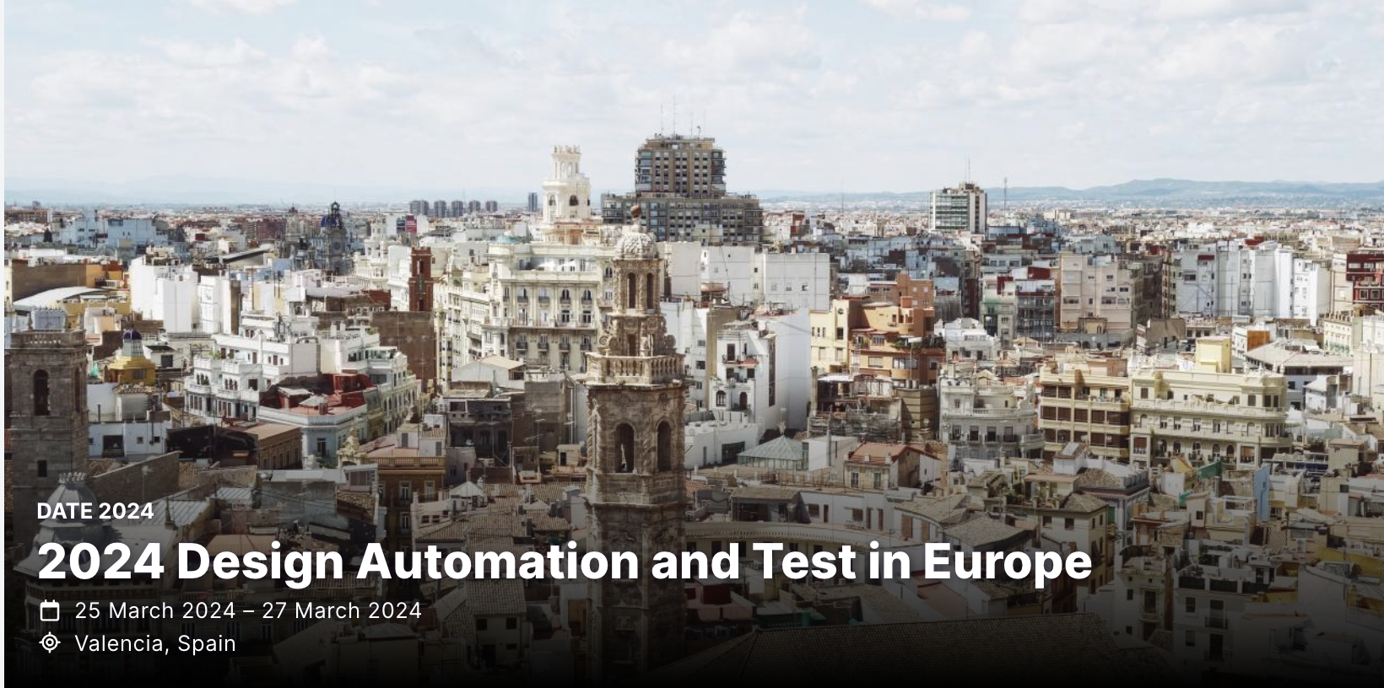

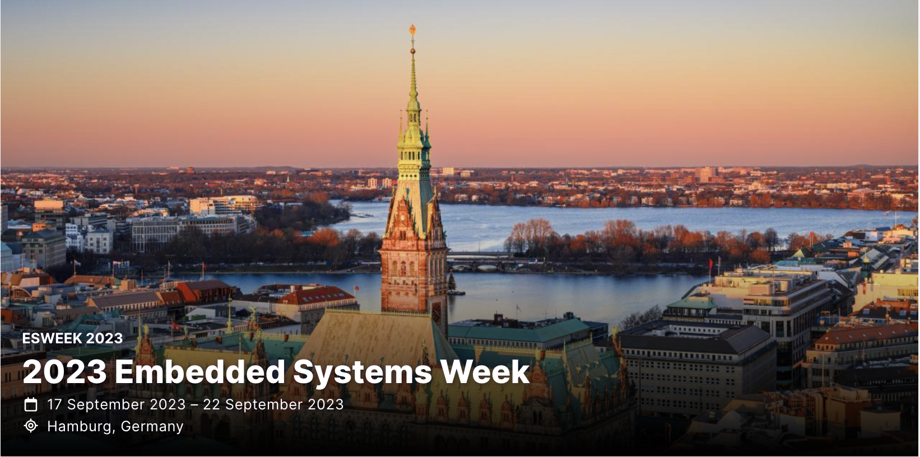
Flagship conferences

Slide 4
DAC Updates
Miguel Silveira
June 23, 2024

Slide 5
DAC 2024 - Record number of submissions
Record number of submissions: 2079 Abstracts, 1575 PDFs; 1545 final valid submissions after some withdrawing (cf. 1156 in 2023 => 34% increase)
TPC committee: 29 tracks, 34 track chairs, 356 TPC members (cf. 266 in 2023 => 34% increase)

Slide 6
Research Paper Submission History
34% increase in submissions!
Clearly a lot of momentum in the Semiconductor, EDA, AI and Security areas.

Slide 7
Top tracks/topics in paper attraction
Track | #papers
AI1. AI/ML Algorithms | 80
AI2. AI/ML Application and Infrastructure | 74
DES3B-I. In-memory and Near-memory Computing Architectures, Applications and Systems - I | 58
DES3B-II. In-memory and Near-memory Computing Architectures, Applications and Systems - II | 60
DES4-I. AI/ML Architecture Design - I | 57
DES4-II. AI/ML Architecture Design - II | 53
DES9. Quantum Computing | 78
EDA3. Timing and Power Analysis and Optimization | 60
EDA5. Analog CAD, Simulation, Verification and Test | 54
EDA6. Physical Design and Verification | 71
EDA7. Design for Manufacturing and Reliability | 51
SEC1. Hardware Security: Primitives, Architecture, Design & Test | 63

Slide 8
Accepted Sessions by Country
2023
2024
337 submissions accepted
21.8% acceptance rate
(cf. 22.7% in 2023)
Most accepted submissions from China and US
  153 papers (45%) with a primary author from China
  82 papers (24%) from USA
Country | Percentage |  | Country | Percentage
China | 41.06% |  | China | 45.40%
United States | 30.42% |  | United States | 24.33%
Hong Kong | 6.46% |  | Korea | 7.12%
Korea | 5.70% |  | Hong Kong | 6.82%
Taiwan | 4.94% |  | Germany | 3.56%
Germany | 3.42% |  | Taiwan | 2.97%
Switzerland | 2.28% |  | Italy | 1.48%
United Kingdom | 1.90% |  | Singapore | 1.19%
Belgium | 0.76% |  | Japan | 0.89%
Italy | 0.76% |  | United Arab Emirates | 0.89%
Austria | 0.38% |  | United Kingdom | 0.89%
Canada | 0.38% |  | Austria | 0.59%
France | 0.38% |  | Canada | 0.59%
Greece | 0.38% |  | France | 0.59%
Japan | 0.38% |  | Greece | 0.59%
Singapore | 0.38% |  | Switzerland | 0.59%
 |  |  | Belgium | 0.30%
 |  |  | India | 0.30%
 |  |  | Luxembourg | 0.30%
 |  |  | Netherlands | 0.30%
 |  |  | Norway | 0.30%

Slide 9
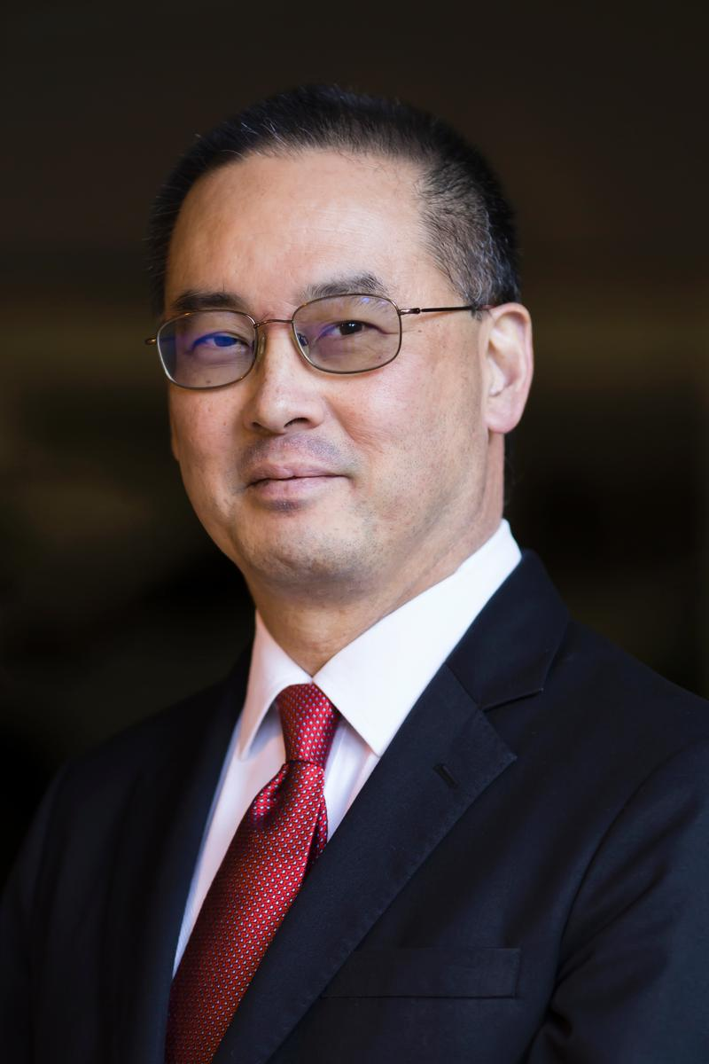
DAC 2024 – CEDA Distinguished Luncheon
Keynote:
Andrew B. Kahng: AI for EDA and Disruptive Innovation
Tuesday, 25th June, 12:00pm – 1:30pm

Slide 10
ICCAD Updates
Jiang Hu
June 23, 2024

Slide 11
ICCAD Strengths
Submissions continue to have a healthy growth (~28% increase) from 2022
1006 abstract submissions, 750 full submissions (2 desk rejects)
172 papers accepted (~23% acceptance rate)
52 sessions: 40 regular, 9 special, 2 tutorials, 1 panel
(1109) Abstract submissions
(803) Full submissions
7% increase from last year.

Slide 12
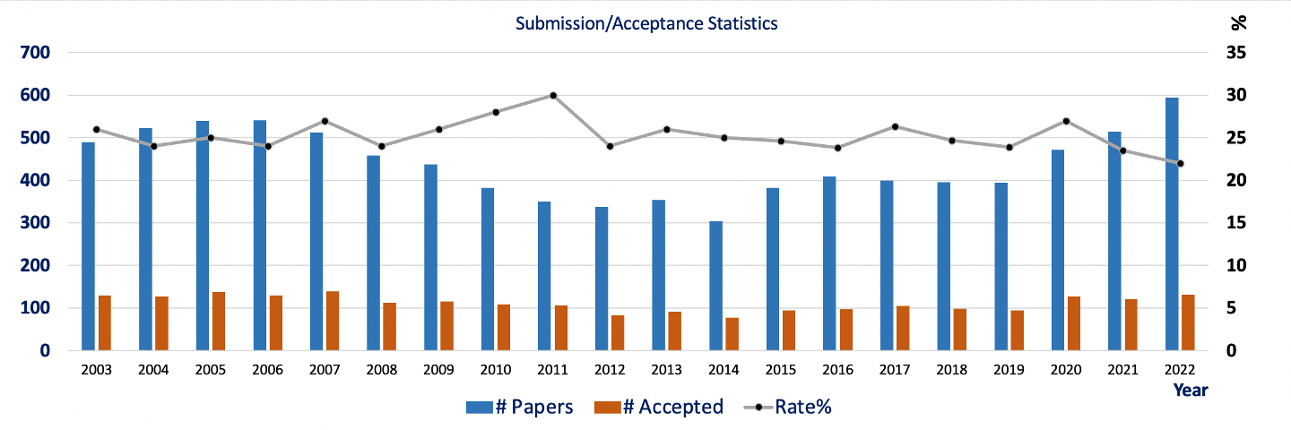
Conference Statistics

Slide 13
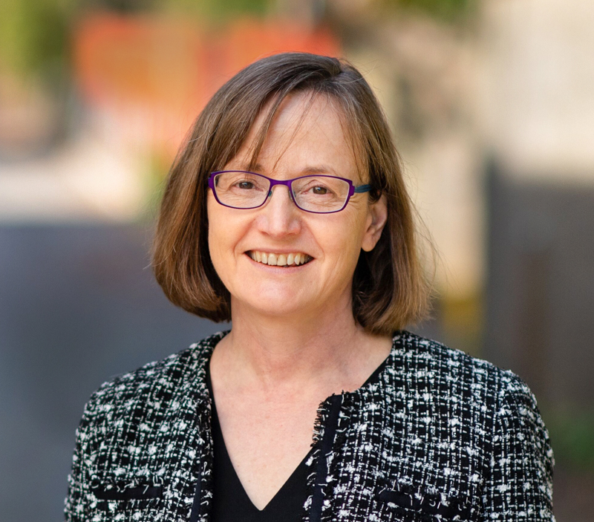
Tuesday IEEE CEDA Invited Keynote Luncheon
Mind the Gap: Challenges and Opportunities in Closing the Algorithms-to-Devices Gap in Quantum Computing
Margaret Martonosi
Professor of Computer Science
Princeton University

Slide 14
DATE Updates
Cristiana Bolchini
June 23, 2024

Slide 15
DATE 2024 in Valencia, Spain
March 25-27
Location: Valencia, Spain
Dates: March 25-27, 2024
consolidating the 3-day format
no exhibition
flash presentations + videos

Slide 16
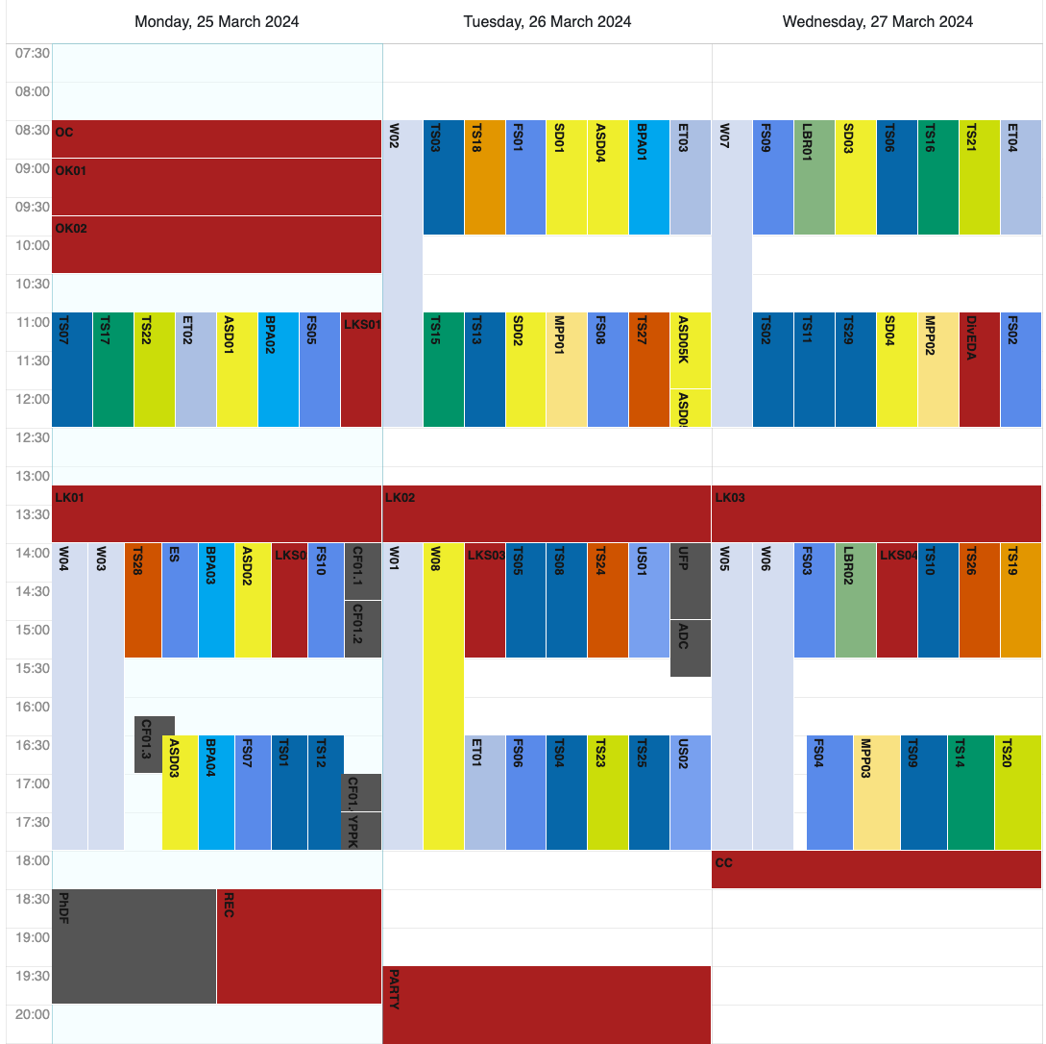
Program
scientific program
embedded tutorials
half-day workshops
focus sessions
late-breaking results sessions
multi-partner project sessions
special days
  responsible and robust AI
  sustainable computing
unplugged sessions
Autonomous System Design initiative
Young People Program
Diversity in EDA*
PhD Forum *
* CEDA sponsor

Slide 17
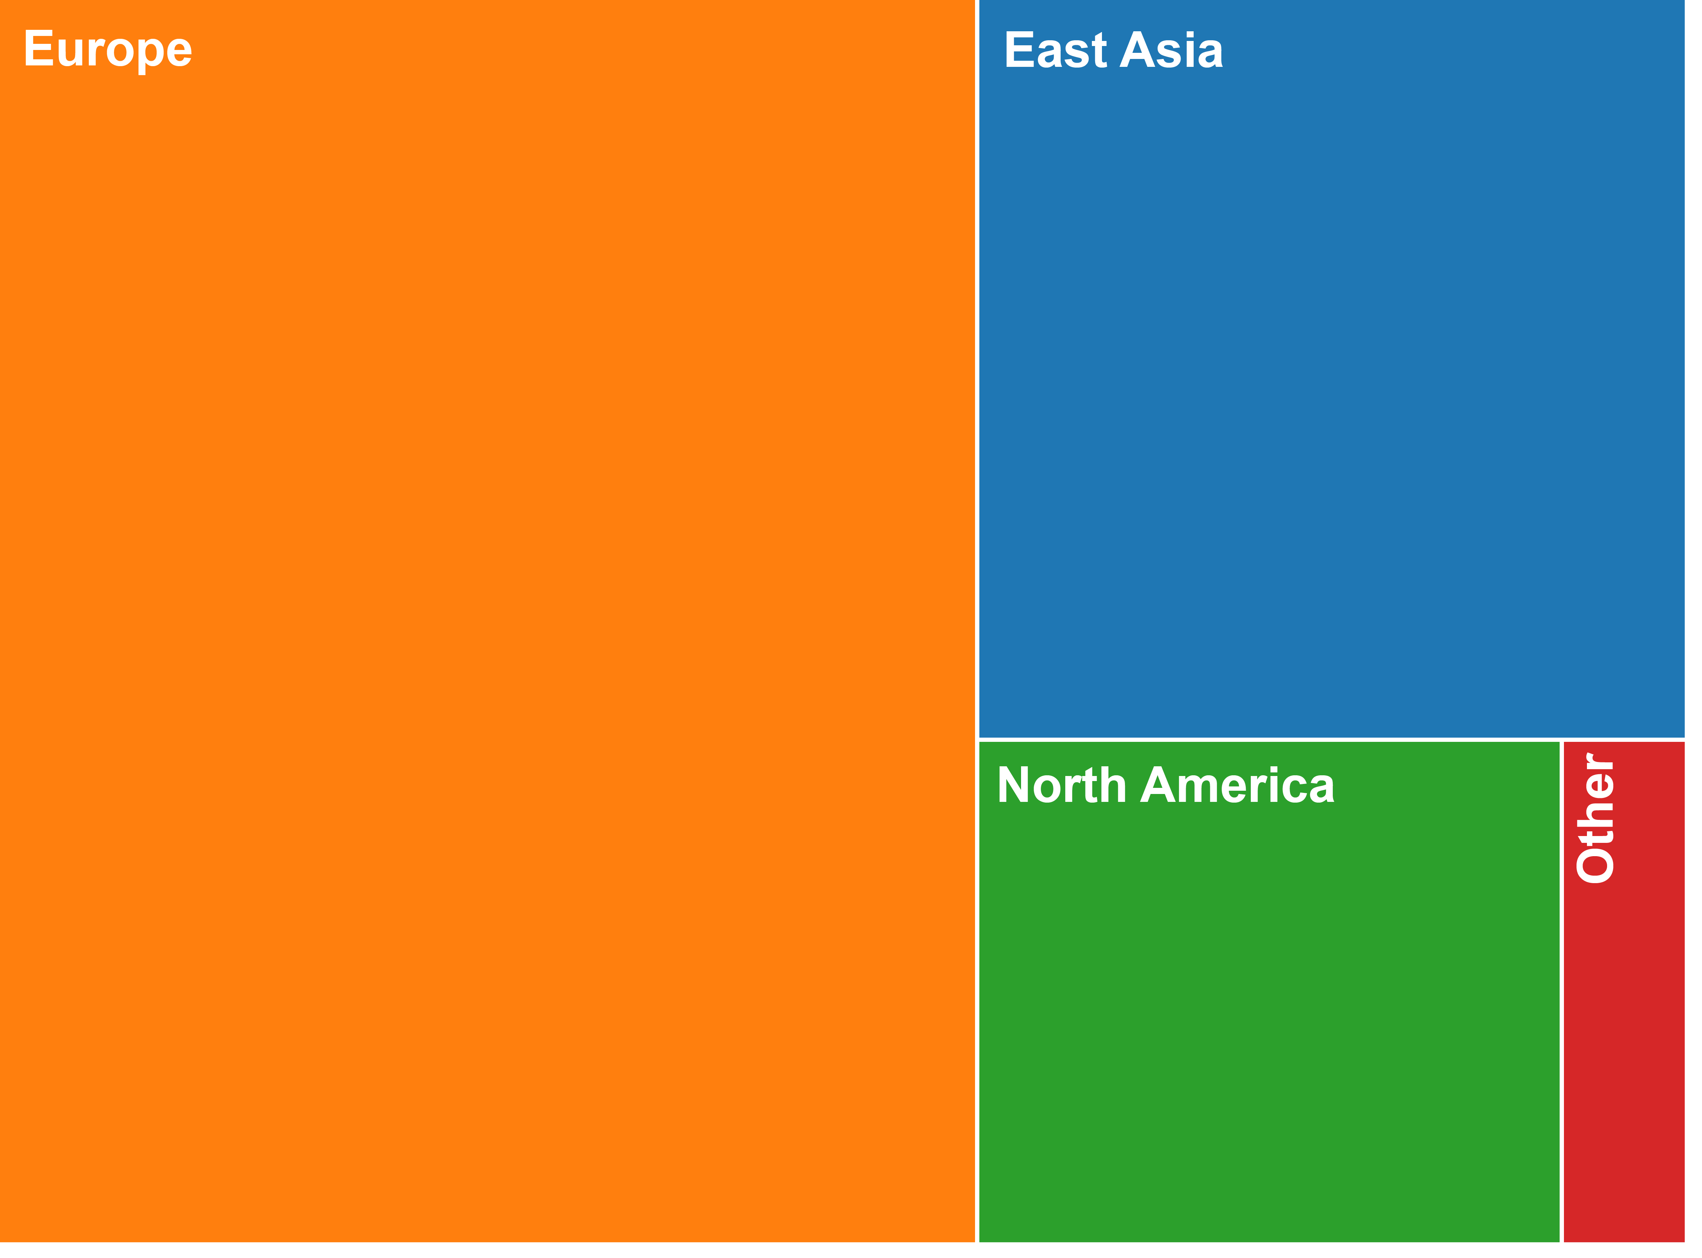
some numbers
+20% w.r.t. 2023 number of submissions/final papers
+36% w.r.t. 2022 number of submissions/final papers
more than 850 participants
attendees' country

Slide 18

DATE 2025
Location: Lyon, France
Dates: March 31 – April 2, 2025
General Chair: Aida Todri-Sanial, Eindhoven University of Technology, NL
Program Chair: Theocharis Theocharides, University of Cyprus, CY

Slide 19
ASP-DAC Updates
Kazutoshi Wakabayashi
June 23, 2024

Slide 20
Paper Submission
529
346
310

Slide 21
Submissions by
Countries / Areas

Slide 22
Attendees (2023) (2021) (2019)
Total Number: 452 (←365) (←348) (←346)
  Academia: 382 (←312) (←300) (←260)
    (including 180 (←87) (←39) (←60)students)
  Industries: 52 (←51) (←47) (←76)
  Others: 18 (←2) (←1) (←3)
Tutorials: 94 (←68) (←50) (←60)
International participation
  Korea: 187
  Overseas: 265
    ASP 176
    Americas 53
    EU 36
Notes:
Conference: paid 325 + free 12 (keynote 4, cadence 5, silvaco 1, ansys 1, opentext 1)
Academia: paid 294 + free 2
Industries: paid 26 + free 10

Slide 23
ESWeek Updates
Joerg Henkel
June 23, 2024

Slide 24
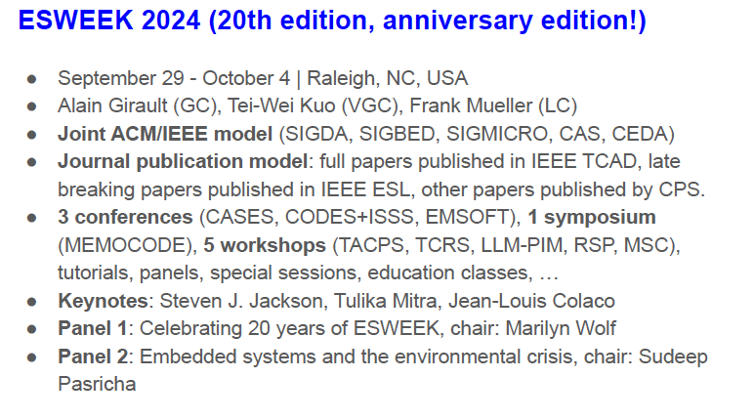
Notes:
Jorg till 21
David president elect from 2016

Slide 25
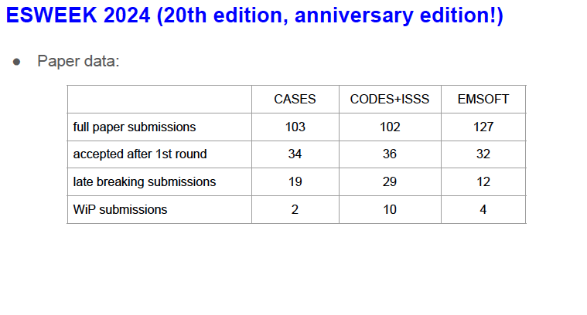
Notes:
Jorg till 21
David president elect from 2016

Slide 26
Conference Representatives
DAC
  Gi-Joon Nam
  Luis Miguel Silveira
ASP-DAC
  Kazutoshi Wakabayashi
DATE
  Cristiana Bolchini
  David Atienza
ICCAD
  Jiang Hu
ESWeek
  David Atienza
Notes:
Jorg till 21
David president elect from 2016

Slide 27
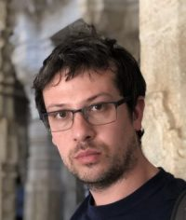
Motion: ESWeek Conference Representative
MOTION: Tsung-Yi HO moves to approve the appointment of Christian Pilato as the new CEDA ESWeek Representative started in July 2024.
Prof. Christian Pilato
Politecnico di Milano, Italy
Notes:
35 papers

