Slide 1


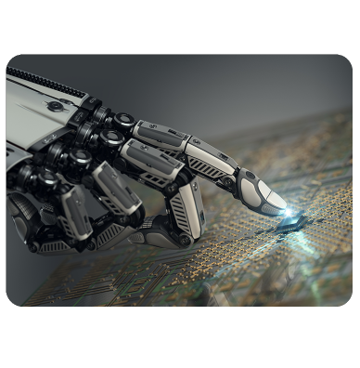

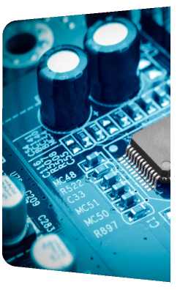
IEEE Electronic Packaging Society
CEDA Report 2024
Jose Schutt-Aine
Electronics Packaging Society

Slide 2
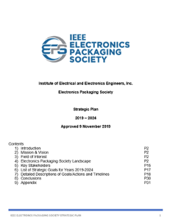
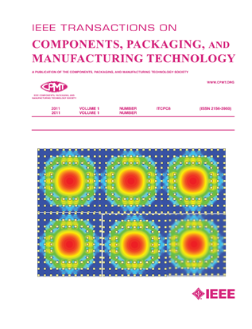
IEEE Electronic Packaging Society
Significant Worldwide Footprint
EPS is a small part of the IEEE organization, with just ~2800 members compared to the 400,000+ IEEE members worldwide
EPS has 43 Chapters, 36 Student/Branch Chapters
12 Technical Committees
Peer Reviewed Transactions
Supports Financially and/or Technically Sponsors /Cosponsors more than 25 Conferences
Solid Education Program
Heterogeneous Integration Roadmap
All the Above Supported by our Strategic Plan (2019 – 2024)
https://eps.ieee.org/

Slide 3
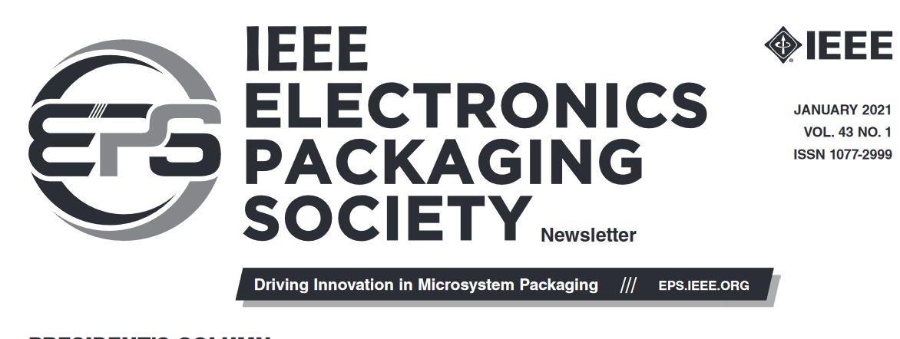
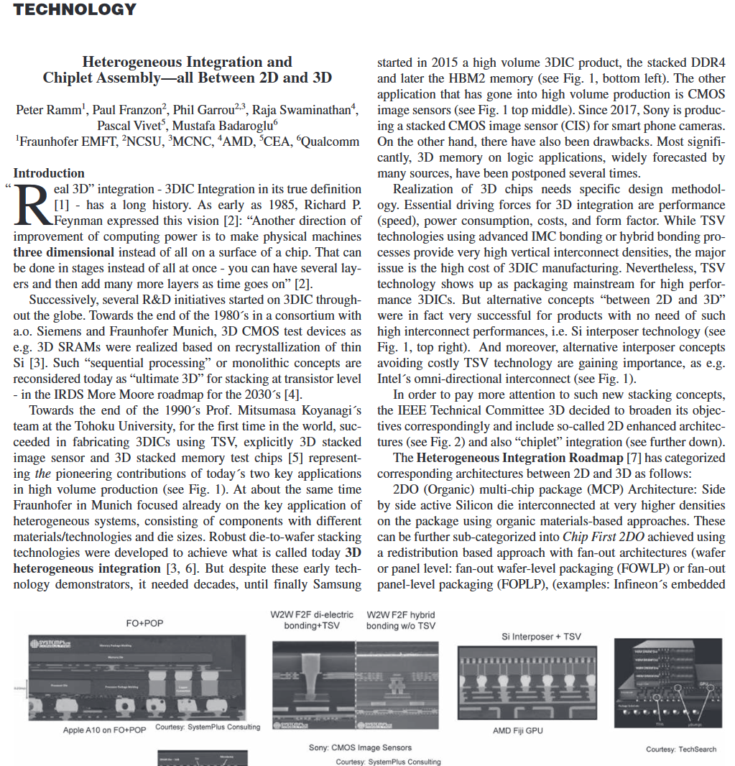
Technical Communities
Materials & Processes
High Density Substrates & Boards
Power & Energy
Electrical Design Modelling and Simulation
Nanotechnology
Photonics
Thermal & Mechanical
3D/TSV
Reliability
RF & TZ Technologies
Test
Emerging Technologies

Slide 4
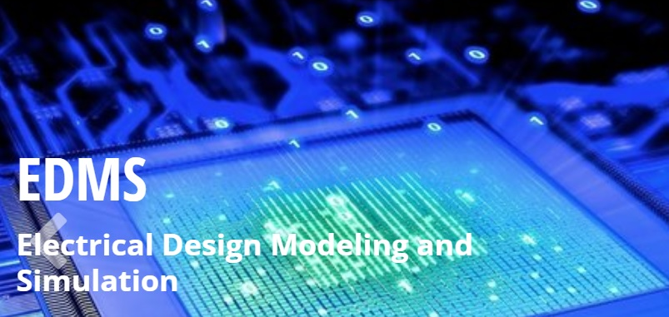
https://cmte.ieee.org/eps-edms/

Slide 5
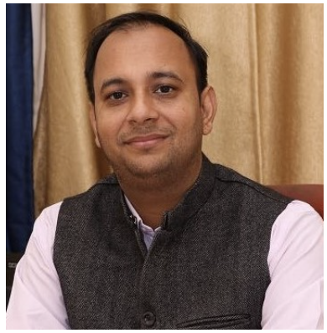
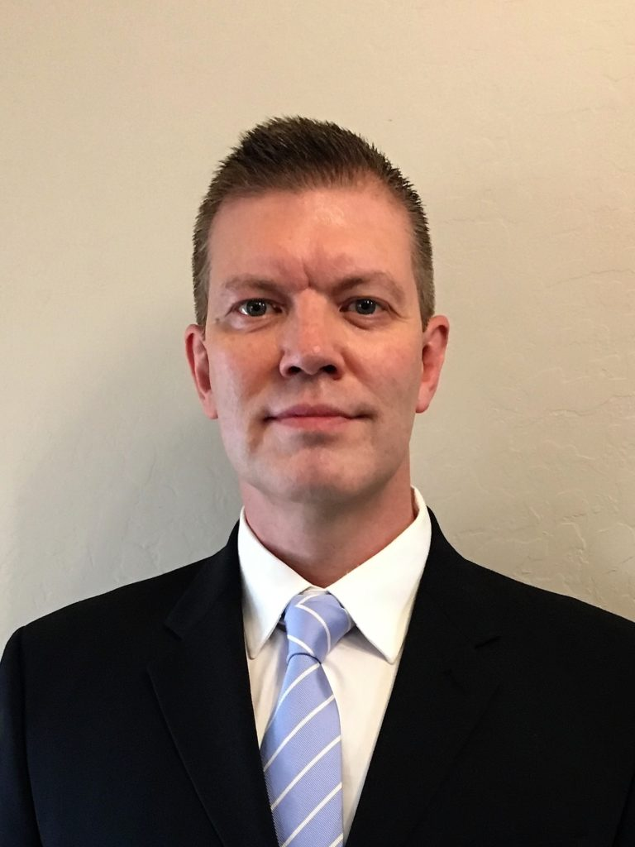
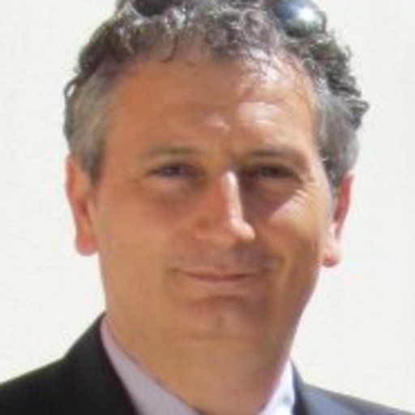
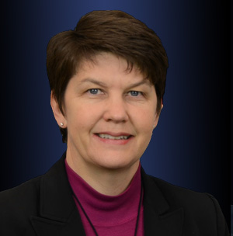
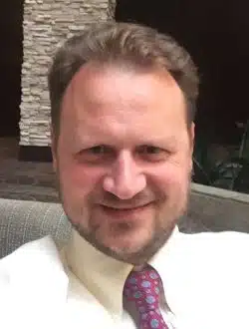
The Technical Committee
Leadership:
  Prof. Rohit Sharma, Indian Institute of Technology Ropar, India (chair)
  Dr. Kemal Aygun, Intel Corporation, Chandler, Az, USA (co-chair)
  Prof. Antonio Maffucci, Univ. Cassino and South. Lazio, Italy (co-chair)
Subcommittee: Packaging Benchmarks
  Dr. Heidi Barnes, Keysight (Chair)
  Prof. Vladimir Okhmatovski, Univ. Manitoba, (co-Chair)
  Three Benchmark subcommittees
Members – 78 on mailing list
Website: https://cmte.ieee.org/eps-edms/

Slide 6

Mission
The EDMS TC addresses the electrical aspects of package and system design.
The committee strives to balance industry and academic participation to guide the members of the EPS society in this area.
Activities
EDMS is involved in several chapters of the Heterogeneous Integration Roadmap, chairing two of them.
A benchmark subcommittee is providing designs for researchers to develop their electrical design methodologies.

Slide 7
EDMS Outreach Areas
IEEE Heterogenous Integration Roadmap (HIR):
  HPC and Co-Design Chapters Leadership and Participation in others such as 2D/3D and simulation
  Workshop and Seminar Presentations by members of TC-EDMS
  https://eps.ieee.org/technology/heterogeneous-integration-roadmap/2023-edition.html
TCPMT Special Sections
  “Advances in Electrical Modeling and Validation of Electronic Packaging and Systems” (Sept 2021, Guest Ed: Kemal Aygün, Intel and Xu Chen, UIUC): https://ieeexplore.ieee.org/xpl/tocresult.jsp?isnumber=9534856
EPS Newsletter articles
  Available at: https://eps.ieee.org/publications/eps-newsletter.html
Packaging Benchmarks
  Website launched with 4 peer reviewed benchmarks: https://packaging-benchmarks.org/
Distinguished Lecturers (DLs)
  Wendem Beyene, Kemal Aygun, Ram Achar, José Schutt-Ainé, Rohit Sharma, Rajen Murugan
  Complete list of EPS DLs at: https://eps.ieee.org/education/distinguished-lecturer-program.html
Conferences sponsored by IEEE EPS Society and TC-EDMS: SPI, EPEPS, EDAPS and DTMES

Slide 8
Education
Certificate Programs
  Achievement
  Distinguished Achievement for Technical Leadership and Expertise
  Distinguished Achievement Certificate for Professional Engagement and Service
Webinars on Resource Center
  Technical Committee webinars are held monthly
Professional Development Courses at conferences
Distinguished Lecturers
Student Competitions at conferences
  Heat Sink Design Challenge
  Itherm Student Poster competition

Slide 9
EPS Sponsored Conferences
DTMES – 3rd annual conference in Ethiopia
EPS-IESA – 2nd annual conference in India

Slide 10
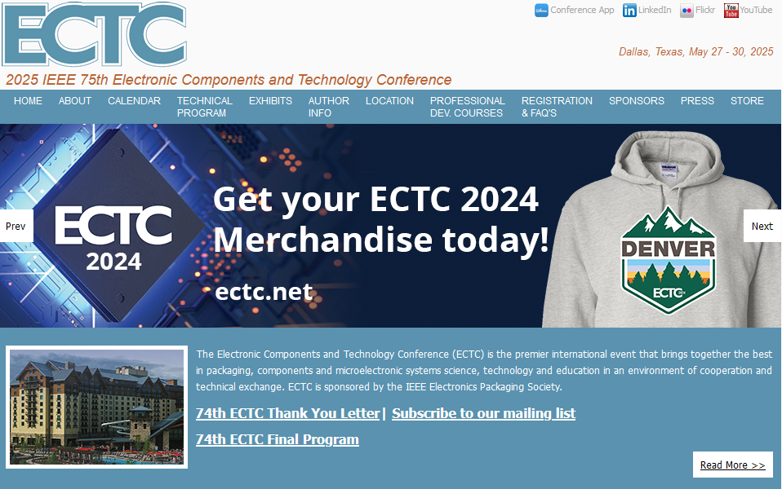
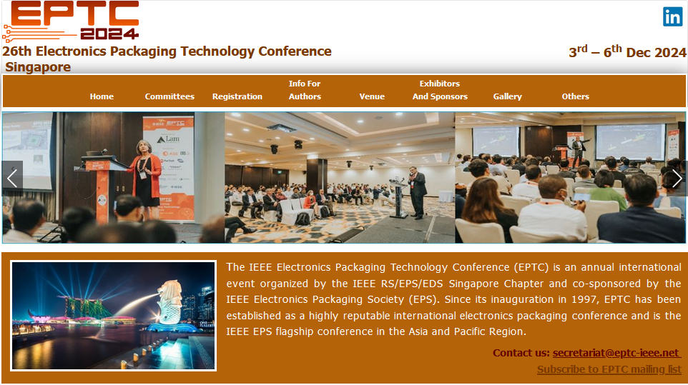
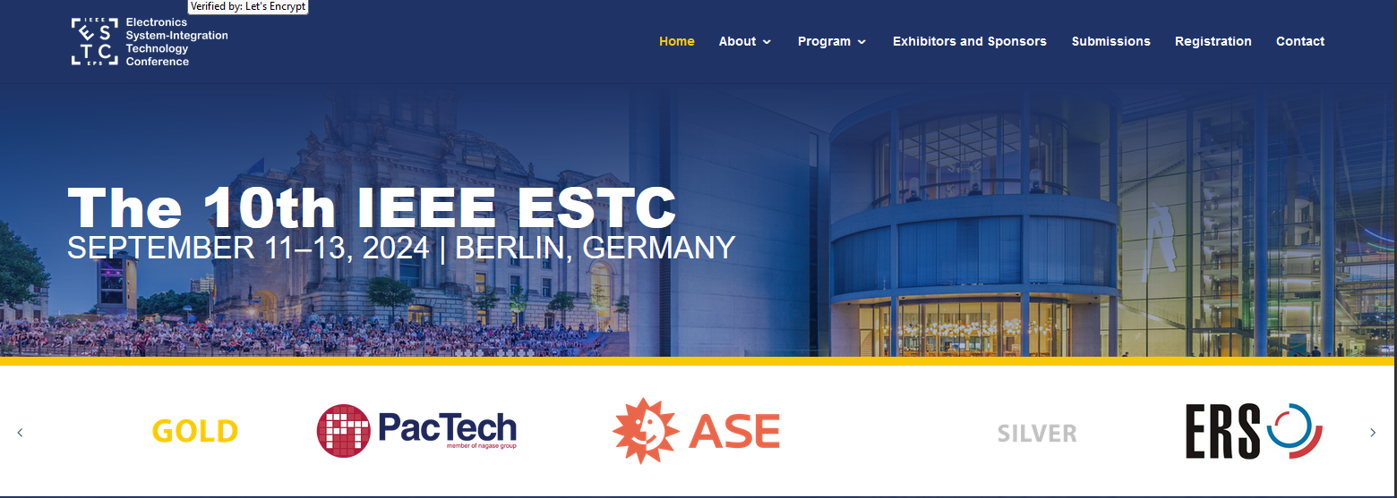
EPS Sponsored Conferences
ECTC
EPTC
ESTC

Slide 11
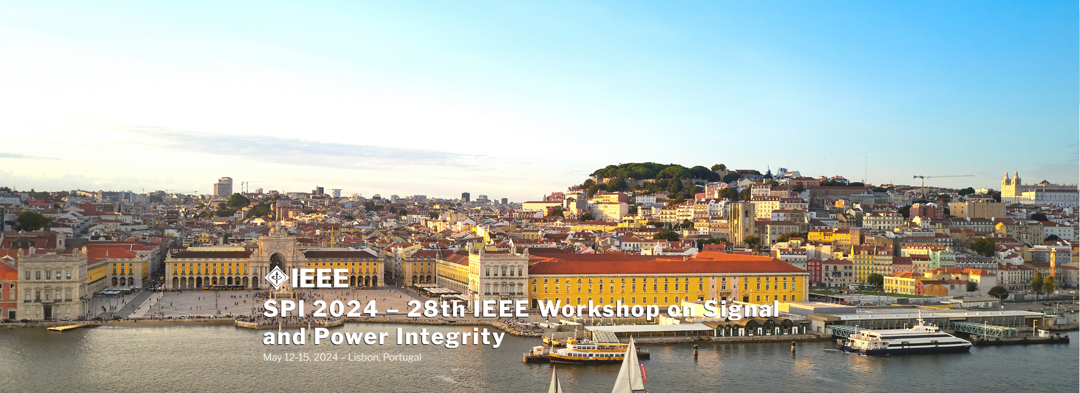
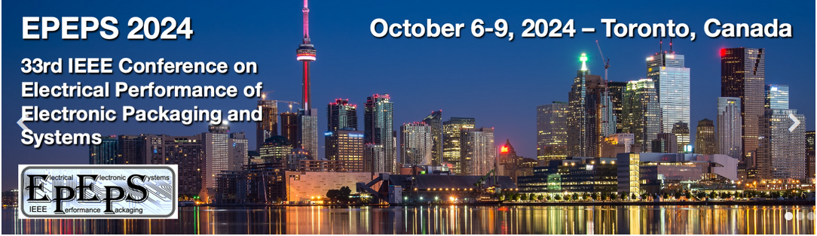
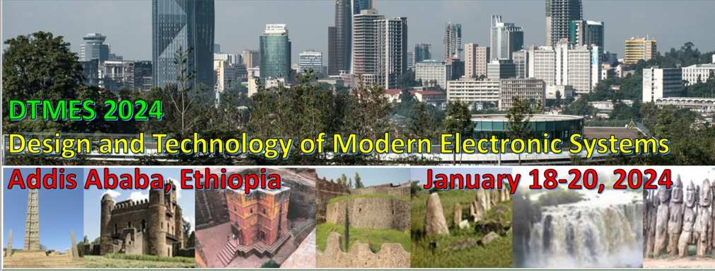
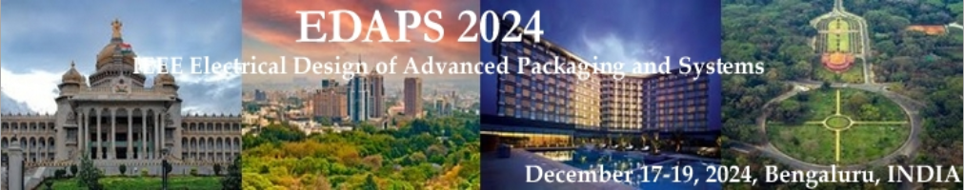
EPS Sponsored Workshops
SPI
EPEPS
DTMES
EDAPS

Slide 12
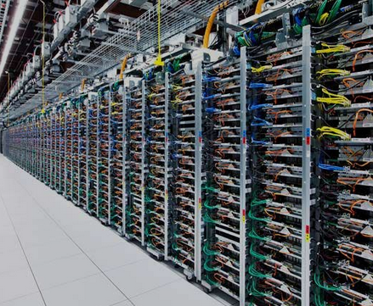
Packaging Main Focus: AI Energy Requirements
Data centers used 2.5% of US electricity in 2022
Projected to increase to 20% by 2030
Training a large language model like GPT-3 is estimated to use 1,300 megawatt hours (MWh) of electricity.
Solution: Advanced Packaging

Slide 13
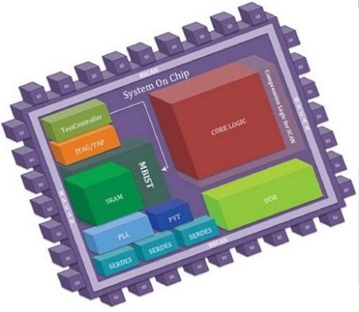
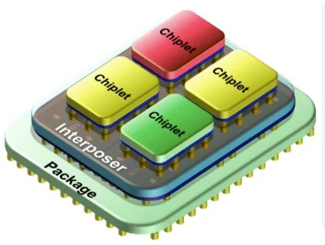
Need for: Heterogeneous Integration
Motivation: Ubiquitous materials and technologies
  Die, interposer, substrate
  Scaling is with wavelength rather than technology
Opportunity: New interconnect technologies
  Increased density of I/Os, finer pitches
  2.5D/3D integration
Performance objective: minimize energy and delay
Approach: Use chiplets
SOC
SiP
13

Slide 14
Barriers to Heterogeneous Integration
Technical Challenges
  problem size and complexity ➔ computational bottleneck
  design tools need more intelligent interfaces
Socio-Academic Challenges
  lack of information sharing within entities (data)
  lack of common standardized formats
  lack of access to low-volume manufacturing for validation
  lack of access to design tools for exploration purposes
  lack of multidisciplinary curriculum in advanced packaging

