Slide 1
Electronics Design for Youngsters An IEEE CEDA Education Initiative
Cristiana Bolchini, Enrico Macii
June 23, 2024

Slide 2
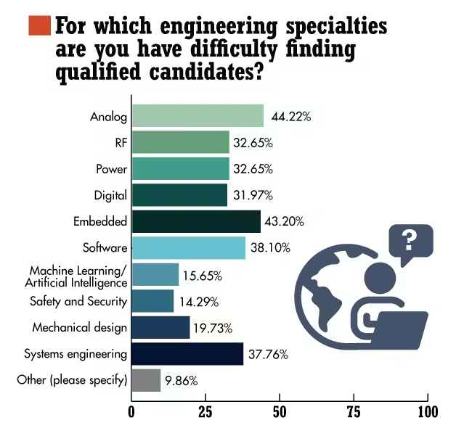
Shortage of design skills
Semiconductor industry needs hundred of thousands of new employees.
Circuits and systems designers are the most critical human resources to be found.

Slide 3
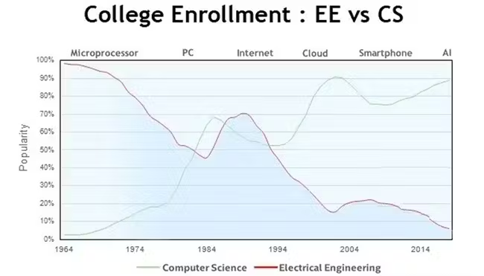
EE vocational crisis
The world is facing an electronics “vocational” crisis.
In the ICT domain, “electronics” is not as appealing as other subjects (e.g., AI, Data Science, Cloud, IoT).
Interest in EE curricula is steadily declining.

Slide 4
CEDA’s initiative
Develop an educational program to introduce high-school students to electronics design.
Timeline
Phase 1: Program set-up (Nov 2023 - Sep 2024)
Phase 2: Pilot implementation (Oct 2024 – Mar 2025)
Phase 3: Assessment and improvement (Apr 2025 – Jul 2025)
Phase 4: World-wide delivery (Aug 2025 on-ward)

Slide 5
Report on Phase 1
The team:
Cristiana Bolchini, Fabrizio Ferrandi, POLIMI
Enrico Macii, Daniele Jahier Pagliari, Gianvito Urgese, POLITO
Achievements:
Preliminary definition of course organization and contents
Identification of design tools and case study, acquisition of FPGA boards
Hiring of a graduate student for material and lab development
Identification of 3 high-schools in Italy to host pilot delivery of the course

Slide 6
Report on Phase 1 (cont.)
Issues:
Selection of design tools
No licenses
Schematic entry of non elementary components
Simulation
Synthesis
Design exploration
Solution: The LATTICE Tool Suite (works with FPGA board, hidden to students)
Involvement of high-schools
Paper work
Timing

Slide 7
Course organization
30 hours, in presence, at university facilities (POLITO, POLIMI) or at high-school premises:
Six 2h lectures
Six 3h labs
Activities spread over a period of max 1.5 months
Max 40 students per course
Instructors: Professors from POLITO and POLIMI

Slide 8
Course contents (preliminary)
Introduction to electronic technologies: overview and applications
What is a "chip", how it is made, how it works
The various types of "chips": calculation, storage, data transmission
The basic components, functional blocks, architectures, complex systems
How to design a “chip”: principles, methods, objectives, project phases
Project tools: how to describe, simulate, synthesize a “chip”
Industry testimonial: A professional designer shares his/her experience

Slide 9
Lab contents (preliminary)
Introduction to the LATTICE Tool Suite
Design examples of simple circuits
The concept of design exploration:
Practicing on a real case: Design of a "chip" capable of doing "Keyword Spotting“

Slide 10
Hiring of graduate students
Christian Conti, received the MS in Electronics Engineering in 2024
Started on June 1, 2024, until October 31, 2024
Expertise on digital design, logic synthesis, circuit simulation

Slide 11
High-schools involved
Liceo Scientifico “Galileo Ferraris”, Torino
Liceo Scientifico “Leonardo da Vinci”, Gallarate (Milano)
Liceo Scientifico “Lorenzo Respighi”, Piacenza

