Slide 1
Finances
Marina Zapater

Slide 2
Outline
Closing numbers 2023
Status 2024
Budget 2025

Slide 3
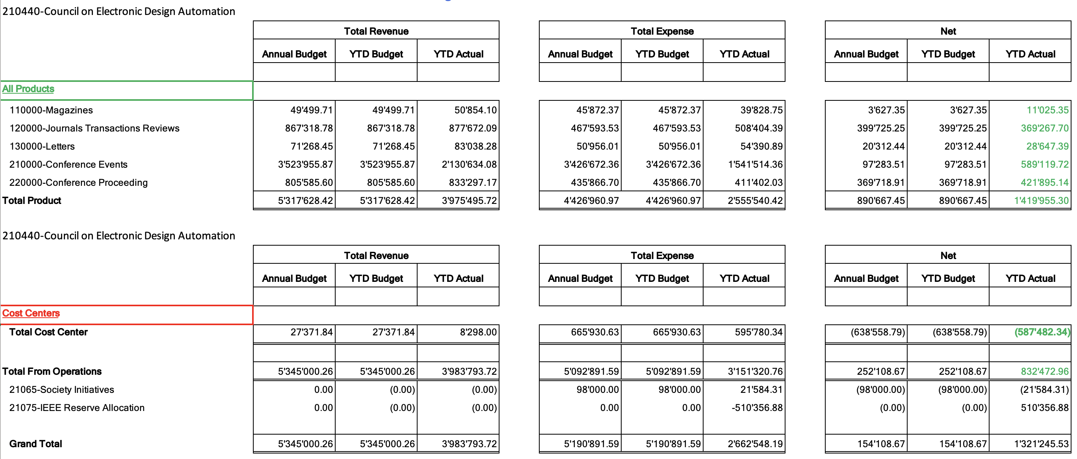
Closing numbers 2023

Slide 4
A closer look into expenses 2023
DATC, SVDTC, TCCPS, HSTTC
Overspending in contests, but underspending in DL program (online)
Expected overspending, due to costs of volunteer travel and venues (compensated, so ok)
Expected underspending, but impacted 2024

Slide 5
Reserve status 2023
Good news, improving 2021 numbers!
2021 Reserves: ~4.2M$, P&L 53k$, Investment loss of 484k$
2022 Reserves: ~3.7M$, P&L 811k$, Investment gains of 545$
2023 Reserves: 5.01M$

Slide 6
Finance Status 2024
More expenses than last year (ok!)
265k vs 165k in 2023
Still some underspending
Contests, DL program:
Ramping up again
Costs are higher than before, but final numbers should be ok
Initiatives:
Travel grants doing better
All other initiatives are underspending

Slide 7
Budget 2025
Legend: Black: same than last year
Red: requesting an increase
Contractors (Editorial services): ~67K
Operational - Conference Catalyst: 88k (secretary + web) + 2K (Zoom)
Meetings venue expenses : 13K
Volunteer travel : 70k (52k in 2023, increase due to 3 EC meetings instead of 2)
CEDA Luncheons ~ 56K DATE, DAC, ICCAD, ASP-DAC
Distinguished Lecturer ~ 26K
Contests ~ 50K PhD Forum, Univ. Demo (DATE, DAC, …)
Awards ~ 28K
Local Chapters 40K
Technical committee ~ 33K → to be discussed DATC, SVDTC, TCCPS, HSTTC
MoU Initiatives (Smartcities, IoT): 40K → to be discussed
Marketing & Advertising: 25K
Standards commitee: 5K (budget for meetings and traveling)
Publications: 5K (face-to-face journal meeting/luncheon with editorial board)

Slide 8
Motions
Approval of Budget 2025
Forecasts for 2025 needs to be submitted on August 8th
In preliminary version still until it is double-checked with IEEE

Slide 9
Finance
Backup slides

Slide 10
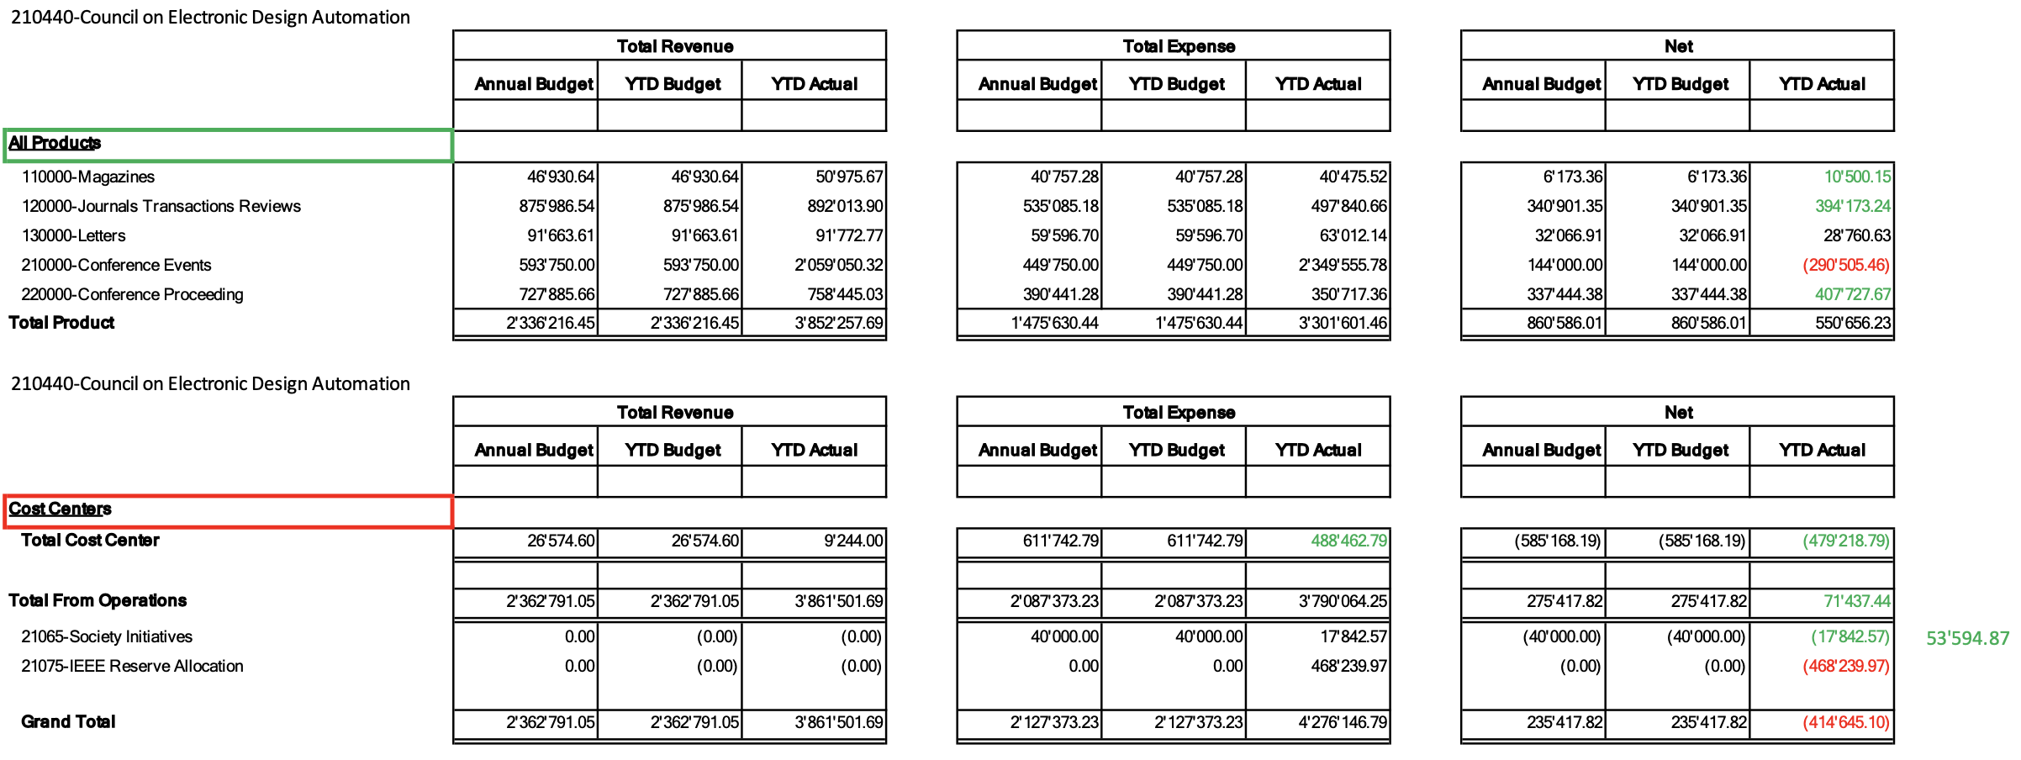
Closing numbers 2022

Slide 11
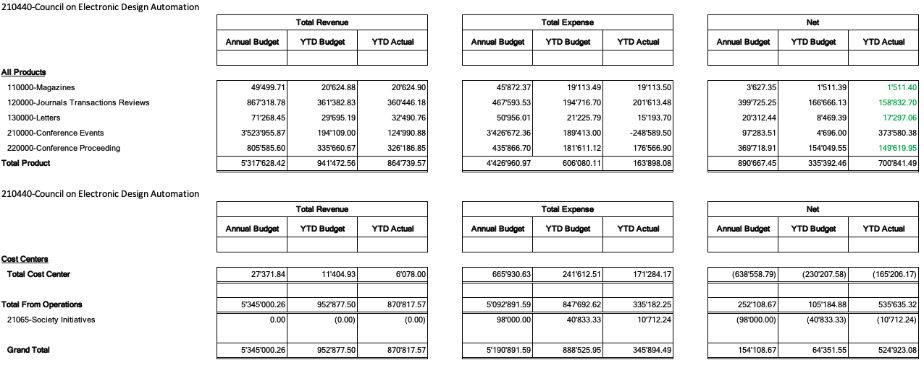
Finance Status 2023 (end of May)

