Slide 1
MTT-S Report
José Rayas-Sánchez
San Francisco, CA
June 23, 2024

Slide 2

MTT-S Report
MTT-S Inter-Society Committee
MTT-S and CEDA recent collaborations
MTT-S Technical Committee on Design Automation (TC-2)
Recent TC-2 events
CEDA related MTT-S Conferences

Slide 3

MTT-S Inter-Society Committee
MTT-S Inter-Society Committee oversees cultivating relationships with IEEE Councils and other technical societies
Inter-Society Committee is aiming at encouraging a stronger participation of MTT-S in IEEE Councils
MTT-S currently has official representation in 7 councils

Slide 4

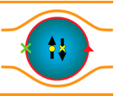


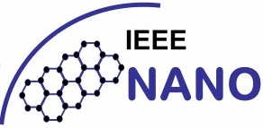


MTT-S Representation in 7 IEEE Councils

Slide 5
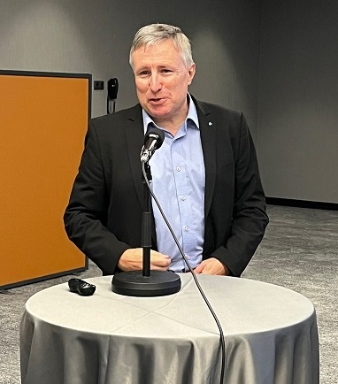
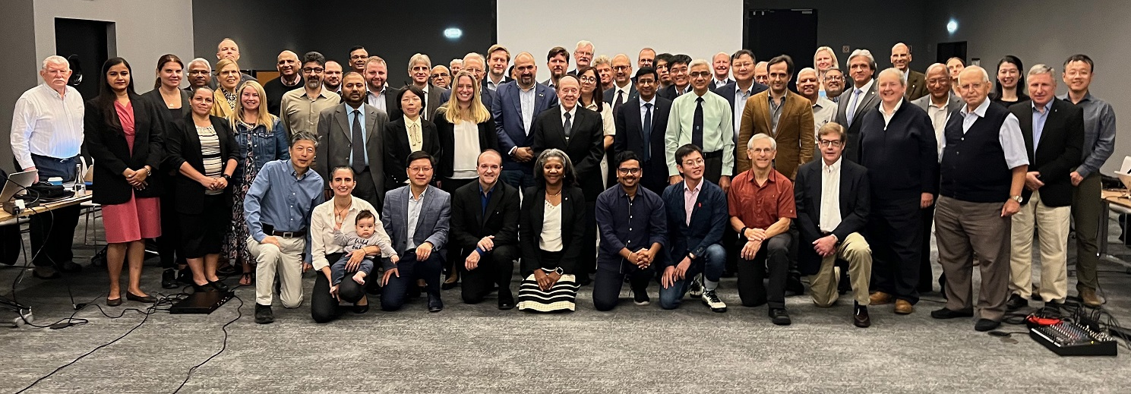
MTT-S and CEDA Recent Collaborations
The MoU between MTT-S and CEDA was recently renewed for 2024‐2026
Miguel Silveira, IEEE CEDA President (2024‐2025), was a special guest of the MTT-S AdCom meeting in Porto, Portugal (Sep. 2023)

Slide 6
MTT-S Tech. Committee on Design Automation
MTT-S has 29 technical committees (TC)
The MTT-S Technical Committee on Design Automation (TC-2) is the closest to CEDA; it focuses on:
  Modelling and simulation of devices, circuits, and systems
  Non-linear analysis
  Optimization techniques
  Multi-physics modelling
  Machine learning and artificial intelligence for design automation
MTT-2 regularly organizes technical events/initiatives on CAD and EDA

Slide 7
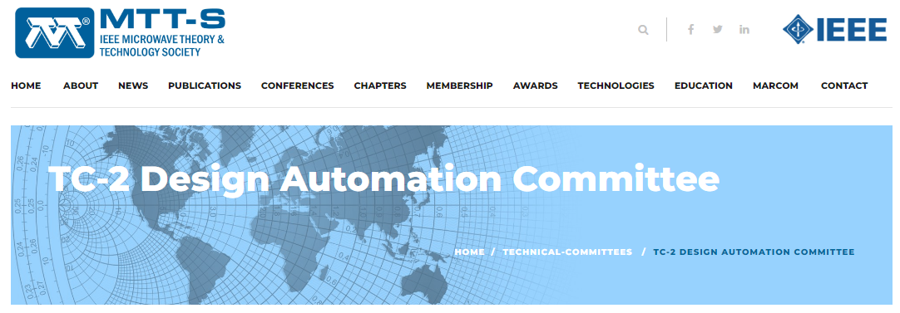
MTT-S Tech. Committee on Design Automation
https://mtt.org/technical-committees/tc-2-design-automation-committee/

Slide 8
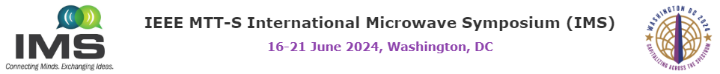
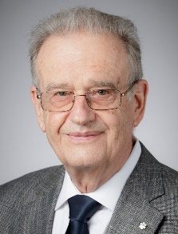
June 19, 2024
1:30pm – 3:10pm
Room 145AB

Slide 9

Recent TC-2 Invited Paper
(to be submitted by June 30, 2024)

Slide 10
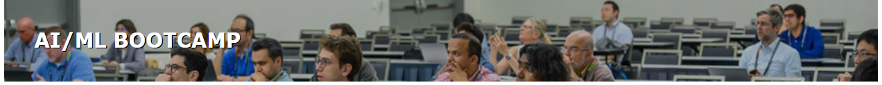
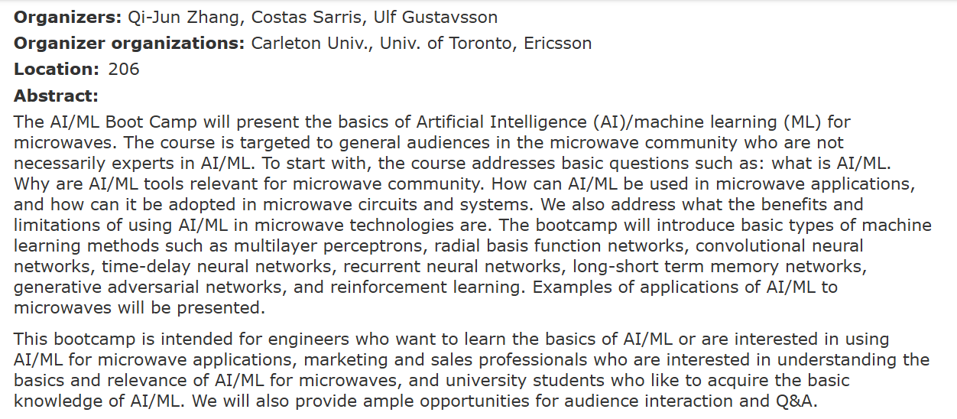
June 16, 2024
1:30pm – 5:20pm
Room 206

Slide 11
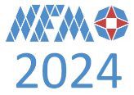
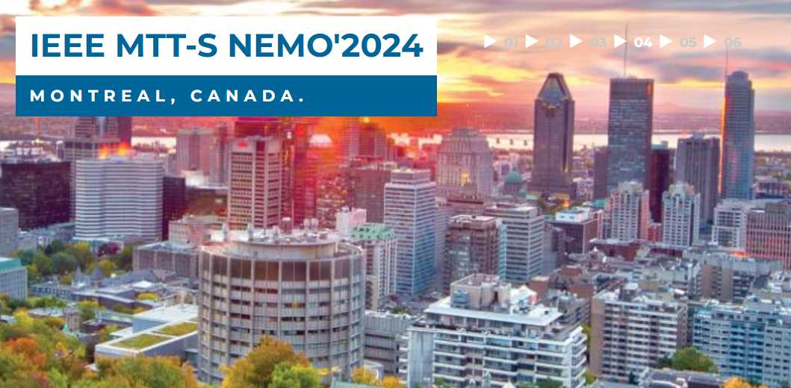
CEDA-related MTT-S Conferences
2024 IEEE MTT-S Int. Conf. on Numerical Electromagnetic and Multiphysics Modeling and Optimization (NEMO’2024)
August 11 - 14, 2024, Montreal, Canada.
http://nemo-ieee.org/

Slide 12
LAMC 2025: San Juan, Puerto Rico, Jan. 22-24, 2025
Seven Main Technical Topics, one of them is on
CAD Techniques for RF and Microwave Engineering
Submissions from CEDA members are very welcome!
https://lamc-ieee.org/

Slide 13

Thanks
José Rayas-Sánchez
IEEE MTT-S Representative for CEDA

