Slide 1
CEDA Publications - Report by VP Publications -
Jörg Henkel
San Francisco, June 23th 2024

Slide 2
Report Overview
Status reports:
TCAS-AI (Yiran Chen)
D&T (Partha Pande)
ESL (Aviral Srivastava)
TCAD (David Atienza)
T-SPI (Jun Fan)

Slide 3
IEEE TCAS-AI Update
EiC: Yiran Chen

Slide 4
TCAS-AI
Editorial Board has been created:
including one EiC, two Associate EiC (one from CEDA and one from SSCS), and 14 Associate Editors (8:4:2 for CASS/CEDA/SSCS).
Management committee formed
The submission portal and management websites have gone alive on May 17th, 2024.
TCASAI has arranged 16 invited papers from prestigious scholars to be published on the inaugural issue of the transactions.
TCASAI has received 35 submissions (including 16 invited ones) since May 17th, 2024, or 1 submission per day on average.

Slide 5
IEEE Design&Test Update
EiC: Partha Pande

Slide 6
Overview
Issues in 2024
Future issues
New initiatives
Publication Statistics

Slide 7
Issues in 2024
Jan/Feb: SI: Ethics in Computing (4 plus editorial), 4 general interest, 1 tutorial, 2 Reports, Last Byte, From the EiC
Mar/Apr: SI: 2021 Workshop on Top Picks (6 plus editorial), 3 general interest, 2 Reports, Last Byte, From the EiC
May/Jun: 7 general interest, 2 Reports, Last Byte, From the EiC
Jul/Aug: SI: Silicon Lifecycle Management (6 plus editorial), Interview, Last Byte, From the EiC
Sept/Oct: SI: Post-Quantum Cryptography for Internet-of-Things
Nov/Dec:

Slide 8
New Special Issues
Open-Source Silicon
Wearable IoT Devices
Top Picks 2022
tinyML

Slide 9
New Initiatives
Top Pick on Reliability and Test
First edition was completed and selected
First round selected (12 out of 30+ submissions) and presented at Top Picks Workshop collocated with ITC 23
The top picks selected (6) and now invited for publication in SI
2nd edition is being planned
New SIs related to Test
Silent Data Corruption (SDC): In planning
GEs: Dimitris Gizopoulos (U Athens), Sriram Sankar (Meta), Mehdi Tahoori (KIT), Yervant Zorian (Synopsys)
Design and test aspects of advanced packaging
In planning

Slide 10
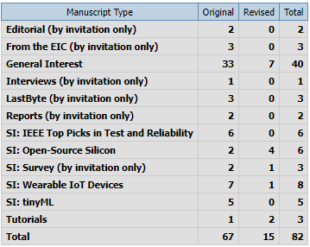
Submission Statistics

Slide 11
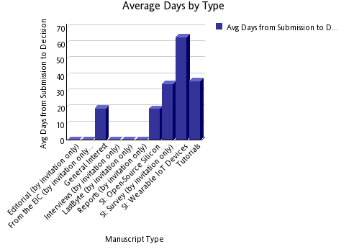
Submission to Decision Time

Slide 12
Challenges
The most important challenge is to increase the number of general interest papers
Also, improving the quality of general interest papers is necessary
Getting editors’ notes for accepted papers promptly

Slide 13
IEEE Design and Test (Video) Roundtables (Ramesh)
A series of quarterly events as D&T zoom-based video roundtables making it lively.
Plan for 3-4 roundtables (is this too many?)
Maybe open it to the public or keep it closed? (try both options?).
Share IEEE D&T roundtable videos via IEEE D&T website. (create a place for IEEE D&T roundtable videos; could be one of the free IEEE D&T resources?).
Each D&T roundtable may include 3 visionaries + moderator. 1-2 visionaries from industry; 1-2 from academia; last for 60 minutes. Q&A type format (similar to the current roundtables)
Sample topics:
Test vs Trust (Rob Aitken, Serge Leef, M. Tehranipoor and S. Mitra; Moderator Ramesh;
ML for EDA; Moderator Y. Chen or Hai Li.
Resurgence of High-Level Design Paradigms: Moderator Luca Carloni; HLS leads from Cadence, Synopsys and Mentor, Jason Cong UCLA
Any feedback?

Slide 14
IEEE Design and Test (Video) Roundtables (Ramesh)
A series of quarterly events as D&T zoom-based video roundtables making it lively.
Plan for 3-4 roundtables (is this too many?)
Maybe open it to the public or keep it closed? (try both options?).
Share IEEE D&T roundtable videos via IEEE D&T website. (create a place for IEEE D&T roundtable videos; could be one of the free IEEE D&T resources?).
Each D&T roundtable may include 3 visionaries + moderator. 1-2 visionaries from industry; 1-2 from academia; last for 60 minutes. Q&A type format (similar to the current roundtables)
Sample topics:
Test vs Trust (Rob Aitken, Serge Leef, M. Tehranipoor and S. Mitra; Moderator Ramesh;
ML for EDA; Moderator Y. Chen or Hai Li.
Resurgence of High-Level Design Paradigms: Moderator Luca Carloni; HLS leads from Cadence, Synopsys and Mentor, Jason Cong UCLA
Any feedback?

Slide 15
Perspectives (Mehdi)
Covers general interest topics, 4-8 pages, with very few references.
Retrospective and forward-looking
It is usually from senior people in academia and industry
Potential topics and authors
Reliability
Jacob Abraham
Ravi Iyer
Testing
Janusz Rajski → Done
John Hayes
Hans-Joachim Wunderlich
EDA
Giovanni DeMicheli → DONE
Masoud Pedram
Alberto Sangiovanni-Vincentelli
?

Slide 16
Interviews (Nicola)
Vishwani Agrawal (transcribed, with Vishwani for editing)
Janusz Rajski (published)

Slide 17
IEEE ESL Update
EiC: Preeti Panda

Slide 18
New Vision for IEEE ESL
To establish IEEE ESL as the top venue for
quick dissemination of early research results in
easily digestible format for the
embedded systems research community.

Slide 19
Current state and Targets
Quality Metric | In 2020 | In 2024 | By 2028
Impact Factor | 2.17 | 1.6 | 4
Submissions per year | 201 | 185 | 1000
Accepts per year | 45 | 27 | 200
Submission-to-final decision | 10.4 weeks | 5.2 weeks | 4 weeks
Submission-to-publication | 11 weeks | 9.6 weeks | 8 weeks
Main Goal: Get the impact factor of IEEE ESL to 4 by 2028.
Reduce submission-final-decision time to 6 weeks
Reduce submission-to-publication time to 8 weeks

Slide 20
Plan 1 – Change to bimonthly publication
Submissions have doubled over the last 2 years
Increased from about 200 in 2020 to > 450 in 2023.
Accepted articles have also doubled over the last 2 years
Increased from about 45 in 2020 to > 85 in 2023.
“Submission-to-publication time” is the most important metric for the authors of IEEE ESL.
Frequent publishing will enable fresh content to the readers
Frequent publishing will enable timely publication for researchers
Will increase IEEE ESL citations.
Especially important for short-form papers, which can be read/gleamed quickly.

Slide 21
Plan 2 – Streamline the review process
Accelerated Review Process
Associate Editors will directly review submitted manuscripts.
Improve the quality of reviews
Given the concise nature of the IEEE ESL manuscripts (4 pages)
It takes more time to find reviewers and get reviews from them, than direct review
To Address the diversity concerns, we plan to enlarge the Editorial Board
Promise IEEE ESL authors a one-month submission-to-decision time

Slide 22
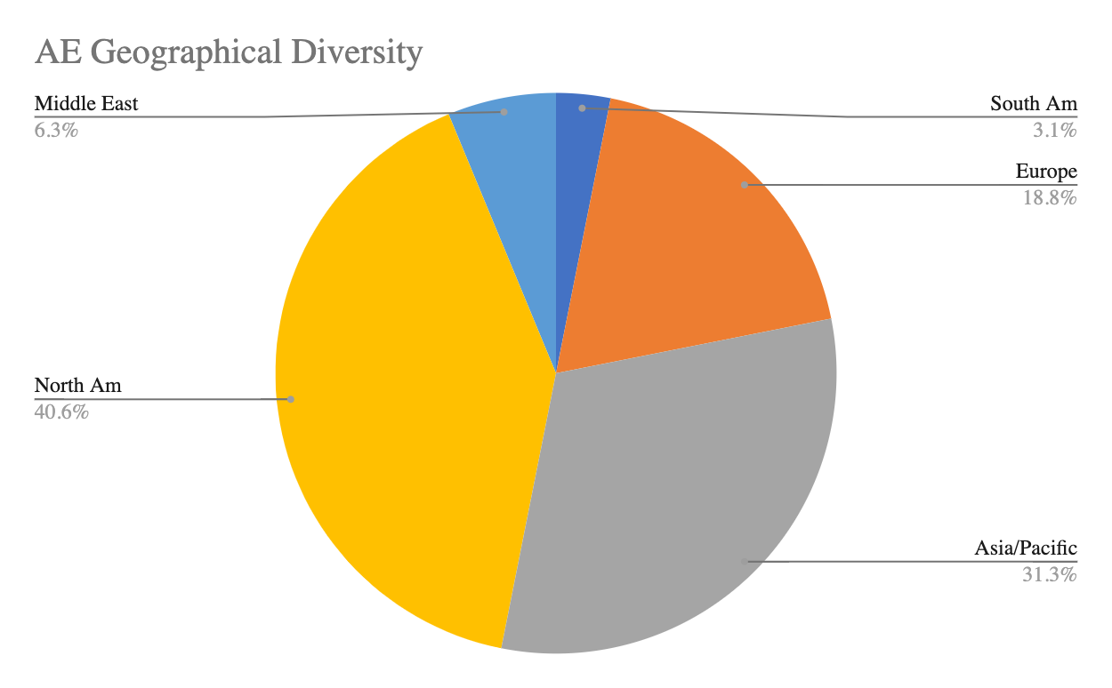
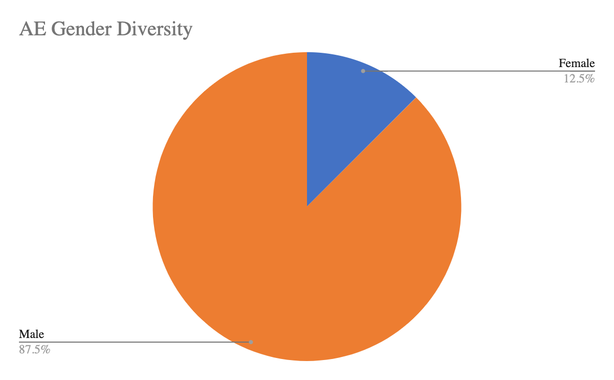
AE Diversity – Better matches the author diversity

Slide 23
Submissions

Slide 24
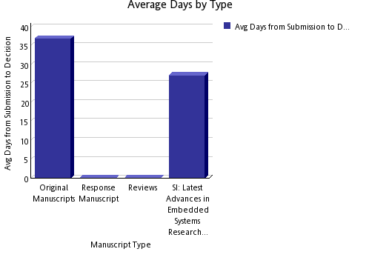
Processing

Slide 25
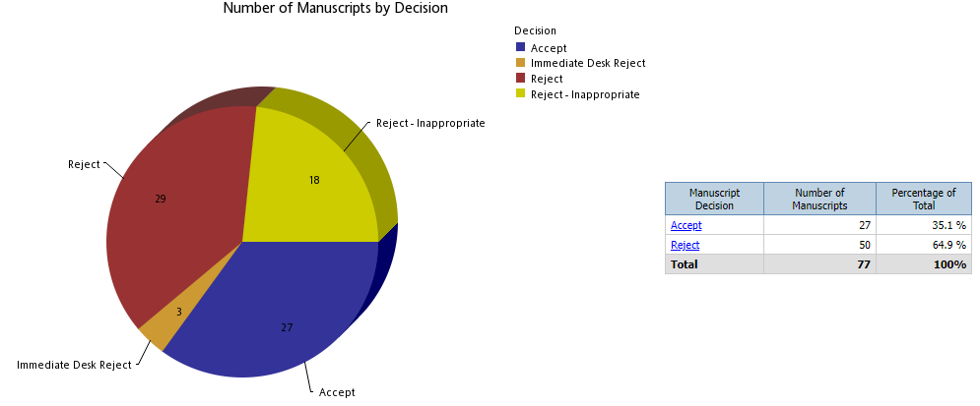
Decisions

Slide 26
Impact
Current Impact Factor: 1.6
5 Year Impact Factor: 1.589
Total Citations: 536
Downloads: 31,629

Slide 27
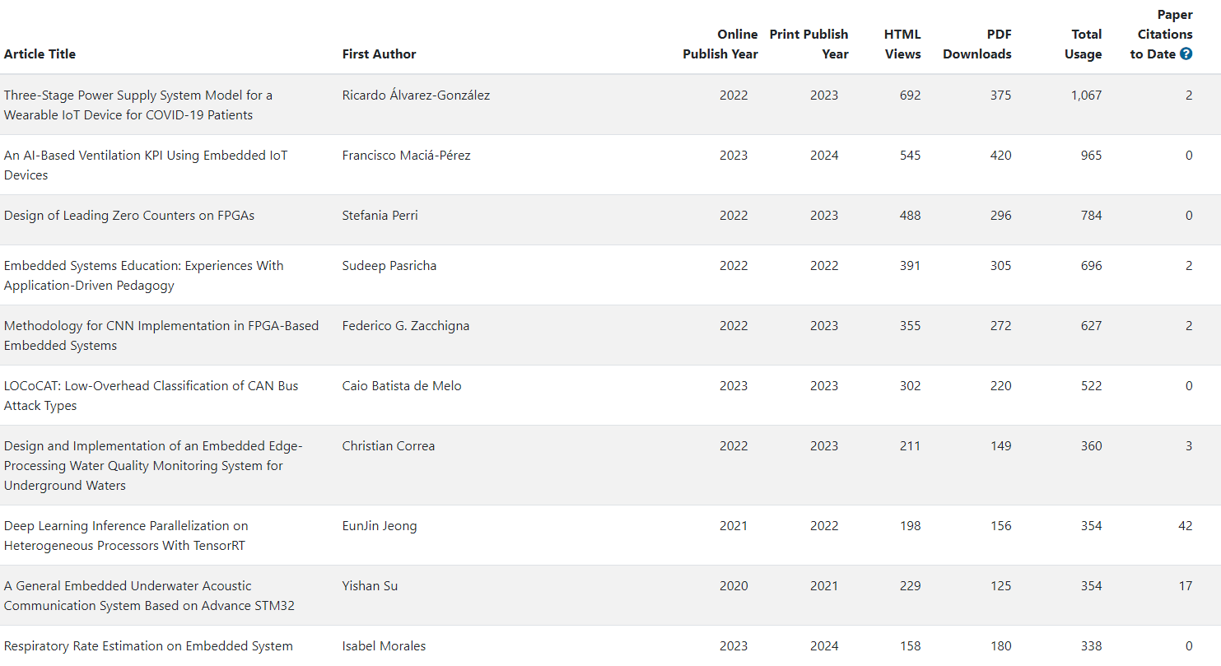
Top 10 Papers

Slide 28
IEEE TCAD Update
EiC: David Atienza

Slide 29
Current Status (1/2)
Current accept. rates (33-34%), top-tier journal for 4 consecutive quarters
Average decision time (1st revision): 71 days
Average final decision time: 84 days until May 2024
Submissions stabilizing (Sep. 2023 to May 2024)
Similar number of submissions vs. same period in 2022-2023
Accept Ratio: YTD is 37% so far, it was 39% in 2023, 2022 was 40.5%
Oldest manuscript without decision: 138 days (it was 203 days in 2021)
Optimized TCAD review process and publication timeline with IEEE HQ
Fast desk-reject policy of IEEE implemented (fast reject: <2 weeks, for low-quality papers)
Automation to reassign reviewers in revisions, identify reviewers/AEs with delays, etc.
IEEE has claimed to remove backlog/publication delay until March 2024 completely as agreed with IEEE HQ (more pages for TCAD) but still not done (50% of backlog remains)
Notes:
Currently there are 257 pending manuscripts

Slide 30
Current Status (2/2)
Editorial board renewed in 2024, 25 new AEs -> 28 new AEs
Limit of two terms (2 x 2 years) based on IEEE guidelines
Increased diversity (Region 10 – Asia and Pacific) and more industrial affiliated AEs (5 new AEs).
Editors-at-Large renewed - 40% women and 2 members replaced
IEEE TCAD Donald O. Pederson Best Paper Awards – 2 winners in 2024:
PACT: An Extensible Parallel Thermal Simulator for Emerging Integration and Cooling Technologies" by Zihao Yuan, Prachi Shukla, Sofiane Chetoui, Sean Nemtzow, Sherief Reda, and Ayse K. Coskun, which was published in IEEE TCAD, vol. 41, no. 4, pp. 1048-1061, April 2022.
An Open-Source Framework for FPGA Emulation of Analog/Mixed-Signal Integrated Circuit Designs, by Steven Herbst, Gabriel Rutsch, Wolfgang Ecker, and Mark Horowitz, which was published in IEEE TCAD, vol. 41, no. 7, pp. 2223-2236, July 2022.
But still authors-based/nominated papers are a very small pool (5 in 2023, 6 in 2023, 5 in 2022)

Slide 31
Key Points to Discuss: New Review Process
TCAD only requires two reviews (by default we suggest 3 to take a decision), AE can be a reviewer as well as decision taking if needed
If the paper is clearly “below bar” (no experiments, comparisons with SoA, etc.) it can be desk rejected: change to 0 reviewers, submit recommendation directly with clarification of why
TCAD must be strict – IEEE Request: unclear novelty or comparisons with SoA, direct reject
Papers as “Research Article With a Prior One or More Conference Publications” must clearly state what is new in the technical contribution (not just evaluation with a new data set or similar) and comparison with state of the art,

Slide 32
Key Points to Discuss: Revisions and Decisions
No two major revisions, authors must address all comments in the first round (except if new major issues arise by reviewers after the first revision)
Not possible to resubmit “as new” if paper is rejected
TCAD requires new publications (30% new research) with previous papers
Adding experiments or more text while contribution does not expand, it is not acceptable
IEEE Regulations does not allow plain verbatim copy (self-plagiarism) – We fixed 40% as rule
Papers submitted with prior conf. papers (last 12 months): 223 (212 in previous year)
50% acceptance rate, much higher than typical TCAD average rate today,
No “complaints” about policy (until exchanges with Yao-Wen Chang early this year)

Slide 33
Key Points to Discuss: Varia
IEEE Allows the use of AI for text editing (ChatGPT) as support tool (but does not encourage it), restrictions:
Acknowledgement to be added to the paper
Authors are responsible for the final text (including copyright issues)
Good cooperation with new IEEE journal on AI/ML side - TCASAI
Checking overlapping with scope
Excellent collaboration with EiC – Prof. Yiran Chen, very receptive to suggestions/proposals
Food for thought from TCAD Editorial Board Meeting at DATE’24: Innovative ways to “reward” the reviewers, ideas from the board
Offer one free page in TCAD published paper after 3 completed review processes
Offer conference registration discounts (e.g., at DATE, DAC, etc.) covered by CEDA

Slide 34
IEEE TSPI Update
EiC: Jun Fan

Slide 35
T-SIPI Editorial Board
Currently the alternative EIC for handling EIC COI is Prof. Tzong-Lin Wu. There are 12 AEs approved by the management committee. They are: Zhiping Yang, Chulsoon Hwang, Enxiao Liu, Joungho Kim, Ram Achar, Dan Jiao, Jai Narayan Tripathi, Dries Vande Ginste, Gabriela Ciuprina, Renato Rimolo Donadio, Erping Li, and Istvan Novak. I recommended two more AE candidates, Richard Gao and Siping Gao (both from Singapore), to the management committee. But the management committee has decided not to add more AEs until a later time.

Slide 36
T-SIPI Paper Statistics
Up to October 30, 2023
 | Submitted | Accepted | Rejected | Withdrawn | In Review Process or No Response
2021 | 7 | 4 | 1 | 0 | 2
2022 | 43 | 27 | 11 | 1 | 4
2023 | 26 | 3 | 9 | 0 | 14
Total | 76 | 34 | 21 | 1 | 20

Slide 37
IEEE Submission To Publication Report
Based on the Q2, 2023 report
 | Average Weeks Submitted to First Decision | Average Weeks Submitted to Online Post | Cumulative Average Weeks Submitted to First Decision for past 12 months | Cumulative Average Weeks Submitted to Online Post for past 12 months
T-SIPI | 8.0 | 33.0 | 7.7 | 31.0
T-EMC (for reference) | 7.6 | 24.1 | 7.8 | 26.5

Slide 38
Submission and Publication
T-SIPI doesn't use ScholarOne for paper submissions, although the review process is still completed in ScholarOne. Paper submissions to the T-SIPI are through the IEEE Author Portal (an IEEE account is required). Below is the link to the submission page: https://ieee.atyponrex.com/journal/TSIPI
T-SIPI is an e-publication only. Papers appear online as soon as the final manuscripts are accepted and edited by the IEEE.

Slide 39
Problems and Challenges
The biggest issue right now is to receive more contributions. We plan to reach more potential authors by sending out the Call for Papers through social media and organizing special sections on hot topics. More ideas and suggestions are welcome!

