Slide 1

Solid State Circuits Society Report
Vivek Tiwari
June 23, 2024
Notes:
Bryan's additional activities:
Bryan was on the Fellow Committee & Constitution and Bylaws Committee

Slide 2
Report Overview
Joint Membership Stats
Quick summary of some key areas of focus
Backup material for reference – SSCS/CEDA joint activities

Slide 3
CEDA and SSCS - Background
Purpose of Engagement:
Solid state circuit design and electronic design automation are so interdependent that they rely on each other for their very existence. Engagement allows the latest knowledge to be shared at both the organizational and the individual contributor level
An opportunity for CEDA and SSCS members to share:
  Most troublesome design methodology challenges faced by designers
  Design opportunities created by latest tool developments
i.e.
  What do designers need from toolmakers, What do toolmakers need from designers
Implement using: Co-sponsored Conferences, Publications and cross-visibility and cross-engagement for Workshop/forums, Webinars, Activities, Initiatives
CEDA membership is free of cost for SSCS members
Explore opportunities to increase benefits for SSCS members through CEDA

Slide 4
CEDA-SSCS Joint Membership Stats
Joint Membership Stats
Source: Adam Greenberg
Council on EDA | Active Members | Total Active SSCS Members | Pct. Active SSCS Members
June 2024 | 10,022 | 943 | 9.67%
(Feb 2024) | 11,542 | 1,143 | 9.9%
(June 2023) | 18,425 | 997 | 5.4%
(Feb 2023) | 16,594 | 1055 | 6.4%
(Dec 2021) | 10,500 | 693 | 6.6%
SSCS AdCom will regularly track joint membership stats for partner Councils and Initiatives
Looking for ideas for increasing joint membership
Increasing visibility about Councils with the SSCS members is an area of focus for the AdCom
Notes:
SSCS roughly same as CEDA last couple of years – 11K June 2023, 9757 June 2024
From Adam: June 2024
OU Analytics shows 9757 SSCS members and 10,022 CEDA participants as of today.
943 SSCS members participate in CEDA, so 9.67% of all SSCS members are CEDA participants and SSCS members account for roughly the same percentage (9.4%) of all CEDA participants.

Slide 5
Summary of Key Topics of Discussion (Updates from last BoG)
1. Increasing visibility of CEDA within SSCS community, leveraging various channels
SSCS magazine: Enhance the CEDA Newsletter insert with an introductory statement – Done. Starting Spring ‘24
SSCS magazine: Submit introductory article on CEDA and CEDA/SSCS collaboration – Done. Winter’23 Magazine
“News from Councils”: Looking to add a “news from Councils” sub-page to the SSCS CCI webpage – Dropped, for now
New: Increase publicity for member society conferences via a section on the Conferences page – SSCS will follow-up
New: Submit updates to be featured in the news section of Solid-State Circuits Magazine each issue – Need contact/help
Conferences: good example: CEDA Phil Kaufman award announcement at ISSCC’23/’24 Opening Session - Sustain
2. Technical collaboration in strategic areas for Circuits/EDA – Focused opportunity “Generative AI for Circuits”
Engagement and support for IEEE “LLM Aided Design” - SSCS very supportive. WIP on next steps
Start engagement with the Solid States Circuits Directions Committee – TBD. Other ideas?
3. Reinvigorate engagement on the Technical Co-Sponsorship conferences (DAC / DATE) and explore for others
Alignment for timely and consistent engagement model. DAC MoU executed till ‘26. ISLPED TCS renewed till ’29. Mutual commitment to move fast for any issues wrt conferences.
Increase ROI beyond “sharing of logos” for TCS conferences – Special Sessions, Design Contests, Workshops - Ongoing
Notes:
Alignment of MOUs for consistent engagement model.
As we are engaging with more conferences at TCS level, many of them ask to set-up SSCS sessions. We need to work on the mechanisms to make this possible. Here some ideas:
- Have specific call for papers for special sessions distributed through the SSCS channels.
- Understanding how we can have SSCS members as part of the conference TPC, at least to review the SSCS papers.
- Possibly having a SSCS member chair the special session, as this will help contacting possible speakers.
- Have a list of possible presenters (including topic) for either tutorials or invited papers (which will still have to go through the review process). This is important as many members of other societies may not have a strong network within the SSCS community.
TCS for DAC and DATE – Alessandro’s focus to increase the ROI of TCS for both conference and SSCS membership.
Discuss/brainstorm with CEDA leadership and help to get the conferences/collaboration fully engaged and plan to discuss further with SSCS.
Workshops/Contests on topics like AI/ML in design/production of designs resonated during our discussion as an interesting collaboration topics.
In the past had the Student Design Contest
One other point to add we discussed – that once we get the engagement with DAC and DATE reinvigorate – we should consider consistency/collaboration across the CEDA portfolio of conferences eg ASP-DAC

Slide 6
Action Items/Help Needed
Submit updates to be featured in the news section of Solid-State Circuits Magazine each issue: CEDA owner/contact?
  CEDA owner?
“Generative AI for Circuit Design”
  SSCS engagement and support for IEEE “LLM Aided Design” – Vivek with SSCS
  Other ideas / CEDA owners?
Streamline conference collaboration beyond TCS
  CEDA owner?
Notes:
SSCS may adopt the newsletter archive idea
Generative AI: setup call with SSCD asap (Payam Heydari, Kaushik Sengupta) –Looking for additional names from CEDA

Slide 7
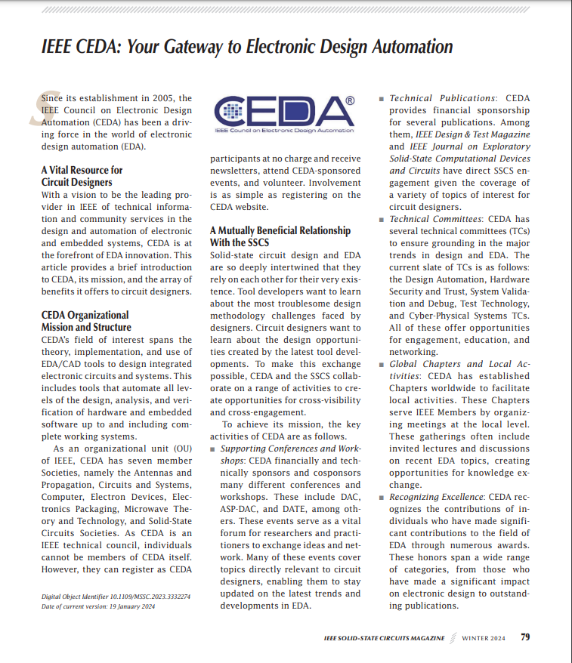
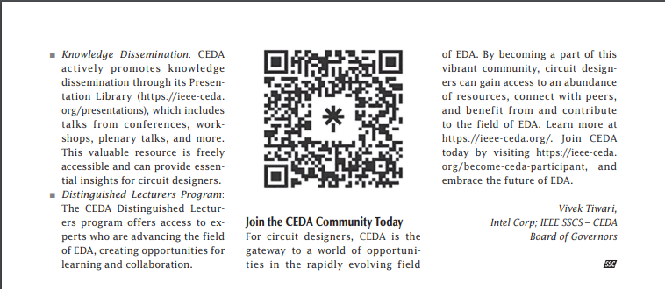
Cross-visibility Opportunities
CEDA Currents Newsletter is published in Solid State Circuits Magazine
Request: Enhance the inclusion template to include :
“CEDA and SSCS have a strong mutually beneficial relationship. CEDA provides tools/networking/services for circuit designer to connect with the EDA community”
Contributed article on CEDA overview and opportunities for collaboration in circuit design community in SSCS Magazine Winter’24 https://ieeexplore.ieee.org/document/10410048/

Slide 8
CEDA Member Society Conferences Publicity
From: Laura Paul <lpaul@conferencecatalysts.com>
Sent: Thursday, May 30, 2024 10:51 AM
Subject: CEDA Member Society Conferences
Dear CEDA Member Society Representatives,
CEDA has recently launched a new website! If you have not yet had a moment to look it over, please visit at: https://ieee-ceda.org/
In an effort to increase publicity, we now have a section on the Conferences page for member society conferences.
If you would like your member society's flagship conferences included on the CEDA webpage, please complete the Google form at the link below. If your society has more than one flagship conference please submit this form for each event.
Form link: https://forms.gle/Gqetr2qczgJSReXE9
SSCS informed. Will be following-up

Slide 9
Request: CEDA Updates
From: Danielle Marinese <d.marinese@ieee.org>
Sent: Thursday, June 20, 2024 5:00 AM
Subject: Solid-State Circuits Magazine: Fall 2024 Issue
SSCS would like to invite council representatives to submit reports/updates to be featured in the news section of Solid-State Circuits Magazine each issue. We request that one representative volunteer.
The deadline to send any submissions for SSC-M: Fall 2024 is August 30.
Please respond to this email to let me know if you would like to submit an article.
Please include the below information upon submission:
- Author name(s)
- Author email address(es)
- Author institutional mailing address(es) (not emails)
- Author ORCID(s)
- Your submission must be kept at 1000 words + 1-3 photos in .doc format.
Let me know if you have any questions!
Thank you,
Danielle

Slide 10




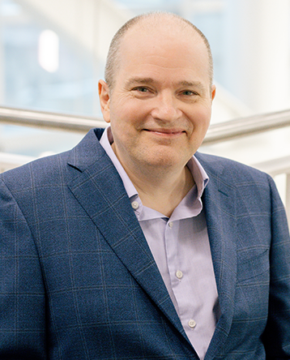

PHIL KAUFMAN AWARD
CEREMONY & BANQUET
JOIN US TO HONOR—
ABOUT THE RECIPIENT
Dr. Pileggi is being recognized for his
significant contributions to the Electronic System Design Industry.
ABOUT THE AWARD
The Phil Kaufman Award honors individuals who have had a demonstrable impact on the field of electronic system design through technology innovations, education/mentoring, or business or industry leadership.
MORE INFO &
REGISTER HERE
Dr. Lawrence T. Pileggi
Coraluppi Head and Tanoto Professor of Electrical and Computer Engineering
Carnegie Mellon University
https://semiamericas.org/phil-
kaufman-award-banquet
February 22, 2024 | 6:30–9:30pm | The Glasshouse | San Jose, CA
Immediately following ISSCC on Thursday Evening

Slide 11
Exploring collaboration on AI/ML for Circuit Design/EDA
In last AdCom we talked about “LLMs for Circuits” as a topic that would be of particular interest at the intersection of Circuits and EDA and had talked about exploring organizing a workshop for this
Upcoming CEDA sponsored first ever “International Workshop on LLM-Aided Design” https://www.islad.org/
  Appears to be the perfect venue for building SSCS interaction in this area with the EDA community
  Expect this to continue and develop into a Symposium. Exploring TCS sponsorship for Wkshp/Symposium
  Discussion with Prof Deming Cheng (CEDA VP of Awards) and Ruchir Puri General Chair of ISLAD
  “ML use in design is a very interesting topic that is likely to significantly change the way we design and optimize circuits – please consider if there are opportunities for SSCS to collaborate and potently also be a sponsor of workshop.”
  “CEDA welcomes SSCS's sponsorship toward this workshop too. ”
Other:
Collaboration with the CEDA Design Automation Technical Committee
  See the DATC materials in backup for reference
Collaboration with System Validation and Debug Technical Committee
  Active WG on AI/ML for Validation/Debug, White-paper is WIP

Slide 12
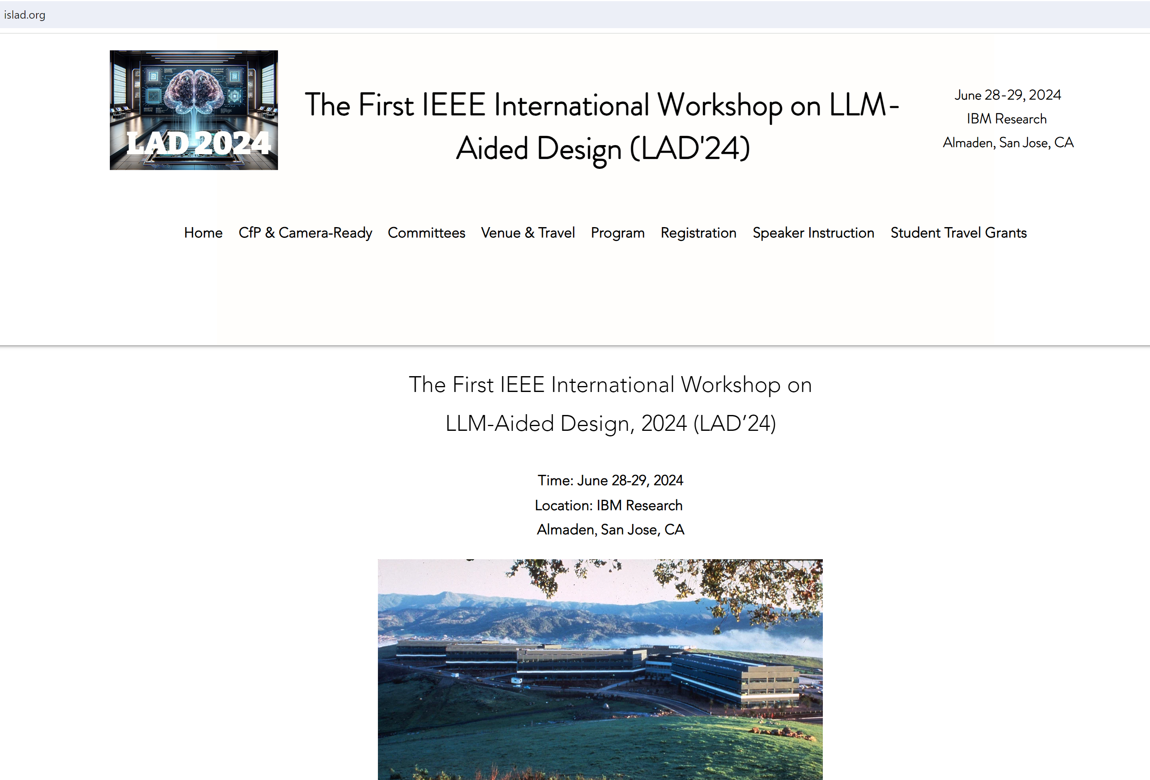

Slide 13
Conference Engagement/Collaboration Thoughts
As we are engaging with more conferences at TCS level, many of them ask to set-up SSCS sessions. We need to work on the mechanisms to make this possible.
Some ideas:
  Have specific call for papers for special sessions distributed through the SSCS channels
  Understanding how we can have SSCS members as part of the conference TPC, at least to review SSCS papers
  Possibly having a SSCS member chair the special session, as this will help contacting possible speakers
  Have a list of possible presenters (including topics) for either tutorials or invited papers (which will still have to go through the review process). This is important as many members of other societies may not have a strong network within the SSCS community.
Workshops/Contests on topics like AI/ML in design/production of designs resonated during our discussion as an interesting collaboration topic. In the past had the Student Design Contest
Once we get the engagement with DAC and DATE reinvigorated – we should consider consistency/collaboration across the CEDA portfolio of conferences eg ASP-DAC

Slide 14
Backup

Slide 15
CEDA: Summary Update (incremental update for Feb 2024)
Conferences – Return to in-person
  DATE March ’24; DAC Jun ’24; ICCAD Nov ’24; ASP-DAC Jan’24, ESWEEK Sep-Oct’24
  Great effort to attract attendees with new formats, new activities, sponsored activities for young people
Publications: Doing well, identified continued improvements being applied
  TCAD: growth in submissions (Asia), focus on maintaining, improving metrics, EiB refreshed
  D&T magazine: increase general interest topics - special editions, conference tie-ins
  JxDC: awaiting Impact Factor in 2022; Paper solicitation is highest priority with focus on Special Topics
  HW Security, AI/ML interest accelerating, Manufacturing, Semi Life Cycle – in line with prior strategic areas
Financials:
  Expenses in 2022 slowly ramping-up to pre-COVID levels, some uncertainty about winter
  Budget 2023 - conservatively going back to pre-COVID budgets
  Priority for changes: Initiatives; Periodicals increased page counts
Strategy discussions:
  Government investments across the world in Semiconductor Design and Tools
  The world is facing an electronics “vocational” crisis, interest in EE curricula is steadily declining, not as appealing as other subjects (e.g., AI, Data Science, Could, IoT) – create outreach to high school students
  Leverage the fact that AI/ML/Data Analytics can offer a “modern” look to design
Notes:
Revenues from periodicals and conference related publications
Slowly recovering pre-COVID levels for meetings and conferences.
Still conferences sponsorship lower than normal, We’ll see what happens 2nd half of the year
Periodicals – increased page counts to be managed
Initiatives – Pending discussion on expected expenses for 2022 (and 2023)
Budget focus: Awards, Distinguished Lecturer Program, CEDA Luncheons, Local Chapters, Technical Committees, Contests, Young Professionals, Initiatives
2023 Initiatives focus: Cyber-physical systems summer school, Design Automation for Power Electronics (DAPE) wkshp support, Diversity in EDA, ML-CAD workshop, Student Travel Grant
ASP-DAC'23 was hybrid. All sessions ran as in-person events, but they also provided live zoom sessions with live / pre-recorded presentations for authors who couldn't attend in-person (for example, presenters from China etc).
ASPDAC’23 Tokyo, DATE’23 Antwerp
The ACM/IEEE International Conference on Computer-Aided Design was held in San Diego, California from 30 October-4 November. The event brought together over 500 attendees from around the world, both virtually and in-person. Attendees were able to witness three stimulating keynote talks, fifty-five technical sessions, seven different workshops, three different contests, the first ever job fair, and many other networking opportunities.
Strategic Areas:
RISC-V and open hardware – Architectures (HW and SW), tools, applications
Very hot in Europe
Edge AI – Toolchains for AI/ML automatic deployment of HW platforms
Industry 5.0 – Add social impact and sustainability to the I4.0 paradigm
Digital Twins – From data to models and DTs (automatically)

Slide 16
CEDA: Summary Update Feb 2024
Activities Summary:
  Awards, Tools, Standards, Outreach through the Technical Committees; Goal to increase engagement and participation of Member Societies and representatives
  Some highlights:
    CAD for Assurance Webinar – initiated Feb’21; Two panels in ‘23 series.
    May’23 panel “Microelectronics Supply Chain Security: What Can Save Us?”
    Design Automation Webinars (DAWN) – initiated 2020 during COVID. April 11-12 2022, on website, Youtube
    Distinguished Lecturer Program
      Feb’23: Dr. Sheldon Tan Title: Data-Driven Deep Learning for Full-Chip Thermal & Power Estimation …”
      Mar’23: Dr. Mohammad Abdullah Al Faruque Title: Cross-Layer Security of Embedded and Cyber-Physical Systems
      April’23: Dr. Hai Li Title: On Device AI to Better Mobile and Implantable Devices in Healthcare
      Registration is free for all webinars. If you are unable to attend the "live" virtual events, the presentations are available on the Presentation Library (as part of Virtual DL webinar series) and the CEDA YouTube channel after the event.
    Philip Kaufman Award – 2023: Dr. Lawrence T Pileggi– Ceremony Feb 22, San Jose. Wally Rhines Moderator
    Requesting publicity at ISSCC like in 2023
    Young Professionals – DAC Early Career Workshops, PhD Forums, Univ Demos; Planning Contests, ICCAD events
    Design Automation Technical Committee updated goals - Research foundations for IC Physical Design and ML-Enabled EDA (slides in backup)
    System Validation and Debug TC – focus and progress on IEEE P2929; AI/ML for Validation WG and White-paper
    Hardware Security and Trust Technical Committee – Asian HOST Singapore’22 (hybrid), Top Picks Wkshp ICCAD’22
Notes:
https://cadforassurance.org/
https://ieee-ceda.org/cad-assurance
https://ieee-ceda.org/dawn-webinars
https://ieee-ceda.org/distinguished-lecturers-program
https://ieee-ceda.org/presentations/grid
https://www.youtube.com/channel/UCtV0i4UH8cElzn4lgl7VrAw
https://www.ieee-hsttc.org/
IEEE P2929 scan & array debug standards

Slide 17
CEDA and SSCS Joint Activities
Current Formal Engagements:
Design & Test Magazine
Journal on Exploratory Solid-State Computational Devices and Circuits (JxCDC)
CEDA Currents Newsletter in Solid State Circuits Magazine
  CEDA publishes SSSC news/conferences in Currents and monthly Community Calls upon request
Initiatives: Rebooting Computing Initiatives (& IOT and Brain Initiatives)
On-going/Future explorations:
Webcasts and Webinars
  Cross-publicity of respective Webinars (utilize offline/archived viewing opportunities – accelerated by COVID era; free online content competition from ad-hoc sources);
  Joint Webcasts on special topics (e.g. “Design challenges for advanced notes”);
  SSCS Distinguished Lecturer Series - Currently EDA representation is low. Should we nominate some EDA speakers from CEDA and vice-versa?)
Leveraging publications like D&T Magazine and JxCDC better between the two communities
Increase cross-engagement on technical activities (DATC – benchmarks, datasets; HW Security, Semiconductors Device Modelling and Measurements)
CEDA members as Mentors in SSCS Mentoring Program
Strengthening cross-engagement in conferences. E.g. “Sponsored” special sessions/invited talks in conferences
  Continue support for Intl Symposium on Low Power Electronics and Design – ISLPED for next 5 years (2025-2029). SSCS Conference Committee approved unanimously. I will be the ISPLED contact for SSCS.
  Continue support for DAC and DATE as SSCS Technical Co-Sponsorship conferences. Any help needed to make contacts?
In the last SSCS Ad-com meetings we were discussing ways to increase awareness among Society members about the Councils
  Phil Kaufman Award call-out at ISSCC
  CEDA overview in SSCS Magazine
  SSCS Workshop announcements on CEDA Current Newsletter and CEDA Workshop announcements on SSCS newsletter
  E.g. IEEE SSCS Non-Traditional Computing Paradigms with Emerging Technologies for Energy Efficiency Workshop included in CEDA Currents October ’23
  Requesting CEDA to consider sending these out via email
Notes:
DAC MOU is valid for 2024/25/26

Slide 18
SSCS TCS Conferences
Goals
Highlight and publicize leading topic forums to SSCS community: logo, magazine, newsletter, mail list
Widen participation from SSCS members: organizing, authoring, and attendance; registration discount
Increase cooperation with other IEEE Societies working on SSCS related topics
  Continue great cooperation with EDS and MTTS; Improve cooperation with CASS and CS
  Establish relationship with RS, PES, CS, COMM
Increase outreach of SSCS in underserved geographical areas and communities
  Latin America (Region 9), Africa and Middle-East (Region 8), India, South Asia, Australia (Region 10)
Have SSCS contribute to the development of new interesting topics and emerging technologies
  Energy, Sustainability, Smart Agriculture and Food Industry, Brain-Circuit Interface, …
Promote and exchange technical content
  Tutorials, Educational Sessions, Invited papers, Student Best Paper exchange, Conference Highlights

Slide 19

TCS Conferences – Current Portfolio
9 TCS Conferences
Society
Technical Co-Sponsor

Slide 20
TCS Conferences – Future Portfolio
Society
Technical Co-Sponsor

Slide 21
SSCS TCS Conferences Mail Lists
SSCCONFCOMM-TCS@IEEE.org – Technically Co-Sponsored Conferences (TCS) Attendees
Needs Update!

