Slide 1
IEEE CEDA Standards Committee CEDA EC Meeting @ DAC
Aparna Dey
Vice-President of Standards
Chair –Standards Committee
23 June 2024

Slide 2
Agenda
AI Coalition Workshop Update
CEDA Standards Committee Update

Slide 3
IEEE Future Directions Committee Chair Report to TAB
Christine Miyachi – FDC Chair, Samina Husain – FDC Vice Chair,
Dejan Milojicic – IAB Chair, Bruce Kraemer – Roadmaps Chair
Bill Tonti, Kathy Grise - Staff

Slide 4
2023 IEEE Future Directions Coverage
2024 IEEE Future Directions Coverage
Becomes Quantum TC managed by Computer Society in 2024
Wireless Power Technologies
Wireless Power Technologies**
**
AI Coalition
**
Global Semiconductors
Ad Hoc**
TechNav AI
TechNav AI
Global Semiconductors
Ad Hoc
**New in 2023
ieee.org/futuredirections

Slide 5
2024 Future Directions Committee
Progress to date
Technology Coverage
Industry Outreach and Engagement
Technology Megatrends Report
Technology Roadmaps
SXSW
Global Semiconductors
Collaborations
AI Coalition
Imagination in Action
Wireless Power Technologies

Slide 6
Artificial Intelligence Coalition meeting 6 June 2024
Held at the Microsoft New England Research and Development Center (NERD), Cambridge, MA
37 attendees and 28 in person
Analysis conducted for AI content across IEEE
Looked for gaps in coverage
Will form activities around those gaps
AI Policy presented by IEEE USA and European Office
Heard from volunteers and staff how IEEE is using AI as an organization
Discussed long term vision of the AI Coalition
Attended Imagination In Action at MIT on 7 June
Heard from our first project “TinyML”
Next Steps: Top gaps identified
AI Technology - Advancing Hardware topics in AI
Action: Work with Leadership Team to identify experts to lead this effort (Computer Society, CIS, etc)
Social Implications, partner with Tech Ethics and SSIT
Social implications related to implementation
Responsible AI
Technology to Verify AI Models and Data to build Trust and Understanding
Action: Recruit leadership / form subcommittee
Future Tech Forum / AI Coalition Event
Nov 7, 8 2024 NERD Center Cambridge, MA
Will invite Imagination in Action to collaborate
Notes:
Vistage
Technology trends for 2024 and beyond
https://www.vistage.com/research-center/business-financials/economic-trends/20231030-technology-trends-for-2024-and-beyond/#:~:text=As%20we%20look%20forward%20to,VR%2C%20and%20other%20emerging%20innovations.
CTA: AI “Al On”
https://www.ces.tech/articles/2023/october/ai-in-action-how-select-sectors-use-the-tech.aspx#:~:text=Increasing%20innovation%20in%20AI%20can,Register%20today

Slide 7
AI for Good – Survey Opinion Key Results By UN ITU – Shared by Gustavo Gianattasio

Slide 8
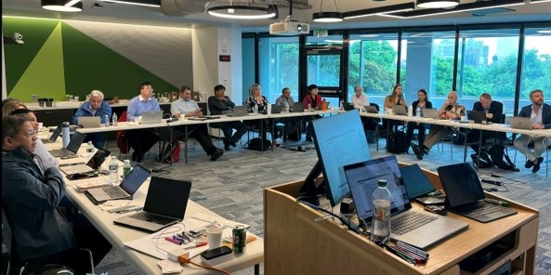
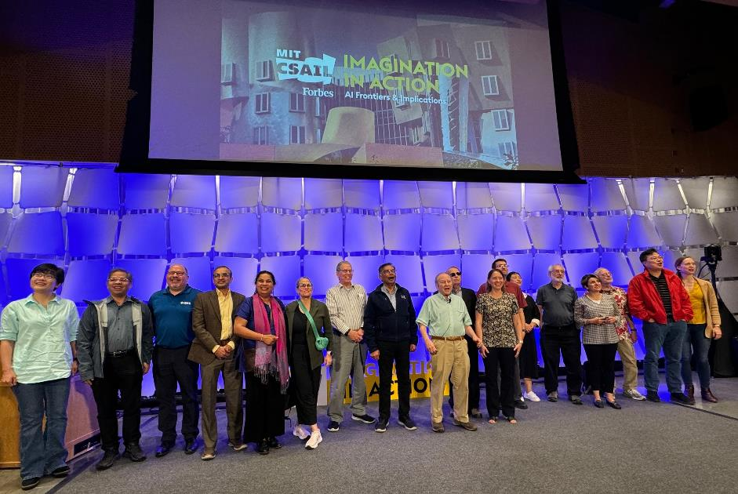
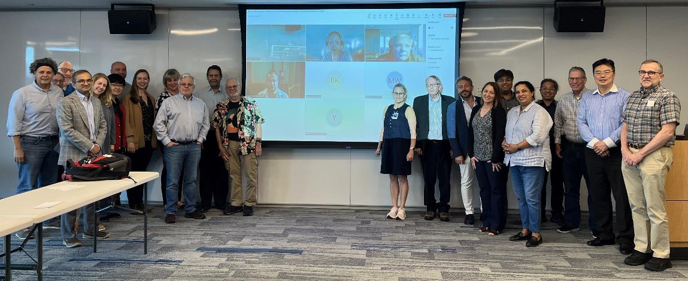
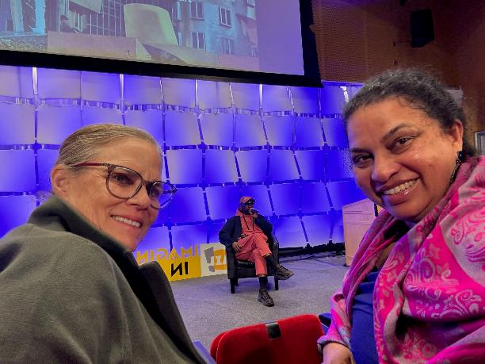
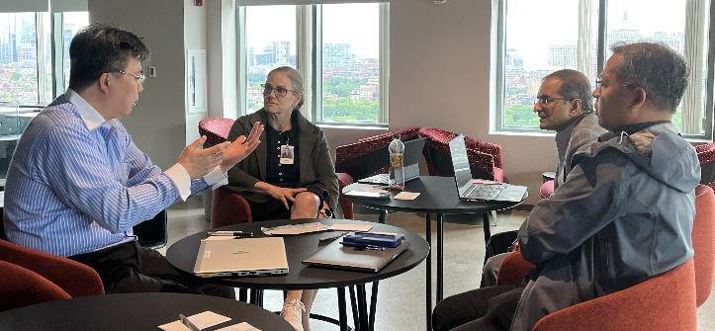
Notes:
Will discuss the gaps verbally here (will have more information when presentating)

Slide 9
SC Mission /Objectives
Drive Standardization in advanced EDA topics with focus on “research-based topics”
Proposals from Academia, and Industry Adv. Research groups
Collaborate/ Joint sponsor w/ IEEE DASC & other Industry Standards organizations/committees
Leverage CEDA Events/Network/CEDA Standards site

Slide 10
Current Status & Achievements
CEDA Standards Committee infrastructure -done active/updated
https://ieee-sa.imeetcentral.com/ceda-sc/home
CEDA SC public site : https://sagroups.ieee.org/ceda-sc/
23 new members. 3 EDA companies, User companies –Intel, Qualcomm, Ericsson, 3 Universities, e.t.c
Standards Committee kickoff -done
Agenda, Invitation to participate, Request for proposal for PAR or study group in key EDA areas
CEDA Chapter meeting presentation – done 12/15
CEDA SC Open-Source Maintainer
Discuss possible use of SA Open-Source platform for standard development
Dennis Brophy

Slide 11
Standards Committee Kick-off Meeting -11/21/23 SC now open to accept standard proposals !!
Call to Order
Introduction and Affiliation Declaration
Establishment of CEDA SC Membership
Approval of Agenda
Review and Approval of CEDA SC Policies & Procedures (P&P) : Dennis Brophy
Appointment of Officers : Aparna Dey
IEEE Policies – Vanessa Lalitte
IEEE SA Call for Patents
IEEE SA Copyright Policy Presentation
IEEE SA Participant Behavior – Individual Method
8. Presentation
IEEE SA Standards Overview – Vanessa Lalitte
CEDA SC Overview – Aparna Dey
Discussion/Action Plan
Future Meetings

Slide 12
Potential Areas for Standardization
AI/ML in EDA
3D/2.5D, Chiplets design, Standard Format
Photonics
Digital Twin
Functional Safety
Low Power
Thermal Constraints
Functional Verification
Simulation

Slide 13
Opportunities
Increasing relevant membership/participation from Academia and Industry
Standards Committee promotion – chapter meeting, discussion with industry/academia
Regular meeting schedule
Define scope and encourage study groups/white papers in new areas – creating a research focus short list
Increasing CEDA/SC visibility with Industry & Academia
Present at Academic Network meetings
Promotions online and with other committees, industry events
Attracting differentiated Standardization proposals/ study group in advanced topics
Discussion with Jiang Hu from T&M to start a new PAR for AI/ML infrastructure for EDA standards in CEDA standards. Potential contribution of a white paper to the study group.
Potential for joint sponsorship with DASC and IEEE Standards Committee

Slide 14
Next Steps
Submission of Ideas, PARS, Proposals
SC WG Meeting regular Schedule
Working on potential ML Infrastructure proposal
Targeted SC Promotion in conferences, chapter meetings, Academia, Industry
Review of Proposals

Slide 15
Questions?

