Slide 1
IEEE TCAD – CEDA BoG Meeting (DAC 2024)
David Atienza, TCAD EiC: 2022-2025
June 23rd, 2024

Slide 2
Current Status (1/2)
Current accept. rates (33-34%), top-tier journal for 4 consecutive quarters
Average decision time (1st revision): 71 days
Average final decision time: 84 days until May 2024
Submissions stabilizing (Sep. 2023 to May 2024)
Similar number of submissions vs. same period in 2022-2023
Accept Ratio: YTD is 37% so far, it was 39% in 2023, 2022 was 40.5%
Oldest manuscript without decision: 138 days (it was 203 days in 2021)
Optimized TCAD review process and publication timeline with IEEE HQ
Fast desk-reject policy of IEEE implemented (fast reject: <2 weeks, for low-quality papers)
Automation to reassign reviewers in revisions, identify reviewers/AEs with delays, etc.
IEEE has claimed to remove backlog/publication delay until March 2024 completely as agreed with IEEE HQ (more pages for TCAD) but still not done (50% of backlog remains)
Notes:
Currently there are 257 pending manuscripts

Slide 3
Current Status (2/2)
Editorial board renewed in 2024, 25 new AEs -> 28 new AEs
Limit of two terms (2 x 2 years) based on IEEE guidelines
Increased diversity (Region 10 – Asia and Pacific) and more industrial affiliated AEs (5 new AEs).
Editors-at-Large renewed - 40% women and 2 members replaced
IEEE TCAD Donald O. Pederson Best Paper Awards – 2 winners in 2024:
PACT: An Extensible Parallel Thermal Simulator for Emerging Integration and Cooling Technologies" by Zihao Yuan, Prachi Shukla, Sofiane Chetoui, Sean Nemtzow, Sherief Reda, and Ayse K. Coskun, which was published in IEEE TCAD, vol. 41, no. 4, pp. 1048-1061, April 2022.
An Open-Source Framework for FPGA Emulation of Analog/Mixed-Signal Integrated Circuit Designs, by Steven Herbst, Gabriel Rutsch, Wolfgang Ecker, and Mark Horowitz, which was published in IEEE TCAD, vol. 41, no. 7, pp. 2223-2236, July 2022.
But still authors-based/nominated papers are a very small pool (5 in 2023, 6 in 2023, 5 in 2022)

Slide 4
Key Points to Discuss: New Review Process
TCAD only requires two reviews (by default we suggest 3 to take a decision), AE can be a reviewer as well as decision taking if needed
If the paper is clearly “below bar” (no experiments, comparisons with SoA, etc.) it can be desk rejected: change to 0 reviewers, submit recommendation directly with clarification of why
TCAD must be strict – IEEE Request: unclear novelty or comparisons with SoA, direct reject
Papers as “Research Article With a Prior One or More Conference Publications” must clearly state what is new in the technical contribution (not just evaluation with a new data set or similar) and comparison with state of the art,

Slide 5
Key Points to Discuss: Revisions and Decisions
No two major revisions, authors must address all comments in the first round (except if new major issues arise by reviewers after the first revision)
Not possible to resubmit “as new” if paper is rejected
TCAD requires new publications (30% new research) with previous papers
Adding experiments or more text while contribution does not expand, it is not acceptable
IEEE Regulations does not allow plain verbatim copy (self-plagiarism) – We fixed 40% as rule
Papers submitted with prior conf. papers (last 12 months): 246 (212 in previous year)
50% acceptance rate, much higher than typical TCAD average rate today,
No “complaints” about policy (until exchanges with Yao-Wen Chang early this year)

Slide 6
Key Points to Discuss: Varia
IEEE Allows the use of AI for text editing (ChatGPT) as support tool (but does not encourage it), restrictions:
Acknowledgement to be added to the paper
Authors are responsible for the final text (including copyright issues)
Good cooperation with new IEEE journal on AI/ML side - TCASAI
Checking overlapping with scope
Excellent collaboration with EiC – Prof. Yiran Chen, very receptive to suggestions/proposals
Food for thought from TCAD Editorial Board Meeting at DATE’24: Innovative ways to “reward” the reviewers, ideas from the board
Offer one free page in TCAD published paper after 3 completed review processes
Offer conference registration discounts (e.g., at DATE, DAC, etc.) covered by CEDA

Slide 7
Backup Slides

Slide 8
Current TCAD Submission Issues
Yao-Wen Chang, Deming Chen, Tsung-Yi Ho, Jiang Hu (?), Iris Hui-Ru Jiang (?), Gi-Joon Nam (?), Sri Parameswaran (?), Bei Yu, and Qi Zhu (?)

Slide 9
Motion
Motion: To remove the requirement “The submission material shall not have more than 40% total text overlap percentage with prior accepted/published versions of the work.”
Nothing to do with the 30% new technical content rule set around 2002.
Reasons:
The current TCAD checking system does NOT follow this rule: it checks the 40% text overlap by comparing all articles in the database, not just “prior accepted/published versions of the work,” resulting in self-contradictions in exercising this submission rule.
All other related/competing journals, ACM TODAES, IEEE TVLSI, TPEL, JETCAS, TCAD-I, and TEC (more), do not have such a 40% overlap rule, which is unfavorable to attract TCAD submissions.
Such an over-restricted rule is not healthy for the career establishment of our EDA new blood; they could just choose TODAES/TVLSI to build their publication record.
Such an over-restricted rule would incur a counter-selection problem to TCAD because it makes regular 6-page DAC paper much harder to be eligible for TCAD submissions (the earlier 30% delta rule already makes 8-page ICCAD papers harder for TCAD submissions, especially also with TCAD’s 14-page limit), eventually hurting the TCAD quality.
It is much easier for a 2-page DAC LBR or a non-prior accepted paper to satisfy the 40% overlap rule, which is often with lower quality than the regular DAC/ICCAD papers.
F. Policy on Self-Plagiarism
IEEE Publications has long indicated that verbatim copying another's work (plagiarism) is unacceptable author conduct. Moreover, the IEEE Board of Directors approved in November 2002 a new policy on Duplicate Publication and Self-Plagiarism. This policy is included in the IEEE Policies document, precisely in Sections 6.4.1B(f) and 6.4.1B(h). These two sections are indicated next:
(f) Plagiarism is unacceptable. The verbatim copying or reuse of one's own research) as indicated in paragraph "h" below) is considered another form of plagiarism or self-plagiarism; it is unacceptable.
(h) Except as indicated in Section 6.3.4 (Multiple Publication of Original Technical Material in IEEE Periodicals), authors should only submit original work that has neither appeared elsewhere for publication nor which is under review for another refereed publication. If authors have used their own previously published work(s) as a basis for a new submission, they are required to cite the previous work(s) and very briefly indicate how the new submission offers substantial novel contributions beyond those of the previously published work(s).

Slide 10
Motion
Motion: To remove the requirement “The submission material shall not have more than 40% total text overlap percentage with prior accepted/published versions of the work.”
Nothing to do with the 30% new technical content rule set around 2002.
Reasons:
The current TCAD checking system does NOT follow this rule: it checks the 40% text overlap by comparing all articles in the database, not just “prior accepted/published versions of the work,” resulting in self-contradictions in exercising this submission rule.
All other related/competing journals, ACM TODAES, IEEE TVLSI, TPEL, JETCAS, TCAD-I, and TEC (more), do not have such a 40% overlap rule, which is unfavorable to attract TCAD submissions.
Such an over-restricted rule is not healthy for the career establishment of our EDA new blood; they could just choose TODAES/TVLSI to build their publication record.
Such an over-restricted rule would incur a counter-selection problem to TCAD because it makes regular 6-page DAC paper much harder to be eligible for TCAD submissions (the earlier 30% delta rule already makes 8-page ICCAD papers harder for TCAD submissions, especially also with TCAD’s 14-page limit), eventually hurting the TCAD quality.
It is much easier for a 2-page DAC LBR or a non-prior accepted paper to satisfy the 40% overlap rule, which is often with lower quality than the regular DAC/ICCAD papers.
Yes, we do follow the rule. Papers are manually checked by Sara with actual publications, see example with 45% overlap with actual DAC paper:

Slide 11
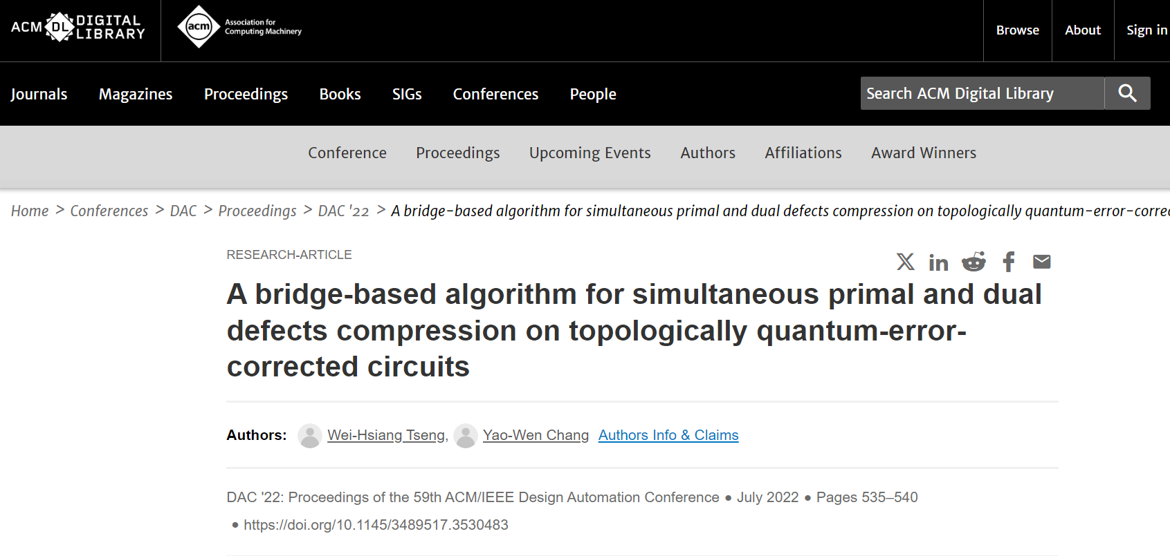
Critical Problems with the TCAD Checking System
The current TCAD checking system does NOT follow the rule specified by the TCAD office: it checks the 40% text overlap by comparing all articles in the database, not just “prior accepted/published versions of the work,” resulting in self-contradictions in exercising this submission rule.
See the example ReportFromTCAD.pdf: 61% Overall Similarity; the combined total of all matches, including overlapping sources, for each database: 11% Internet database, 60% Publications database, etc. (not comparing to the prior versions of the work, as described in the TCAD website)
See also the file named “Unreasonable_Inspection_Report.pdf” in Yao-Wen’s previous email on the similarity report provided by the TCAD office, where even the TCAD full name “IEEE TRANSACTIONS ON COMPUTER-AIDED DESIGN OF INTEGRATED CIRCUITS AND SYSTEMS”, “ACM/IEEE Design Automation Conference”, the page number “1”, and “shown in Figure 17 and Figure 18” are counted into similarity.
Obviously, they match some descriptions from the database, not from Yao-Wen’s DAC’22 paper, because their DAC’22 paper does not have Figure 17 or Figure 18.
The new “40% total text overlap rule” is given by TCAD alone, not generally for IEEE journals! The IEEE set general guidelines in 2002 (by the IEEE Board of Directors in November 2002 for a policy on Duplicate Publication and Self-Plagiarism, included in the IEEE Policies document, precisely in Sections 6.4.1B(f) and 6.4.1B(h)), without this 40% requirement! Further, the 2002 guideline (leading to the 30% delta rule) is for technical content; however, the TCAD new 40% total text overlap is for “text”; the former is more reasonable/useful for academic advancement.

Slide 12
Critical Problems with the TCAD Checking System
The current TCAD checking system does NOT follow the rule specified by the TCAD office: it checks the 40% text overlap by comparing all articles in the database, not just “prior accepted/published versions of the work,” resulting in self-contradictions in exercising this submission rule.
See the example ReportFromTCAD.pdf: 61% Overall Similarity; the combined total of all matches, including overlapping sources, for each database: 11% Internet database, 60% Publications database, etc. (not comparing to the prior versions of the work, as described in the TCAD website)
See also the file named “Unreasonable_Inspection_Report.pdf” in Yao-Wen’s previous email on the similarity report provided by the TCAD office, where even the TCAD full name “IEEE TRANSACTIONS ON COMPUTER-AIDED DESIGN OF INTEGRATED CIRCUITS AND SYSTEMS”, “ACM/IEEE Design Automation Conference”, the page number “1”, and “shown in Figure 17 and Figure 18” are counted into similarity.
Obviously, they match some descriptions from the database, not from Yao-Wen’s DAC’22 paper, because their DAC’22 paper does not have Figure 17 or Figure 18.
The new “40% total text overlap rule” is given by TCAD alone, not generally for IEEE journals! The IEEE set general guidelines in 2002 (by the IEEE Board of Directors in November 2002 for a policy on Duplicate Publication and Self-Plagiarism, included in the IEEE Policies document, precisely in Sections 6.4.1B(f) and 6.4.1B(h)), without this 40% requirement! Further, the 2002 guideline (leading to the 30% delta rule) is for technical content; however, the TCAD new 40% total text overlap is for “text”; the former is more reasonable/useful for academic advancement.

Slide 13
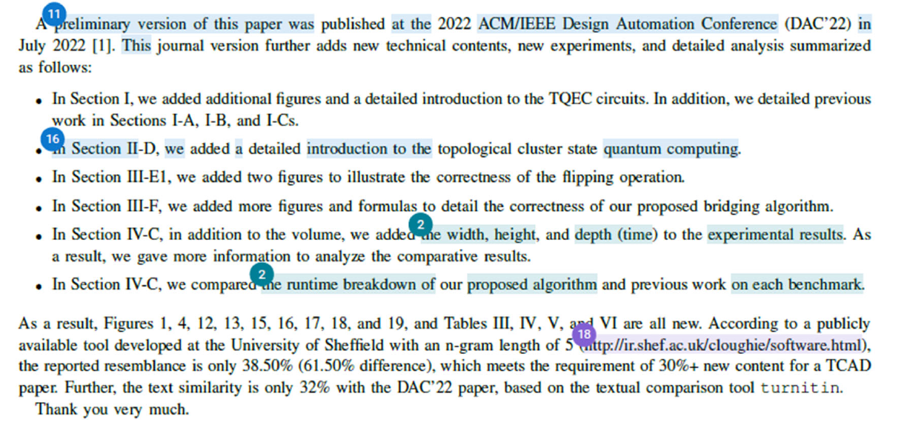
Survey: Rules of Other Competing Journals
Targets: ACM TODAES, IEEE TVLSI, TPEL, JETCAS, TCAD-I, and TEC
They only follow the 30% additional technical content rule; none have the 40% text overlap rule.
In the circuit design, power, microwave, and electromagnetic compatibility communities, their conference papers typically consist of only 2-4 pages, so it is much easier for them to add new content for IEEE trans. publications.
Page numbers: 2 pages for an ISSCC paper, then for a JSSC journal one, top conference/journal in circuit design; 4 pages for an ISCAS conference paper for JETCAS and TCAD-I; 3 pages for electromagnetic compatibility, then for TEC; 2-4 pages for power electronics, then for TPEL, etc.
TODAES: generally 25%/30% new technical content.
At CEDA, we always try to help our community with technological advancement and talent cultivation, especially for the young generation/researchers. TCAD's new rules would not only hurt TCAD itself (and EDA conferences) but also give our young EDA researchers a much more difficult time building up their publication records.

Slide 14
Decision on Papers with 40% overlap rule
In 2024: 20 papers / 560 (3.57% of total)
Almost half also violated the 30% novelty, so real figure: 10 / 560 (1.78%)
Other journals allow more overlap, but CEDA ones do not (D&T has a threshold of 30% as maximum overlap in the latest special issue!)
Only one complaint from Yao Wen, but he lists this set of authors in his presentation:
Yao-Wen Chang, Deming Chen, Tsung-Yi Ho, Jiang Hu (?), Iris Hui-Ru Jiang (?), Gi-Joon Nam (?), Sri Parameswaran (?), Bei Yu, and Qi Zhu (?)

Slide 15
(Wrong) Conclusions, but (Possible) Suggestions
Conclusions
The new TCAD submission rule of less than 40% similarity with prior published conference versions sets the strictest constraint in our related ACM/IEEE domains. The longer lengths of our EDA conference papers further aggravate its negative effects.
The new TCAD submission rule would incur a no-win (lose-lose) scenario for TCAD and our EDA conferences, creating competing side effects between TCAD and top-conference publications.
The new TCAD submission rule would push many EDA researchers to choose other journals (e.g., TODAES and TVLSI) for their journal publications, with our young generation being hurt the most and suffering a much more difficult time establishing their publication records.
Our sincere suggestions:
Please remove or relax the less than 40% similarity rule between a TCAD submission and its published conference versions.
Please carefully apply the similarity-checking tool to compare only with published conference versions to conform to the rules given on the TCAD website, not the whole database; if it is infeasible to check with only published conference versions, please relax the 40% threshold to consider the checking error.
Technical content matters the most, not verbatim text. The original 30% additional technical content rule suffices to control the TCAD quality, especially together with our typically longer EDA conference papers, which already make our TCAD submissions much more difficult than competing IEEE/ACM journal ones.

