Slide 1
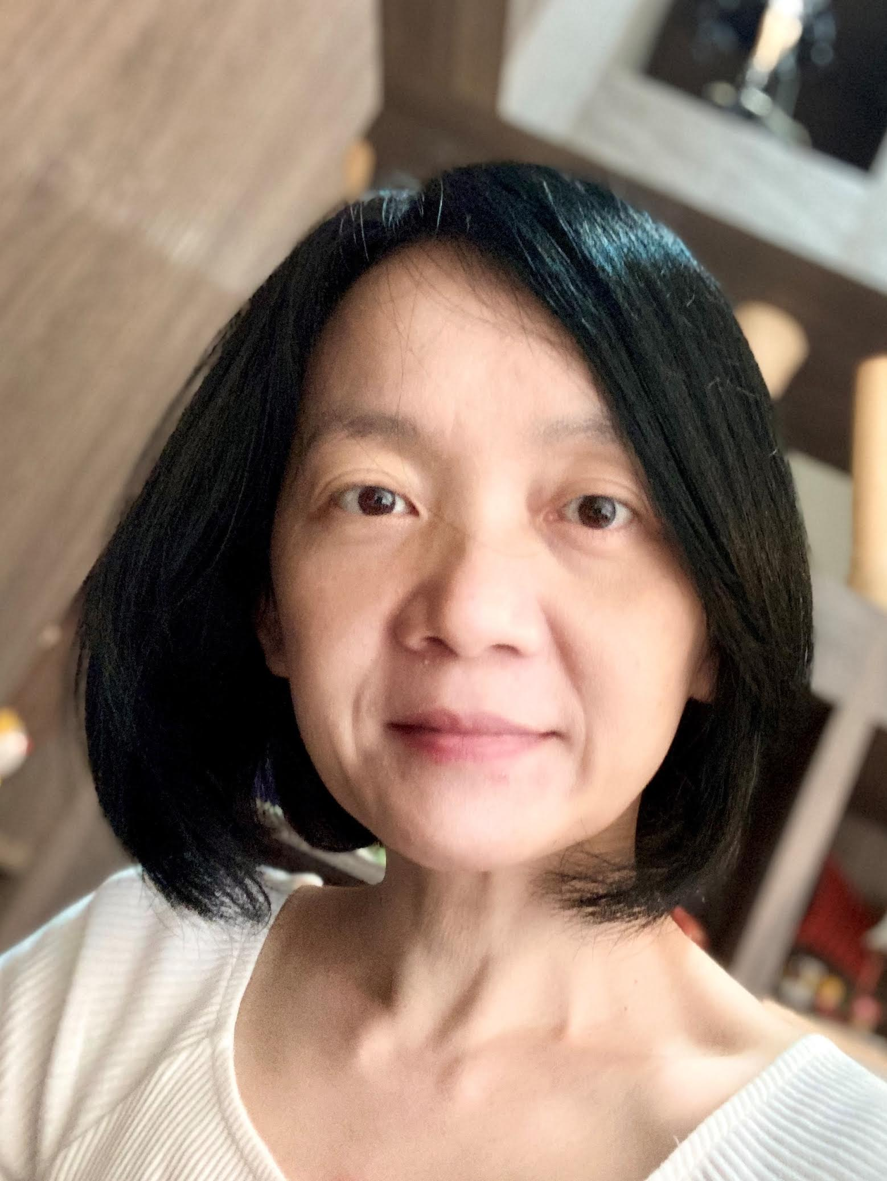
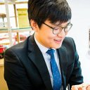
YP Activities
Young Professionals (YP) sub-committee
Conference activities for young professionals
Early Career Workshops
PhD Forums
University Demonstrations, Contests
Student travel grant program for CEDA-sponsored conferences and workshops
Iris Hui-Ru Jiang
NTU, Taiwan
Mohammad Al Faruque
UC Irvine, USA
Chung-Wei Lin
NTU, Taiwan
Meng Li
Meta, USA
Jinwook Jung
IBM Research, USA
Iris Hui-Ru Jiang

Slide 2
YP Activities – DAC
DAC Young Fellow Program is not included
Co-sponsor the YP events with SIGDA
Event |  | Lead
Early Career Workshop Organizers: Zhiding Liang (RPI), Rickard Ewetz (UCF), Mengxin Zheng (UCF), Ganapati Bhat (WSU) Speakers from LBNL, NYU, PNNL, JHU, NSF, Gatech, JHU, UW-Madison, UPenn, Northeastern University, Duke, UT Austin, UT Dallas, Argonne, Synopsys, JPMC, Microsoft. | R3016, 9am-5pm, Jun 23 | SIGDA
PhD Forum Organizers: Yingyan (Celine) Lin (Gatech), Vidya Chhabria (ASU), Guohao Dai (Shanghai Jiao Tong Univ.) | L2 Lobby, 7-9pm, Jun 25 | CEDA
University Demo Organizers: Umamaheswara Rao Tida (North Dakota State Univ.), Nan Wu (George Washington Univ.), Sumitha George (North Dakota State Univ.) | L2 Lobby, 7-9pm, Jun 25 | CEDA
System Design Contest Organizers: Meng Li (Peking Univ.), Qi Sun (Zhejiang Univ.), Sitao Huang (UC Irvine), Atefeh Sohrabizadeh (UCLA) |  | SIGDA

Slide 3
YP Activities – ICCAD / ESWEEK / SMACD
ICCAD
Co-sponsored YP events with SIGDA: SRC, CADathlon, … etc.
CEDA sponsored event: CAD Contest
ESWEEK
Co-sponsor with SIGDA: Fair and intelligent contest (led by SIGDA)
SMACD
EDA Competition approved in Feb. EC meeting

Slide 4
Student Travel Grants Plan
ESWEEK: proposing 6K (5K in 2023)
ICCAD: proposing 6K (5K in 2023) for student presenters
[proposing 5K (4.8K in 2023) for CAD contest winners]
DAC / DATE / ASP-DAC: merge with YP events
MLCAD 2024: 3K (approved in March)
Other workshops: planning up to 5K
Ad-hoc applications: planning up to 5K
https://ieee-ceda.org/ieee-ceda-student-travel-grant-program
Notes:
2023 ICCAD:
SIGDA provided 3K, CEDA provided 5K to support students travel to ICCAD to present their respective papers
SIGDA provided 16K for CADathlon, 9.2K for SRC
CEDA provided 4.8K for ICCAD contest

