Slide 1
Strategy Session CEDA Meeting at DAC 2014 Shishpal Rawat, President-Elect

Slide 2
NOTE TO PEOPLE WHO WANT TO REUSE CHARTS
Dear EC members
Presentation was not polished enough for external consumption.
No credits for quotes etc.
You can reuse this as you see fit as long as there are appropriate credits for source in your presentations.

Slide 3
“Strategy is about predicting a future and charting out a path to it”

Slide 4
“Predictions are hard, especially about the future”

Slide 5
“The best way to control the future is to invent it”

Slide 6
“Control your own destiny or someone else will”

Slide 7
The Landscape: We are part of a consolidating $300B+ industry.

Slide 10
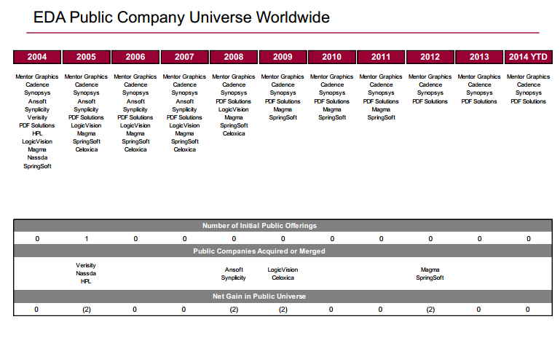
Source: Needham

Slide 11
Derivative Designs
While the ASP’s are declining and not supported by “decreasing” manufacturing costs

Slide 12
Other Evolutions
Research: IEEE Societies merged their CAD/EDA efforts - CEDA
Standards: Accellera has been a continuously evolving
VI + VHDL + SPIRIT + OSCI + OCPIP ….
CEDA → ?

Slide 13
Three pillars of CAD
Formalisms
Mathematicians
CAD
Developers
Designers
Design
Software

Slide 14
A perspective on EDA/CAD
Multicore/SOC integration
Physical
synthesis
Component abstraction
Move design to
system engineers
Module abstraction
EEs are back!!
Synthesis
SPICE, DRC checkers
As industry moves to SOCs
this phase is increasingly
commoditized (> 6 vendors)
Logic abstraction
Moved design from EEs
to CSs
Device abstraction
Moved design from
physicists to EEs
Process technology drivers
Faster, cheaper, leakier Xtors
Performance
TTM

Slide 15
The wineglass model – Where do the investments go?
Software
Software
Systems
Architecture/Sys
High-level Synthesis
Firmware
Firmware
Microarchitecture
Microarchitecture
On-chip fabrics
On-chip fabrics
Power delivery
Power delivery
AMS
AMS blocks
Digital
Disruptive combinations
are always interesting
Logic blocks
Cells
Cells
Interconnect
Interconnects
Devices
Devices

Slide 16
As EDA evolves, so can CEDA – FoI example
Janet Barth, President, IEEE Nuclear and Plasma Sciences Society
Proposed revisions to the NPSS Field of Interest (FOI).
Once endorsed, the item will go on the TAB Consent Agenda for final approval.

Slide 17
Promote/Collaborate on new Pubs/Journals
Started
ESL
Proposals for collaboration
IEEE Transactions on Sustainable Computing - PDC Review Complete - LOI - June 2014
IEEE Transactions on Intelligent Vehicles - PDC Review Complete - LOI - June 2014
IEEE Transactions on Signal and Information Processing over Networks - Ready for Review - Phase 1 and 2 - June 2014

Slide 18
Long Range Goals (Proactive vs Reactive)
Be on board for new initiatives
Convince the member society (and IEEE Pubs) that CEDA has a *critical* interest and become a financial sponsor
Consider sponsoring new magazines/publications, and in what areas.
Growth Areas
Emerging Technologies (Photonics, Quantum Computing
Engage CEDA champions in advisory role
Engage Fellow Travelers
CEDA can help bring them along (NSF, DARPA, SRC)

Slide 19
Conferences/Workshops
Similar themes as pubs
However, we will need to consolidate some areas in order to initiate new ones (limited human/$$ resources)
New – Seed/Encourage CAD conferences/pubs/ workshops in alternative computing
Reach out to CAD challenges in alternative computing themes (rebooting computing)
CEDA can and will seed (current efforts are opportunistic)
Utilize/Fund our committees CANDE/DATC with such a scope

Slide 20
“How do we know we are making progress?

Slide 21
“What's measured progresses”

Slide 22
Operations manual
Draft operations manual and get past VP to review it
Include measures of success for our operations
Easy to collect
Tell us if we are making progress to our goals
If accelerated help us achieve our goals
Lynn can help create repository for ops manual
Put in place by August meeting (VPs to commit)
Review measures (indicators) in Sept meeting and present to CEDA BOG in Nov meeting

Slide 23
CEDA - Creating EDA/Design Automation Futures
Industry is consolidating rapidly. Classical EDA is behind us
EDA/CAD has to consider multiple (new) domains in an integrative way to be successful. CEDA to provide resources for such initiatives
Consolidate some of our existing efforts
Institute an operations/measurement philosophy to chart our progress

Slide 24
Next Step

Slide 25
Strategy Committee
Current: Bill (chair), John Darringer, Andreas, and representatives of the technical committees and councils (DATC, CANDE, TTTC, DTC)
Committees and Councils are the responsibility of the Strategy VP (Shishpal)
What should the committee look like -- What does the committee want to achieve?

