Slide 1
Strategy Committee
President-elect, Yao-Wen Chang
Committee:
  Giovanni De Micheli
  Sani R. Nassif
  Shishpal S. Rawat
  Sachin Sapatnekar
  Donatella Sciuto

Slide 2
In 2018: IEEE FC’s Motion on Disempowering Councils
Fellow Committee approved to dis-allow councils for fellow process
  Main reasons: (1) very high elevation probability for TCs, (2) more consistent fellow evaluations, (3) problem with convening FECs with 5 Fellows, and (4) overlapping areas of technical expertise with those of Societies
Problems with this move
  Damage interdisciplinary and multidisciplinary technical activities
  Cause further burden on Society Fellow Committees
  No problem and only minor % of processing fellows through councils
Our CEDA strategies?
  Worked with 6 parent societies and other councils to stop the move
  Encouraged council supporters to send letters to the president, BoD, & FC chair
  Asked the motion to be approved at TAB meeting before sending it to BoD
  Go for the EDA Society (EDAS)? (1) better to form a task force first, (2) organize meetings at major EDA conferences for discussion

Slide 3
TC Fellow Nomination and Elevation Statistics
Fewer nominations and higher elevation rates
Nominations | BIO | CEDA | RFID | CSC | NANO | SEN | SysC
2012 | 3 | 11 | 0 | 1 | 0 | 2 | 1
2013 | 6 | 6 | 0 | 2 | 6 | 0 | 0
2014 | 4 | 11 | 0 | 3 | 4 | 9 | 2
2015 | 0 | 11 | 0 | 1 | 5 | 3 | 0
2016 | 2 | 10 | 0 | 0 | 7 | 4 | 3
2017 | 3 | 21 | 0 | 3 | 6 | 5 | 4
2018 | 4 | 18 | 2 | 1 | 10 | 1 | 4
Elevation | BIO | CEDA | RFID | CSC | NANO | SEN | SysC
2012 | 2 | 6 | 0 | 1 | 0 | 0 | 1
2013 | 2 | 3 | 0 | 1 | 2 | 0 | 0
2014 | 1 | 4 | 0 | 2 | 2 | 4 | 2
2015 | 0 | 5 | 0 | 1 | 1 | 1 | 0
2016 | 0 | 4 | 0 | 0 | 2 | 1 | 0
2017 | 1 | 9 | 0 | 1 | 1 | 2 | 2
2018 | 2 | 6 | 0 | 0 | 2 | 0 | 2
% | BIO | CEDA | RFID | CSC | NANO | SEN | SysC | IEEE (no TCs)
2012 | 66.7 | 54.6 |  | 100.0 |  | 0.0 | 100.0 | 40.8
2013 | 33.3 | 50.0 |  | 50.0 | 33.3 |  |  | 35.6
2014 | 25.0 | 36.4 |  | 66.7 | 50.0 | 44.4 | 100.0 | 33.9
2015 |  | 45.5 |  | 100.0 | 20.0 | 33.3 |  | 34.2
2016 | 0.0 | 40.0 |  |  | 28.6 | 25.0 | 0.0 | 35.9
2017 | 33.3 | 42.9 |  | 33.3 | 16.7 | 40.0 | 50.0 | 31.4
2018 | 50.0 | 33.3 | 0.0 | 0.0 | 20.0 | 0.0 | 50.0 | 32.3
Mean | 34.7 | 43.2 | 0.0 | 58.3 | 28.1 | 23.8 | 60.0 | 34.9
CI-95% | ±28.1 | ±9.3 | 0.0 | ±48.5 | ±15.4 | ±24.3 | ±51.9 | ±2.9

Slide 4
Elevation Probability vs Mean Number of Nominations

Slide 5
“New Findings” from FC on Societies and Councils
Some takeaways on Elevation Probability (EP) data
Small Societies and Councils have large variations in EP over time due to small number effects and also often have higher than average EP. Furthermore, Councils generally have higher EP than Societies.
Possible explanation: IEEE Judges “over-weigh” the rankings in small Societies and Councils
  Top ranking nominees in small Societies and Councils tend to be elevated with higher probability than middle ranked nominees in larger Societies. E.g., a nominee ranked #15 among 40 has an EP in the 10%-25%, much smaller than the EP of top ranking nominees in small Societies and Councils.
  A possible solution would be to require that IEEE Judges performed more due diligence on the nominees of small Societies and Councils without being influenced too much by the provided rank/score ➔ Small Societies and Councils should not rank/score nominees, just provide the narrative on nominee’s impact.
  If S/TCs with less than or equal to X nominees did not rank/score their nominees then:
    For X=10, there would be ~50 unranked nominees out of ~900. Workload increase: ~5 nominees per IEEE Judge.
    For X=20, there would be ~140 unranked nominees out of ~900. Workload increase: ~14 nominees per IEEE Judge.
Will inform FSPS and Ad Hoc of these recent findings to re-discuss the matter.

Slide 6
Counter Arguments from TCs Viewed by Stefano Galli (FC Chair)
TCs can better evaluate nominees that have contributed to very specific fields for which it is difficult to find experts in one Society.
  Not convincing and unfounded, TCs use Fellows from their constituent Societies as evaluators, there is no reason why Societies would not be able to evaluate nominees referred to TCs.
  And if the topic is so esoteric, it is not easier to find Evaluators in Councils because the same evaluators are listed under the constituent Societies.
TCs are communities, they should be allowed to evaluate nominees.
  The argument is somewhat weak, should we then extend the same argument to the other 19 Technical Communities we have (Big Data, BlockChain, Brain, etc.)?
Today, some contributions are interdisciplinary, and this requires the capability of picking evaluators from different Societies.
  The argument has some validity and recognizes an existing trend;
  However, it happens very rarely that nominees are referred to TCs because of the interdisciplinary nature of their work (not measured, but consistent feedback form Judges);
  And even then, it cannot be stated with certainty that the necessary expertise to evaluate them cannot be found in Societies (no need to appoint evaluators that are all experts, also some “generalists” can be appointed as they would still comment intelligently).

Slide 7
Problems Beyond Stats Viewed by Stefano
There is a strong belief that nominees evaluated by TCs get a “pass” because they need to compete with a smaller pool of candidates.
  This is confirmed by the higher than usual elevation probability of some TCs, but the problem extends to small Societies as well. Stats alone are not enough to justify taking away evaluations form Councils
Nominees that contribute to computer, signal processing, power, or comms, compete with 50-120 nominees if they go through a Society but would compete with 3-15 nominees if evaluated by a TC.
Fellow “worthiness” is not a binary state, there is a continuum in the qualification and the process is competitive because of the finite number of elevations available.
Due to the competitive nature of the process, it is very important that ALL nominees contributing to the same field be evaluated by the same committee so that we have a single ranking.

Slide 8
Stefano’s Suggestions to FC: Reaffirm the 2018 Decision?
Implementation of the motion:
  Sent for approval to the IEEE Board in February 2020
  Implemented for Fellow Class 2022, i.e., for 2021 evaluations
If yes, should FC also consider additional provisions?
  Allow nominators to specify secondary/tertiary S/TCs so that a wider pool of Fellows can be chosen as evaluators (address inter-disciplinary cases)?
  Resolve the issue of small Societies as in one or more of the following:
    Group small Societies per Division? Basically FC makes them as Councils but larger, so FC gets a single ranking of affine fields.
    Not allow expedited evaluation of small Societies (<15 nominees)?
    Flag all nominees from small Societies and with a preliminary Pass recommendation for discussion at the FC f2f meeting?

Slide 9
Stefano’s Suggestions to FC: Reaffirm the 2018 Decision?
If no, should FC consider alternative solutions?
  S/TCs with less than X nominees do not rank/score their nominees but just provide narrative answers:
    This requires Judges to perform more due diligence which should be manageable after the Expedited Evaluation Procedure starts in 2020
      For X=10, there would be ~50 unranked nominees out of ~900. Workload increase: ~5 nominees per IEEE Judge.
      For X=20, there would be ~140 unranked nominees out of ~900. Workload increase: ~14 nominees per IEEE Judge.
    Another good side effect is that any bias a small S/TC may have (gender, geographical, etc.) would not propagate to the Fellow Committee.
  Have a panel of Judges that looks at nominations referred to TCs and decides which ones should be moved to Societies and which ones can stay with TCs.
    This can be combined with allowing nominators to specify secondary/tertiary Society.

Slide 10
Many against this Motion
David: Wrong to say Councils call upon Fellows of Societies for evaluation. I am not sure if there are more Councils representatives as the members of the Ad-Hoc committee. It is not a very “transparent” process either…
Yao-Wen: I got a chance to talk to the TAB chair, Prof. Ray Liu, last month and he was also strongly against disallowing councils to nominate fellows mainly because councils play a crucial role in disciplinary collaborations among societies, which is a very important mechanism for our IEEE to grow in emerging areas.
Yonhua Tzeng (NTC): Council’s FEC is very important to NTC. We have recruited many outstanding younger scholars and technologists from Fellow nominees who were evaluated by our FEC to become our active volunteers. The success rate is about the same as the average value across IEEE. Many multidisciplinary volunteers are working very hard and diligently wishing to be recognized as a Fellow in the future.
John Przybysz (Superconductivity): The goal of the Fellow review process is to ensure that only the best candidates are elected to the rank of Fellow. There is no evidence that this goal is not being achieved. Equal elevation probability is not the goal. We can achieve that with a lottery. In any case, we want candidates to be evaluated by those who know their work and are best able to fairly and honestly rate their achievements. The Societies and Councils do not choose Fellows, they review and rank nominations. We trust the IEEE Fellow Committee to normalize scores and choose the best candidates for election by the Board of Directors.

Slide 11
Many against this Motion (cont’d)
Jagadish (Photonics Society): Councils have an important role to play in terms of multidisciplinary fields. It makes no sense to stop them evaluating Fellow candidates. That means we will be disadvantaging members of our community working in multidisciplinary fields while science and engineering is becoming more multidisciplinary. People working in multidisciplinary fields will be ranked poorly by societies as they look at from their discipline perspective. We are making big fuss about this based on poor statistics. I have served on both council and society fellow committees as well as Fellow committee and I haven’t seen major differences in terms of elevated candidates. We will oppose any move to stopping councils evaluating fellow candidates.
Meyya Meyyappan: A nominee chooses to go through a TC because he/she contributed in a topic that falls in the field of interest of that TC, not to circumvent having to compete with a larger pool… TCs are not evaluating nominees who could go through some of their parent societies but those who are directly involved in their FOI… It looks to me some of you have decided on this change way back and since then have been putting forward one argument after the other to justify it. Like someone writing the conclusions of the paper first and then walk into the lab to cook up or simply make up the results. What you keep missing is that Councils were formed for something specific where impact of that technology can be across multiple Societies. Often, contributions and developments in the FOI of the TC continue independent of the sponsoring Societies and a clear separation has developed between TCs and their founding Societies and continues so.

Slide 12
Comments from Nazanin Bassiri-Gharb (UFFC-S)
The statistics presented are neither strong nor the statistics should play a role for a technical area to submit nominations for some of their most meritorious members for Fellow grade elevation
”nominees evaluated by TCs get a “pass” because they need to compete with a smaller pool of candidates”
  Stats alone are not enough to justify taking away evaluations from Councils. There is no such a thing as a “pass”. maybe there is a better pre-selection of nominations in the smaller communities.
“Nominees that contribute to computer, signal processing, power, or comms, compete with 50-120 nominees if they go through a Society but would compete with 3-15 nominees if evaluated by a TC.”
  And all nominations get evaluated by a large group of evaluators at the IEEE level. technical societies do a substantially better job at creating strong packages for the nominees than the larger societies, where the evaluation committee has a larger “workload”.
“Fellow “worthiness” is not a binary state, there is a continuum in the qualification and the process is competitive because of the finite number of elevations available.”
  This is not an argument that shows there is any existing problem to be fixed.

Slide 13
Comments from Nazanin Bassiri-Gharb (UFFC-S)
“ALL nominees contributing to the same field be evaluated by the same committee so that we have a single ranking.”
  It clearly underlies why the Technical Councils should retain all their rights for nomination and evaluation of their members to Fellow grade. Technical councils or a small societies exist by virtue of a very strong and common FOI. They are not at the same level of any of the “Future Directions” initiatives that have indeed not yet graduated to become a Council.
  Sending a nominee from a council to a society for “re-evaluation” implies that this candidate will not be evaluated at all with peers contributing to the same field, but often, a very different field.
  Sensors, Superconductivity and Nanotechnology Councils are only some of the councils that UFFC has supported over the years and neither myself nor our Fellows Committee Chairs feel that UFFC should evaluate our affiliate Council members. These Council, while originally derived from a desire to support a strongly growing interdisciplinary field, are fully free-standing entities. The overlap of a member of the Superconductivity member with another member of the Superconductivity Council is by orders of magnitude larger than with any other member of the UFFC-S.
  The grouping for the sake of numbers is even more faulty. Ultrasonics, Ferroelectric and Frequency Control would get lumped together with Instrumentation and Measurements. What we consider Instrumentation doesn’t cut it with them and vice versa.
Asking nominees from the technical councils and smaller societies to have secondary and tertiary nominators and evaluators, puts undue burden on some of our members, and specifically implies that the judgement of the current evaluators are faulty

Slide 14
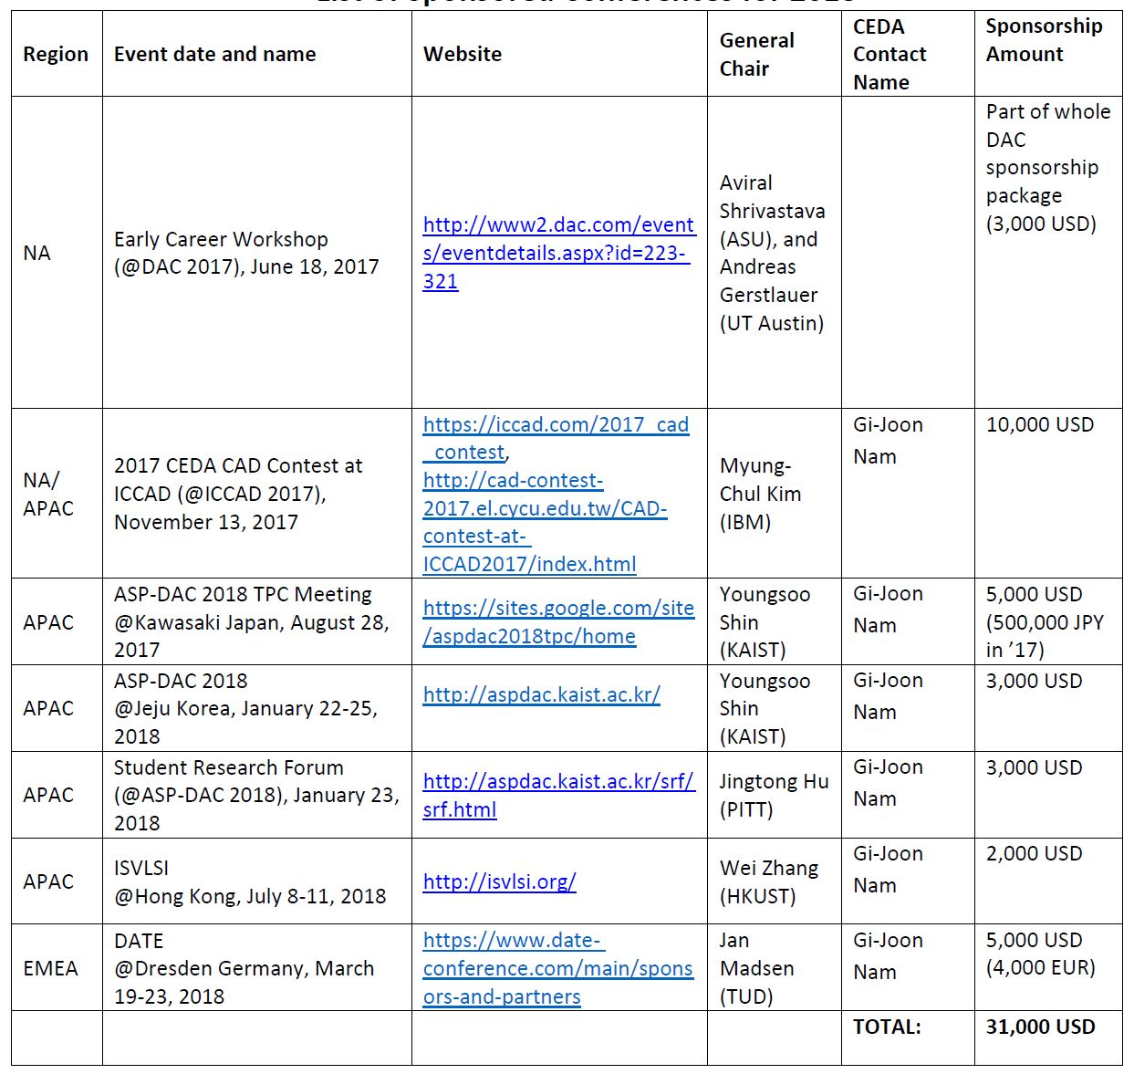
CEDA & Cadence Global Sponsorship Collaboration
Sponsored Conferences for 2018, any more to add?

