Slide 1
Finance
VP: Cristiana Bolchini
VP Assistant: Marina Zapater

Slide 2
2019 Net
Periodical & Conferences
 | 2017 | 2018 | 2019 Budget | 2019
TCAD | 181K | 141.9K | 212K | 283K
ESL | 37.8K | 36.3K | 40.0 | 65K
D&T | -24.1K |  |  | -17.5K
Conferences | 238K | 239.4K (DAC ~170K) | 349.5K | 175K (DAC ~130K)
… of which Pub. Dist. | ~160K | ~170K | 184K | 253K
TCAD
+ 60K subscriptions
- 20K overlength
Conferences:
DAC 2020 change of time: -178K MPSOC 2020: -31K
DAC 2019 PhD Forum 21K

Slide 3
2019 Main expenses
Administration: ~160K
Committee: ~300K
Technical activities: ~90K
Local chapters: 33K
Dist. Lecturer Program: 19K
Contests: 5K
Awards: 5K
Salaries ~105K
Travelling costs ~65K
Notes:
Salaries: 43.5 + 58.6
Travels: 90.5

Slide 4
2020 Activities
Local chapter funding (15 chapters – 7 active)
Distinguished Lecturer Program
Awards
Contests (DATE, ICCAD, SMACD)
CEDA Luncheon Talks
Projects
Student support
Diversity in EDA
CPS Summer school

Slide 5
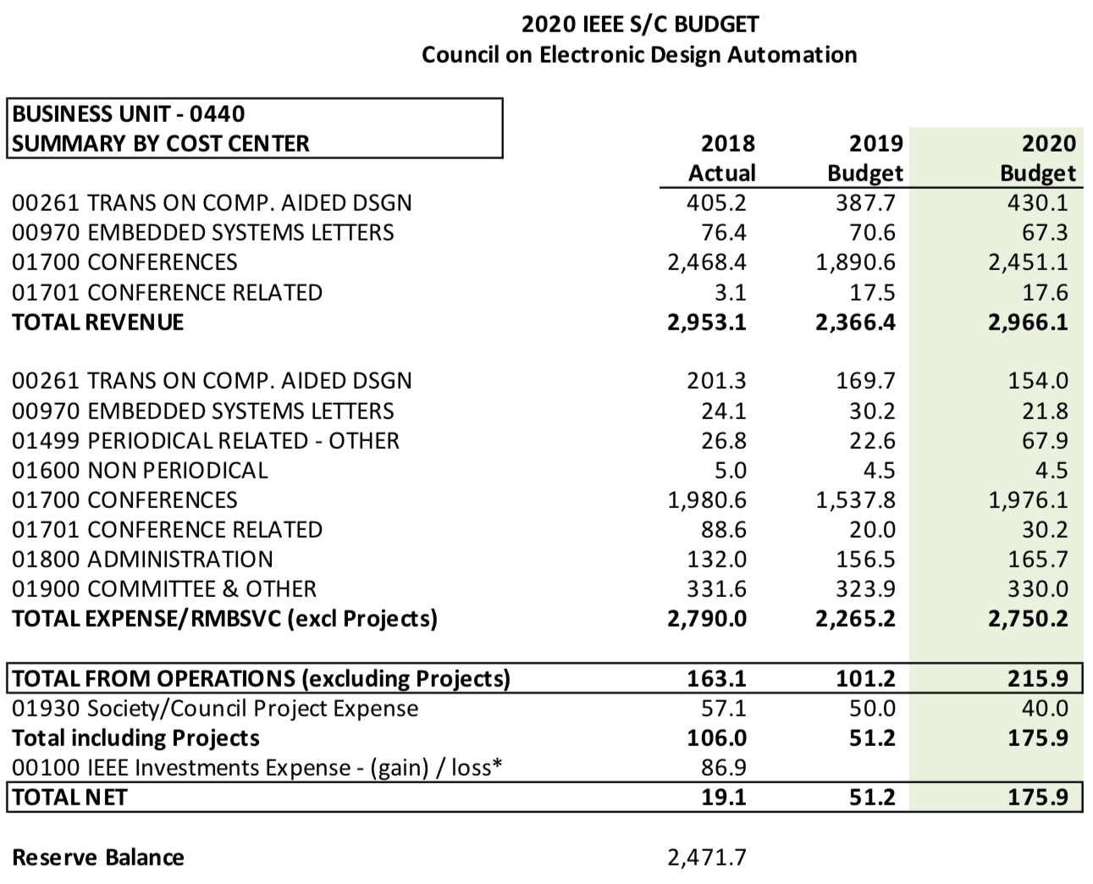
2020 Budget
Maintain supported technical activities
Keep close control on expenses
Keep expenses in the fiscal year

Slide 6
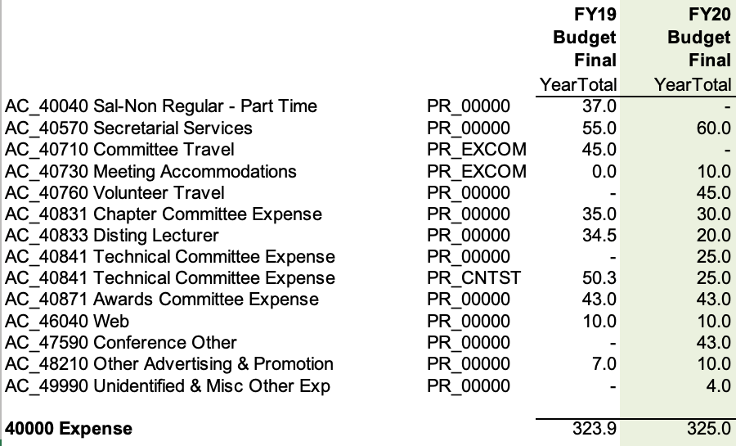
2020 Budget
Maintain supported technical activities
Keep close control on expenses
Keep expenses in the fiscal year

Slide 7
2020 budget expenses
Conference Catalyst: 60K (secretary) + 10K (web)
Volunteer Travel: 45K
CEDA EC/BoG meeting expenses: 10K
Local Chapters: 30K
DL: 20K
CEDA Luncheons: 43K
Technical Committees (DATC / SVDTC / TCCP): 20K + 5K
Contests/Competitions/Demos (DATE / DAC / ICCAD CAD / SMACD): 25K
Awards (A. R. Newton / Early Career / Dist Serv / TCAD D. O. Peterson / W. J. McCalla / Outstanding Service / DL Award @ CEDA Luncheon / Phil Kaufman Dinner): 43K
Advertising: 10K
Misc: 4K
Notes:
Outstanding Service Award: given to ASP-DAC / DAC / DATE / ESWEEK / ICCAD General chair

Slide 8
Requests for funding not in 2020 budget
Low-Power Computer Vision @ CVPR – 2.5K
MPSoC – 5K
DAC support to students – 10K

